Slide 1

1. structure
portfolio
python

Slide 2
1.1 sources

Slide 3


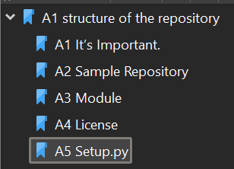
2. python
Structuring Your Project — The Hitchhiker's Guide to Python
structure\project_structure_python.pdf

Slide 4
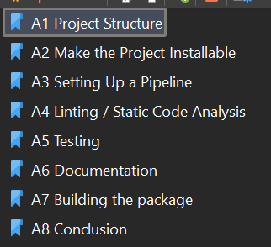
3. 2024
Setting Your Python Project Up for Success in 2024
structure\project_structure_2024.pdf

Slide 5
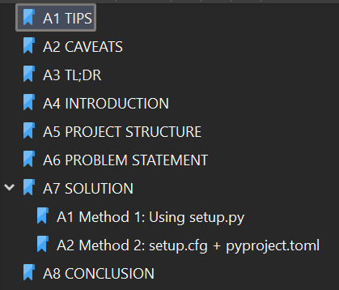
4. 2023
Guide to Python Project Structure and Packaging 20223
structure\project_structure_2023.pdf

Slide 6
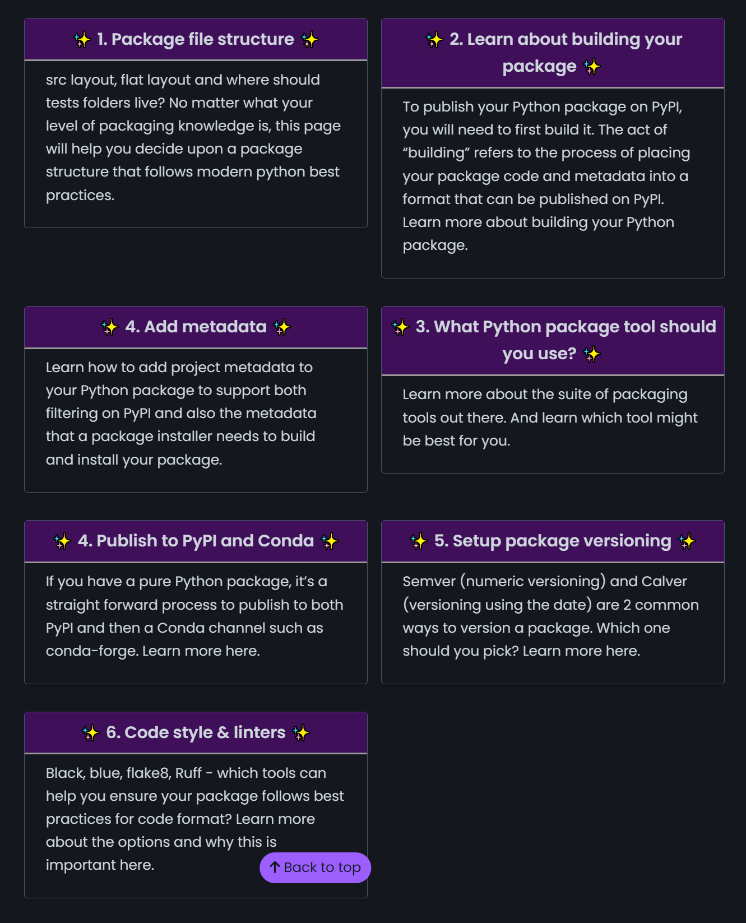
5. scientific
Python Package Structure for Scientific Python Projects — Python Packaging Guide

Slide 7
6. pyproject.toml

Slide 8
6.1 what
what
is a configuration file
used by:
packaging tools
linters
type checkers
etc.
python.org/guides/writing-pyproject-toml

Slide 9
6.2 tables
what
there are
three possible
TOML tables
python.org/guides/writing-pyproject-toml

Slide 10
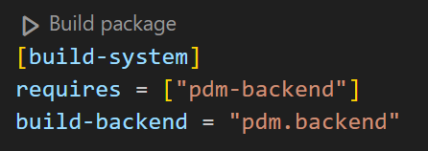
6.2.1 build
what
[build-system]
python.org/guides/writing-pyproject-toml
It allows to
declare
the build backend
to use
and
other dependencies
that are needed
to build
your project

Slide 11
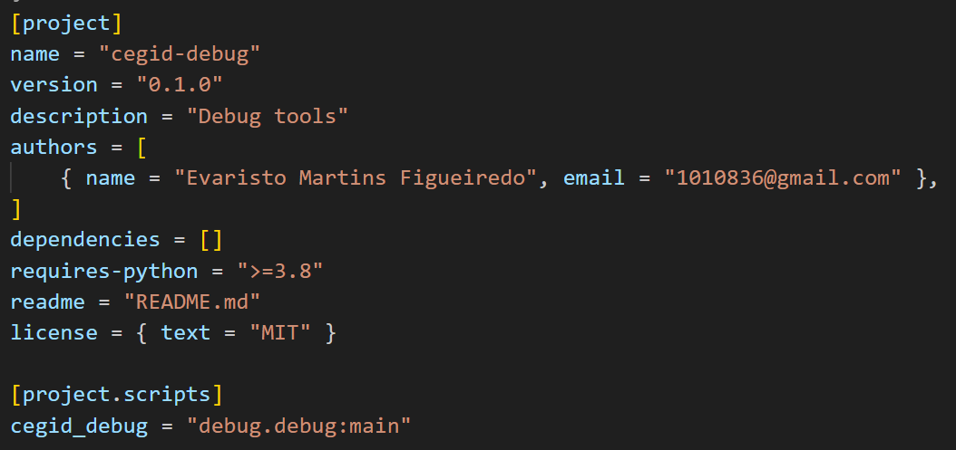
6.2.2 project
what
[project]
python.org/guides/writing-pyproject-toml
is the format that
most build backends
use
used to specify
project’s
basic metadata
such as
the dependencies
your name
etc.

Slide 12
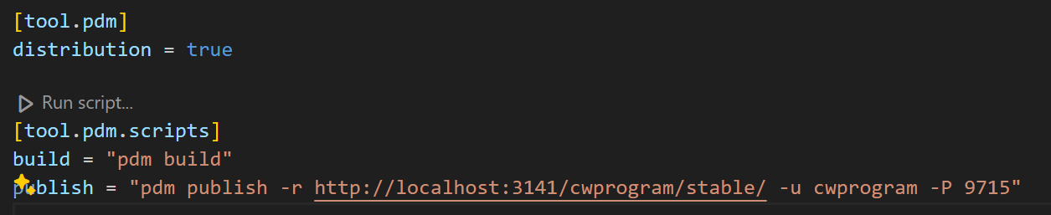

6.2.3 tool
what
[tool]
python.org/guides/writing-pyproject-toml
has
tool-specific
sub tables
e.g.
[tool. Hatch],
[tool. Black],
[tool. Mypy]
contents
are defined
by each tool
pdm/6. pyproject.toml

Slide 13
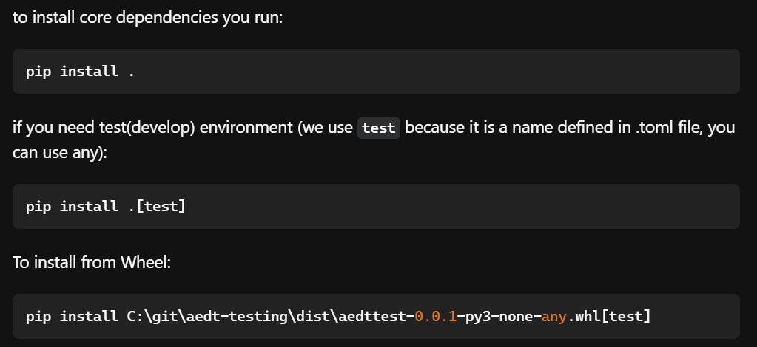
6.3 pip
what
contains
build system
requirements
and
information
used
by
pip
to build
the package.
pyproject-tom
download-dependencies-declared-in-pyproject-toml-using-pip
video with pip

Slide 14
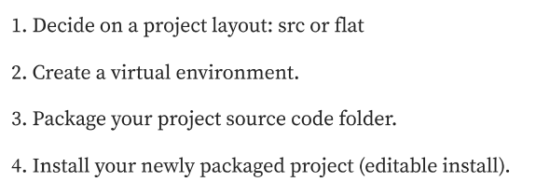
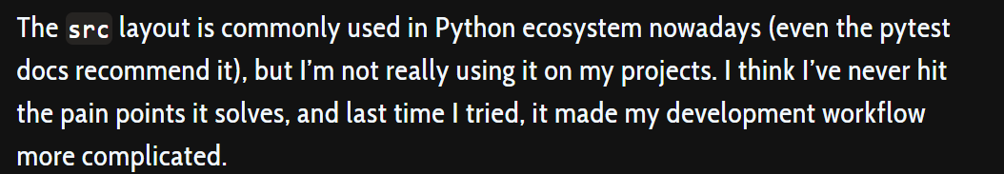
7. src
steps
Good Integration Practices - pytest documentation
unit testing - Python import src modules when running tests - Stack Overflow
Testing & Packaging (hynek.me)
src/ directory
environment\_resources\project_structure.pdf
Packaging a python library
a-practical-guide-to-python-project-structure
/src-layout-vs-flat-layout
development mode
convert-existing-poetry-to-src-layout/

Slide 15
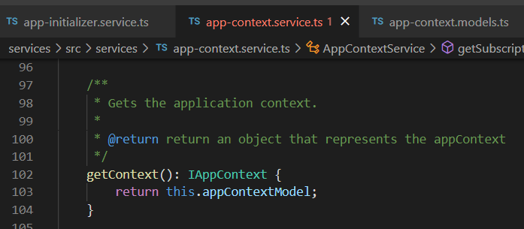


Z. template
new project
ExecuteAsync
square post-it
download
exe
download
exe
why
A slash
followed
by
two consecutive asterisks
D:\A1_research\C2_c0dice\B1_jmeter\A1_install
functionalities
introduction
build-exe
entity framework plus
zig help
⊂
4
every key-frame
defines the operation
success

