Slide 1

1. virtual environments
python
environment

Slide 2

2. what
problem
because
each project
has its own
set of dependencies
it’s a good practice
to avoid
mixing them
If all the dependencies
are installed
together
in
a single Python
environment
then it will be difficult
to discern
where
each one
came from
two different projects
may depend
on two different
versions
of
a package,
virtual environments
but with Python
can only have
one version
of
a package installed
at
one time
enter
virtual
environments
you can think
of
a virtual environment
as
a carbon copy
of
a base version of Python
solution
example
installed:
Python 3.7.3,
can create
many virtual environments
based
off of it
when install a package
in
a virtual environment,
it is installed
in isolation
from other
Python environments
each
virtual environment
has
its own copy
of
the python executable

Slide 3
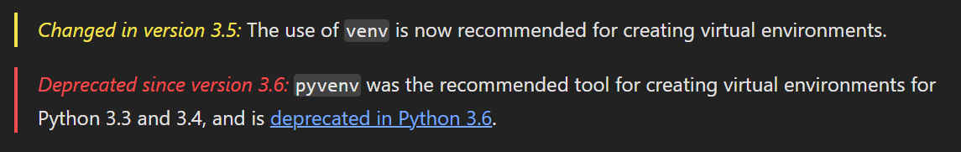
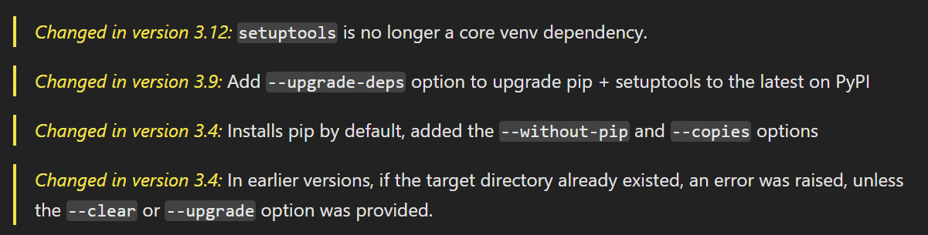
3. venv
what

Slide 4
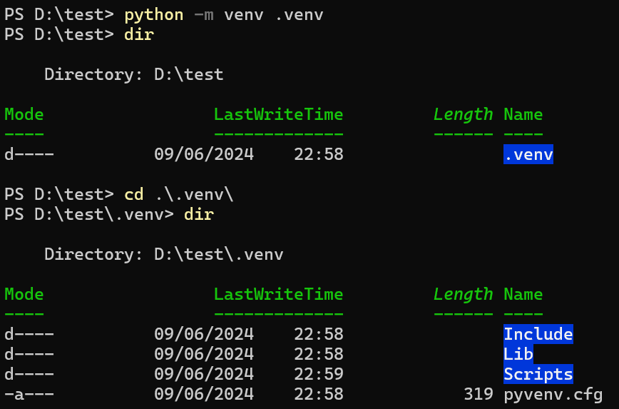
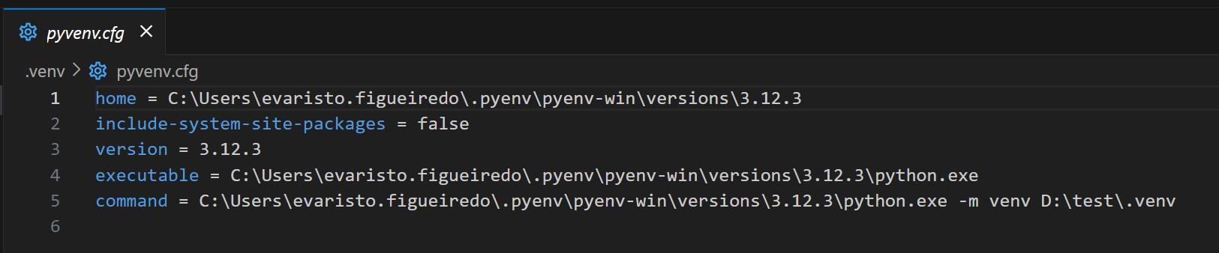
3.1 create
what
python -m venv .venv
If an existing directory is specified,
it will be re-used.
creates the target directory
and
places a pyvenv.cfg file in it
with
a home key
pointing to
the Python
installation
from which
the command
was run

Slide 5
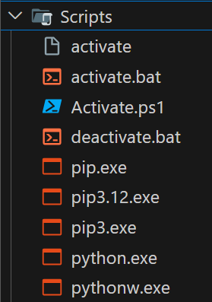
3.1.1 scripts
what
creates
a Scripts subdirectory
containing
a copy/links
of
the Python
binary/binaries

Slide 6
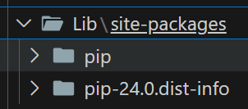
3.1.2 packages
what
also creates
a Lib\site-packages

Slide 7
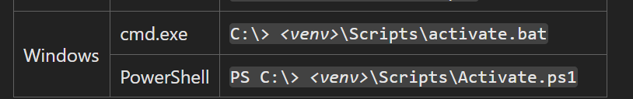
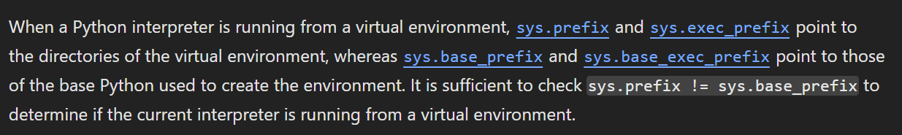
4.2 activate
what
how venvs work

Slide 8
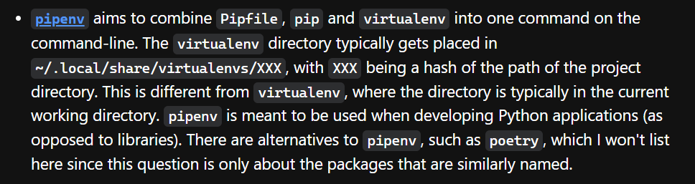
5. pipenv
what
other tools
is a relatively new tool
seeks to combine package management
with
virtual environment management
mostly abstracts
the virtual environment management
from you,
tutorial: pipenv
package management

Slide 9
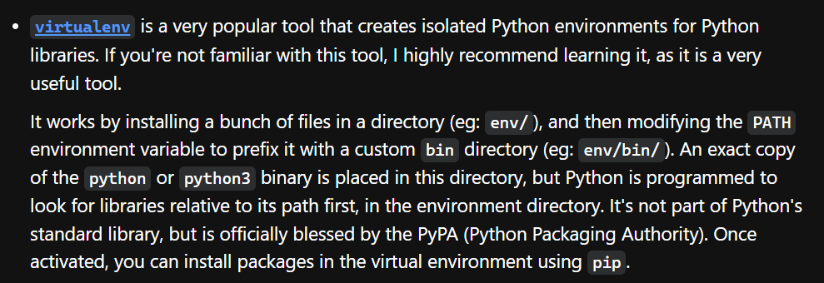
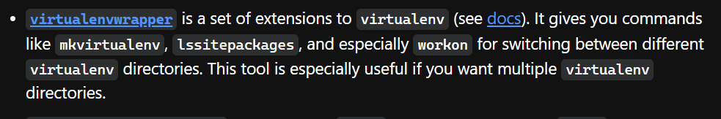
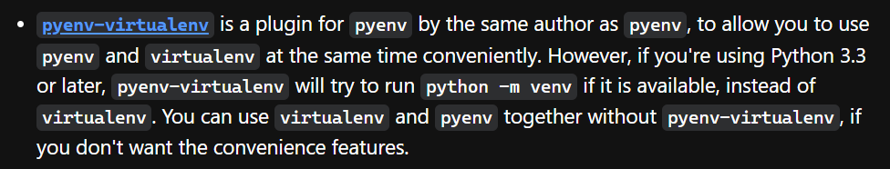
6. other
virtual env
other tools
pyenv

Slide 10
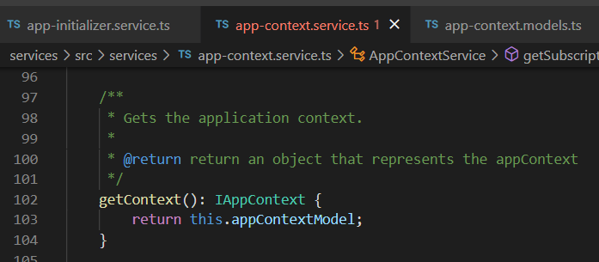




Z. template
new project
ExecuteAsync
square post-it
download
exe
download
exe
why
A slash
followed
by
two consecutive asterisks
D:\A1_research\C2_c0dice\B1_jmeter\A1_install
functionalities
introduction
build-exe
entity framework plus
zig help
⊂
4
every key-frame
defines the operation
success

