Slide 1

1. code generation
python

Slide 2
1.1 index
mdd

Slide 3


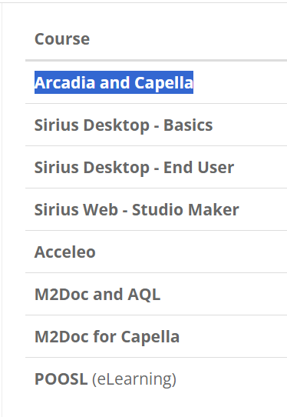
1.2 sources
templates
jinja
mako
wheezy
management
build-exe
lbuid
MDD
mdd
pyecore
arcadia_capela
arcadia capela: videos list
m2doc
data model
datamodel-code-generator
acceleo
atl
areas
tiles
obeo training
poosl
comments
cog

Slide 4
2. wheezy
what
wheezy
properties
Minimizes the number of keystrokes required to build a template.
Enables fast and well read coding.
You do not need
to explicitly denote
statement blocks
within HTML
the parser is smart enough
to
understand your code
enables
compact
expressive
syntax
is
really clean
just pleasure to type.
Intuitive, No time to Learn
Master layout templates for inheritance
guide
user guide

Slide 5

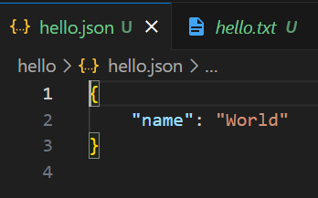
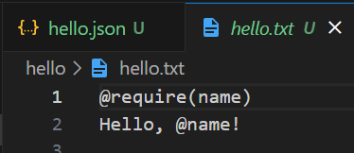
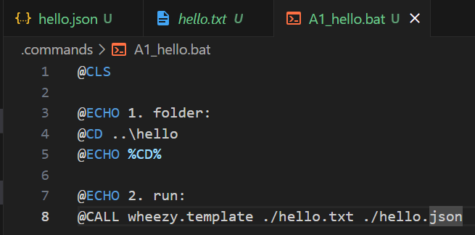
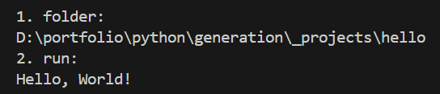
2.1 install/run
install
pip install -U wheezy.template
wheezy: install
run
wheezy.template ./hello.txt ./hello.json
_projects\hello
data
template
run
result

Slide 6
3. pymultigen
what
To use JINJA and MAKO
to generate
code or reports
to generate
multiple files
in
different folders,
simply adds
an easy
to configure
file
and
folder
management layer
on top of
one or more
existing
code generators
pymultigen

Slide 7
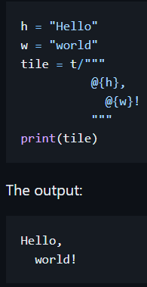
4. tiles
what
tiles

Slide 8
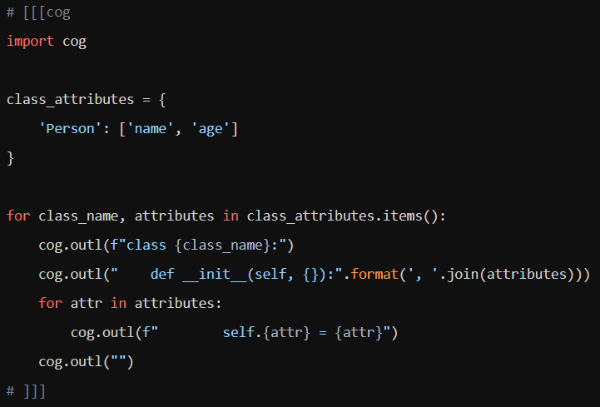
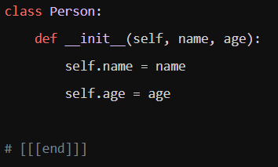
4. cog
what
cog

Slide 9
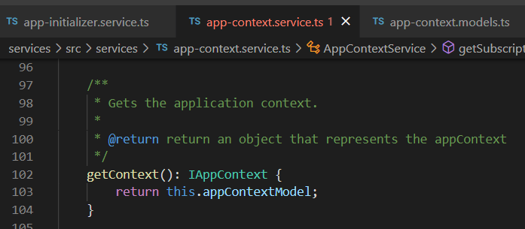



Z. template
new project
ExecuteAsync
square post-it
download
exe
download
exe
why
A slash
followed
by
two consecutive asterisks
D:\A1_research\C2_c0dice\B1_jmeter\A1_install
functionalities
introduction
build-exe
entity framework plus
zig help
⊂
4
every key-frame
defines the operation
success

