Slide 1

1. mdd
python
generation

Slide 2

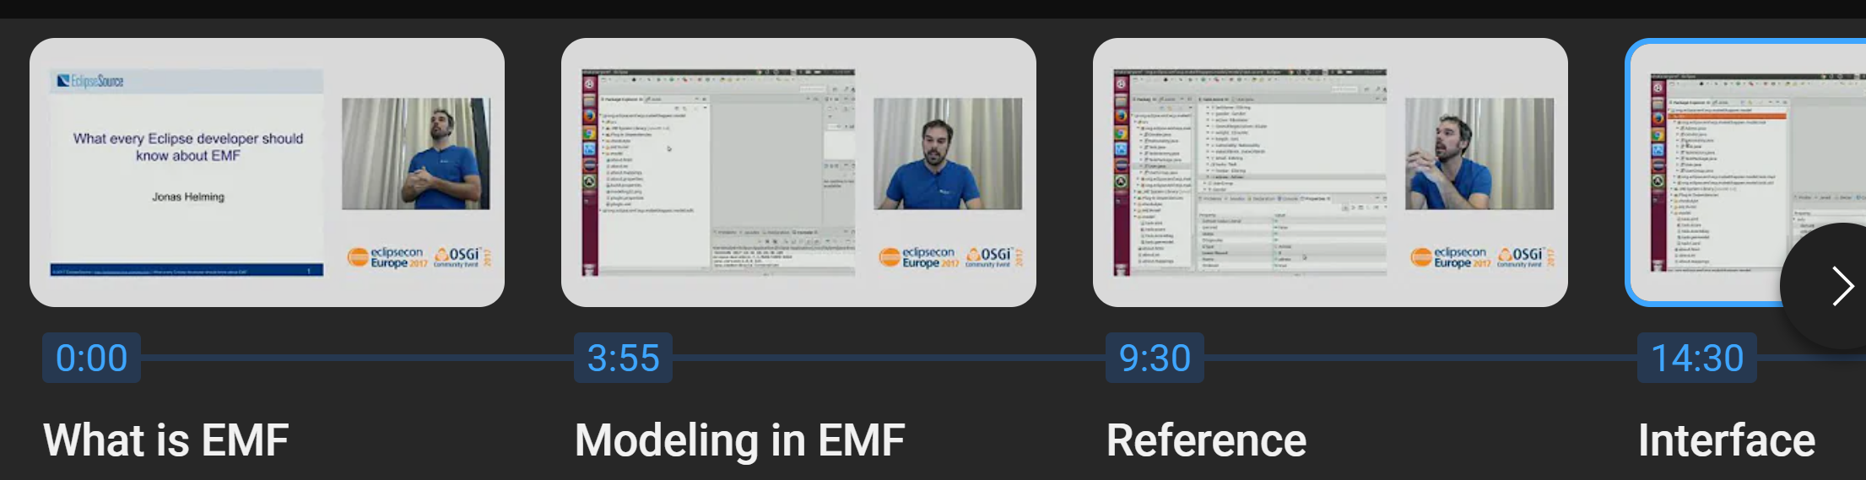
1.1 sources
tools
py ecore gen
py ecore
ecore tools
start
video: What every developer should know about EMF

Slide 3
2. context

Slide 4
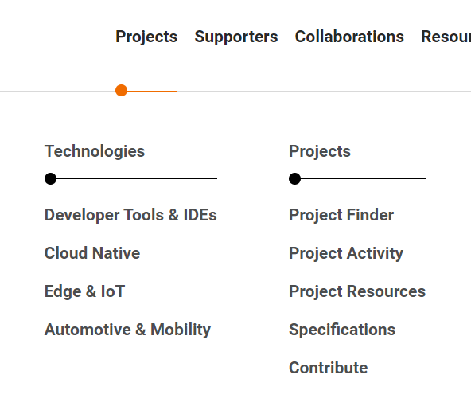




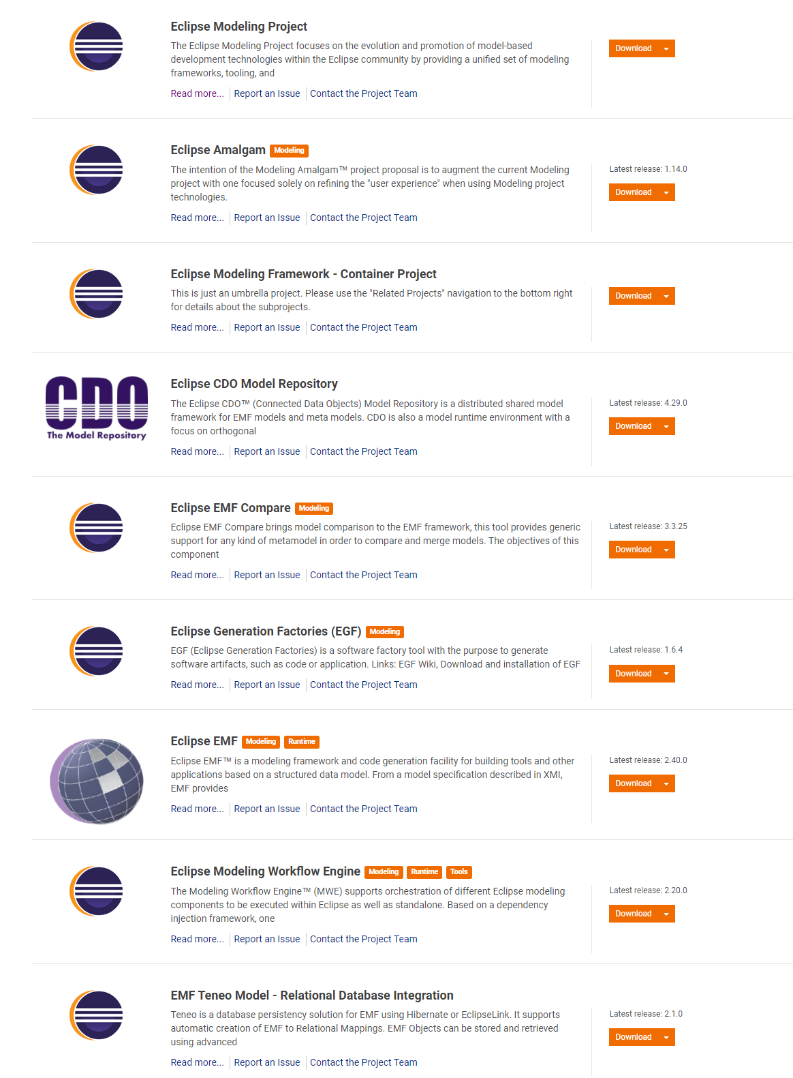
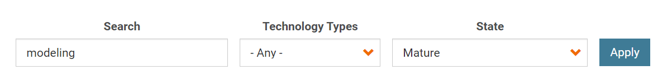
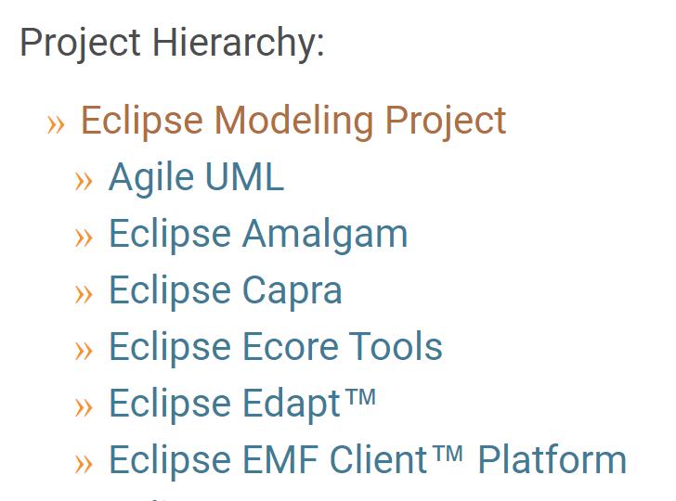
2.1 org
main
main site
projects
find projects: modeling
modeling
project: modeling

Slide 5

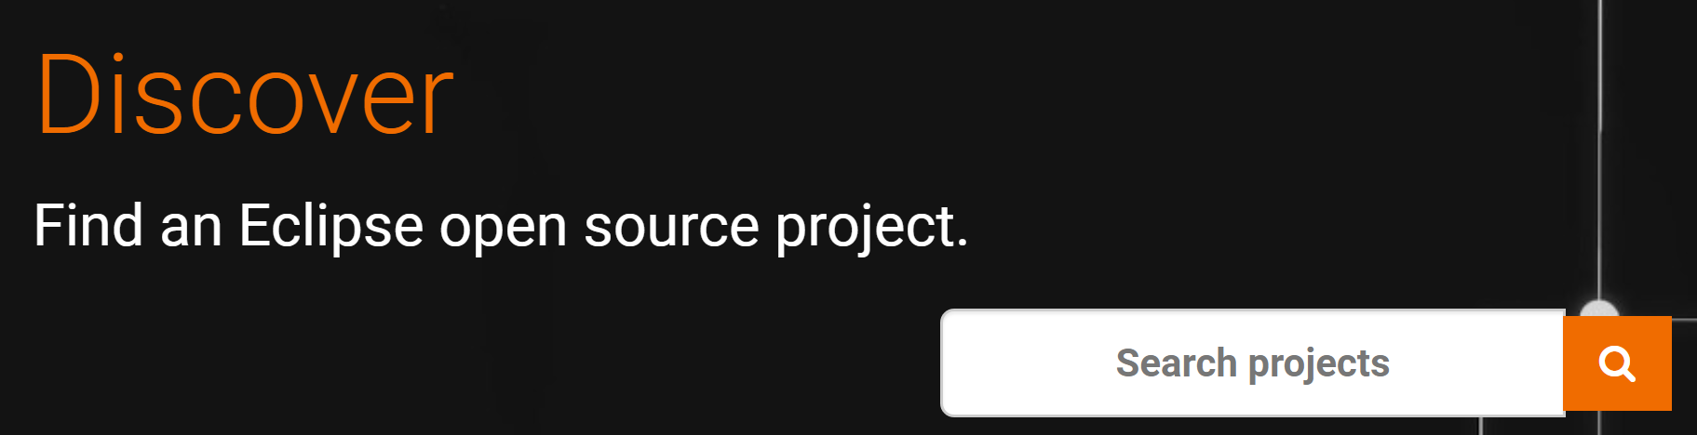

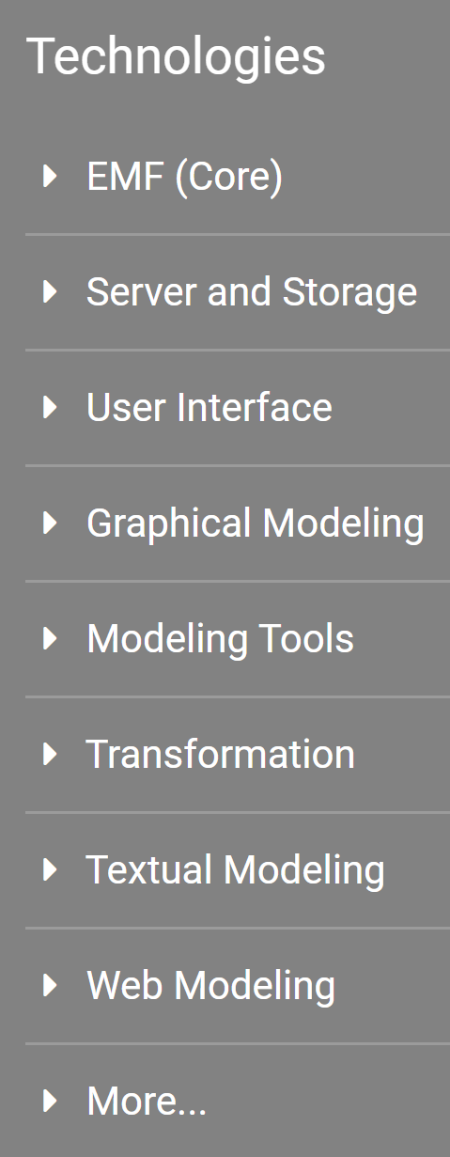
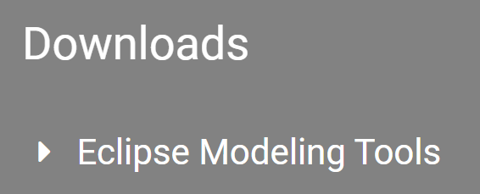
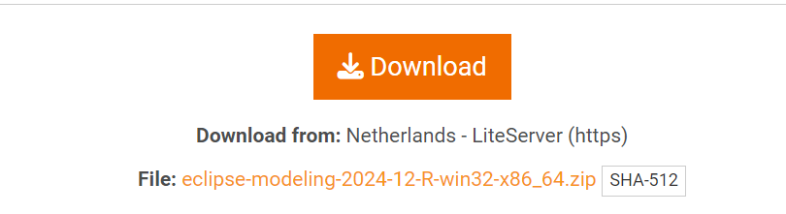

2.2 dev
main
main site
projects
modeling
download (24/12/29)
..\..\..\..\mdd
modeling

Slide 6
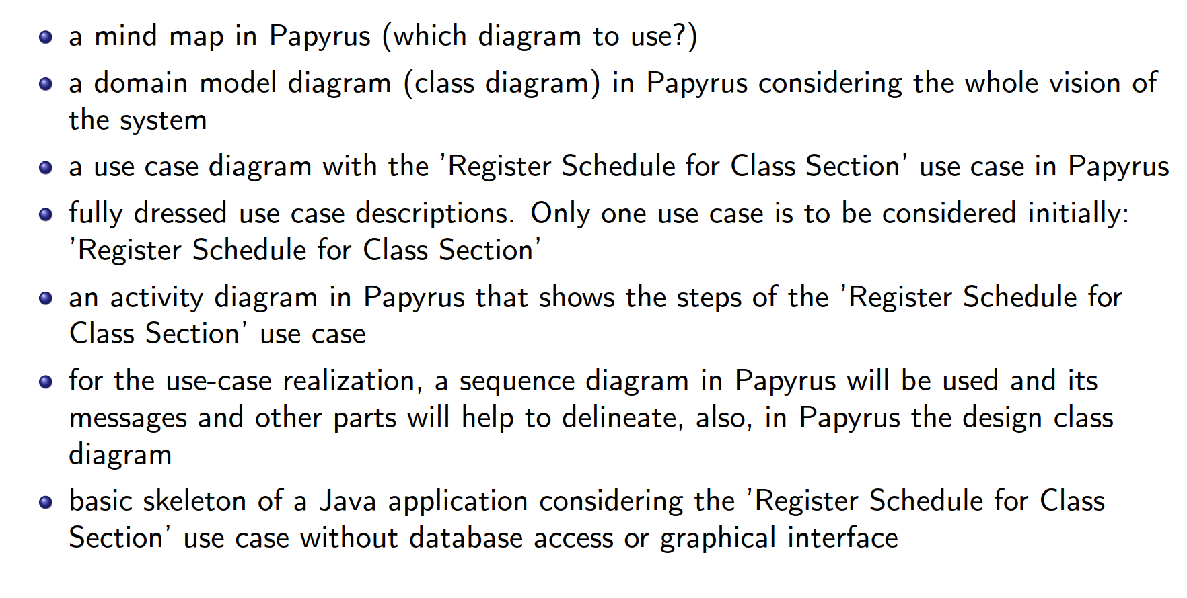
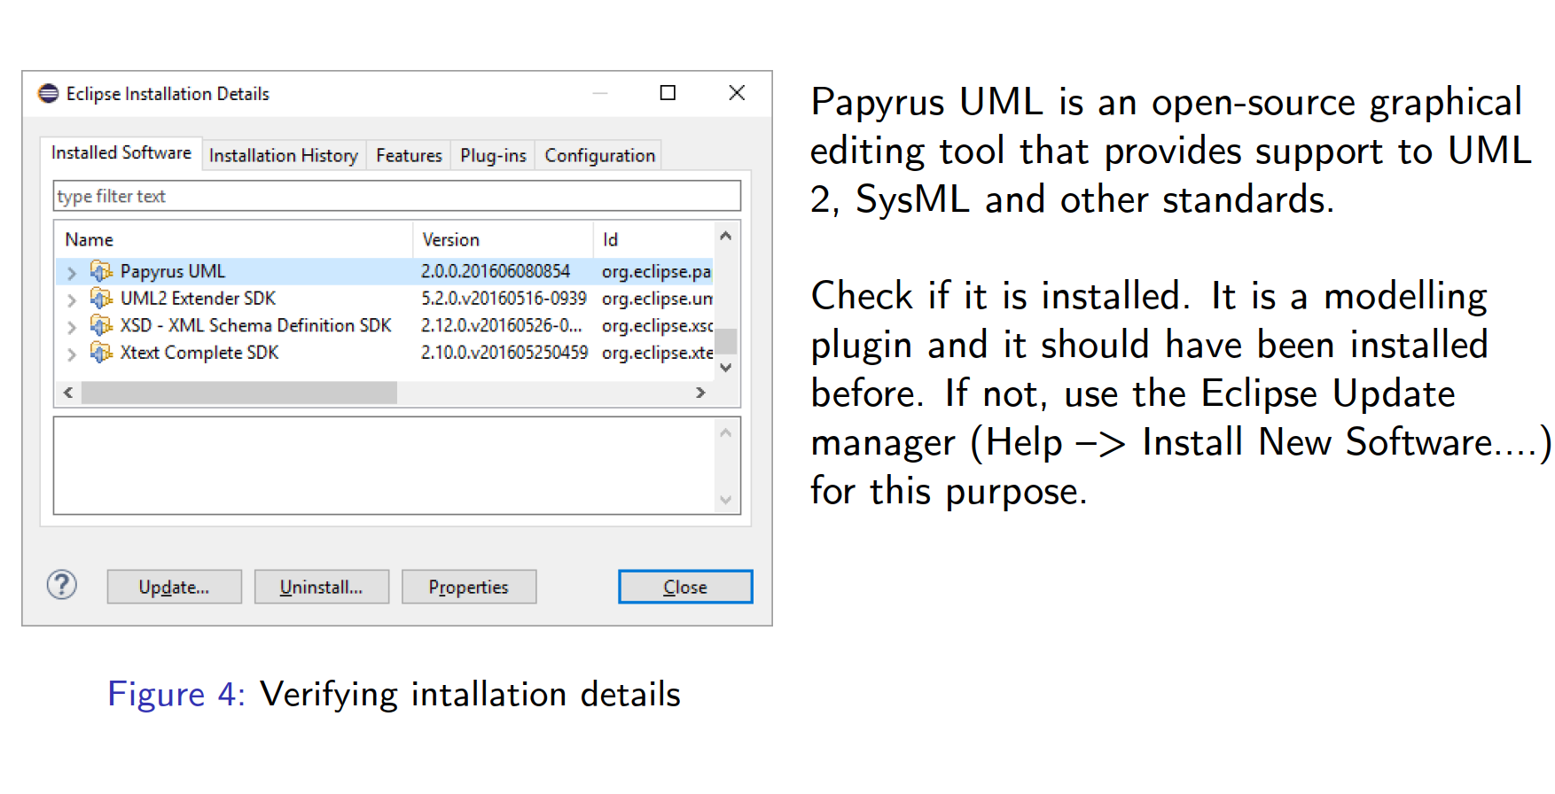
3. modeler
in this step (exercise 1)
I should only
create a mind map
with papyrus
where
only analyze graphic tools
Exercise1\PL\Semana2
nothing to learn
nothing to do
conclusion: use sirius
replacement for papyrus
sirius UML designer

Slide 7
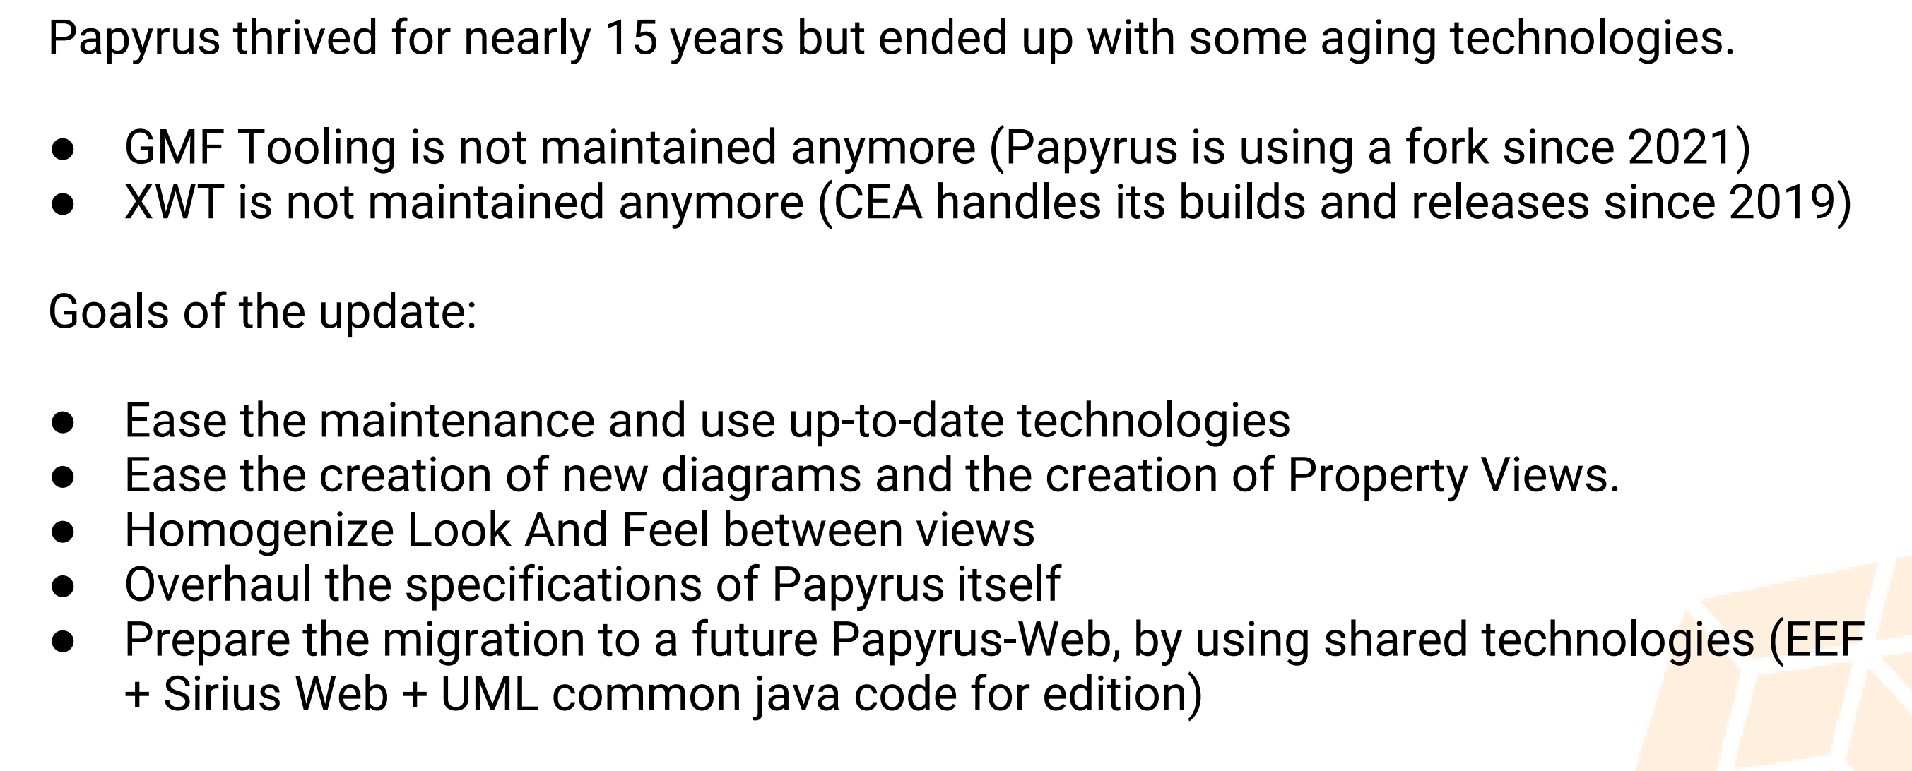
3.1 papyrus
what
Sirius
Papyrus
projects are unrelated
use some common libraries,
fill some similar needs
eclipse forum
historically
papyrus
sirius
standard UML
Graphical
Modeler
customizable
EMF-based
graphical model editor
UML-based
customization
support
UML implementation
(UML Designer).
both
based on
GMF Diagram/Runtime
the serialization
of
diagrams
is based on
GMF Notation
UML Designer and Papyrus
manipulate
Eclipse UML (semantic) models.
Sirius/UML Designer and Papyrus
cannot share
their Diagrams
papyrus
migrating sirius
papyrus -> sirius

Slide 8
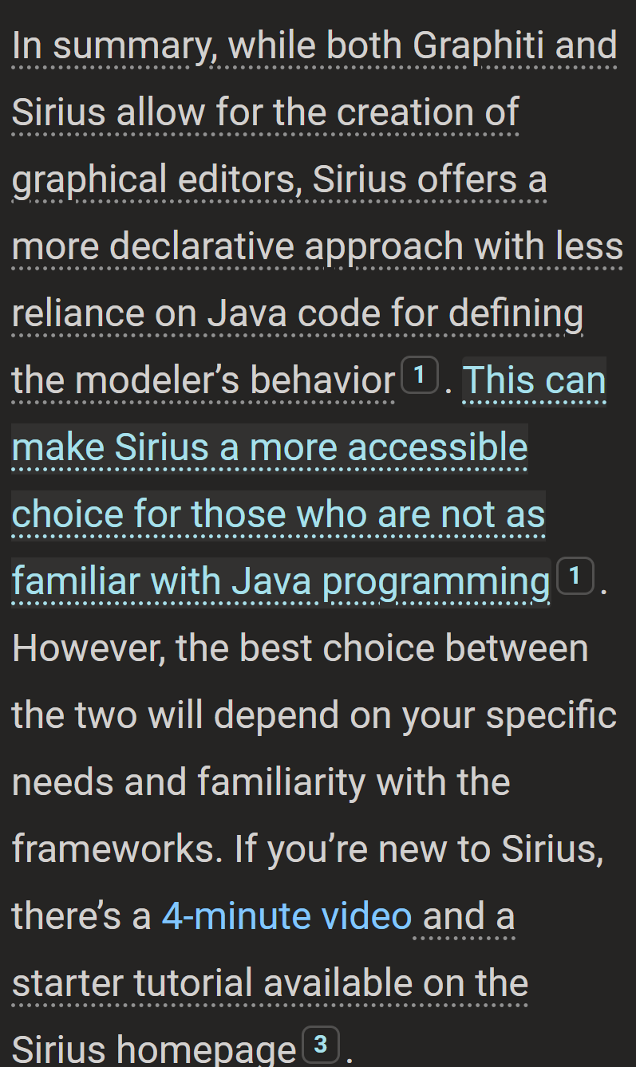
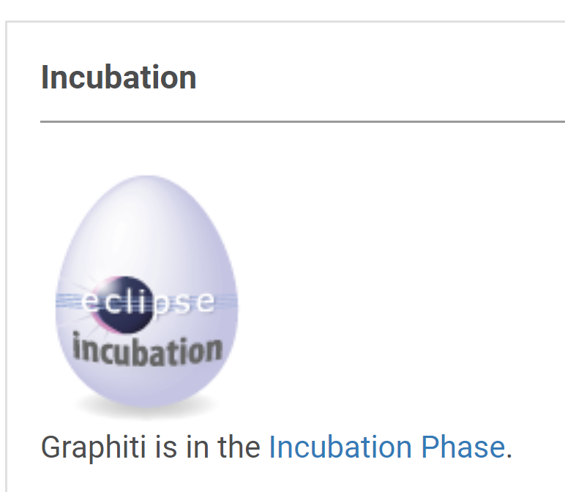
3.2 graphiti
graphiti
not good
what
graphiti not finished

Slide 9
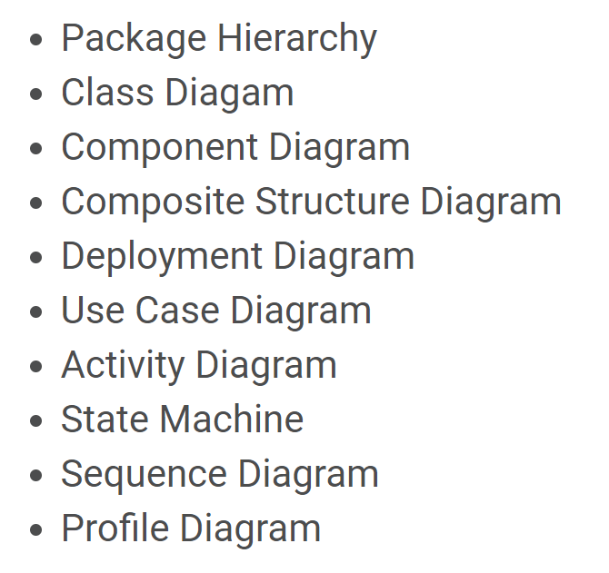
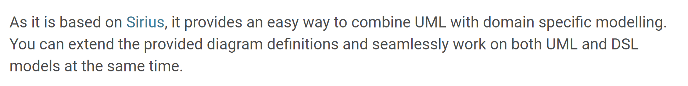
3.3 sirius
sirius UML designer
sirius

Slide 10
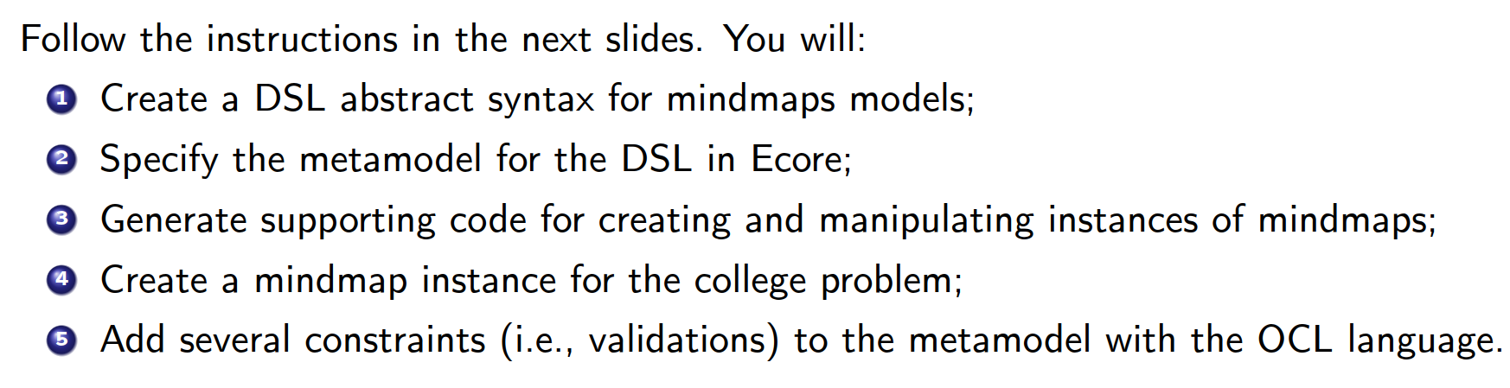
4. emf
where
A2_Exercise2\A1_PL\A1_Semana4

Slide 11
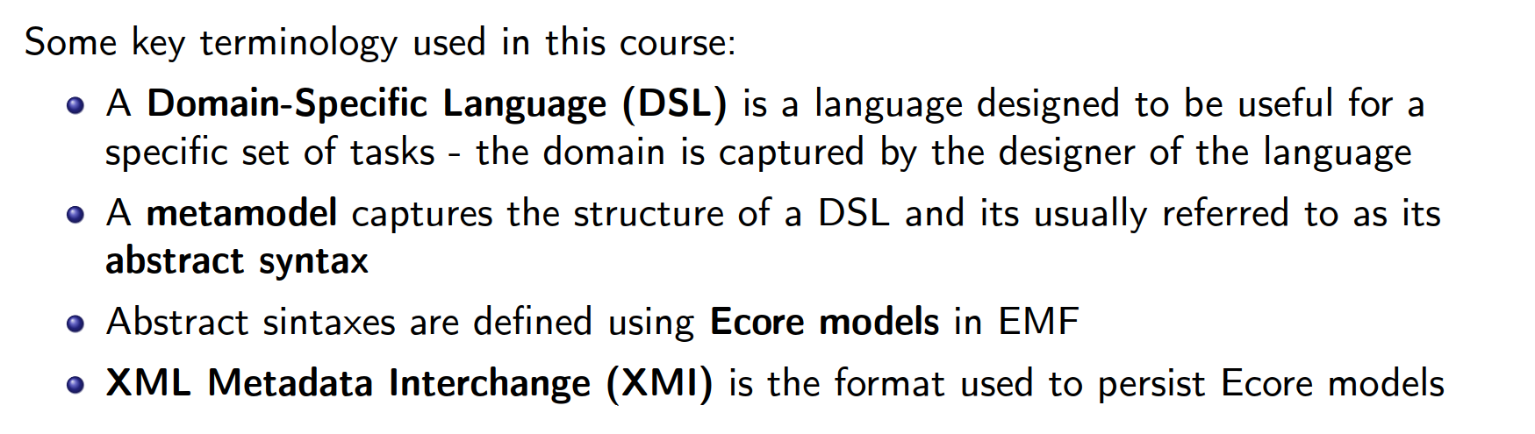
4.1 lexicon
what

Slide 12
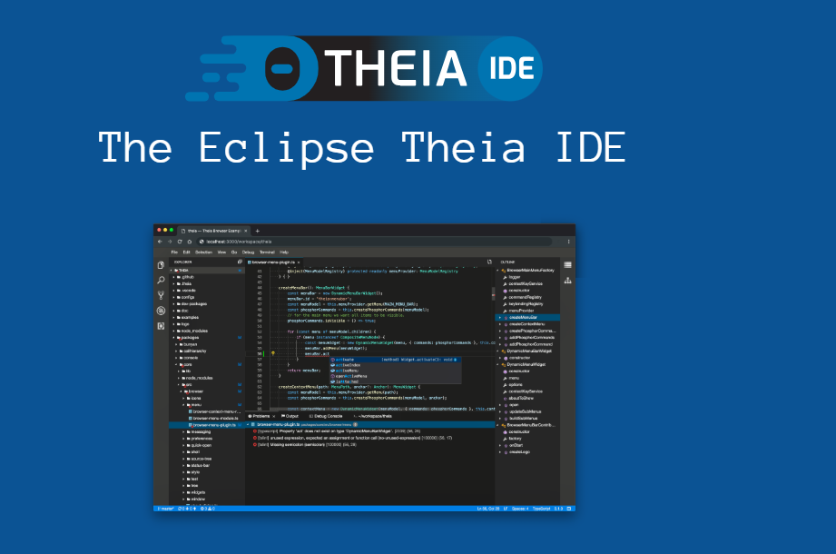
5. theia
what
very new
not mature
theia main site
eclipse/projects/theia
github
theia vs vscode
video: modeling tools
video: introduction
documentation
video: 2024 status

Slide 13
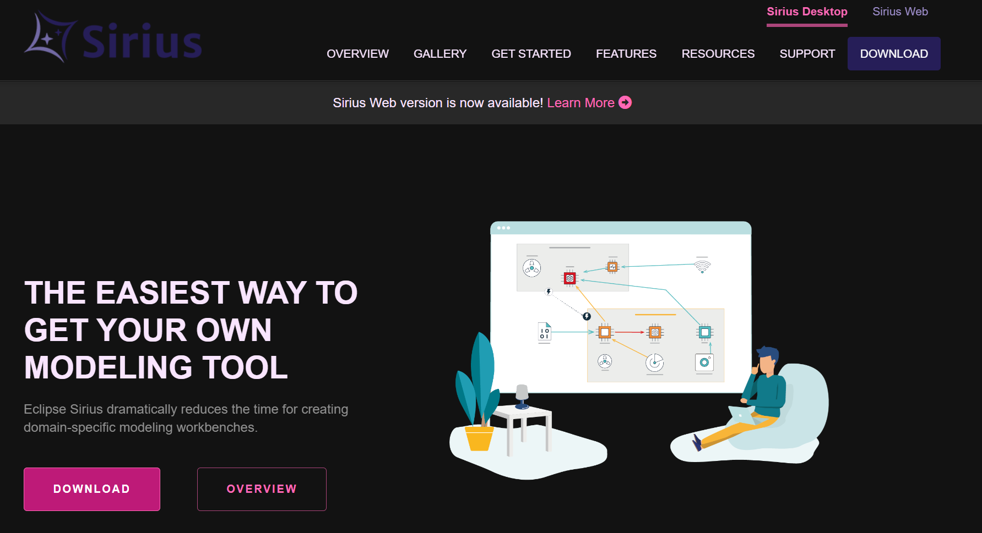
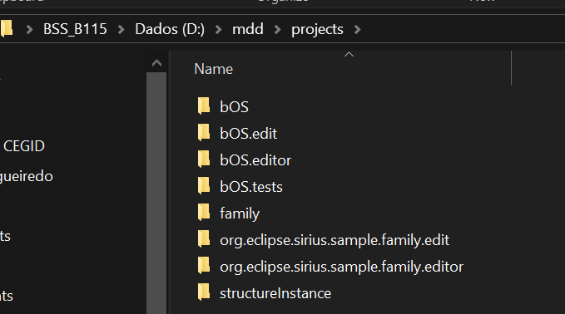
6. obeo
what
need to document
java and libraries and paths
main site
sirius-desktop-7.4.6
releases/2024-12
course
course 2
videos list
Code generation from visual models using Eclipse Sirius and Acceleo
D:\mdd\obeo
D:\mdd\ws\obeo
java releases

Slide 14
6. obeo
what
need to document
java and libraries and paths
main site
sirius-desktop-7.4.6
releases/2024-12
course
course 2
videos list
Code generation from visual models using Eclipse Sirius and Acceleo
D:\mdd\obeo
D:\mdd\ws\obeo
java releases

Slide 15
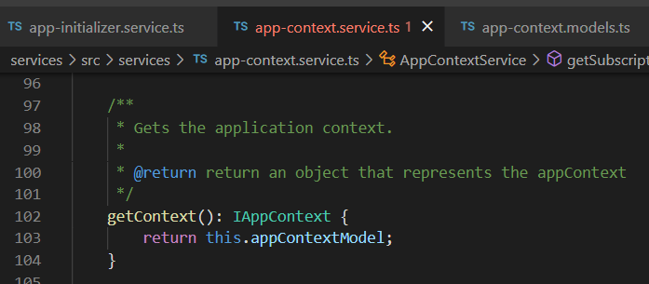





Z. template
new project
ExecuteAsync
square post-it
download
exe
download
exe
why
A slash
followed
by
two consecutive asterisks
D:\A1_research\C2_c0dice\B1_jmeter\A1_install
functionalities
introduction
build-exe
entity framework plus
zig help
⊂
⊂
4
every key-frame
defines the operation
deploy

