Slide 1

1. language
python

Slide 2
1.1 index
arrays
functions
interfaces
loops
oop
syntax
variables

Slide 3

1.2 sources
tutorial
python-tutorial

Slide 4

1.3 resources
language\_resources
language\_projects

Slide 5
2. what
what
is a multi-paradigm programming language
procedural
object-oriented
functional programming
paradigms

Slide 6
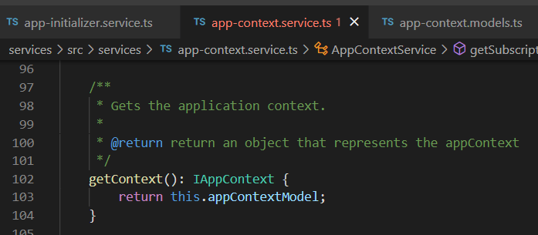

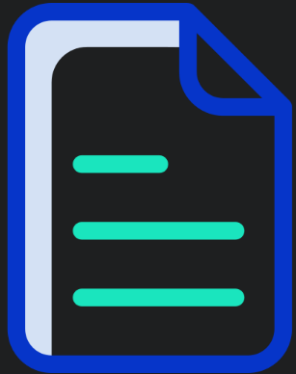


Z. template
new project
ExecuteAsync
square post-it
download
exe
download
exe
why
A slash
followed
by
two consecutive asterisks
D:\A1_research\C2_c0dice\B1_jmeter\A1_install
functionalities
introduction
build-exe
entity framework plus
zig help
⊂
procedural, object-oriented, and functional programming
4
introduction
every key-frame
defines the operation
success

