Slide 1

1. libraries
python

Slide 2


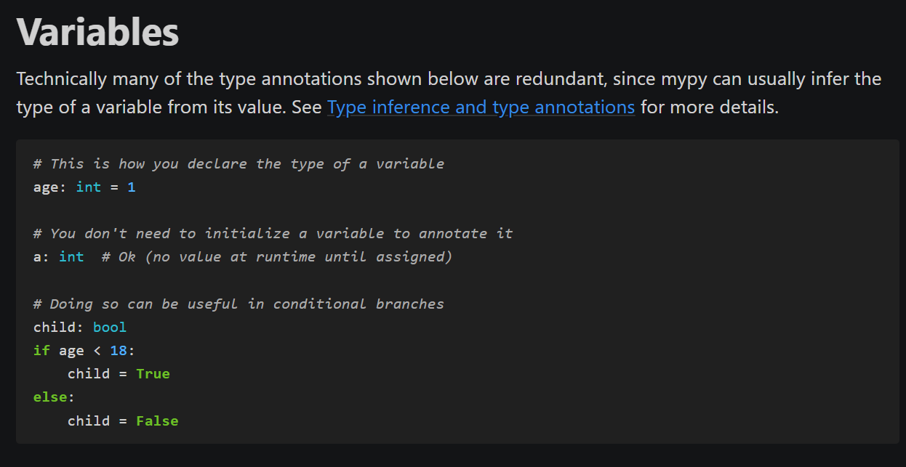
2. typing
what
typing
cheat sheet

Slide 3

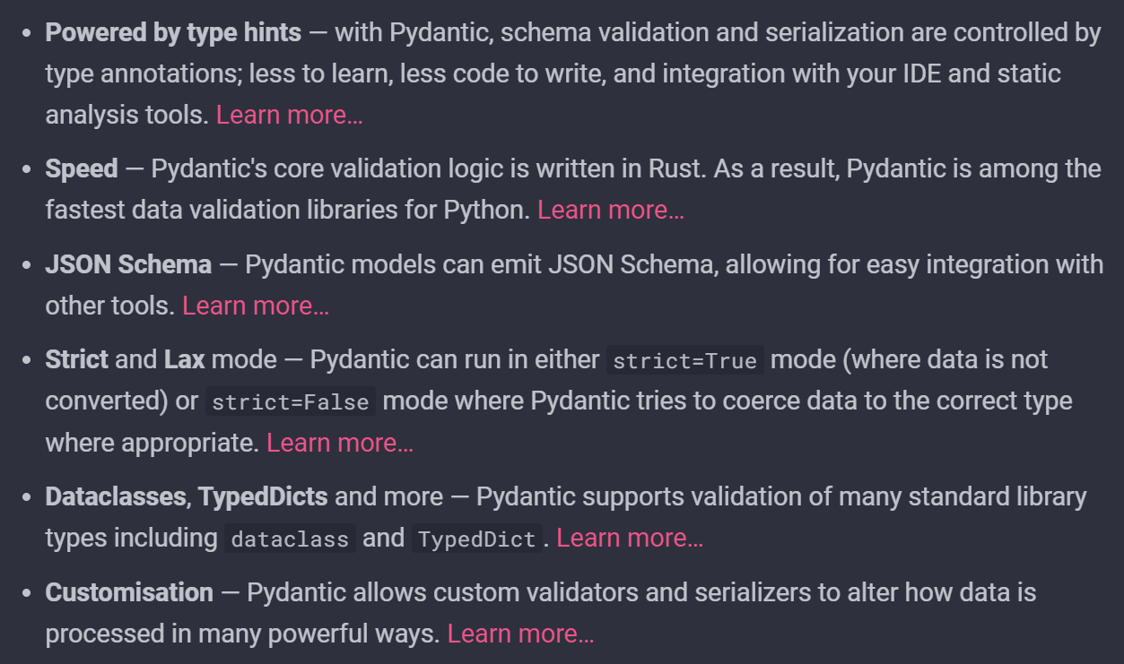
3. pydantic
what
pydantic
video overview and concept
video very complete with setting

Slide 4
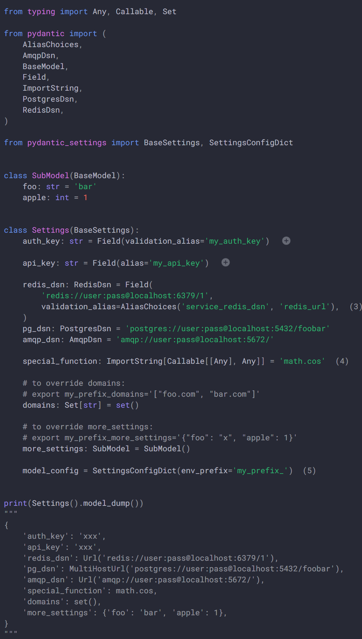
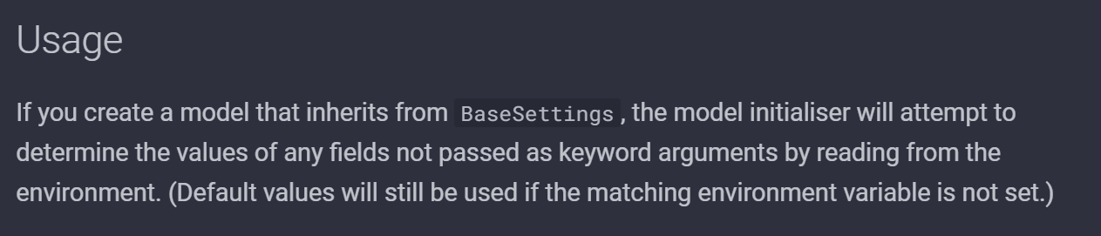
3.1 settings
what
pydantic settings

Slide 5
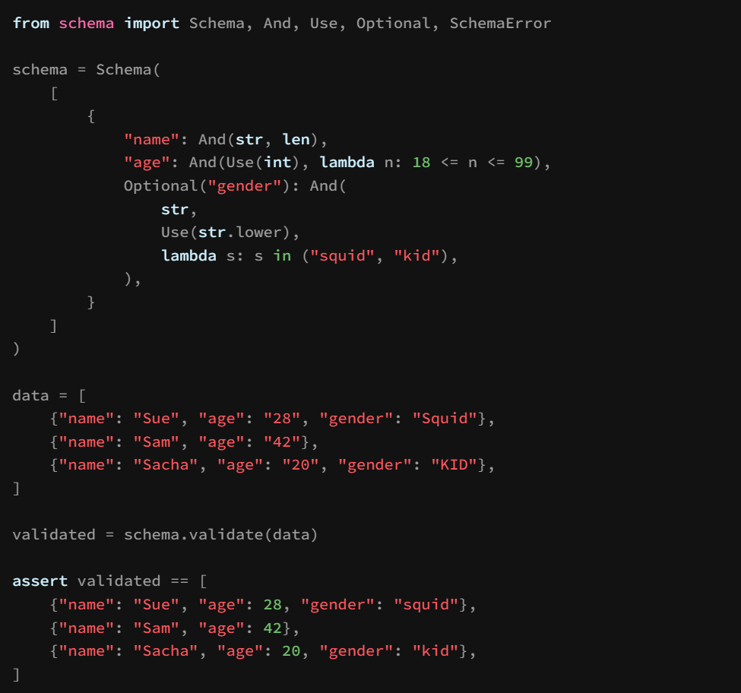
4. schema
what
schema

Slide 6
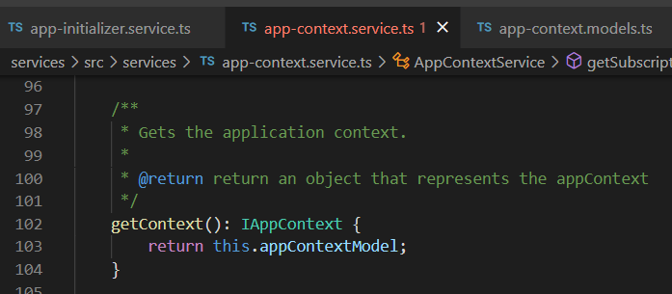




Z. template
new project
ExecuteAsync
square post-it
download
exe
download
exe
why
A slash
followed
by
two consecutive asterisks
D:\A1_research\C2_c0dice\B1_jmeter\A1_install
functionalities
introduction
build-exe
entity framework plus
zig help
⊂
4
every key-frame
defines the operation
success

