Slide 1

1. settings
python

Slide 2

1.1. sources
Learn TOML in 10 Minutes (Tutorial) (youtube.com)
Python and TOML: New Best Friends – Real Python
video: part explains pydantic settings

Slide 3
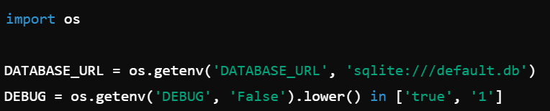
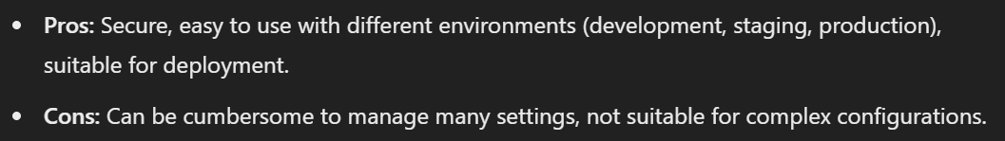
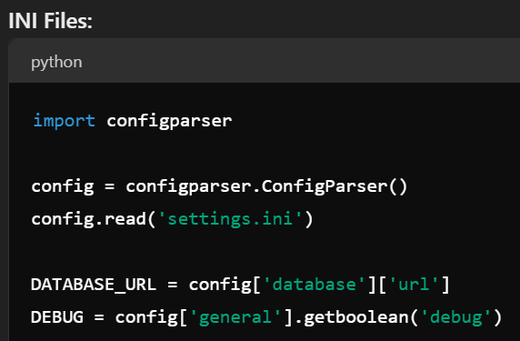
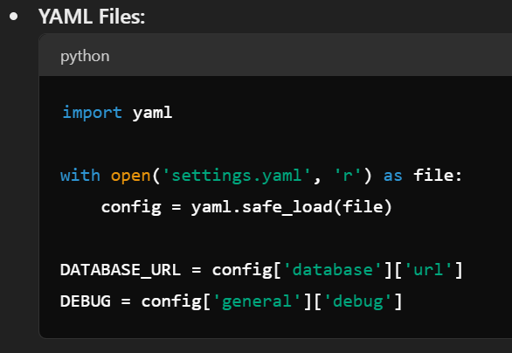
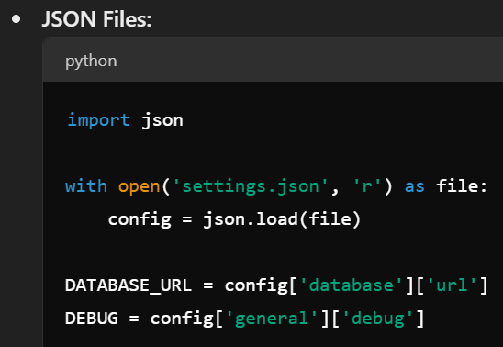
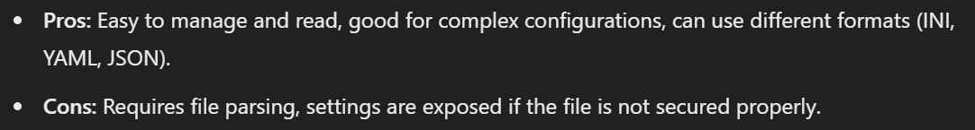
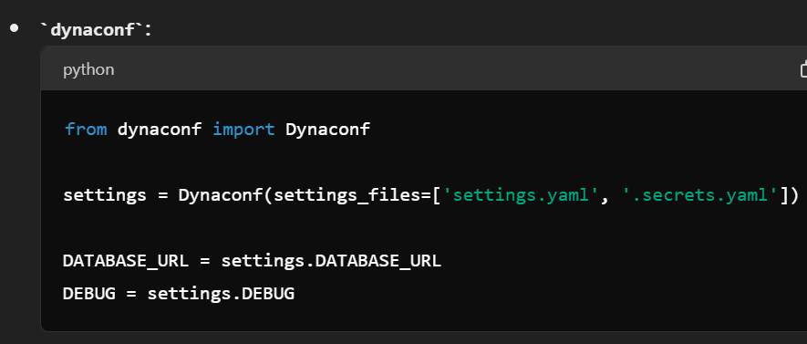
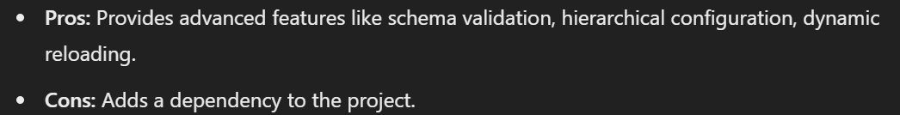
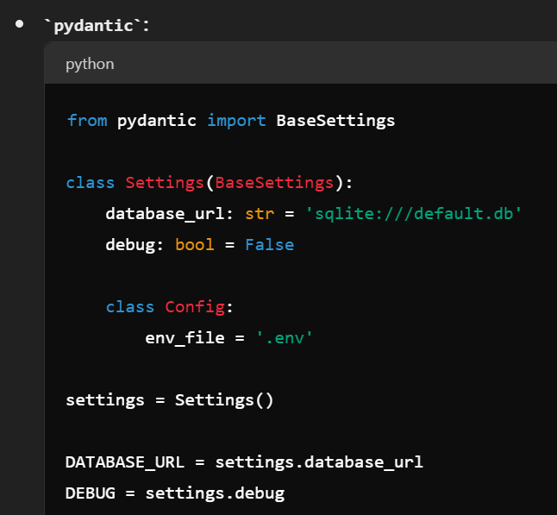
2. ways
environment variables
configuration files
configuration library

Slide 4
3. dynaconf
what
video: dynaconf
best practices
install
init
prefix

Slide 5
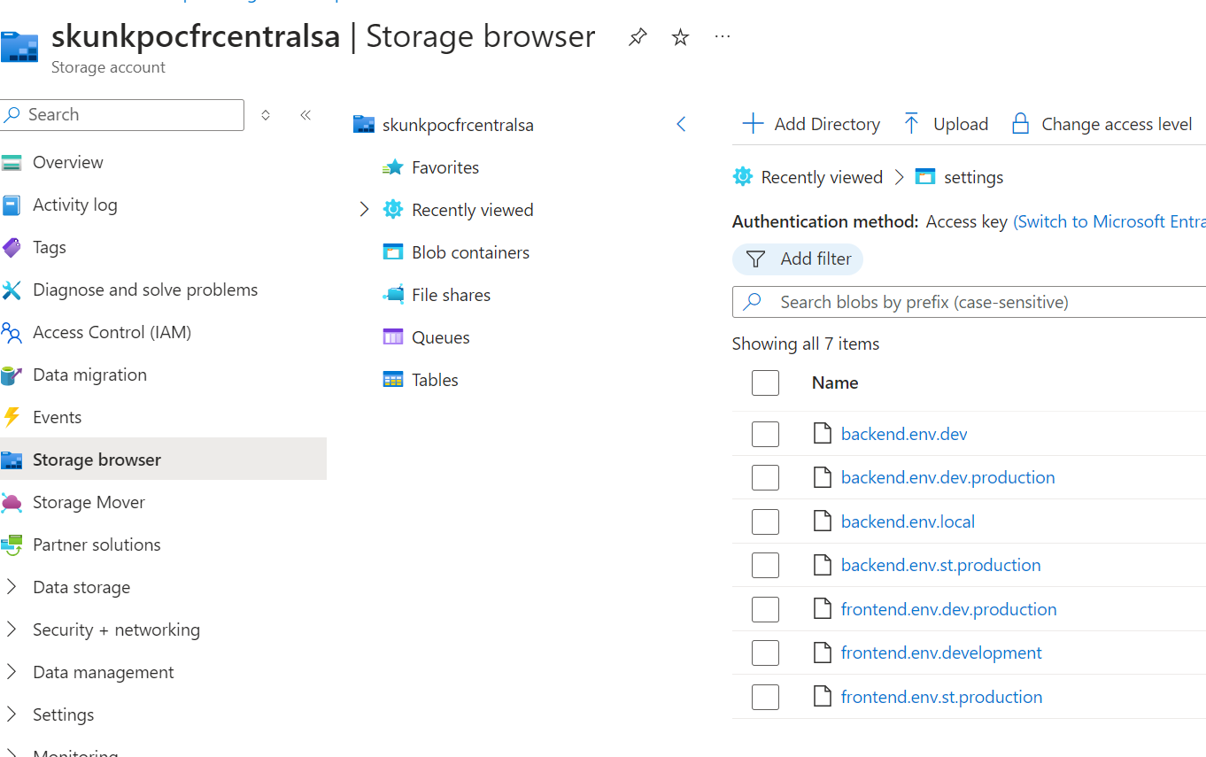
4. pos
what
azure
documentation
Settings012109*

Slide 6
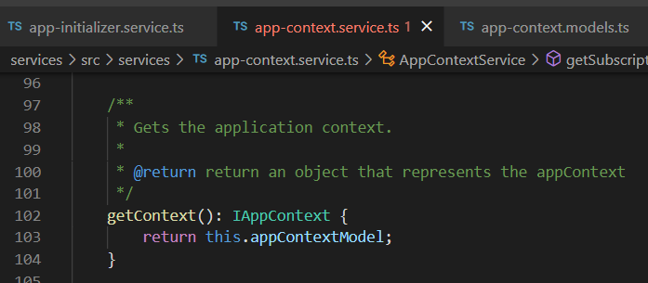


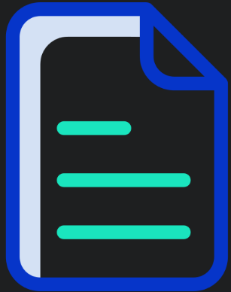

Z. template
new project
ExecuteAsync
square post-it
download
exe
download
exe
why
A slash
followed
by
two consecutive asterisks
D:\A1_research\C2_c0dice\B1_jmeter\A1_install
functionalities
introduction
build-exe
entity framework plus
zig help
⊂
4
every key-frame
defines the operation
success

