Slide 1

1. tests
python

Slide 2

1.1. sources
video: vsCode
Testing Python in Visual Studio Code
video: pyTest
Python Testing Frameworks with Unit test, PyTest, and Nose (cloudthat.com)
PyTest vs Unit test: A Comparison | Browser Stack
Nose, PyTest, and Python's built-in unit test framework | LinkedIn

Slide 3
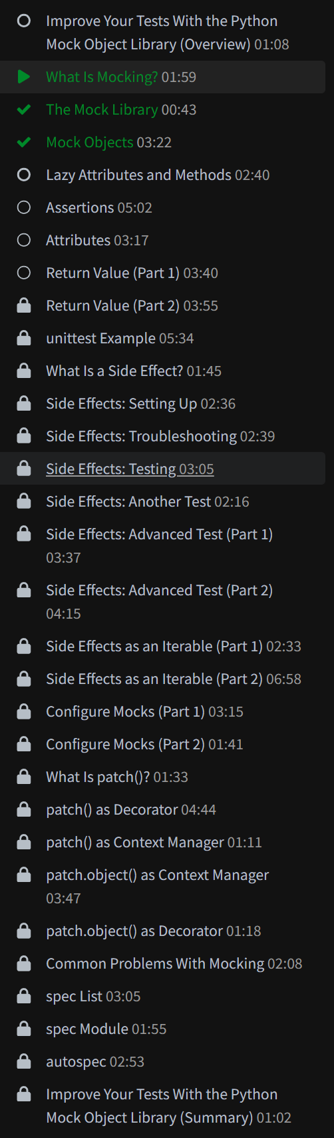
2. mock
lessons/mocking

Slide 4
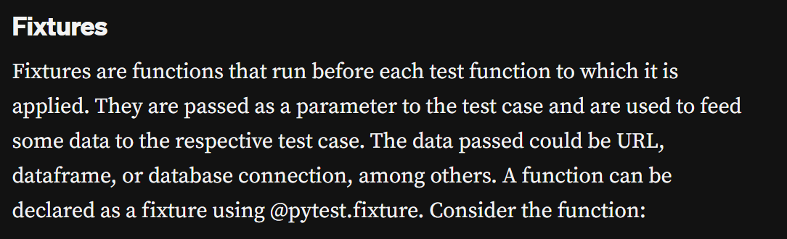
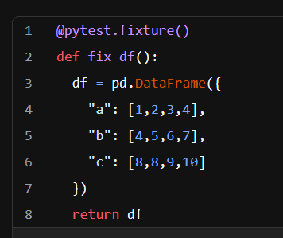
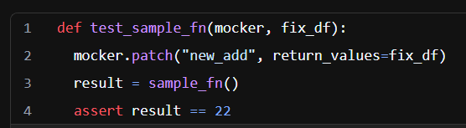
3. data
fixtures

Slide 5
4. how

Slide 6
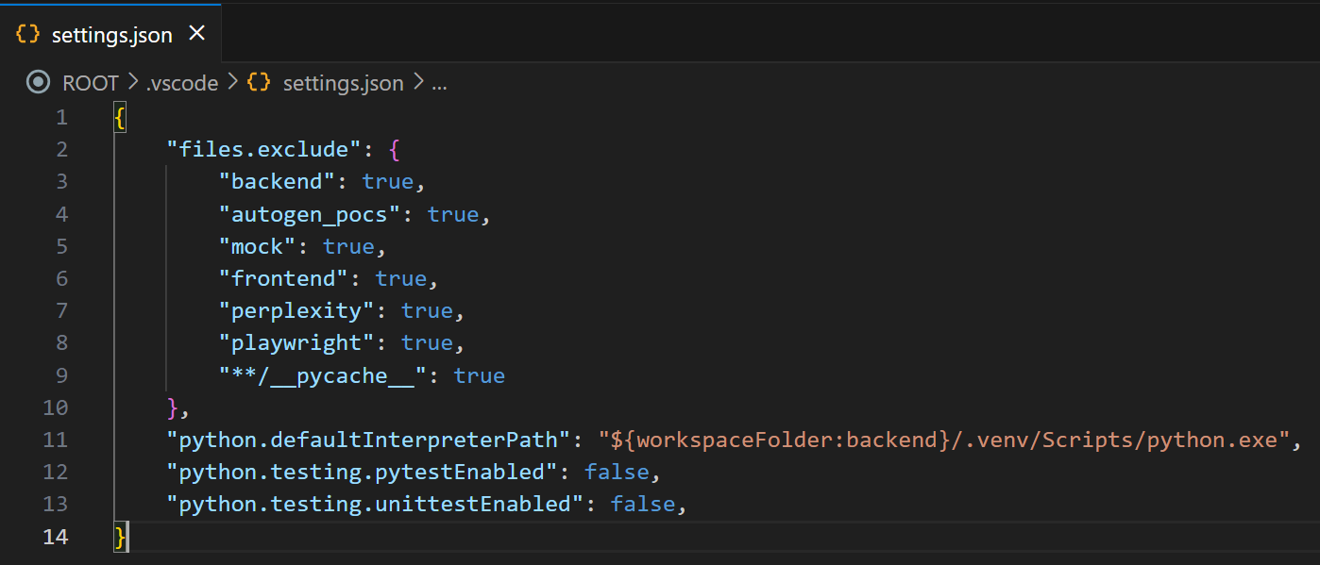
4.1 disable
disable
in the settings files
for
every workspace
this two lines
disable tests

Slide 7
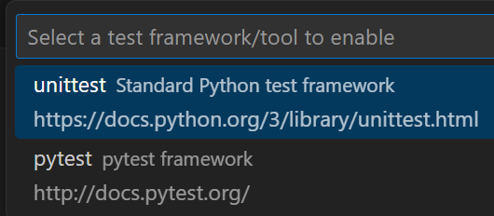
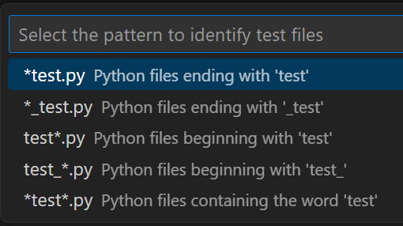
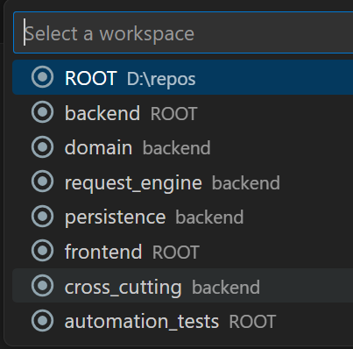
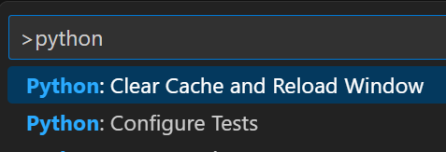
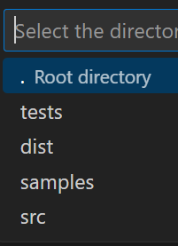
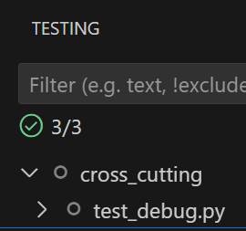
4.2 configure
configure
{
"python.defaultInterpreterPath": "${workspaceFolder}/.venv/Scripts/python.exe",
"python.testing.cwd": "${workspaceFolder}",
"python.testing.unittestArgs": [
"-v",
"-s",
"./tests/cross_cutting",
"-p",
"*test*.py"
],
"python.testing.pytestEnabled": false,
"python.testing.unittestEnabled": true,
}
this folder
identifies
what appears
in vsCode

Slide 8
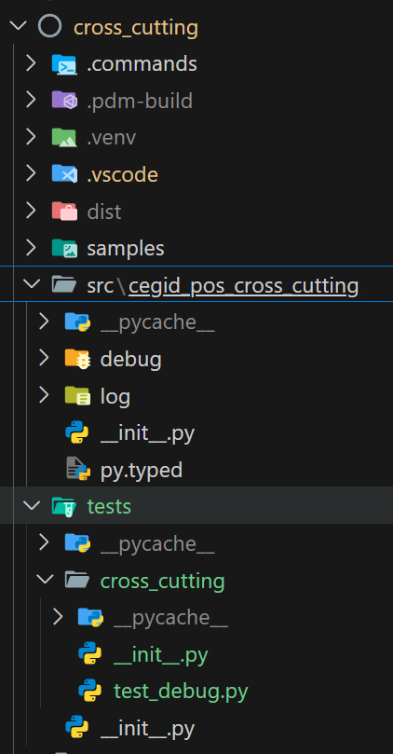
4.3 folder
the name of the folder
can´t be the same
as
the name of the package
error:
not finding the name
of
the current package
that is in
PDM list as -e
because looks
in
__init__.py

Slide 9
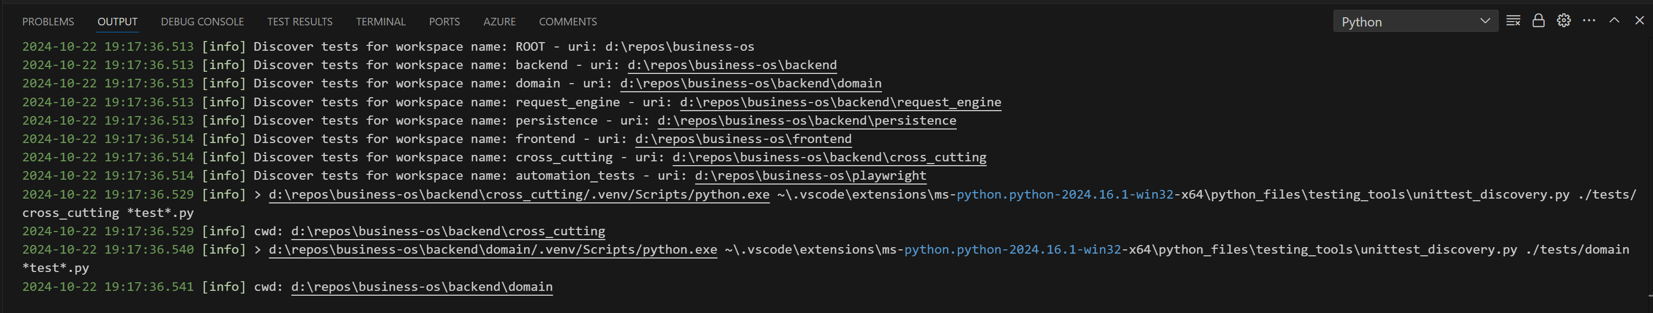
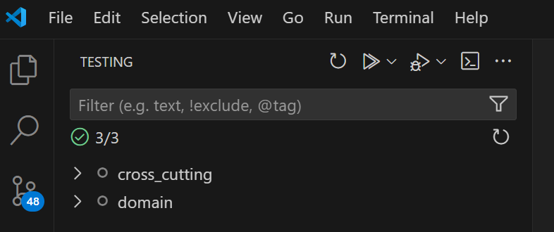
4.4 console

Slide 10
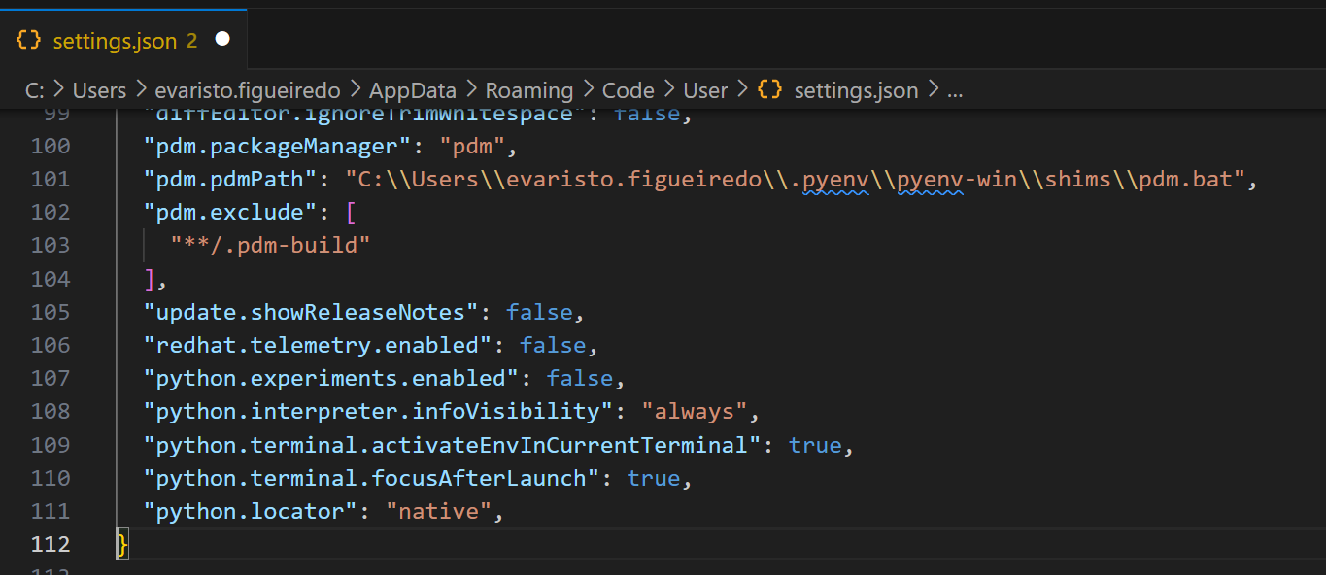
4.5 setup
need research

Slide 11
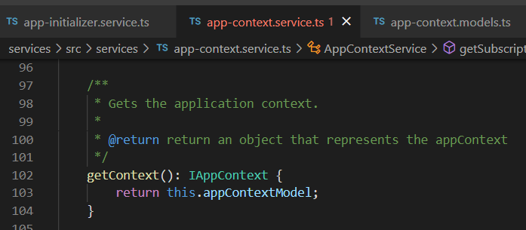




Z. template
new project
ExecuteAsync
square post-it
download
exe
download
exe
why
A slash
followed
by
two consecutive asterisks
D:\A1_research\C2_c0dice\B1_jmeter\A1_install
functionalities
introduction
build-exe
entity framework plus
zig help
⊂
4
every key-frame
defines the operation
success

