Slide 1

1. types
python

Slide 2

1.1. sources
Pydantic V2 - Full Course - Learn the BEST Library for Data Validation and Parsing (youtube.com)
Model Config – Pydantic
Validation Errors - Pydantic
Static type checking with Mypy — Perfect Python – YouTube
Type hints cheat sheet - mypy 1.10.0 documentation
Getting started - mypy 1.10.0 documentation
mypy.ini

Slide 3
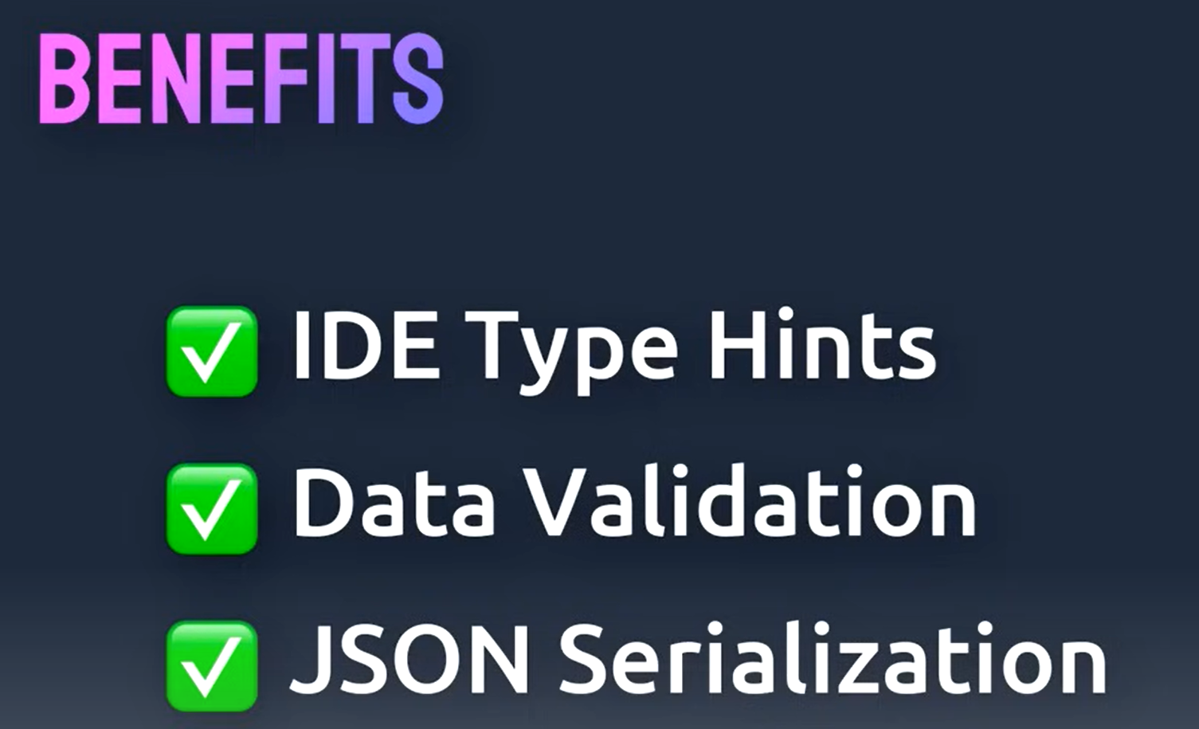
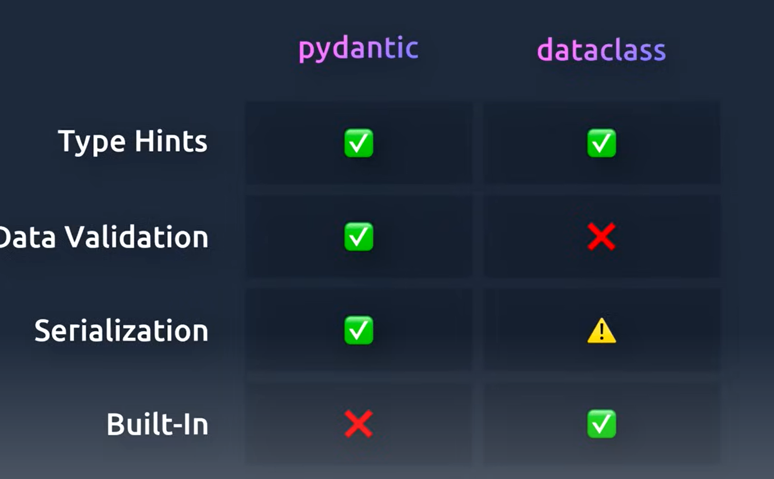
2..overview
pydantic – overview

Slide 4
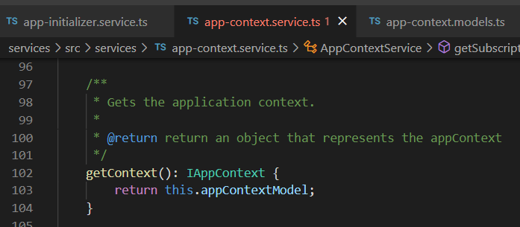




Z. template
new project
ExecuteAsync
square post-it
download
exe
download
exe
why
A slash
followed
by
two consecutive asterisks
D:\A1_research\C2_c0dice\B1_jmeter\A1_install
functionalities
introduction
build-exe
entity framework plus
zig help
⊂
4
every key-frame
defines the operation
success

