Slide 1

1. python
skunk
portfolio

Slide 2

1.1 index
blocking
_projects
build in modules
_sources
command
console
decorators
environment
generation: code
history
language
libraries
logging
profile
settings
tests
types

Slide 3

1.2 sources
programming-resources
python inspect - Google Search

Slide 4
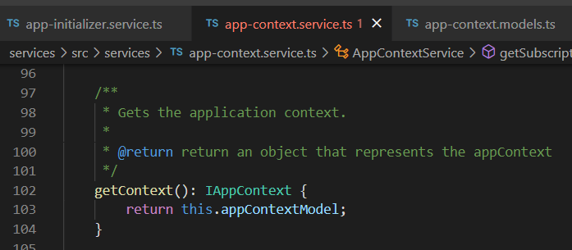



Z. template
new project
ExecuteAsync
square post-it
download
exe
download
exe
why
A slash
followed
by
two consecutive asterisks
D:\A1_research\C2_c0dice\B1_jmeter\A1_install
functionalities
introduction
build-exe
entity framework plus
zig help
⊂
4
every key-frame
defines the operation
success

