Slide 1

1. requirements
portfolio

Slide 2
1.1 index
archi

Slide 3


1.2 sources
video
book
_resources\use-case_2_0_jan11.pdf

Slide 4
2. glossary

Slide 5
2.1 use-case
what
an use-case
is
all the ways
of using
a system
to achieve
a particular goal
for
a particular user
taken together
the set of
all the use cases
gives you
all of
the useful ways
to use
the system,
and illustrates
the value
that it will provide

Slide 6
2.1.1 approach
The use-case approach
has a much broader scope
than
just requirements capture.
It does not prescribe
how you should plan
or
manage your development work,
or
how you should design, develop or test your system
they can and should be used to
drive the development,
It provides
a structure
for the successful adoption
of
your selected
management
and
development
practices
they supports the
analysis
design,
planning,
estimation,
tracking
testing
of systems

Slide 7
3. how
the use cases capture the goals of the system.
to understand a use case we tell stories
as a use case
is focused on
the achievement
of
a particular goal,
it provides
a focus for
the storytelling
the stories cover
how to successfully achieve the goal,
and
how to handle any problems
that may occur on the way
rather than trying to
describe the system
in one go
we can approach it
use case
by use case
the results of the storytelling
are captured and presented
as part of the use-case narrative
that accompanies each use case
use cases provide a way
to identify and capture
all the
different
but related
stories
in
a simple
but comprehensive
way
this enables
the system’s requirements
to be
easily captured,
shared
and
understood

Slide 8
3.1 tests
when using storytelling
as a technique
to communicate requirements
the test cases
are the most important part
of a use case’s description,
more important even than
the use-case narrative
it is essential
to make sure that
the stories are captured
in a way that makes them
actionable
and
testable
this is because
they make the stories real,
and
their use can unambiguously demonstrate
that the system
is doing what it is supposed to do
a set of test cases
accompanies
each use-case narrative
to complete
the use case’s description
it is the test cases
that define what it means to
successfully implement
the use case

Slide 9
4. steps

Slide 10
4.1 organize
objective
Gather and Organize Existing Requirements
objective
start by gathering all existing requirements
from your current Excel files
and
organizing them
artifact
create a consolidated document or database containing all raw requirements
example
import the Excel file into a spreadsheet or a requirements management tool
ensure each requirement is clearly identified
Requirement ID
Description
Priority
action
group these requirements based on common functionality or themes

Slide 11
4.2 diagram
title
Identify High-Level Use Cases
objective
define high-level use cases based on the grouped requirements
artifact
a Use-Case Model Diagram
that visually represents the system’s use cases
and the actors involved
example
if your system includes user login, account management, and order processing, each of these functionalities would be identified as separate use cases (e.g., "User Login," "Manage Account," "Process Order").Action: Draw a use-case diagram showing actors (e.g., User, Admin) and their interactions with the system's use cases.
action
group these requirements based on common functionality or themes.

Slide 12
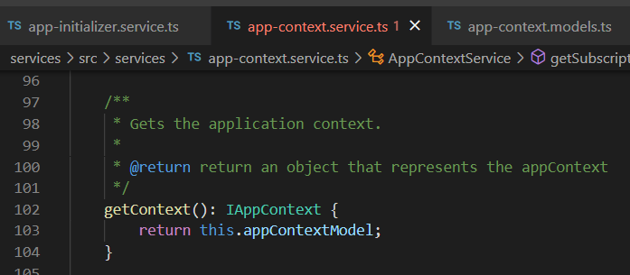



Z. template
new project
ExecuteAsync
square post-it
download
exe
download
exe
why
A slash
followed
by
two consecutive asterisks
D:\A1_research\C2_c0dice\B1_jmeter\A1_install
functionalities
introduction
build-exe
entity framework plus
zig help
⊂
4
every key-frame
defines the operation
success

