Slide 1
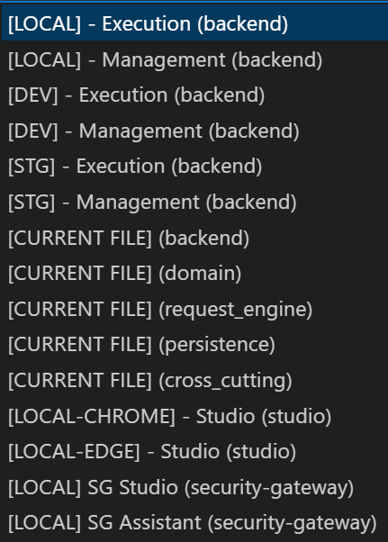
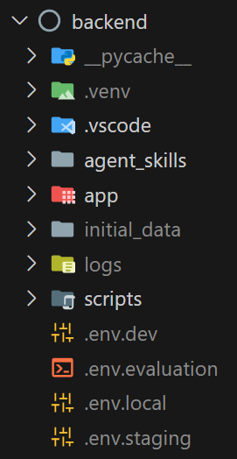
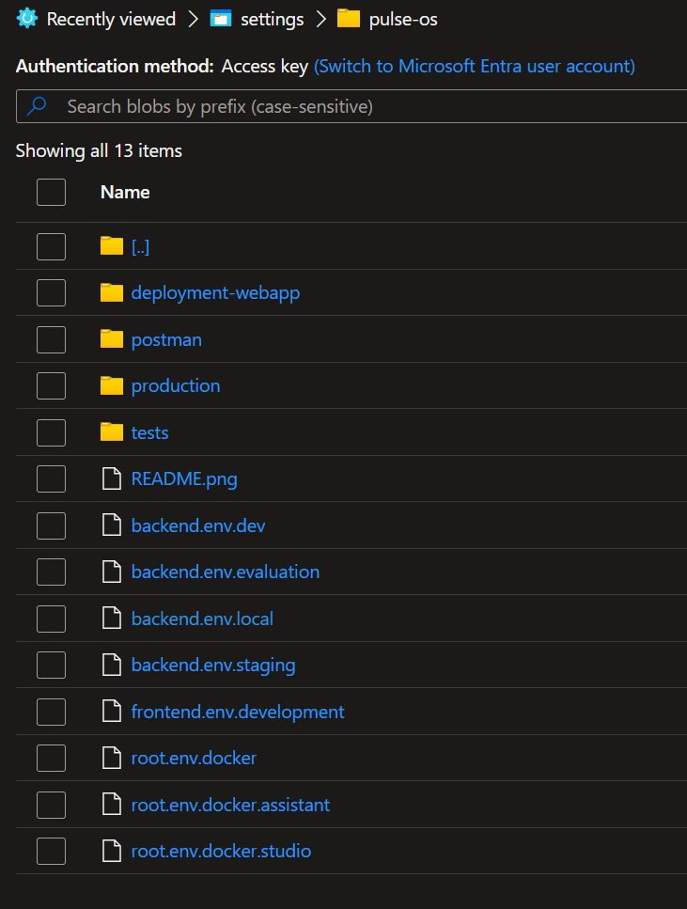
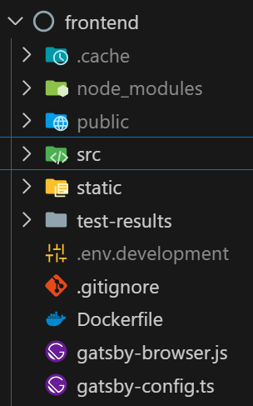
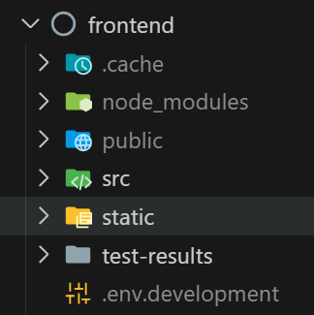
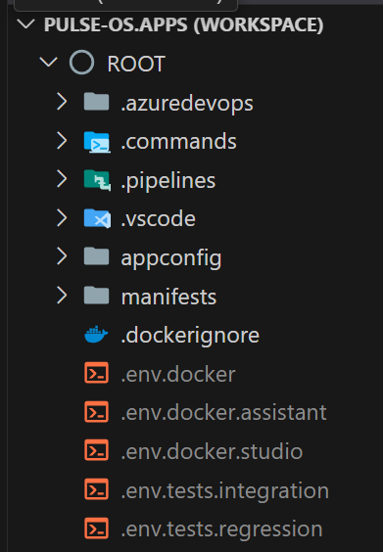
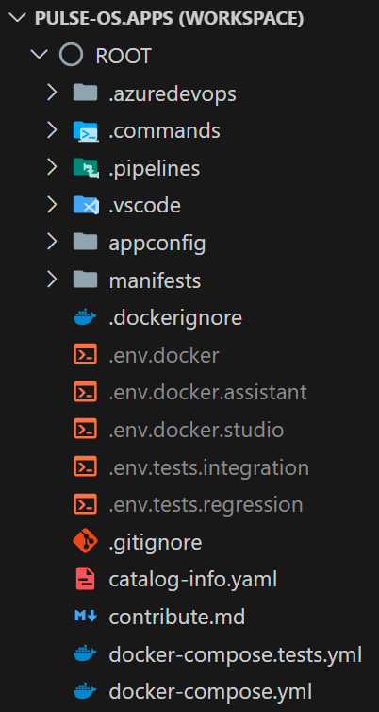
1. settings
copy of the
azure pipelines
variables

Slide 2
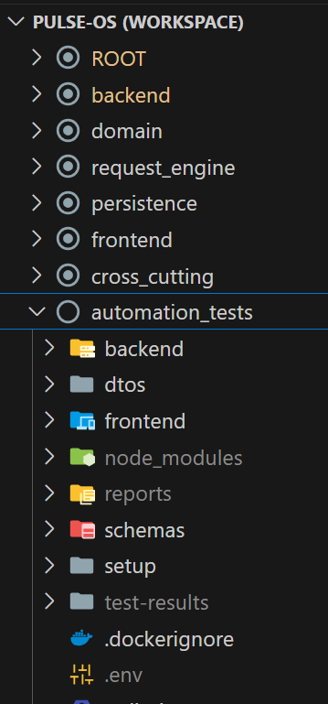
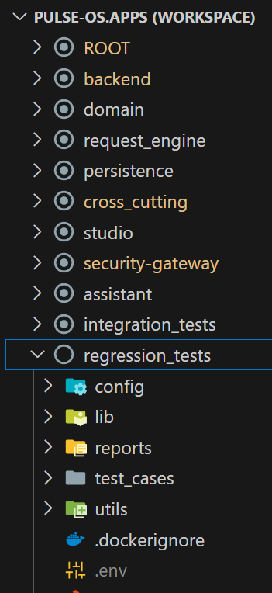
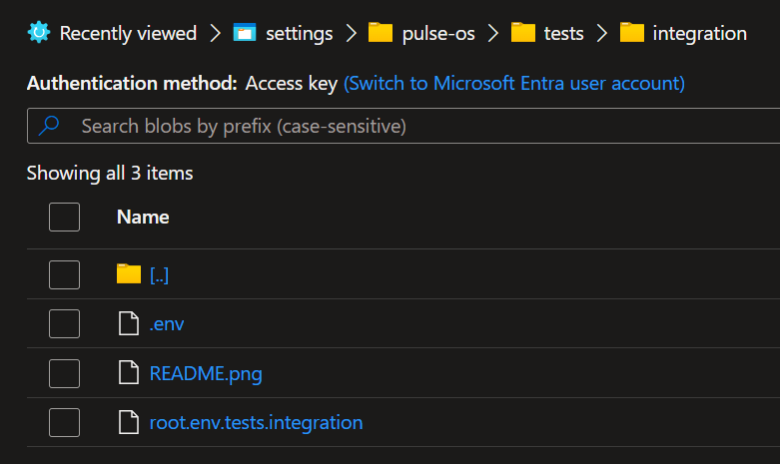
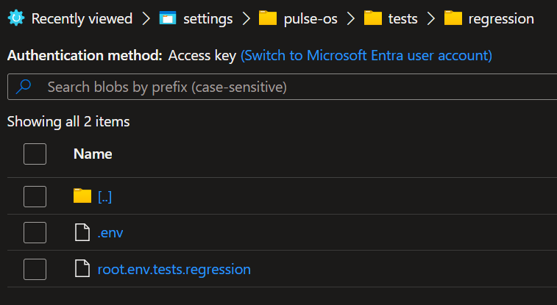
2. tests
this is a specific folder for tests
inside
the settings folder

Slide 3
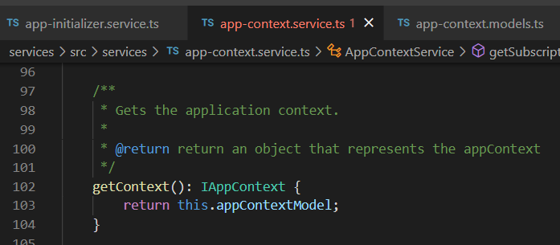






Z. template
new project
ExecuteAsync
square post-it
why
download
exe
download
exe
A slash
followed
by
two consecutive asterisks
D:\A1_research\C2_c0dice\B1_jmeter\A1_install
functionalities
introduction
build-exe
entity framework plus
zig help
⊂
4
every key-frame
defines the operation
deploy

