Slide 1

1. clean architecture python
portfolio

Slide 2
1.1 index

Slide 3

3. resources
blog
mind map
book
mind map

Slide 4

2. summary

Slide 5

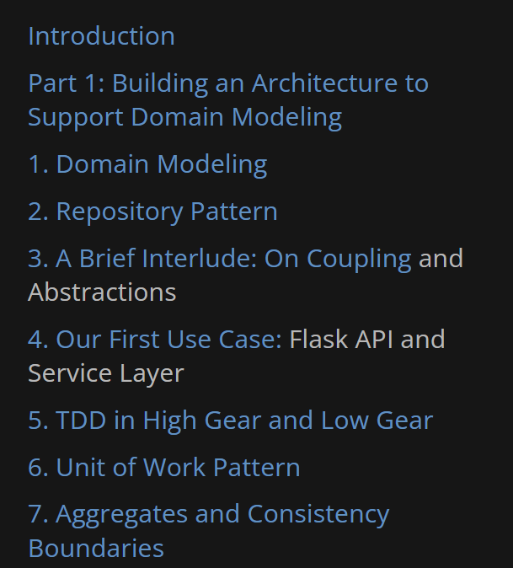
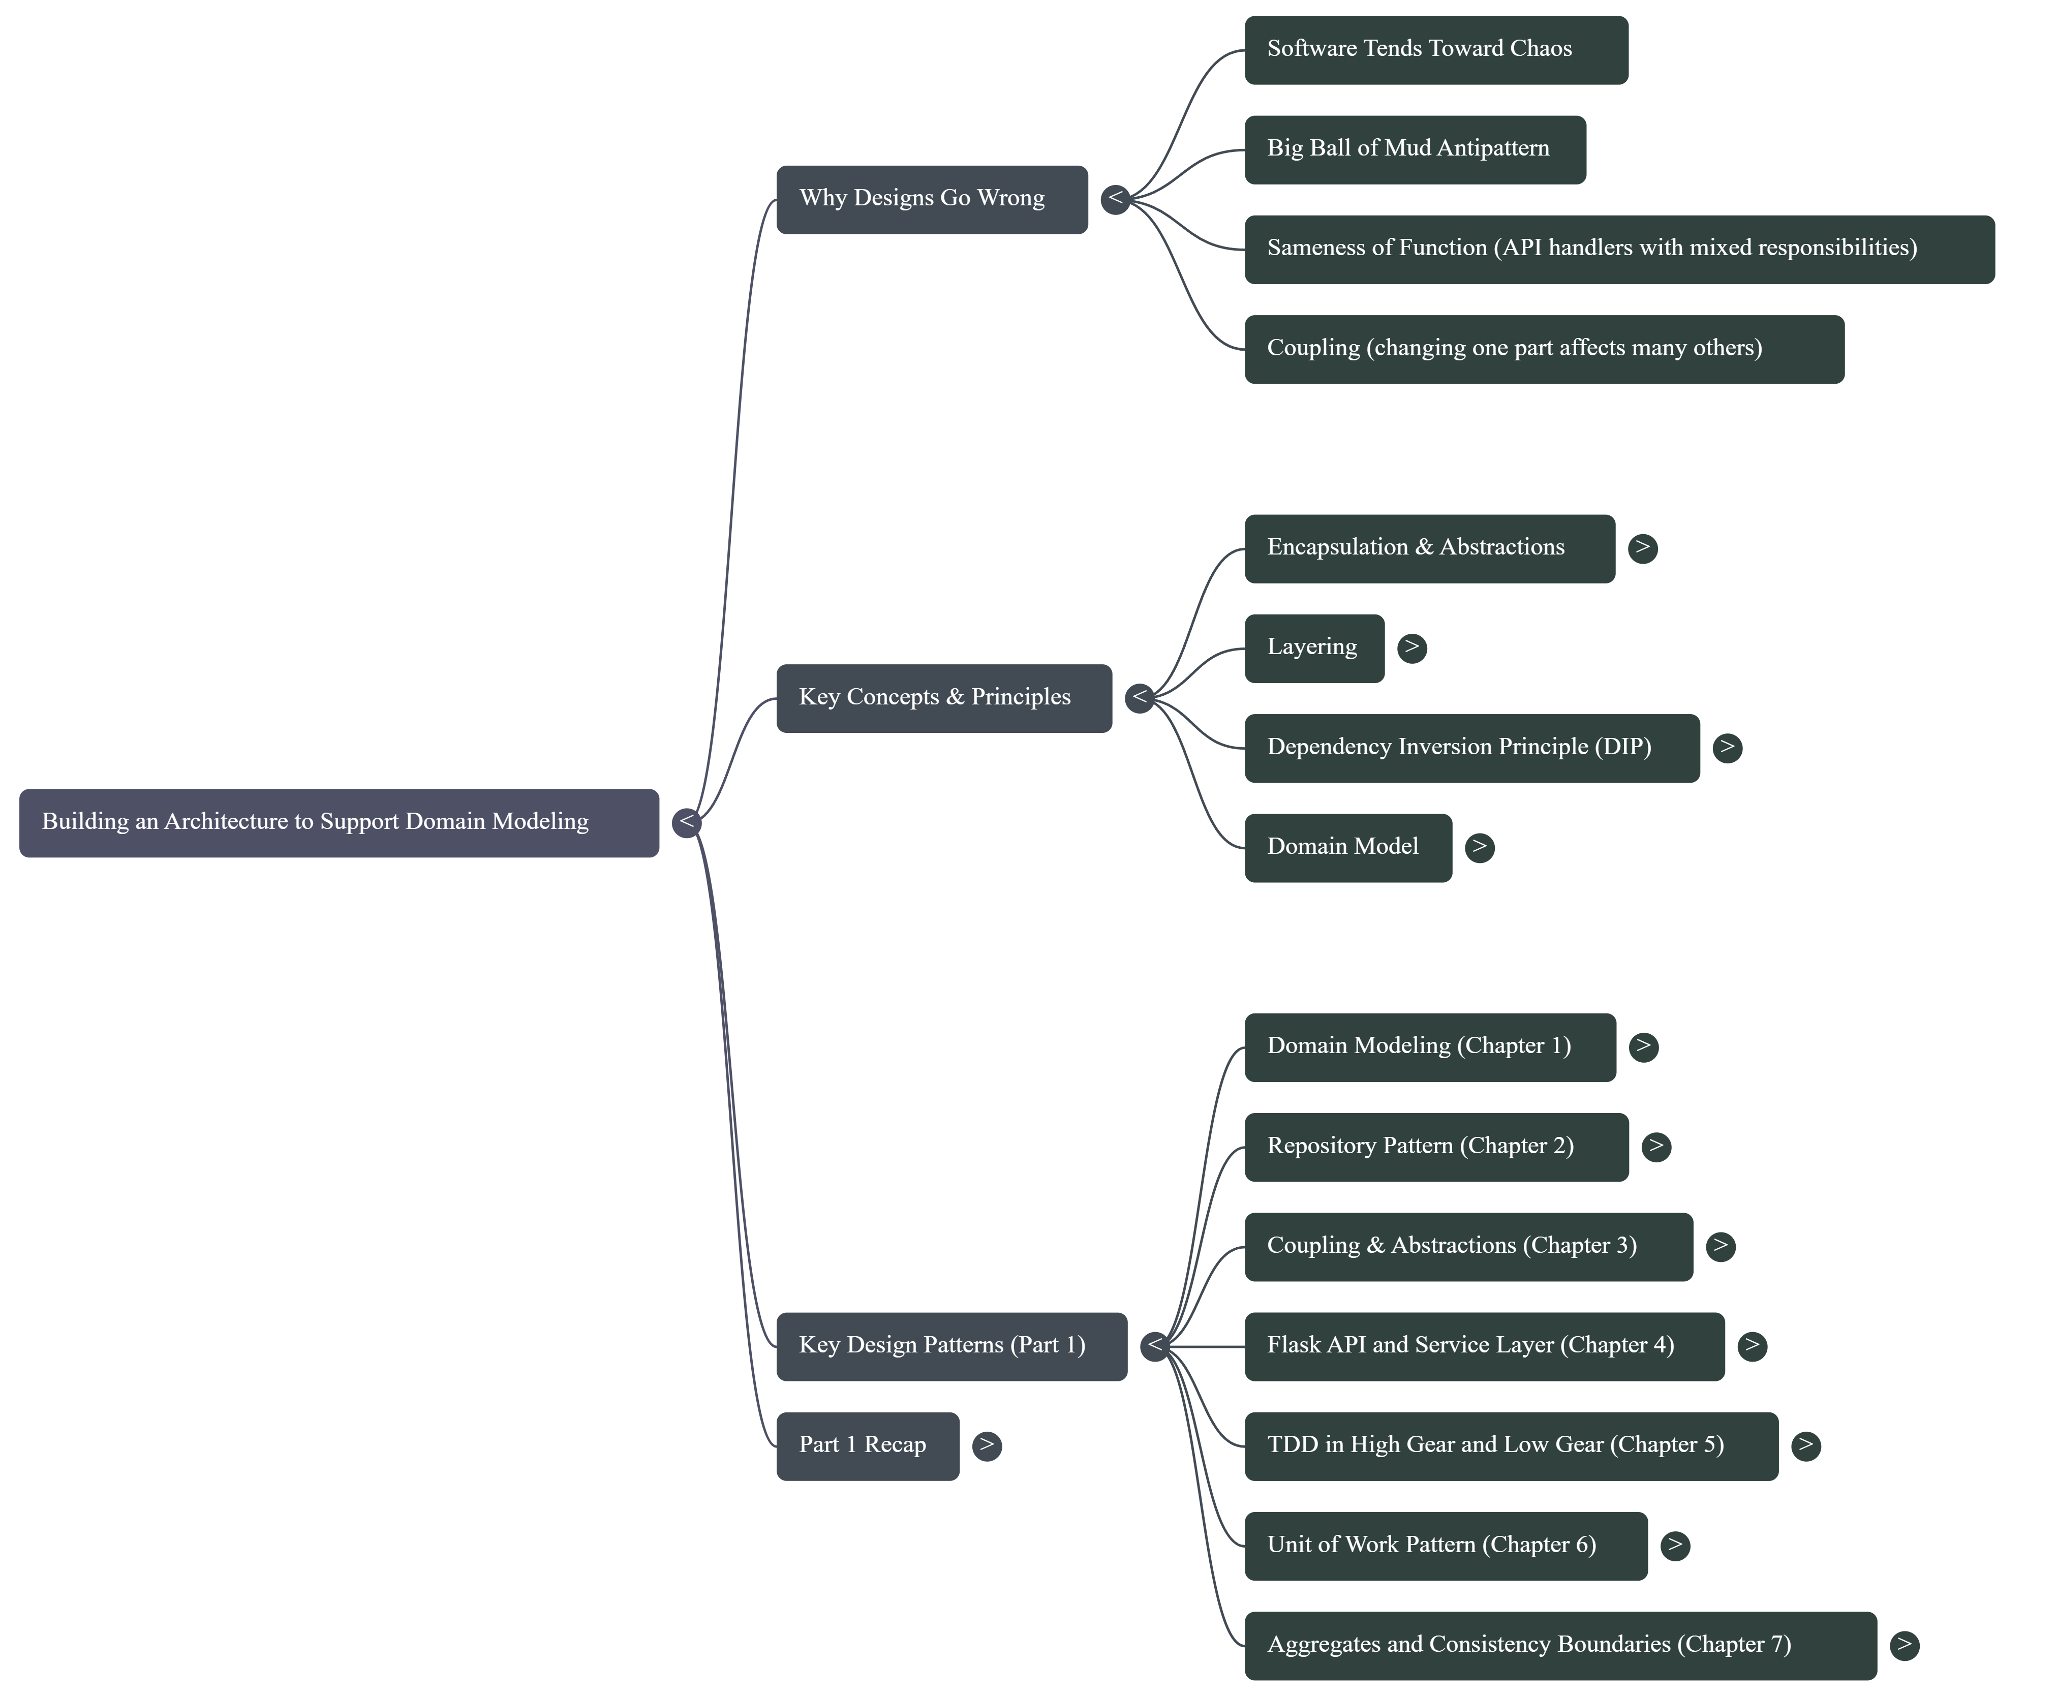
2.1 map
1. Introduction
principles

Slide 6
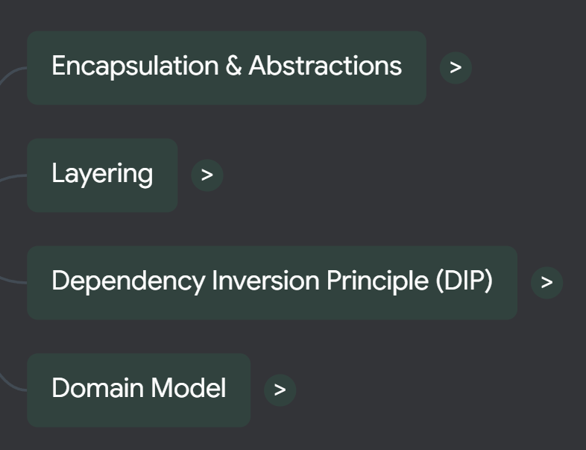
3.1 principles
encapsulation and abstractions
layering
DIP
domain

Slide 7
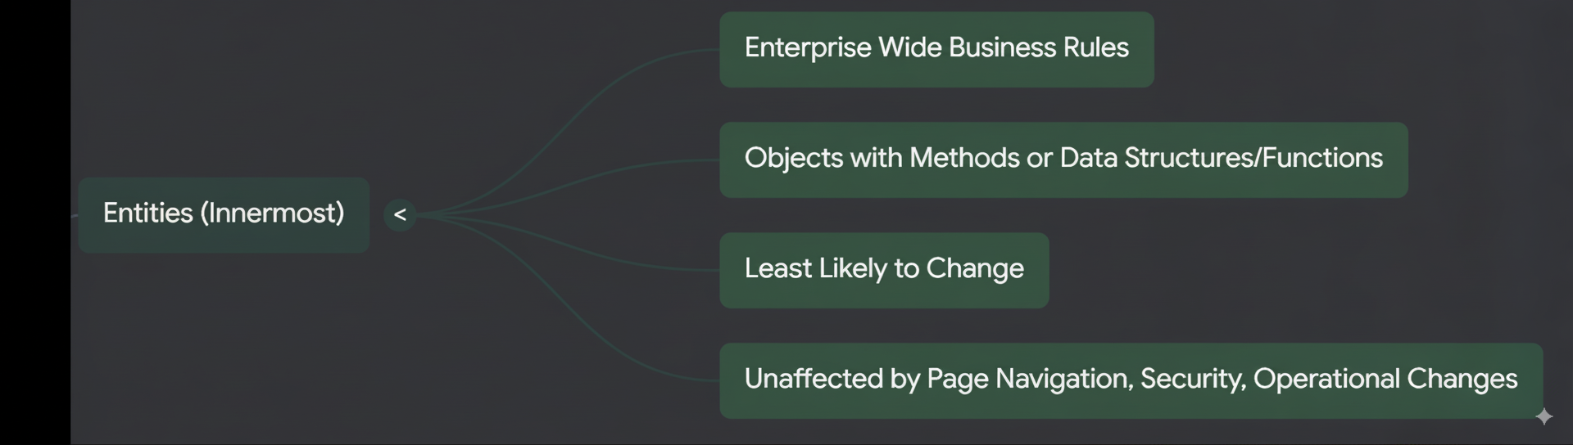
2.2 entities
what
entities
patterns for modeling domains
entity,
value object
domain service
patterns

Slide 8
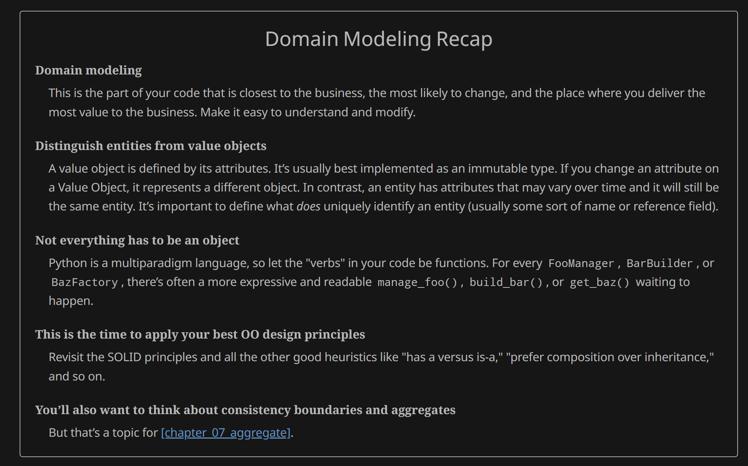
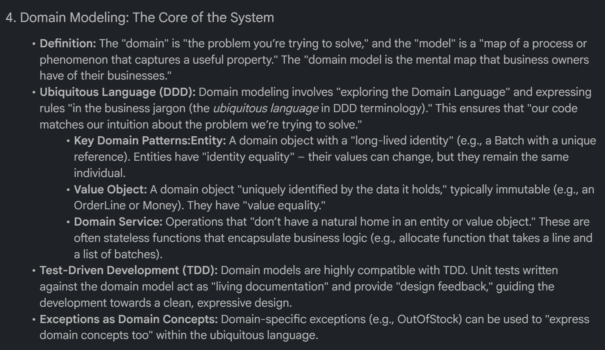
2.2.1 recap
what
patterns

Slide 9




1.1 index
ExecuteAsync
square post-it
download
  exe
download
  exe
why
A slash
  followed
by
  two consecutive asterisks
D:\A1_research\C2_c0dice\B1_jmeter\A1_install
engines
functionalities
foundry
build-exe
foundry
zig help
⊂
2. FOUNDRY
4
every key-frame
defines the operation
1. project
V
success

