Slide 1
1. engines

Slide 2

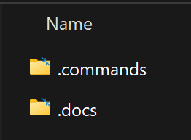
1.1 resources
D:\portfolio\foundry\_reference\engines

Slide 3
2. requirements
domain
  models
  agents
    system
      planner
      recommendation
      summarize
      designer
      proxy
    business (template)
  workflows
  MCP/tools/skills
    PDF
    email
    oauth2
    file management
observability
  database
    sessions
    requests
  App-Insights
    Log
    Trace
  Grafana
    Performance
    Cloud
security
  security agent
  content filters
compliance
  impor/export data
  anonymization
  RGPD
sandbox
  run code
    engines
    workflows
    agents
  security
    allowed
      packages
      URLS
    secret settings
memory management
  tenant
    attributes
    preferences
  user
    attributes
    preferences
  session
    context
    historic
  request
    context
events
  event broker (kafka)
  message broker (redis queue)
authentication
authorization
cost management
debug
evaluation
  offline
  online
  adversarial testing
UI: assistant, studio, vsCode

Slide 4
3. sota

Slide 5
3.1 context
The new requirement is
  to allow clients to:
    develop;
    deploy
  their own custom engines
    that implement
  a defined Python interface
what
Python application
on Azure Kubernetes Service (AKS)
processes tasks asynchronously using Celery
architecture
a REST API (fixed scaling)
  for receiving requests,
a Redis queue
  for buffering tasks,
multiple Celery worker pods
  scaled by KEDA
    based on queue length
  for
    executing tasks
Each task
  placed on the Redis queue
will specify
  which engine to use
  (standard or a specific custom engine),
the Celery worker
  must dynamically execute
the task
  using
the requested engine
each Celery worker
  uses
    a single “standard” engine
  to
    process tasks
these custom engines
  should run
    within the Celery worker’s execution environment
    (not as permanently running independent services),
though
  they could be isolated
    in:
      separate containers,
      pods
  if needed
      for
    security

Slide 6
3.1.1 infra
D:\repos\pulse-os.infra

Slide 7
3.1.1.1 tech
tech
terraform
Provisions all the Azure infrastructure
  (RGs, VNet, AKS cluster, storage accounts, Key Vault, etc.)
    via
  the AzureRM provider.
Defines
  Kubernetes cluster itself
    in terraform/aks.tf
  surrounding network
    in terraform/network.tf.
Manages state of:
  cloud resources;
  handles dependencies
    (e.g. can’t deploy workloads until AKS exists).
both
Terraform
  is great at
    cloud-level infrastructure
    (networks, AKS, identities).
Helm (via Terraform)
  is great at:
    packaging Kubernetes applications;
    and CRDs
• splitting into:
    two workspace;
    two pipelines:
      .pipelines/.../terraform_*.yaml,
      terraform_apply_helm.yam
  keeps
      infra state;
      app state
    separate
  can upgrade:
    cluster
      without touching
    workloads;
    redeploy apps
      without re-provisioning
    Azure resources;
helm
uses:
  Terraform’s Kubernetes;
  Helm providers
to install:
    charts;
    custom CRDs
  into
    AKS cluster
contains
    helm_release blocks
  for apps:
    Grafana (helm/monitoring_grafana.tf);
    FluxCD;
    Dynatrace;
    Redis-Celery exporters;
    etc.
applies
  raw Kubernetes manifests
      via kubernetes_manifest or kubectl_manifest
    for
      things Helm doesn’t cover
        KEDA ScaledObjects (helm/keda_rules.tf);
        Gateway API;
        mTLS policies;
        etc.

Slide 8
3.1.1.1 tech
– Defined in
    d:/repos/pulse-os.infra/terraform/resources_groups.tf#L1
      as
    azurerm_resource_group.cluster
– Holds
  AKS control plane
  identity
  extensions
  node pools,
  etc.
RSG834900PASD01-CLUSTER
Automatically created by AKS
  I don’t declare it myself
exposed via
  local.cluster_nodes_rg_name
used in
  AKS definition’s: node_resource_group
contains
  VMSS VMs
    backing AKS node pools
RSG834900PASD02-NODES
defined in
  d:/repos/pulse-os.infra/terraform/resources_groups.tf#L8
    as
  azurerm_resource_group.services
hosts
  all of your “leaf” PaaS services:
    ACR,
    App Configuration,
    CosmosDB,
    Redis Cache,
    Storage Accounts,
    Key Vaults,
    OpenAI Cognitive Account,
    Application Insights,
    Log Analytics workspace,
    role assignments,
    private endpoints,
    etc.
RSG834900PASD03-SERVICES

Slide 9
4. design

Slide 10
5. construction

Slide 11

5.1 containers
V
1. new project
V
2. add dependencies
V
3. implement new task
V
4. deploy to local docker
V
5. deploy to azure
5.1.3 deploy to azure

Slide 12
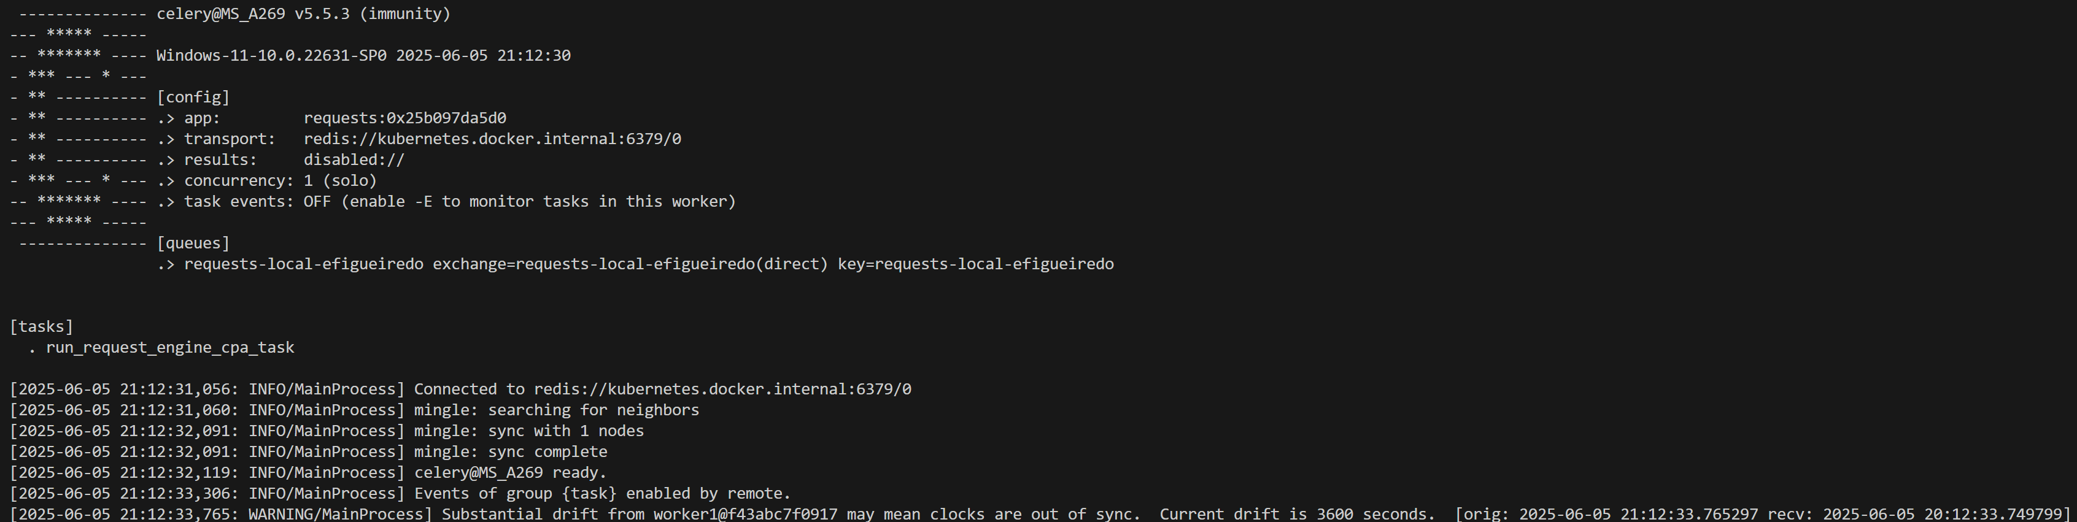
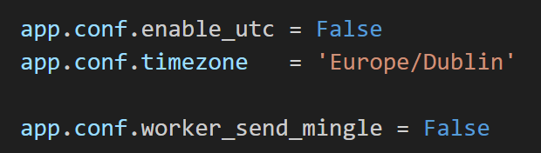

5.1.2 time drift
what
Substantial drift from may mean clocks are out of sync Current drift is 3600 seconds
no solution
celery problem
I try
update celery
problem remains
tbd
document the time zone settings
document discoveries made
sources
google search
worker stops consuming tasks
Solve drift problem

Slide 13
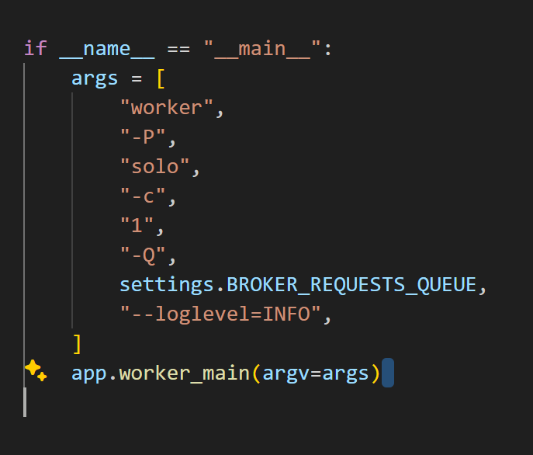
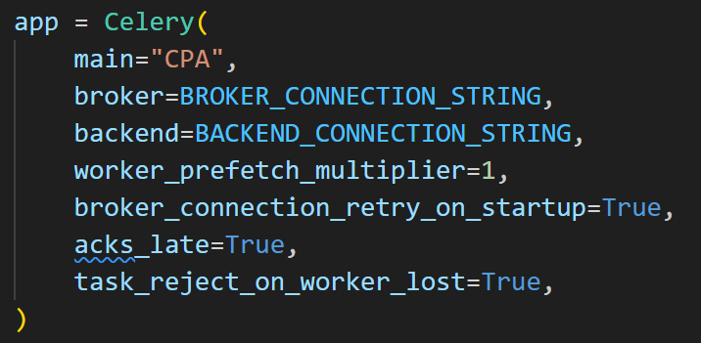
5.1.1 new task
what are
  the correct parameters ?
explanation
chat GPT
copy from apps
’main’ is different

Slide 14
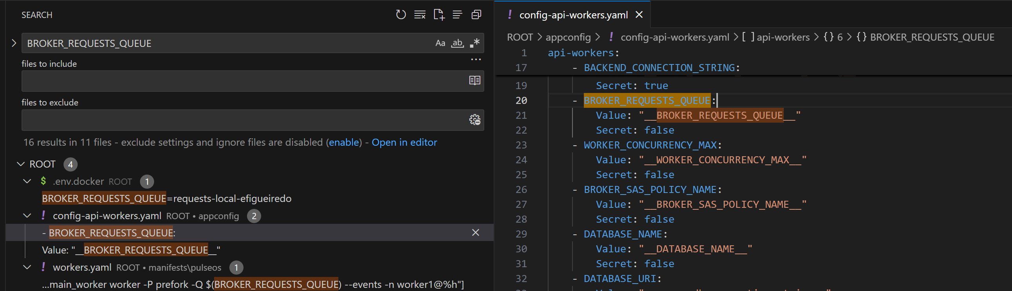
5.1.3 deploy to azure
missing
add
  new queue variable
nothing to do
D:\repos\pulse-os.apps\appconfig\config-api-workers.yaml
ask Raphael
implement
or
description

Slide 15




Z. template
new project
ExecuteAsync
square post-it
download
  exe
download
  exe
why
A slash
  followed
by
  two consecutive asterisks
D:\A1_research\C2_c0dice\B1_jmeter\A1_install
functionalities
introduction
build-exe
entity framework plus
zig help
⊂
4
every key-frame
defines the operation
success

