Slide 1

1. spotify
leadership

Slide 2
1.1 index

Slide 3

1.2 sources
Futurespective09052025
New methodology
report

Slide 4
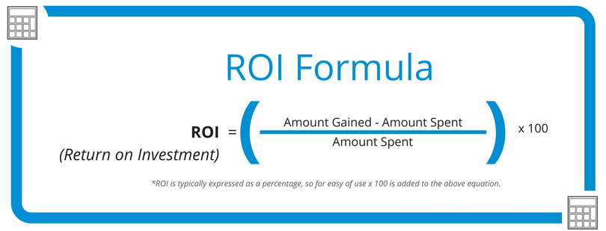
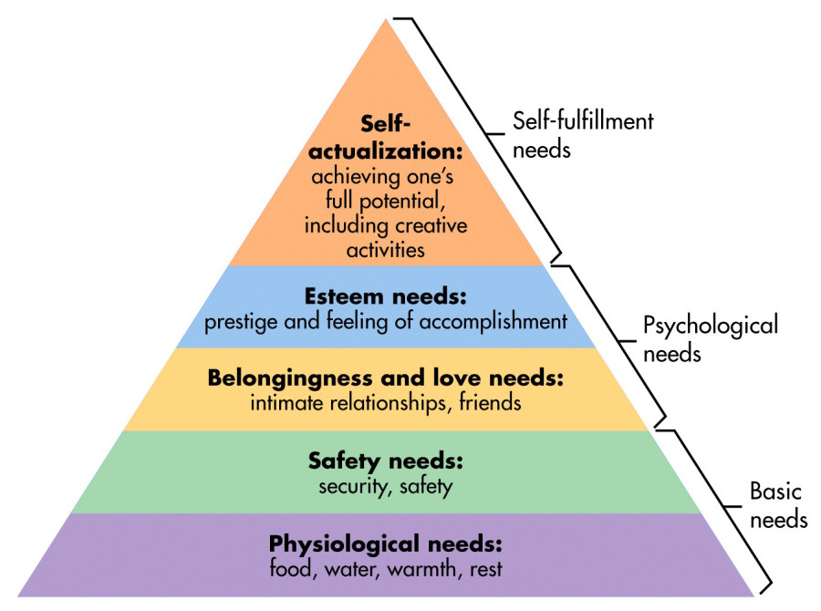

2. perspective
assume ROI constant
if I produce more value
the company needs to improve my income
new process => more value
  so is good for me
new process allows for my team members to lead
  so is good for me

Slide 5
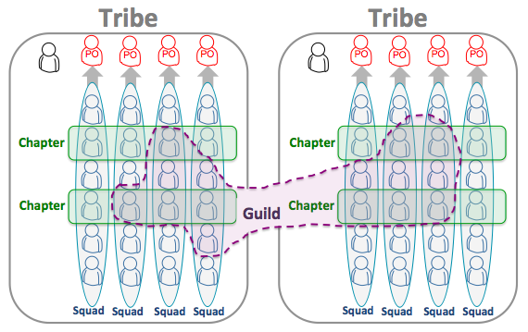
2. what

Slide 6
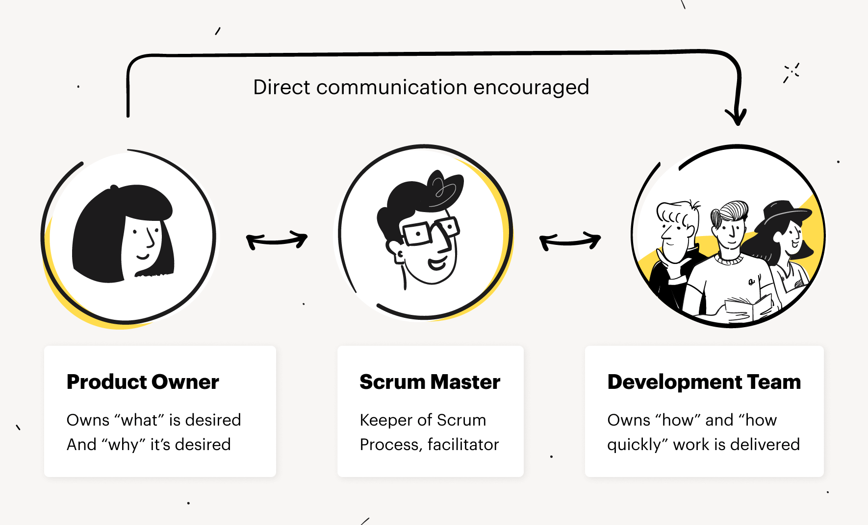
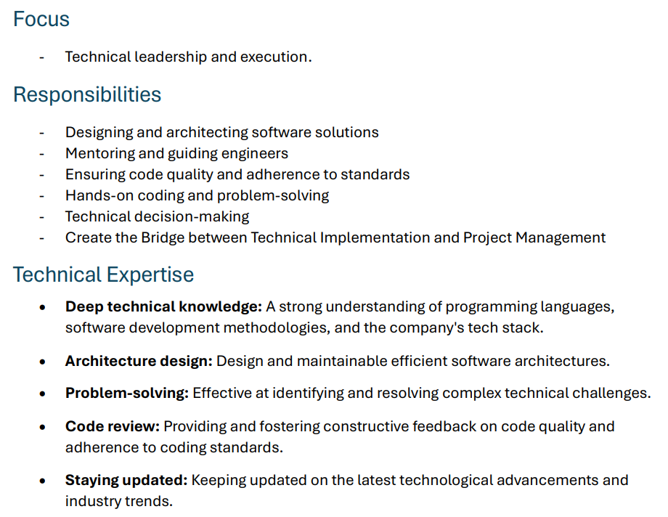
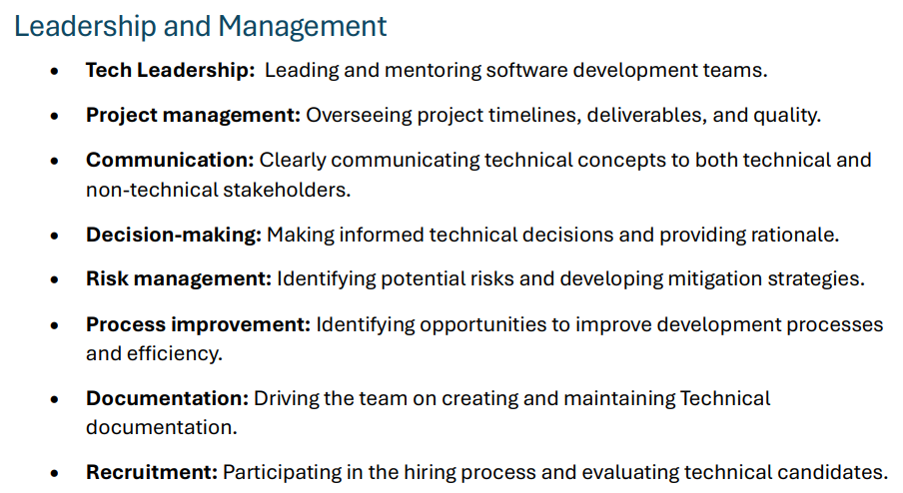
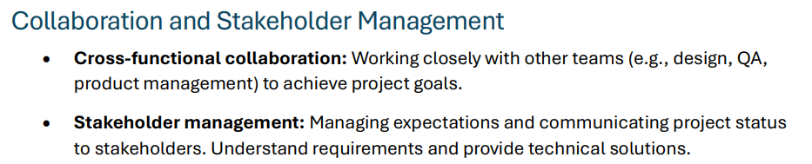
3. tech lead
scrum
current
spotify
the Spotify model
  does not prescribe
a formal “Tech Lead” role
technical leadership
  is distributed across
    squads,
    chapters,
    guilds
often embodied by
  senior engineers
who combine
  hands-on coding
  mentorship
  architecture guidance

Slide 7





Z. template
new project
ExecuteAsync
square post-it
download
  exe
download
  exe
why
A slash
  followed
by
  two consecutive asterisks
D:\A1_research\C2_c0dice\B1_jmeter\A1_install
functionalities
introduction
build-exe
entity framework plus
zig help
⊂
4
every key-frame
defines the operation
deploy

