Slide 2
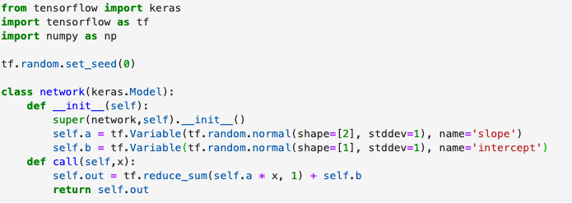

f(x) = ax + b
f([0.6, 0.2]) = 0.6*1.5110626 + 0.2*0.42292204 + 1.0668802 = 2.0581021

