Slide 1
JQUERY
SONA COLLEGE OF TECHNOLOGY
JANANI BAAI

Slide 2
What is jQuery
Jquery is a small, fast and lightweight javascript library.
Jquery is platform-independent.
Jquery means "write less do more".
Jquery simplifies ajax call and dom manipulation.
JQuery is the most popular and the most extendable. Many of the biggest companies on the web use jQuery.
Some of these companies are:
Microsoft
Google
IBM

Slide 3
jQuery Features
HTML Manipulation
DOM Manipulation
DOM Element Selection
CSS Manipulation
Effects And Animations
Utilities
Ajax
HTML Event Methods
JSON Parsing
Extensibility Through Plug-ins

Slide 4
Why jQuery is required
It is very fast and extensible.
It facilitates the users to write UI related function codes in minimum possible lines.
It improves the performance of an application.
Browser's compatible web applications can be developed.
It uses mostly new features of new browsers.
jQuery History
JQuery was first released in January 2006 by John Resig at BarCamp NYC. It is currently headed by Timmy Wilson and maintained by a team of developers.
Nowadays, jQuery is widely used technology. Most of the websites are using jQuery.

Slide 5
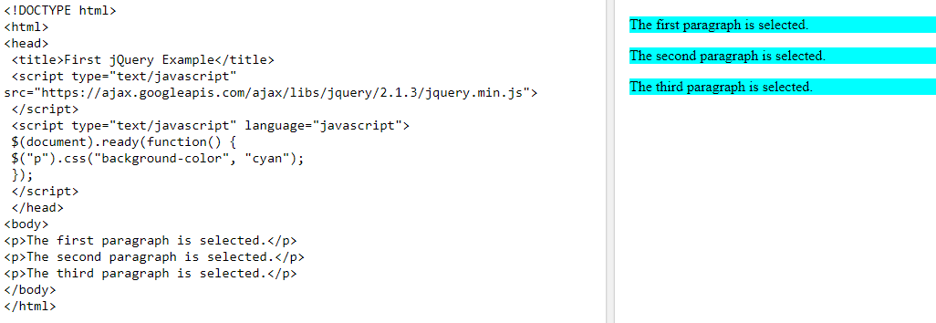
Example

Slide 6
JQUERY SELECTORS
jQuery selectors allow you to select and manipulate HTML element(s).
jQuery selectors are used to "find" (or select) HTML elements based on their name, id, classes, types, attributes, values of attributes and much more. It's based on the existing CSS Selectors, and in addition, it has some own custom selectors.
All selectors in jQuery start with the dollar sign and parentheses: $().
1) The Element Selector
2) The #id Selector
3) The .class Selector

Slide 7
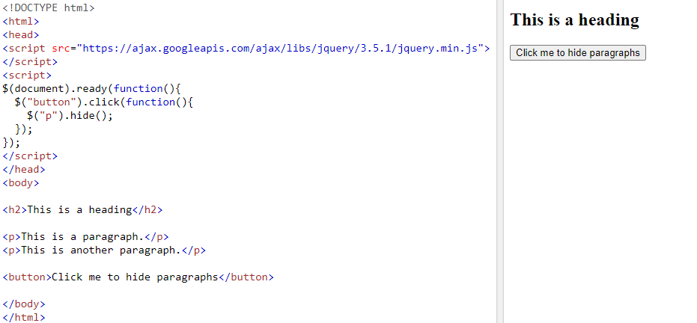
THE ELEMENT SELECTOR
The jQuery element selector selects elements based on the element name.
You can select all <p> elements on a page like this:
$("p")

Slide 8
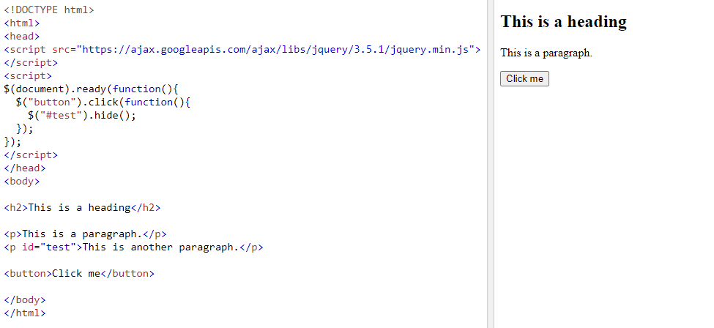
THE #ID SELECTOR
The jQuery #id selector uses the id attribute of an HTML tag to find the specific element.
An id should be unique within a page, so you should use the #id selector when you want to find a single, unique element.
To find an element with a specific id, write a hash character, followed by the id of the HTML element:
$("#test")

Slide 9
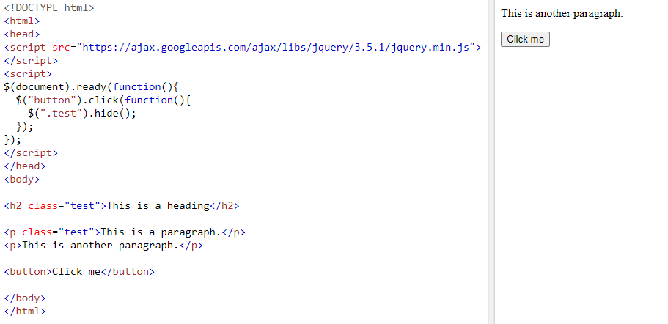
THE .CLASS SELECTOR
The jQuery .class selector finds elements with a specific class.
To find elements with a specific class, write a period character, followed by the name of the class:
$(".test")

Slide 10
JQUERY EVENT METHODS
What are Events?
An event represents the precise moment when something happens.
Examples:
moving a mouse over an element
selecting a radio button
clicking on an element
Here are some common DOM events:
Mouse Events | Keyboard Events | Form Events | Document/Window Events
Click | Keypress | Submit | Load
Dblclick | Keydown | Change | Resize
Mouseenter | Key up | Focus | Scroll
Mouseleave | -- | Blur | Unload

Slide 11
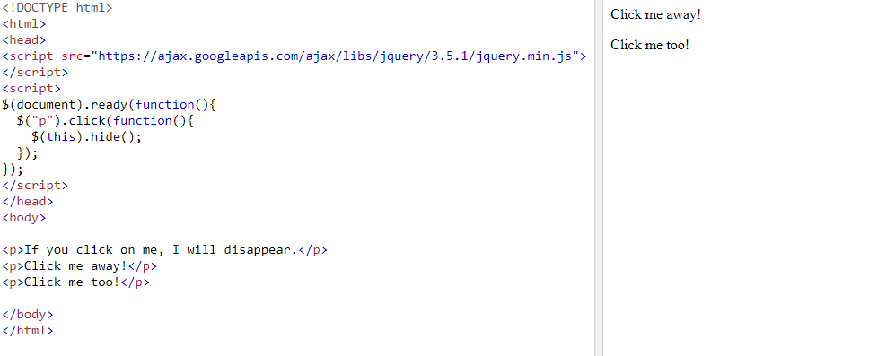
MOUSE EVENTS
1) Click() - The function is executed when the user clicks on the HTML element.
Syntax:
$("p").click(function(){
// action goes here!!
});

Slide 12
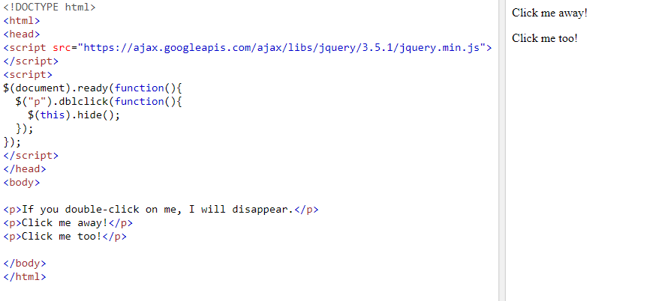
2) dblclick() - The function is executed when the user double-clicks on the HTML element
Syntax:
$("p").dblclick(function(){
// action goes here!!
});

Slide 13
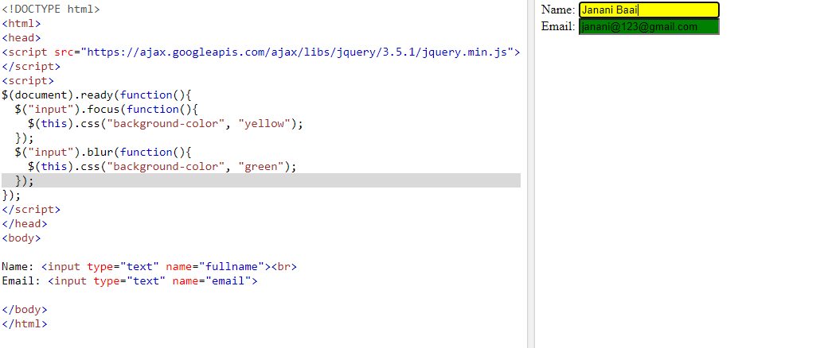
FORM EVENTS
1) Focus - The function is executed when the form field gets focus
Syntax:
$("input").focus(function(){
$(this).css("background-color", "#cccccc");
});

Slide 14
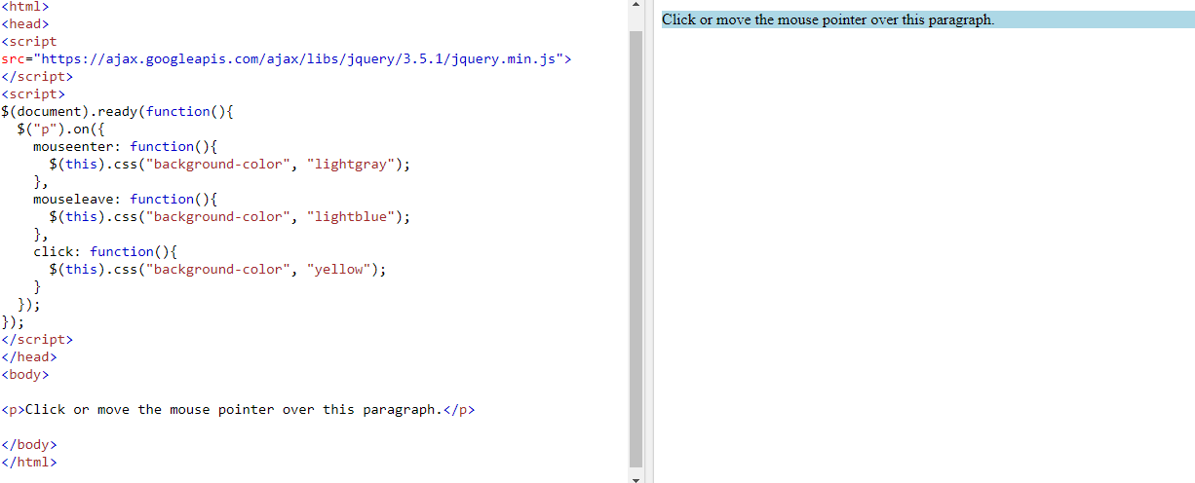
2) on() Method - The on() method attaches one or more event handlers for the selected elements.
Attach a click event to a <p> element:
Syntax:
$("p").on("click", function(){
$(this).hide();
});

Slide 15
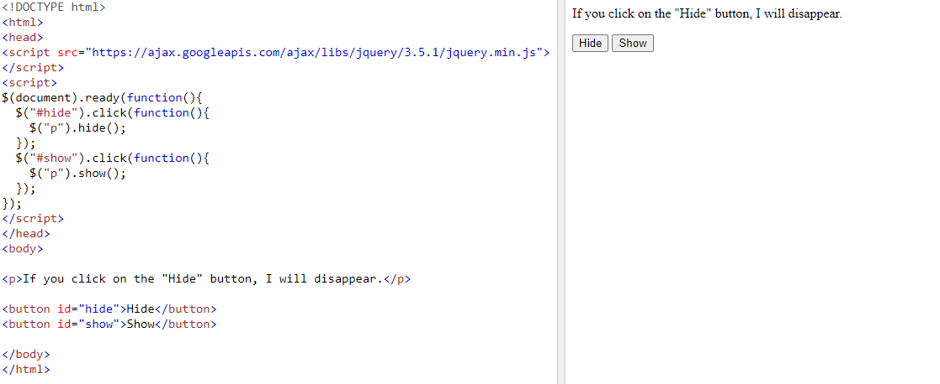
JQUERY EFFECTS
jquery hide/show
Before hiding

Slide 16
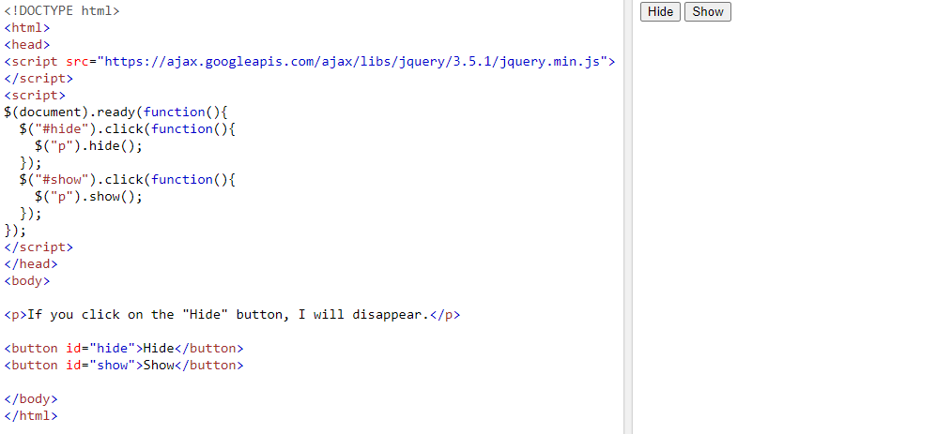
After hiding

Slide 17
JQUERY FADING METHODS
With jQuery you can fade an element in and out of visibility
jQuery has the following fade methods:
fadeIn()
fadeOut()
fadeToggle()
fadeTo()

Slide 18
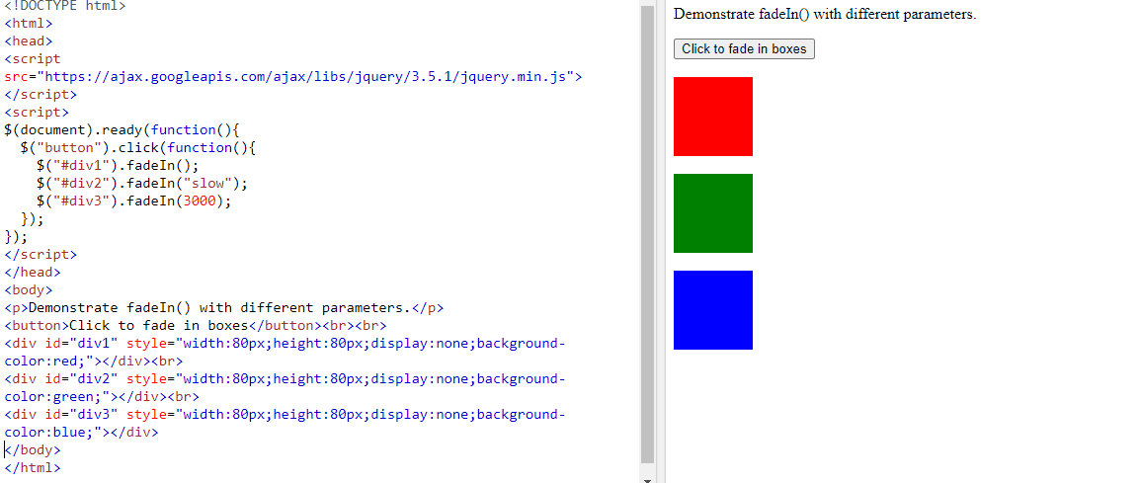
FADEIN() - The jQuery fadeIn() method is used to fade in a hidden element.
Syntax:
$(selector).fadeIn(speed,callback);

Slide 19
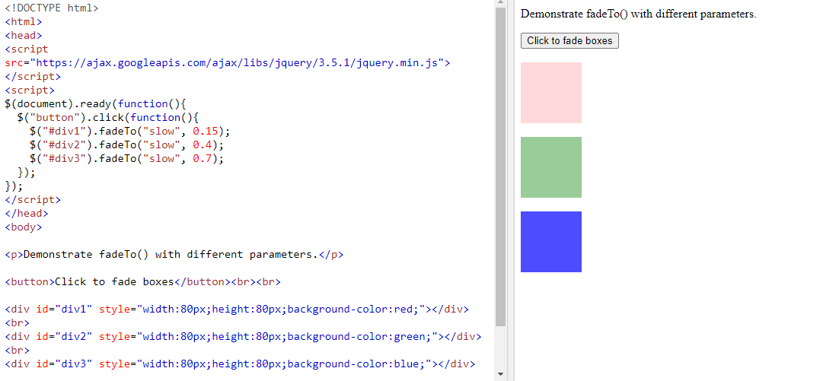
FADE TO() METHOD -The jQuery fadeTo() method allows fading to a given opacity (value between 0 and 1
Syntax:
$(selector).fadeTo(speed,opacity,callback);

Slide 20
JQUERY SLIDING METHODS
With jQuery you can create a sliding effect on elements.
jQuery has the following slide methods:
1) slideDown()
2) slideUp()
3) slideToggle()

Slide 21
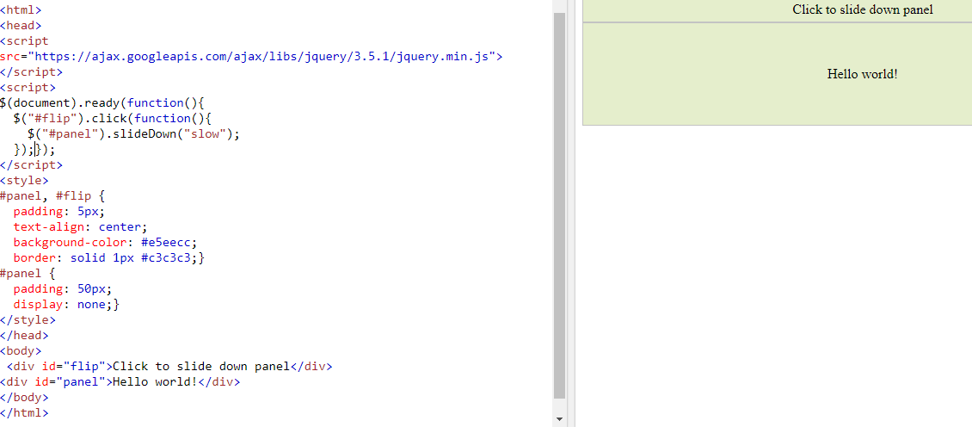
1) SLIDE DOWN() METHOD -The jQuery slideDown() method is used to slide down an element.
Syntax:
$(selector).slideDown(speed,callback);

Slide 22
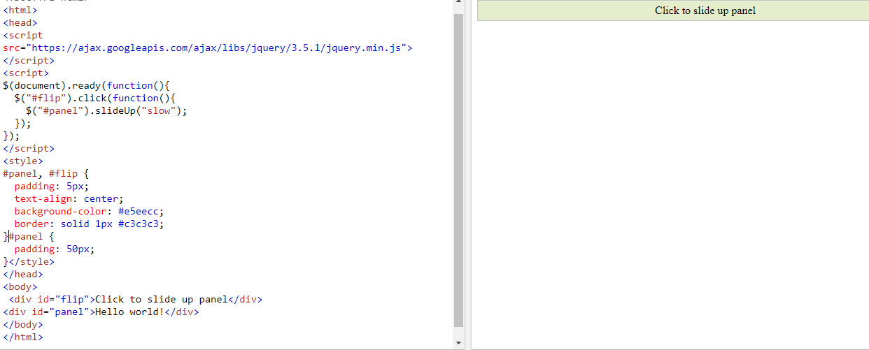
2) SLIDEUP() METHOD -The jQuery slideUp() method is used to slide up an element.
Syntax:
$(selector).slideUp(speed,callback);

Slide 23
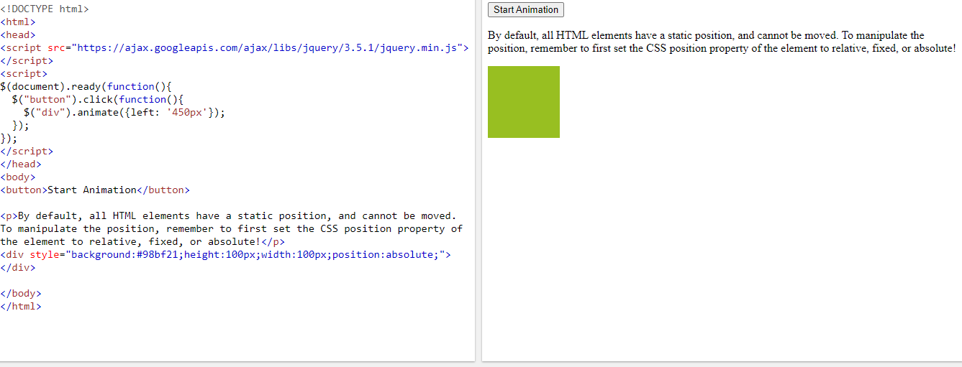
JQUERY ANIMATIONS
1) THE ANIMATE() METHOD -The jQuery animate() method is used to create custom animations.
Syntax:
$(selector).animate({params},speed,callback);
Before Animation:

Slide 24
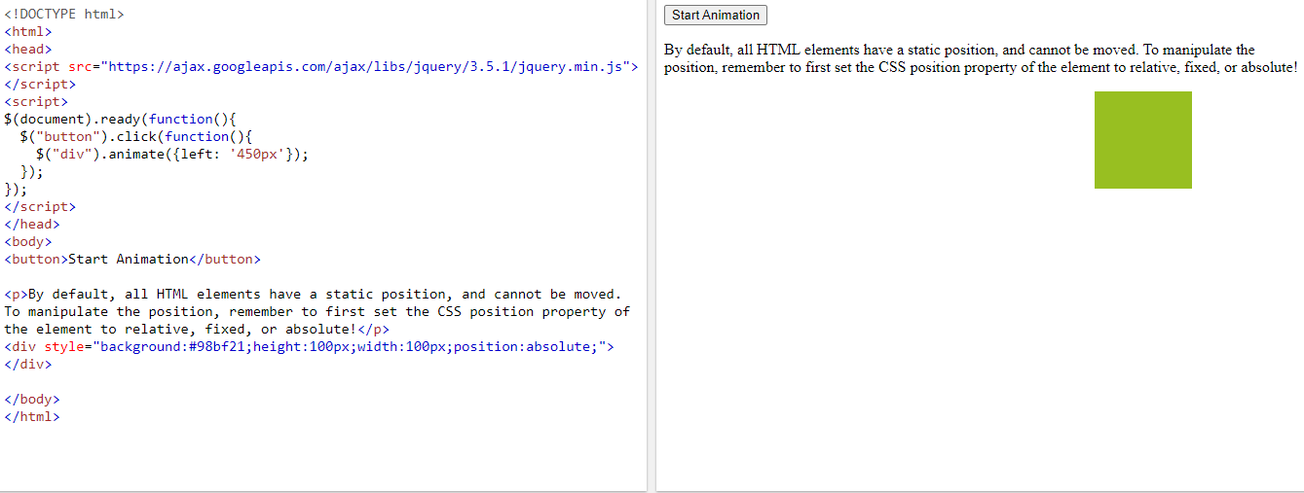
After Animation:

Slide 25
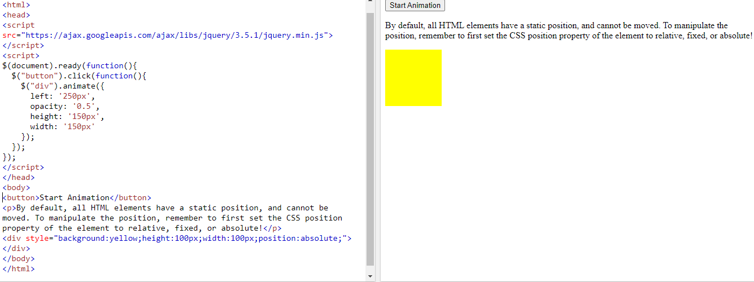
2) MANIPULATE MULTIPLE PROPERTIES
Notice that multiple properties can be animated at the same time
Before Animation:

Slide 26
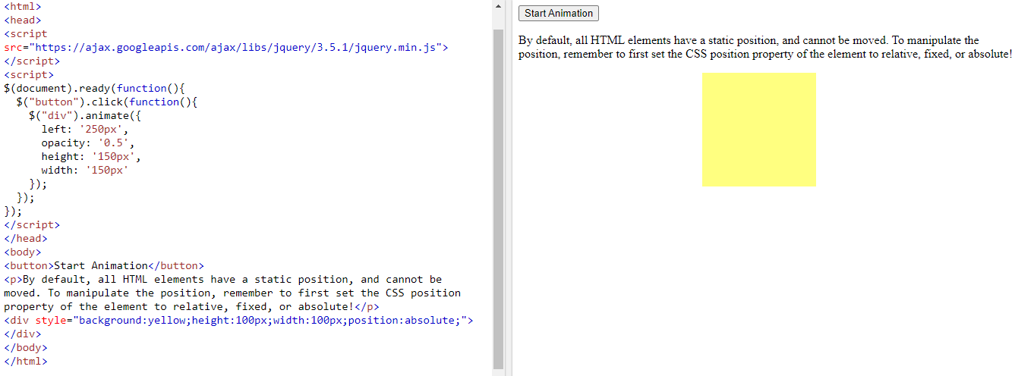
After Animation:

Slide 27
JQUERY – CHAINING
It allows us to run multiple jQuery commands, one after the other, on the same element(s).
Tip: This way, browsers do not have to find the same element(s) more than once.
To chain an action, you simply append the action to the previous action.
The following example chains together the css(), slideUp(), and slideDown() methods.
The "p1" element first changes to red, then it slides up, and then it slides down

Slide 28
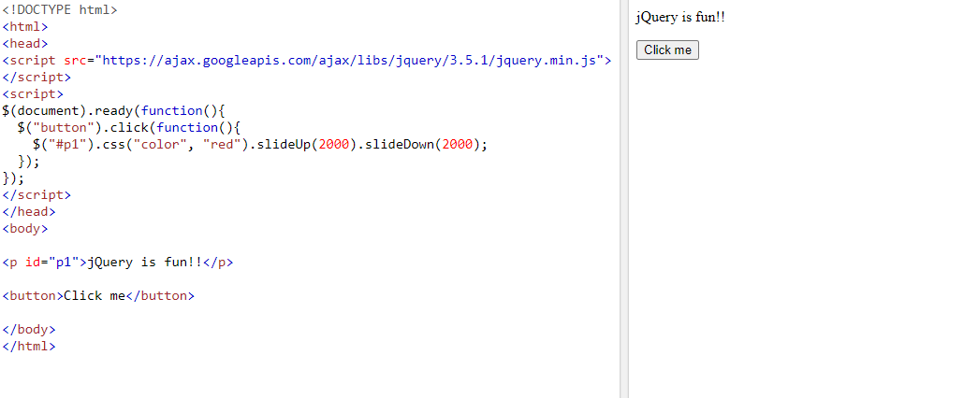
Before chaining

Slide 29
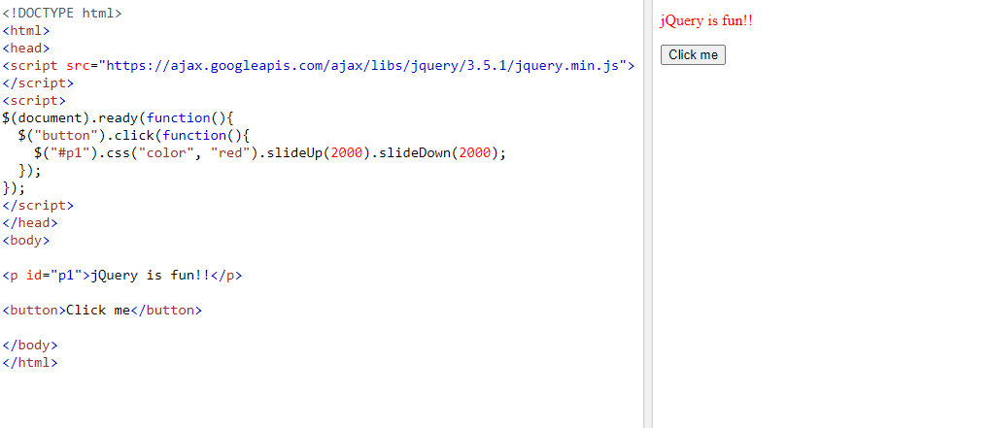
After chaining:

Slide 30
JQUERY - ADD ELEMENTS
jQuery methods that are used to add new content
append() - Inserts content at the end of the selected elements
prepend() - Inserts content at the beginning of the selected elements
after() - Inserts content after the selected elements
before() - Inserts content before the selected elements

Slide 31
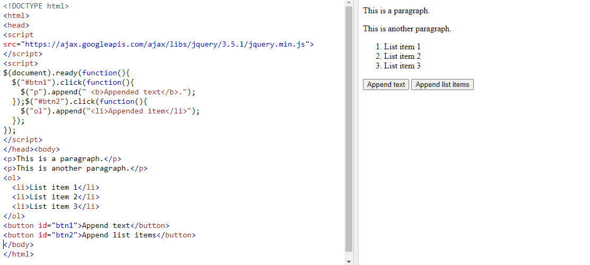
1) JQUERY APPEND() METHOD -The jQuery append() method inserts content at the end of the selected HTML elements.
Syntax:
$("p").append("Some appended text.");
Before Appending:

Slide 32
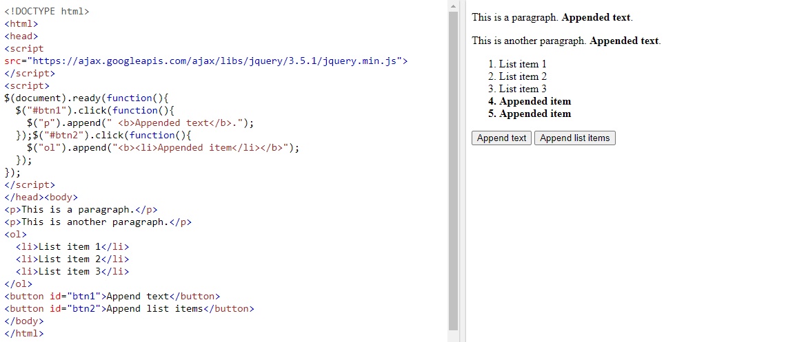
After appending:

Slide 33
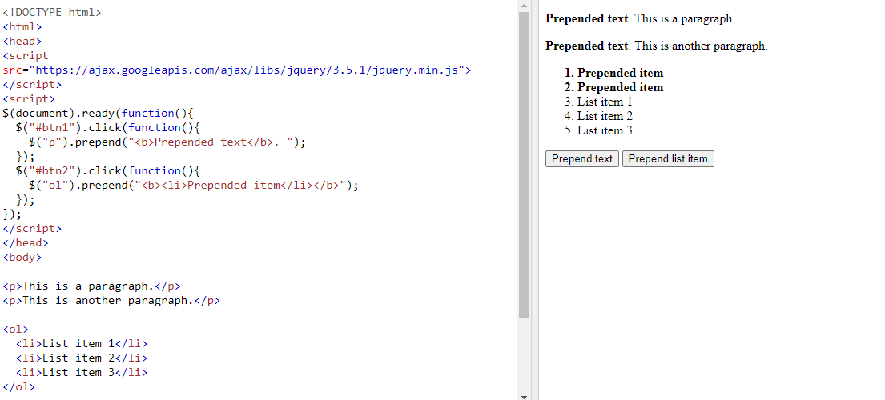
PREPEND() METHOD
The jQuery prepend() method inserts content at the beginning of the selected HTML elements.
Syntax:
$("p").prepend("Some prepended text.");

Slide 34
JQUERY - REMOVE ELEMENTS
Remove Elements/Content
To remove elements and content, there are mainly two jQuery methods:
remove() - Removes the selected element (and its child elements)
empty() - Removes the child elements from the selected element
1) REMOVE() METHOD -The jQuery remove() method removes the selected element(s) and its child elements.
Syntax:
$("#div1").remove();

Slide 35
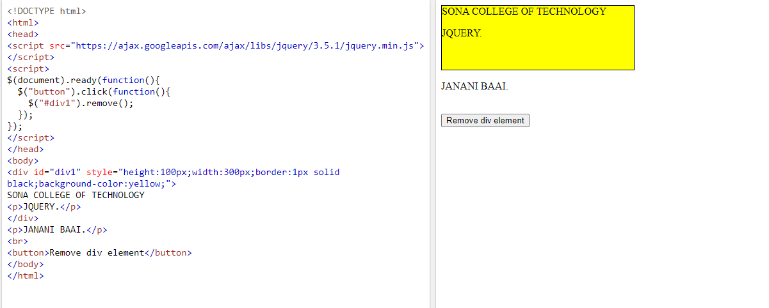
Before removing:

Slide 36
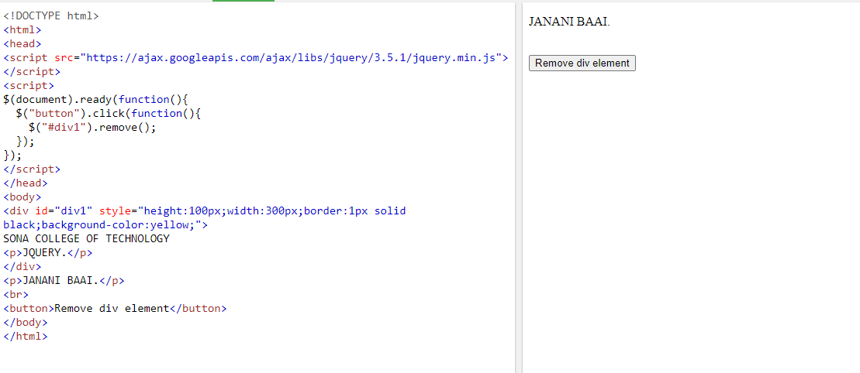
After removing:

Slide 37
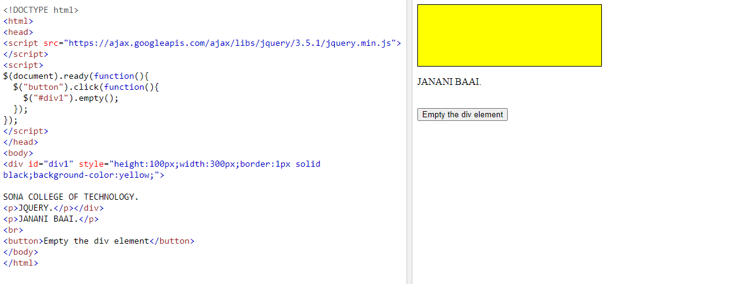
2) EMPTY() METHOD
The jQuery empty() method removes the child elements of the selected element(s).
Syntax:
$("#div1").empty();

Slide 38
Thank You

