Slide 1



Slide 2
Hibernate Framework
Hibernate is a Java framework that simplifies the development of Java application to interact with the database.
Hibernate is the best, ORM Framework for Java.
It is an open source, lightweight, ORM (Object Relational Mapping) Tool.
Hibernate implements the specifications of JPA (Java Persistence API) for data persistence.
Hibernate internally uses the JDBC API to interact with the database.
Hibernate simplifies the data creation , data manipulation and data access.
It is programming technique that maps the object to the data stored in the database [CRUD].

Slide 3


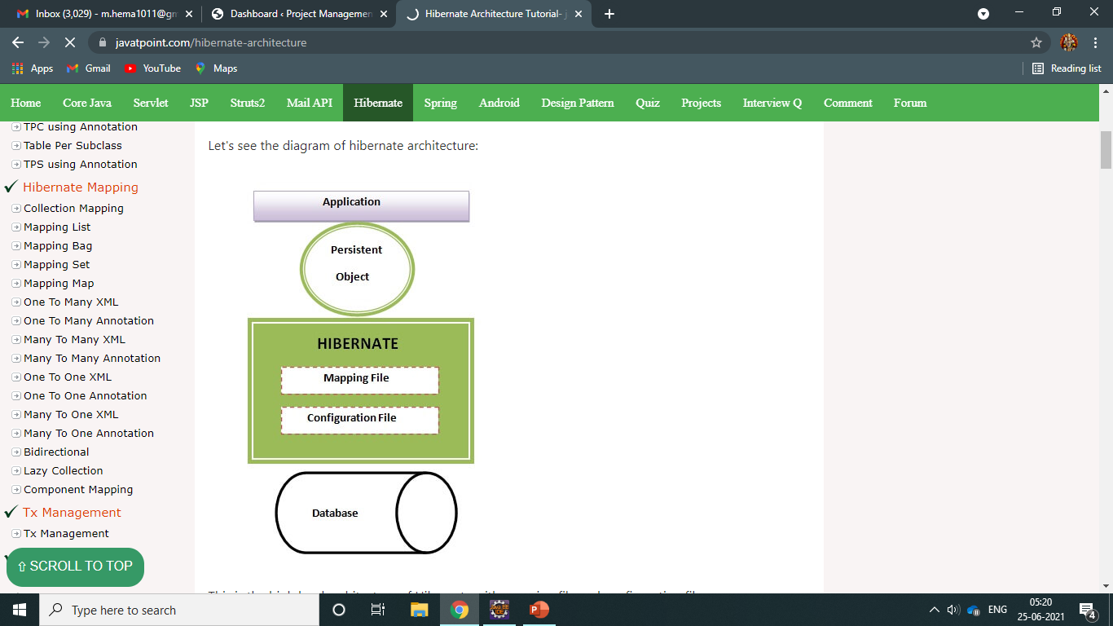
Architecture

Slide 4
Hibernate Architecture
Elements of Hibernate Architecture
SessionFactory
Session
Transaction
ConnectionProvider
TransactionFactory.
The Hibernate architecture includes many objects such as persistent object, session factory, transaction factory, connection factory, session, transaction etc.
The Hibernate architecture is categorized in four layers.
Java application layer
Hibernate framework layer
Backhand api layer
Database layer

Slide 5
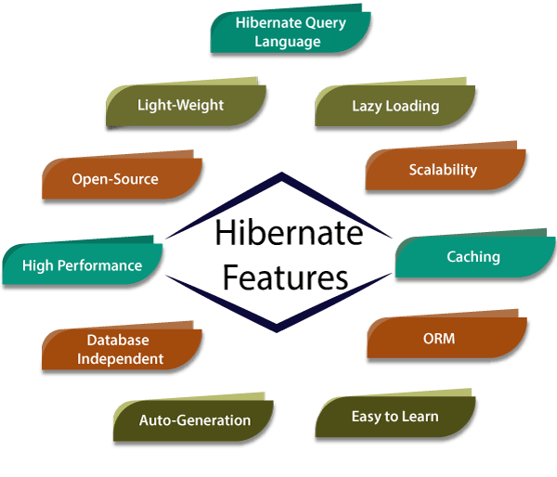

Slide 6
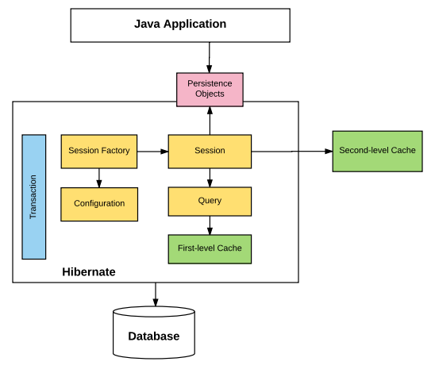
Flow of Hibernate

Slide 7
JDBC Connectivity
RDBMS
JDBC SQL SERVER, MySQL
(Persistence)
APP(IDE) Database
JAVA APPLICATION
Db
Java Database Connectivity

Slide 8
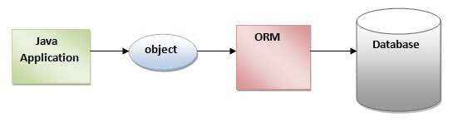
ORM Tool Connectivity

Slide 9
WHAT IS ORM?
ORM (Object Relational Mapping) it is the tool for persisting the Data’s.
Storing all data’s in database called “Persistence”.
Normally we connect both Java Application with Database called “JDBC”.ORM tool will create data’s without accessing/writing any queries in database.[CRUD Operations]
Data can be in variable, object, primitive values like int, string, float, double, or the data are in Object format.
Like Eg: Student Table

Slide 10
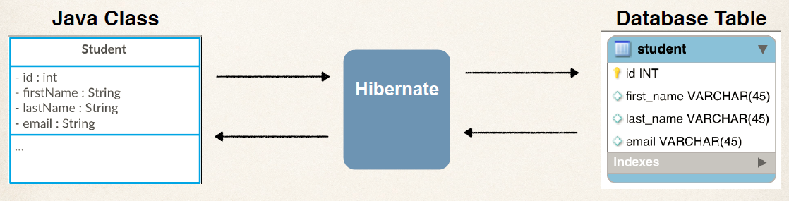
Example

Slide 11
How it Works?
If we create Student Table : class Student { (one Object) ,it stores 4 values in Db.
int id; Every Object contains some Data’s.
String firstName;
String lastName;
String email;
}
So without accessing SQL query we can save the data’s by using the Method: save(obj);
Here we can directly store the data inside database by using this Method .
Then how we will convert Object into Table ?
So here is the concept called ORM , by using this ORM tool it contains –Object , Relational , Mapping

Slide 12
How its Possible from Object to Table?
If we talk about the class structure and it should be same as Table structure.
class has a Table and Object is your Rows.(2 rows, with 2 obj).
So that means we are trying to create an Relationship between Object Oriented Programming concept.
It is the possible with the help of ORM concept we use here.
Object(Java concept) , Relational(Database concept) , Mapping(we need map it).
id | firstName | lastName | email
101 | Raj | kumar | raj@gmail.com
102 | Priya | dharshini | priya198@gmail.com

Slide 13
What is the Use of Hibernate?
By using Hibernate we can store your Objects into your Database directly with the help of using the Method called: save(obj);
How we use this same method for all ?
So we need to create an Object called , Session/Session Object as,
s.save(obj);

Slide 14
How do we create Session?
For that we need to create an Object of Session Factory under that we can create Session.
In Session Factory we need to provide those details to configuration for database.
When we working with JDBC , we have to provide certain steps Driver Name , specify the database URL , Username and Password in the configuration file , so that we can load inside the Session Factory Object.
So , there are multiple ways for configuration like: 1. XML
2. Java Configuration.
Once we got an session Factory Object , we can work with Session & by using Session we can save the Object -> s.save(obj); not only save we can also use get(); method to fetch the data.
So we can use all this concept to implement the hibernate and also ORM Tool.
session . save(book);

Slide 15
How to implement Hibernate
Use any IDE: Eclipse, Netbeans , IntelliJ.
In eclipse IDE, we can create Maven Project because the advantage of using an maven project it will give you a Project Structure.
For hibernate we must use some certain libraries , we need to download those libraries and we add it .
Install Hibernate configuration tool Help->Eclipse Marketplace->search hibernate,
->JBoss Tools->select checkbox->hibernate(uncheck all other options)->click->install->restart eclipse .
Right click on project or resource package->select new->other->search->hibernate->choose->hibernate configuration file ->fill all options ->Finish.
(hibernate.cfg.xml) file will be created.

Slide 16
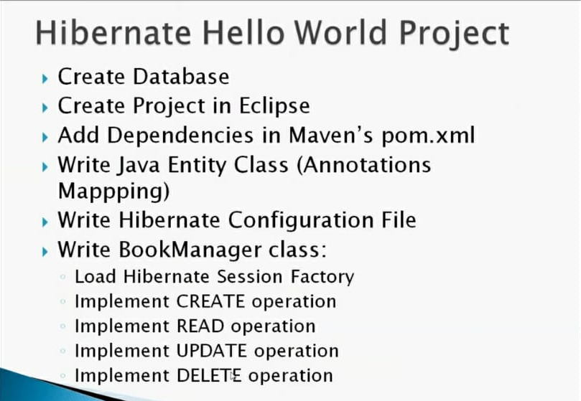
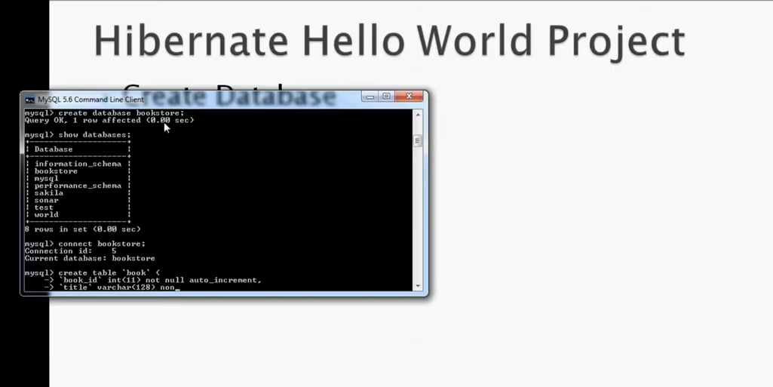

Slide 17
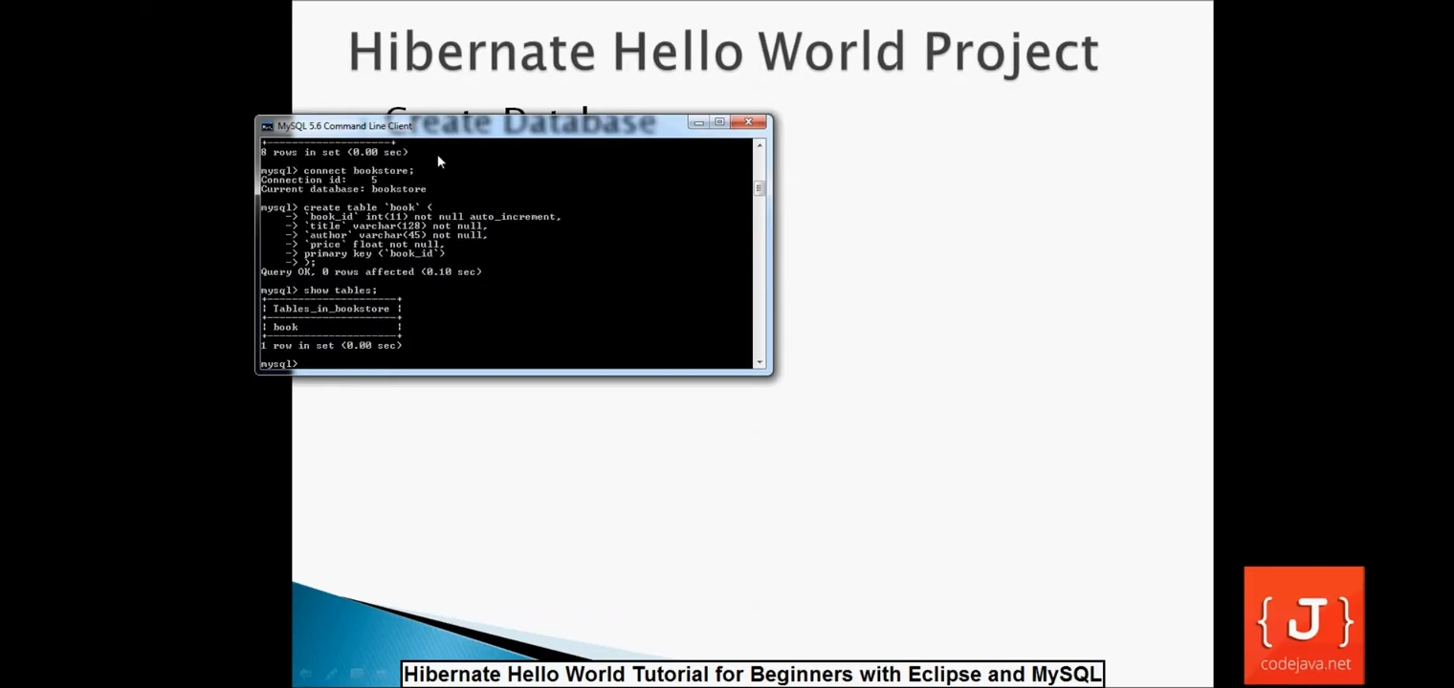
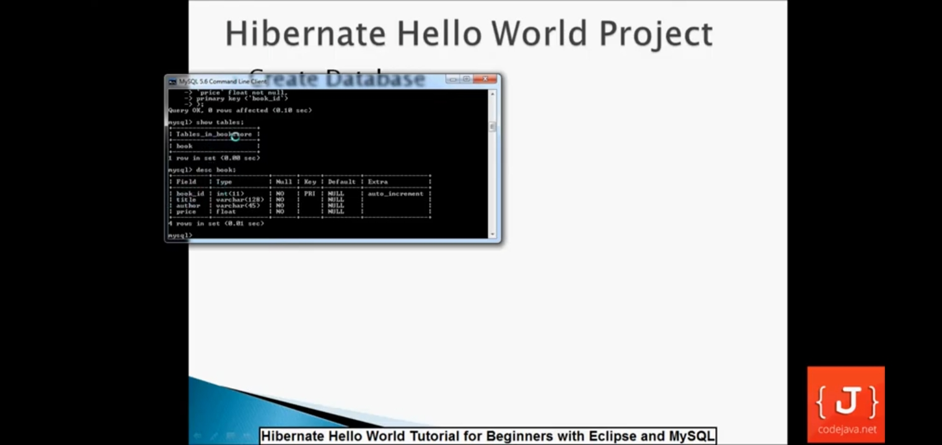

Slide 18
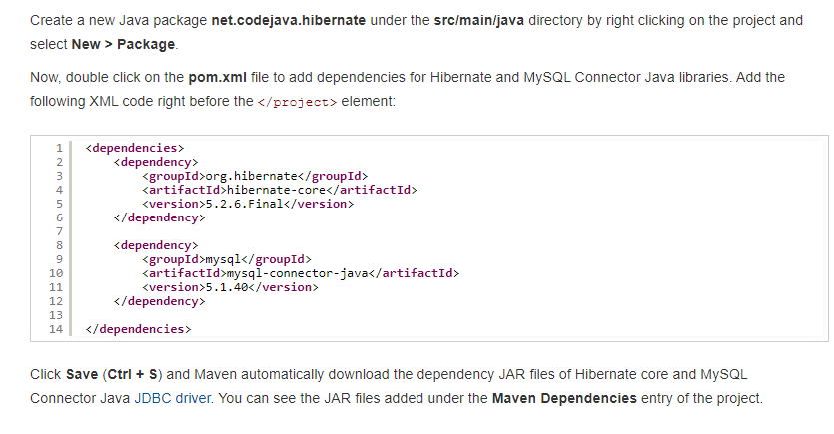
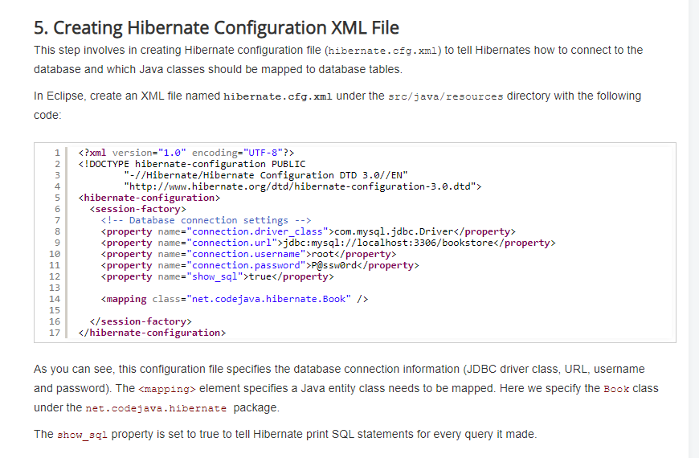

Slide 19
REFER :Example program
https://www.javatpoint.com/hibernate-tutorial
https://www.codejava.net/frameworks/hibernate/hibernate-hello-world-tutorial-for-beginners-with-eclipse-and-mysql
https://youtu.be/JR7-EdxDSf0
https://youtu.be/m5-6IcxJviw

Slide 20


