Slide 1
W12-图

Slide 2
W12目标
图的概念、图的两种表示
图的BFS与DFS遍历
拓扑排序及BFS实现拓扑排序
图的最小生成树及Prim算法

Slide 3
图的概念与存储

Slide 4
Graphs example: Northwest Airline Flight
Wu LU Mu Qi
ShenYang
Bei Jing
Lan Zhou
Ji Nan
Xi an
WuHan
ShanHai

Slide 5
Graphs example: Computer Network Or Internet
FuDan University
ECNU
Regional Network
UNT
Intel

Slide 6
Application
Traveling Saleman
Find the shortest path that connects all cities without a loop.
Start

Slide 7
Concepts of Graphs
node or vertex
edges (weight)

Slide 8
Graph Definition(图的表示方法)
A graph G = (V,E) is composed of:
V: set of vertices (nodes 节点)
E: set of edges (arcs 边) connecting the vertices in V
An edge e = (u,v) is a pair of vertices
Example:
a
b
V= {a,b,c,d,e}
E= {(a,b),(a,c),(a,d),
(b,e),(c,d),(c,e),
(d,e)}
c
d
e

Slide 9
概念1-Undirected vs. Directed Graph
Undirected Graph
edge has no oriented
Directed Graph
edge has oriented vertex

Slide 10
概念2-Degree of a Vertex
The degree（度） of a vertex is the number of edges to that vertex
For directed graph,
the in-degree (入度)of a vertex v is the number of edges that have v as the head
the out-degree(出度) of a vertex v is the number of edges that have v as the tail
if di is the degree of a vertex i in a graph G with n vertices and e edges, the number of edges is
Hint: Adjacent vertices are counted twice.

Slide 11
概念3-Simple Path（简单路径）
A simple path is a path such that all vertices are distinct, except that the first and the last could be the same.
ABCD is a simple path
B
A
C
path
D

Slide 12
概念4-Cycle（环）
A cycle is a path that starts and ends at the same point. For undirected graph, the edges are distinct.
CBDC is a cycle
B
A
C
D

Slide 13
概念5-Connected vs. Unconnected Graph：
Connected Graph连通图
Unconnected Graph非连通图
A graph is called connected if there is a path from any vertex to any other vertex(如何判断?).

Slide 14
概念6-Weighted Graph（带权图）
Weighted graph: a graph with numbers assigned to its edges
Weight: cost, distance, travel time, hop, etc.
0
10
20
1
1
2
4
5
3

Slide 15
概念7-strongly connected Vs. Weakly connected(强连通和弱连通)
A directed graph is called strongly connected if there is a directed path from any vertex to any other vertex. If we suppress the direction of the edges and the resulting undirected graph is connected, we call the directed graph weakly connected.

Slide 16
Representation Of Graph
Two representations
Adjacency Matrix/Table 12.2.1 P572 邻接矩阵
Adjacency List 12.2.2 P574 邻接表

Slide 17
Adjacency Matrix/Table
Assume N nodes in graph
Use Matrix A[0…N-1][0…N-1]
if vertex i and vertex j are adjacent in graph, A[i][j] = 1,
otherwise A[i][j] = 0
if vertex i has a loop, A[i][i] = 1
if vertex i has no loop, A[i][i] = 0

Slide 18
Adjacency Matrix/Table Declaration(2) P574
Digraph as an adjacency table:
template <int max_size>
class Digraph {
int count; // number of vertices, at most max size
bool adjacency[max_size][max_size];
};

Slide 19
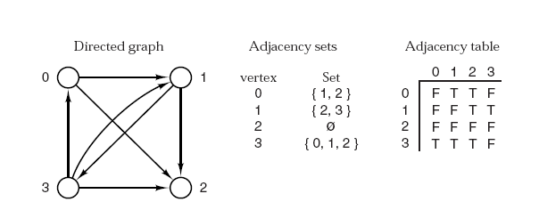
Adjacency Matrix/Table Declaration(2)

Slide 20
Example of Adjacency Matrix/Table 邻接矩阵
A[i][j] | 0 | 1 | 2 | 3
0 | 0 | 1 | 1 | 0
1 | 1 | 0 | 1 | 1
2 | 1 | 1 | 0 | 1
3 | 0 | 1 | 1 | 0
0
1
2
3
0 1 1 0
1 0 1 1
1 1 0 1
0 1 1 0
So, Matrix A =

Slide 21
Undirected vs. Directed
Undirected graph
adjacency matrix is symmetric
A[i][j]=A[j][i]
Directed graph
adjacency matrix may not be symmetric
A[i][j]≠A[j][i]

Slide 22
Directed Graph
A[i][j] | 0 | 1 | 2 | 3
0 | 0 | 1 | 1 | 1
1 | 0 | 0 | 0 | 1
2 | 0 | 0 | 0 | 1
3 | 0 | 0 | 0 | 0
0
1
2
3
0 1 1 1
0 0 0 1
0 0 0 1
0 0 0 0
So, Matrix A =

Slide 23
Weighted Graph
A[i][j] | 0 | 1 | 2 | 3
0 | 0 | 10 | 20 | 1
1 | 10 | 0 | 0 | 5
2 | 20 | 0 | 0 | 4
3 | 1 | 5 | 4 | 0
0
10
20
1
1
2
4
0 20 10 1
20 0 0 5
10 0 0 4
1 5 4 0
5
3
So, Matrix A =

Slide 24
Adjacency List 邻接表
An array of list
the ith element of the array is a list of vertices that connect to vertex i
0
1
2
3
0
1
3
1
2
3
2
3
3
vertex 0 connect to vertex 1, 2 and 3
vertex 1 connects to 3
vertex 2 connects to 3

Slide 25
Weighted Graph
Weighted graph: extend each node with an addition field: weight
0
1
10
2
20
3
1
0
10
20
1
0
10
3
4
1
1
2
2
0
20
3
5
4
5
3
0
1
1
4
2
5
3

Slide 26
Adjacency List implementation
typedef int Vertex;
template <int max_size>
class Digraph {
int count; // number of vertices, at most max_size
List<Vertex> neighbors[max_size];
};

Slide 27
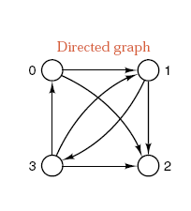
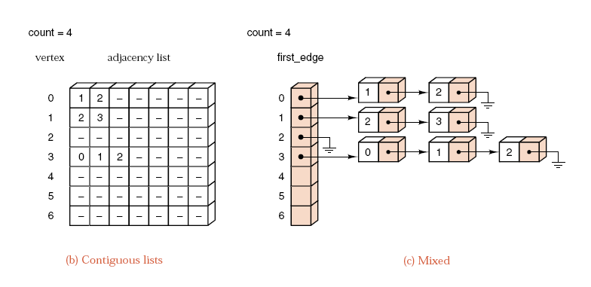
Adjacency List

Slide 28
Linked Implementation-十字链表的实现-不常见
class Edge; // forward declaration
class Vertex {
Edge *first_edge; // start of the adjacency list
Vertex *next_vertex; // next vertex on the linked list
};
class Edge {
Vertex *end_point; // vertex to which the edge points
Edge *next_edge; // next edge on the adjacency list
};
class Digraph {
Vertex *first_vertex; // header for the list of vertices
};
P576 figure 12.5 (a)

Slide 29
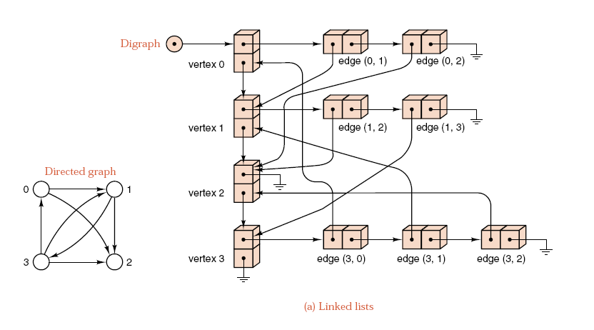
Adjacency List implementation

Slide 30
Comparison Of Representations
Cost | Adjacency Matrix | Adjacency List
Given two vertices u and v: find out whether u and v are adjacent | O(1) | degree of node O(N)
Given a vertex u: enumerate all neighbors of u | O(N) | degree of node O(N)
For all vertices: enumerate all neighbors of each vertex | O(N²) | Summations of all node degree O(E)

Slide 31
图的遍历-DFS与BFS

Slide 32
Graph Traversal Algorithms
Depth-first traversal of a graph is roughly analogous to preorder traversal of an ordered tree. Suppose that the traversal has just visited a vertex v, and let w1;w2; : : : ;wk be the vertices adjacent to v. Then we shall next visit w1 and keep w2; : : : ;wk waiting. After visiting w1 , we traverse all the vertices to which it is adjacent before returning to traverse w2; : : : ;wk .
Breadth-first traversal of a graph is roughly analogous to level-by-level traversal of an ordered tree. If the traversal has just visited a vertex v, then it next visits all the vertices adjacent to v, putting the vertices adjacent to these in a waiting list to be traversed after all vertices adjacent to v have been visited.

Slide 33
Graph Traversal Algorithms

Slide 34
Graph Traversal p577 F12.6 Depth-First Algorithm
template <int max_size>
void Digraph<max_size> :: depth_first(void (*visit)(Vertex &)) const
/* Post: The function *visit has been performed at each vertex of the Digraph in depth-first order.
Uses: Method traverse to produce the recursive depth-first order. */
{
bool visited[max_size];
Vertex v;
for (all v in G) visited[v] = false; //visited[v]=1表示v已经被遍历过
for (all v in G) if (!visited[v]) traverse(v, visited, visit); //visit 是一个用于输出的函数指针
}//背也要背下来

Slide 35
Graph Traversal p577 F12.6 Depth-First Algorithm
template <int max_size>
void Digraph<max_size> :: traverse(Vertex &v, bool visited[],void (*visit)(Vertex &)) const
/* Pre: v is a vertex of the Digraph.
Post: The depth-first traversal, using function *visit, has been completed for v and
for all vertices that can be reached from v.
Uses: traverse recursively. */
{
Vertex w;
visited[v] = true;
(*visit)(v);
for (all w adjacent to v)
if (!visited[w]) traverse(w, visited, visit);
}//背也要背下来

Slide 36
Depth First Traversal
Example
A’s neighbor: B, C, E
B’s neighbor: A, C, F
C’s neighbor: A, B, D
D’s neighbor: E, C, F
E’s neighbor: A, D
F’s neighbor: B, D
start from vertex A
A
B
E
C
F
D

Slide 37
Depth First Traversal (Cont)
A’s neighbor: B C E
B’s neighbor: A C F
C’s neighbor: A B D
D’s neighbor: E C F
E’s neighbor: A D
F’s neighbor: B D
A
B
E
C
F
D
Initial State
Visited Vertices { }
Probing Vertices { A }
Unvisited Vertices { A, B, C, D, E, F }
stack
A

Slide 38
Depth First Traversal (Cont)
A’s neighbor: B C E
B’s neighbor: A C F
C’s neighbor: A B D
D’s neighbor: E C F
E’s neighbor: A D
F’s neighbor: B D
A
B
E
C
F
D
Peek a vertex from stack, it is A, mark it as visited
Find A’s first unvisited neighbor, push it into stack
Visited Vertices { A }
Probing vertices { A, B }
Unvisited Vertices { B, C, D, E, F }
B
A
A
stack

Slide 39
Depth First Traversal (Cont)
A’s neighbor: B C E
B’s neighbor: A C F
C’s neighbor: A B D
D’s neighbor: E C F
E’s neighbor: A D
F’s neighbor: B D
A
B
E
C
F
D
Peek a vertex from stack, it is B, mark it as visited
Find B’s first unvisited neighbor, push it in stack
Visited Vertices { A, B }
Probing Vertices { A, B, C }
Unvisited Vertices { C, D, E, F }
C
B
B
A
A
stack

Slide 40
Depth First Traversal (Cont)
A’s neighbor: B C E
B’s neighbor: A C F
C’s neighbor: A B D
D’s neighbor: E C F
E’s neighbor: A D
F’s neighbor: B D
A
B
E
C
F
D
Peek a vertex from stack, it is C, mark it as visited
Find C’s first unvisited neighbor, push it in stack
Visited Vertices { A, B, C }
Probing Vertices { A, B, C, D }
Unvisited Vertices { D, E, F }
D
C
C
B
B
A
A
stack

Slide 41
Depth First Traversal (Cont)
A’s neighbor: B C E
B’s neighbor: A C F
C’s neighbor: A B D
D’s neighbor: E C F
E’s neighbor: A D
F’s neighbor: B D
A
B
E
C
F
D
Peek a vertex from stack, it is D, mark it as visited
Find D’s first unvisited neighbor, push it in stack
Visited Vertices { A, B, C, D }
Probing Vertices { A, B, C, D, E }
Unvisited Vertices { E, F }
E
D
D
C
C
B
B
A
A
stack

Slide 42
Depth First Traversal (Cont)
A’s neighbor: B C E
B’s neighbor: A C F
C’s neighbor: A B D
D’s neighbor: E C F
E’s neighbor: A D
F’s neighbor: B D
A
B
E
C
F
D
Peek a vertex from stack, it is E, mark it as visited
Find E’s first unvisited neighbor, no vertex found, Pop E
Visited Vertices { A, B, C, D, E }
Probing Vertices { A, B, C, D }
Unvisited Vertices { F }
E
D
D
C
C
B
B
A
A
stack

Slide 43
Depth First Traversal (Cont)
A’s neighbor: B C E
B’s neighbor: A C F
C’s neighbor: A B D
D’s neighbor: E C F
E’s neighbor: A D
F’s neighbor: B D
A
B
E
C
F
D
Peek a vertex from stack, it is D, mark it as visited
Find D’s first unvisited neighbor, push it in stack
Visited Vertices { A, B, C, D, E }
Probing Vertices { A, B, C, D, F}
Unvisited Vertices { F }
F
D
D
C
C
B
B
A
A
stack

Slide 44
Depth First Traversal (Cont)
A’s neighbor: B C E
B’s neighbor: A C F
C’s neighbor: A B D
D’s neighbor: E C F
E’s neighbor: A D
F’s neighbor: B D
A
B
E
C
F
D
Peek a vertex from stack, it is F, mark it as visited
Find F’s first unvisited neighbor, no vertex found, Pop F
Visited Vertices { A, B, C, D, E, F }
Probing Vertices { A, B, C, D}
Unvisited Vertices { }
F
D
D
C
C
B
B
A
A
stack

Slide 45
Depth First Traversal (Cont)
A’s neighbor: B C E
B’s neighbor: A C F
C’s neighbor: A B D
D’s neighbor: E C F
E’s neighbor: A D
F’s neighbor: B D
A
B
E
C
F
D
Peek a vertex from stack, it is D, mark it as visited
Find D’s first unvisited neighbor, no vertex found, Pop D
Visited Vertices { A, B, C, D, E, F }
Probing Vertices { A, B, C }
Unvisited Vertices { }
D
C
C
B
B
A
A
stack

Slide 46
Depth First Traversal (Cont)
A’s neighbor: B C E
B’s neighbor: A C F
C’s neighbor: A B D
D’s neighbor: E C F
E’s neighbor: A D
F’s neighbor: B D
A
B
E
C
F
D
Peek a vertex from stack, it is C, mark it as visited
Find C’s first unvisited neighbor, no vertex found, Pop C
Visited Vertices { A, B, C, D, E, F }
Probing Vertices { A, B }
Unvisited Vertices { }
C
B
B
A
A
stack

Slide 47
Depth First Traversal (Cont)
A’s neighbor: B C E
B’s neighbor: A C F
C’s neighbor: A B D
D’s neighbor: E C F
E’s neighbor: A D
F’s neighbor: B D
A
B
E
C
F
D
Peek a vertex from stack, it is B, mark it as visited
Find B’s first unvisited neighbor, no vertex found, Pop B
Visited Vertices { A, B, C, D, E, F }
Probing Vertices { A }
Unvisited Vertices { }
B
A
A
stack

Slide 48
Depth First Traversal (Cont)
A’s neighbor: B C E
B’s neighbor: A C F
C’s neighbor: A B D
D’s neighbor: E C F
E’s neighbor: A D
F’s neighbor: B D
A
B
E
C
F
D
Peek a vertex from stack, it is A, mark it as visited
Find A’s first unvisited neighbor, no vertex found, Pop A
Visited Vertices { A, B, C, D, E, F }
Probing Vertices { }
Unvisited Vertices { }
A
stack

Slide 49
Depth First Traversal (Cont)
A’s neighbor: B C E
B’s neighbor: A C F
C’s neighbor: A B D
D’s neighbor: E C F
E’s neighbor: A D
F’s neighbor: B D
A
B
E
C
F
D
Now probing list is empty
End of Depth First Traversal
Visited Vertices { A, B, C, D, E, F }
Probing Vertices { }
Unvisited Vertices { }
stack

Slide 50
Breadth-First Algorithm
template <int max_size>
void Digraph<max_size> :: breadth_first(void (*visit)(Vertex &)) const
{
Queue q;
bool visited[max_size];
Vertex v, w, x;
for (all v in G) visited[v] = false;
for (all v in G)
if (!visited[v]) {
q.append(v); //为每个连通子图加入一个节点到队列
while (!q.empty( )){
q.retrieve(w);
(*visit)(w);
visited[w] = true;
for (all x adjacent to w)
if (!visited[x]) q.append(x);
}
q.serve( );
}
}
}

Slide 51
Breadth First Traversal
Probing List is implemented as queue (FIFO)
Example
A’s neighbor: B C E
B’s neighbor: A C F
C’s neighbor: A B D
D’s neighbor: E C F
E’s neighbor: A D
F’s neighbor: B D
start from vertex A
A
B
E
C
F
D

Slide 52
Breadth First Traversal (Cont)
A’s neighbor: B C E
B’s neighbor: A C F
C’s neighbor: A B D
D’s neighbor: E C F
E’s neighbor: A D
F’s neighbor: B D
A
B
E
C
F
D
Initial State
Visited Vertices { }
Probing Vertices { A }
Unvisited Vertices { A, B, C, D, E, F }
A
queue

Slide 53
Breadth First Traversal (Cont)
A’s neighbor: B C E
B’s neighbor: A C F
C’s neighbor: A B D
D’s neighbor: E C F
E’s neighbor: A D
F’s neighbor: B D
A
B
E
C
F
D
Delete first vertex from queue, it is A, mark it as visited
Find A’s all unvisited neighbors, mark them as visited, put them into queue
Visited Vertices { A}
Probing Vertices { B, C, E }
Unvisited Vertices { D, F }
A
B
C
E
queue

Slide 54
Breadth First Traversal (Cont)
A’s neighbor: B C E
B’s neighbor: A C F
C’s neighbor: A B D
D’s neighbor: E C F
E’s neighbor: A D
F’s neighbor: B D
A
B
E
C
F
D
Delete first vertex from queue, it is B, mark it as visited
Find B’s all unvisited neighbors, mark them as visited, put them into queue
Visited Vertices { A, B, }
Probing Vertices { C, E, F }
Unvisited Vertices { D }
B
C
E
C
E
F
queue

Slide 55
Breadth First Traversal (Cont)
A’s neighbor: B C E
B’s neighbor: A C F
C’s neighbor: A B D
D’s neighbor: E C F
E’s neighbor: A D
F’s neighbor: B D
A
B
E
C
F
D
Delete first vertex from queue, it is C, mark it as visited
Find C’s all unvisited neighbors, mark them as visited, put them into queue
Visited Vertices { A, B, C, }
Probing Vertices { E, F, D }
Unvisited Vertices { }
C
E
F
E
F
D
queue

Slide 56
Breadth First Traversal (Cont)
A’s neighbor: B C E
B’s neighbor: A C F
C’s neighbor: A B D
D’s neighbor: E C F
E’s neighbor: A D
F’s neighbor: B D
A
B
E
C
F
D
Delete first vertex from queue, it is E, mark it as visited
Find E’s all unvisited neighbors, no vertex found
Visited Vertices { A, B, C, E}
Probing Vertices { F, D }
Unvisited Vertices { }
E
F
D
F
D
queue

Slide 57
Breadth First Traversal (Cont)
A’s neighbor: B C E
B’s neighbor: A C F
C’s neighbor: A B D
D’s neighbor: E C F
E’s neighbor: A D
F’s neighbor: B D
A
B
E
C
F
D
Delete first vertex from queue, it is F, mark it as visited
Find F’s all unvisited neighbors, no vertex found
Visited Vertices { A, B, C, E, F }
Probing Vertices { D }
Unvisited Vertices { }
F
D
D
queue

Slide 58
Breadth First Traversal (Cont)
A’s neighbor: B C E
B’s neighbor: A C F
C’s neighbor: A B D
D’s neighbor: E C F
E’s neighbor: A D
F’s neighbor: B D
A
B
E
C
F
D
Delete first vertex from queue, it is D, mark it as visited
Find D’s all unvisited neighbors, no vertex found
Visited Vertices { A, B, C, E, F, D }
Probing Vertices { }
Unvisited Vertices { }
D
queue

Slide 59
Breadth First Traversal (Cont)
A’s neighbor: B C E
B’s neighbor: A C F
C’s neighbor: A B D
D’s neighbor: E C F
E’s neighbor: A D
F’s neighbor: B D
A
B
E
C
F
D
Now the queue is empty
End of Breadth First Traversal
Visited Vertices { A, B, C, E, F, D }
Probing Vertices { }
Unvisited Vertices { }
queue

Slide 60
Difference Between DFT & BFT
Depth First Traversal (DFT)
order of visited: A, B, C, D, E, F
Breadth First Traversal (BFT)
order of visited: A, B, C, E, F, D
A
B
E
C
F
D

Slide 61
有向无环图的拓扑排序

Slide 62
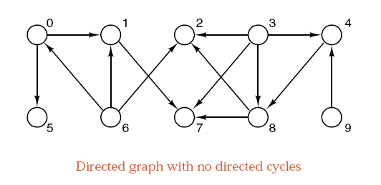
Topological order(拓扑排序)
Let G be a directed graph with no cycles.
A topological order for G is a sequential listing of all the vertices in G such that, for all vertices v,w € G, if there is an edge from v to w, then v precedes w in the sequential listing.
P580 Figure 12.7
Notes:
Let G be a directed graph with no cycles.
G的拓扑序列不一定存在。
G的拓扑序列不是唯一的。

Slide 63
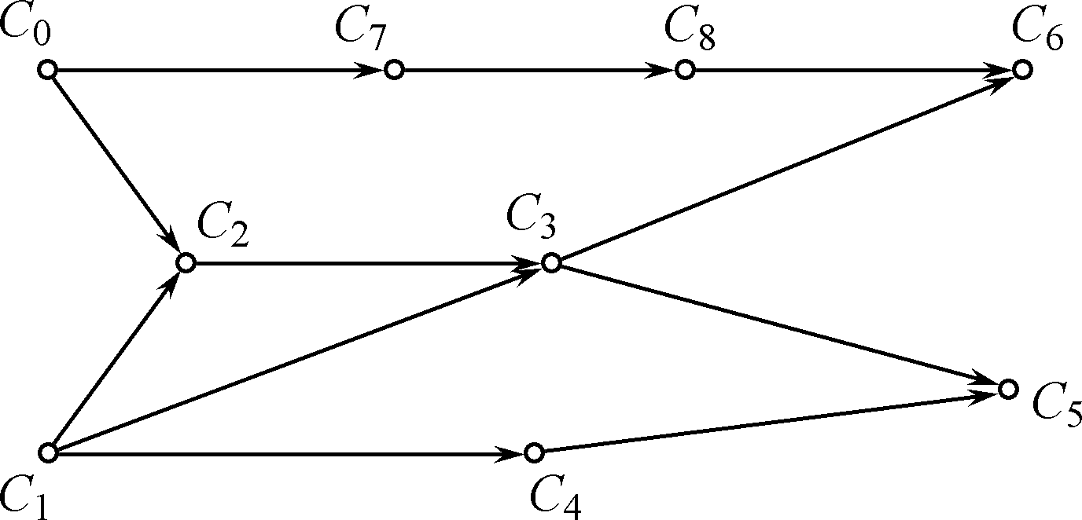
Example: Topological order(拓扑排序)
C0 高等数学，C1 程序设计语言，C2 离散数学， C3 数据结构，C4 算法语言，C5 编译技术，C6 操作系统， C7 概率论，C8 计算机原理
Notes:
C1, C4, C0, C7, C8, C2, C3, C6, C5

Slide 64
12.4.3 Breadth-First Algorithm
Start by finding the vertices that should be first in the topological order. That is the vertices which have no predecessor. 首先找到没有入度的点
将这些点加入到队列。然后不停地从队列中弹出点。
对每一个弹出的点，处理他们的后继，将入度减一。 当入度为0时，即可加入到队列中。
重复上述过程直到所有的点都从队列中弹出。

Slide 66
Breadth-First Algorithm p582
template <int graph_size> void Digraph<graph_size> ::
breadth_sort(List<Vertex> &topological_order)
{
topological_order.clear( );
Vertex v, w;
int predecessor_count[graph size];
for (v = 0; v < count; v++) predecessor_count[v] = 0;
for (v = 0; v < count; v++)
for (int i = 0; i < neighbors[v].size( ); i++) {
neighbors[v].retrieve(i, w); // Loop over all edges v--w.
predecessor_count[w]++; (统计每个点的直接先序节点)
}

Slide 67
Breadth-First Algorithm p582
Queue ready_to_process;
for (v = 0; v < count; v++)
if (predecessor_count[v] == 0) ready_to_process.append(v); // 第一层没有先序的节点
while (!ready_to_process.empty( )) {
ready_to_process.retrieve(v);
topological_order.insert(topological order.size( ), v);
for (int j = 0; j < neighbors[v].size( ); j++) {
neighbors[v].retrieve(j, w); // Traverse successors of v.
predecessor_count[w]−−;
if (predecessor_count[w] == 0)
ready_to_process.append(w);
}
ready_to_process.serve( );
}
}

Slide 68
12.4.2 Depth-first Algorithm
Start by finding a vertex that has no successors and place it last in the order.
By recursive, After placed all the successors of a vertex into the topological order, then place the vertex itself in position before any of its successors. 在遍历所有的后继后，才将当前节点放在后继之前。

Slide 69
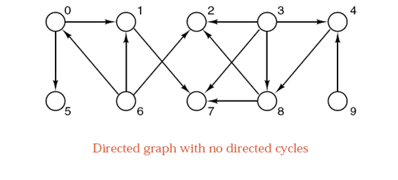
以0开始的DFS后继为： 0517
以3开始的DFS后继为： 3482
以6开始的DFS后继为： 6
以9开始的dfs后继为： 9
DFS顺序为： 9634820517

Slide 70
Digraph Class, Topological Sort
typedef int Vertex;
template <int graph_size>
class Digraph {
public:
Digraph( );
void read( );
void write( );
// methods to do a topological sort
void depth_sort(List<Vertex> &topological_order);
void breadth_sort(List<Vertex> &topological_order);
private:
int count;
List <Vertex> neighbors[graph_size];
void recursive_depth_sort(Vertex v, bool visited[],
List<Vertex> &topological_order);
};

Slide 71
Depth-First Algorithm p581
template <int graph_size> void Digraph<graph_size> ::
depth_sort(List<Vertex> &topological_order)
/* Post: The vertices of the Digraph are placed into List topological_order with a
depth-first traversal of those vertices that do not belong to a cycle.
Uses: Methods of class List, and function recursive_depth_sort to perform depth-
first traversal. */
{
bool visited[graph_size];
Vertex v;
for (v = 0; v < count; v++) visited[v] = false;
topological_order.clear( );
for (v = 0; v < count; v++)
if (!visited[v]) // Add v and its successors into topological order.
recursive_depth_sort(v, visited, topological_order);
}

Slide 72
Depth-First Algorithm p581
template <int graph_size> void Digraph<graph_size> ::
recursive_depth_sort(Vertex v, bool *visited, List<Vertex> &topological_order)
{
visited[v] = true;
int degree = neighbors[v].size( );
for (int i = 0; i < degree; i++) {
Vertex w; // A (neighboring) successor of v
neighbors[v].retrieve(i, w);
if (!visited[w]) // Order the successors of w.
recursive_depth_sort(w, visited, topological_order);
}
topological_order.insert(0, v); // Put v into topological_order.
}

Slide 73
最小生成树

Slide 74
12.6 Minimal Spanning Trees（MST）最小生成树
A (connected) tree that is build up out of all the vertices and some of the edges of G is called a spanning tree of G.
If original graph has n vertices, the spanning tree has n vertices and n-1 edges.
No circle in this subgraph
DEFINITION A minimal spanning tree of a connected network is a spanning tree such that the sum of the weights of its edges is as small as possible.

Slide 75
Two Spanning Tree

Slide 76
Minimum Spanning Tree (MST)
Spanning tree with minimum weight
6
6
10
10
1
1
7
20
5
5

Slide 77
Prim's Algorithm for Minimal Spanning Trees
Start with a source vertex.
Keep a set X of those vertices whose paths to source in the minimal spanning tree that we are building have been found.
Keep the set Y of edges that link the vertices in X in the tree under construction.
The vertices in X and edges in Y make up a small tree that grows to become our final spanning tree.

Slide 78
Prim's Algorithm for Minimal Spanning Trees
Initially:
source is the only vertex in X, and Y is empty.
At each step:
we add an additional vertex to X:
This vertex is chosen so that an edge back to X has samllest weight. This minimal edge back to X is added to Y .
neighbor[w], is a vertex in X which is nearest to w.
Distance[w], is the value for the nearst distance of w.

Slide 79
Example of Prim's Algorithm

Slide 80
Example of Prim's Algorithm

Slide 81
Example of Prim's Algorithm

Slide 82
Example of Prim's Algorithm

Slide 83
Implementation of Prim's Algorithm
template <class Weight, int graph size>
class Network: public Digraph<Weight, graph size> {
public:
Network( );
void read( ); // overridden method to enter a Network
void make empty(int size = 0);
void add edge(Vertex v, Vertex w, Weight x);
void minimal spanning(Vertex source,
Network<Weight, graph size> &tree) const;
};

Slide 84
template <class Weight, int graph size>
void Network < Weight, graph size > :: minimal spanning(Vertex source, Network<Weight, graph size> &tree) const
/* Post: The Network tree contains a minimal spanning tree for the connected component
of the original Network that contains vertex source. */
{
tree.make empty(count);
bool component[graph size]; // Vertices in set X
Weight distance[graph size]; // Distances of vertices adjacent to X
Vertex neighbor[graph size]; // Nearest neighbor in set X
Vertex w;
for (w = 0; w < count; w++) {
component[w] = false;
distance[w] = adjacency[source][w];
neighbor[w] = source;
}
component[source] = true; // source alone is in the set X.

Slide 85
for (int i = 1; i < count; i++) {
Vertex v; // Add one vertex v to X on each pass.
Weight min = innity;
for (w = 0; w < count; w++) if (!component[w])
if (distance[w] < min) {
v = w;
min = distance[w]; } //每次取distance最小的,记为v
if (min < innity) {
component[v] = true;
tree.add edge(v, neighbor[v], distance[v]);
for (w = 0; w < count; w++) if (!component[w]) //更新所有点的distance
if (adjacency[v][w] < distance[w]) {
distance[w] = adjacency[v][w];
neighbor[w] = v; }
}
else break; // finished a component in disconnected graph
}
}

Slide 86
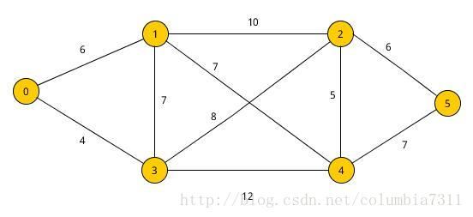
上机作业
用邻接表存储下图
Google Kruskal Algorithm, 并用上述邻接表和该算法计算最小生成树

Slide 87
The End Thank you！

