Slide 1
W13-分治法

Slide 2
Recap-Merge sort
Merge-Sort A[1..n]
1. If n = 1, done.
2. Recursively sort A[1..[n/2]]
and A[[n/2]+1..n]
3. “Merge” the 2 sorted lists.
Key subroutine: Merge

Slide 3
Merging two sorted arrays
12 20 12 20 12 20 12 20 12 20 12
11 13 11 13 11 13 11 13 11 13
9 7 9 7 9 9
1 2
1 2 7 9 11 12
Time = Θ(n) to merge a total
of n elements (linear time).

Slide 4
Analyzing merge sort
T(n) Merge-Sort A[1..n]
Θ(1) 1. If n = 1, done.
2T(n/2) 2. Recursively sort A[1..[n/2]]
and A[[n/2]+1..n]
Θ(n) 3. “Merge” the 2 sorted lists.
Sloppiness: n可以是奇数或者偶数，但在渐近分析中不重要

Slide 5
Recurrence for merge sort
if n = 1 ;
We shall usually omit stating the base case when T(n) = Θ(1) for sufficiently small n, but only when it has no effect on the asymptotic solution to the recurrence.
课本提供了多种计算T(n)渐近上界的方式.
if n > 1.

Slide 6
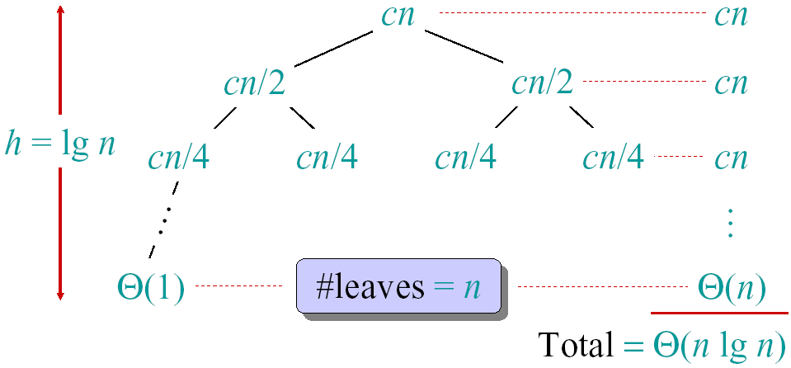
Recursion tree
Solve T(n)=2T(n/2)+cn, where c>0 is constant.

Slide 7
Conclusions
Θ(n*lgn) grows more slowly than Θ(n²).
Therefore, merge sort asymptotically beats insertion sort in the worst case.
In practice, merge sort beats insertion sort for n > 30 or so.

Slide 8
recap-Asymptotic notation
O-notation (“big-Oh”, upper bounds)
f(n) = O(g(n)) if ∃ const c, n₀ such that 0≤ f(n) ≤ cg(n), ∀n≥n₀.
e.g. 2n² = O(n³) (c=1, n₀=2)
Think of O(g(n)) as a set of functions:
O(g(n)) = {f(n): ∃ const c, n₀ such that 0≤ f(n) ≤ cg(n), ∀n≥n₀}
Then 2n² ∈ O(n³)

Slide 9
Ω-notation (lower bounds)
Again, think of Ω(g(n)) as a set of functions:
Ω(g(n)) = {f(n): ∃ const c, n₀ such that 0 ≤ cg(n) ≤ f(n), ∀n≥n₀}
e.g. n^{½} = Ω(lgn) (c=1, n₀=16)

Slide 10
Θ-notation (tight bounds)
Θ(g(n)) = {f(n): ∃ const c₁, c₂, n₀ such that 0 ≤ c₁g(n) ≤ f(n) ≤ c₂g(n), ∀n≥n₀}
Example:
Pick c₁= ¼ , c₂ = ¾ (educated guess),
then find satisfying n₀=8.

Slide 11
Useful Theorems
Theorem: Leading constants and lower-order terms don’t matter.
Theorem: (O and Ω) ⇔ Θ.

Slide 12
Merge Sort (review)
To sort n numbers:
1. if n=1, done.
2. recursively sort 2 lists of numbers with n/2 and n/2 elements
3. merge 2 sorted lists in Θ(n) time
Example: 1 5 2 4 6 3 2 6

Slide 13
Example of Merge Sort
1 5 2 4 6 3 2 6
1 5 2 4
6 3 2 6
1 5
2 4
6 3
2 6
1
5
2
4
6
3
2
6
1 5
2 4
3 6
2 6
1 2 4 5
2 3 6 6
1 2 2 3 4 5 6 6

Slide 14
Structure of merge sort algorithm
break problem into similar (smaller) subproblems
recursively solve subproblems
combine solutions to produce final answer

Slide 15
Divide-and-conquer paradigm
1. Divide problem into subproblems.
2. Conquer subproblems by solving recursively.
3. Combine subproblem solutions.

Slide 16
Binary search
Search for a key in a sorted array
Example: Given array:
3 5 7 8 9 12 15
Find key 9

Slide 17
Binary search
Binary search as Divide-and-conquer
algorithm:
1. Divide: Check middle element.
2. Conquer: Search one subarray.
3. Combine: Trivial.

Slide 18

最大连续子数组问题
problem definition
一个整数组成的数组，包含若干正数与负数，找到其中的一个连续片段(子数组)，使得其中所有元素相加之和最大。

Slide 19
divide-conquer-combine
Divide:
Get middle element, partition into two sub-arrays
Conquer
Solving the sub-arrays.
Combine
Comparing three results and get max:
from left subarray
from right subarray
Subarray cross the middle element

Slide 20
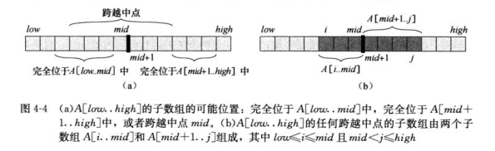
combine
左子数组
右子数组
跨过中点的子数组

Slide 21
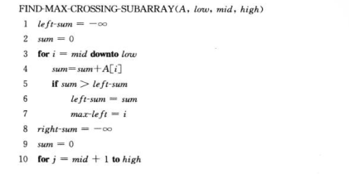

如何求第三种情况的最大子数组？
向左向右依次探索到边界，维护最大值即可
复杂度Θ(n)

Slide 22
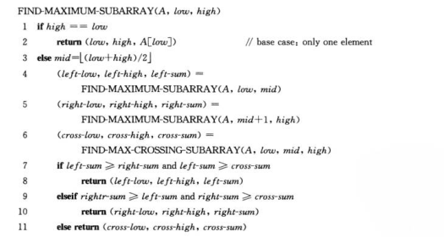
The whole algorithm

Slide 23
Solving Recurrences
Three methods:
Substitution, Iteration, Master
Substitution Method (most general)
Guess form of solution
Verify by induction
Solve for satisfying constant.

Slide 24
Example of substitution method proof
Example: solve T(n) = 4T(n/2) + n
Guess that T(n) ∈ O(n³), i.e. that T of form cn³.
Assume T(k) ≤ ck³ for k < n and
Prove T(n) ≤ cn³ by induction
T(n) = 4T(n/2) + n ≤ 4c(n/2)³ + n
= cn³/2 + n = cn³ − (cn³/2−n)
≤ cn³ if c ≥ 2 and n ≥ 1
Thus T(n)=O(n³)!

Slide 25
Substitution Method (cont.)
Notes:
To prove inductive step, try to write expression as
<answer you want> − <something > 0>
In example above:
did not show that T(n) = Ω(n) or Θ(n) thus n³ is not a tight bound!
Can show O(n²).

Slide 26
Substitution: Achieving Tighter Bounds
Try to show T(n)=O(n²)
Assume T(k) ≤ ck²
T(n) = 4T(n/2) + n
≤ 4c(n/2)² + n
= cn² + n
≤ cn² for no choice of c>0. Lose.
What went wrong?

Slide 27
Fallacious argument
The problem? We couldn’t rewrite the equality
T(n) = cn² + n
as
T(n) = cn² − <(something positive)>
in order to show the inequality we wanted:
T(n) ≤ cn²

Slide 28
Corrected Proof
Idea: Strength inductive hypothesis by subtracting lower-order term:
Assume T(k)≤c₁k² − c₂k for k< n
T(n) = 4T(n/2) + n Given
≤ 4(c₁(n/2)² − c₂(n/2)) + n Ind. Hyp.
= c₁n² − 2c₂n + n simplify
= c₁n² − c₂n − (c₂n−n) Rearrange
≤ c₁n² − c₂n if c₂ ≥ 1
Pick c₁ big enough to handle initial conditions.
Thus T(n)=O(n²)!

Slide 29
Iterating recurrences
Basic idea: expand, and convert to summation
Example:
T(n)=n+4T(n/2)
=n+4(n/2+4T(n/4))
=n+4(n/2+4(n/4+4T(n/8)))
=n+4(n/2+4(n/4+4(n/8+4T(n/16))))
=n+2n+4n+…+2^{lgn}T(1)
=2⁰n+2¹n+2²n+…+2^{lgn}T(1)
=Θ(n²)+Θ(n)=Θ(n²)

Slide 30
To iterate recurrences
Should know rules and have intuition for arithmetic and geometric series
Math can be messy and hard. Often, use iterating recurrence to generate guess for substitution method.

Slide 31
Iteration method: Visualizing recursion tree
Construction of recursion tree for
T(n) = T(n/4) + T(n/2) + n²:
n²
n²
(n/4)²
(n/2)²
T(n/4)
T(n/2)
n²
T(n/16)
T(n/8)
T(n/8)
T(n/4)
(n/4)²
(n/2)²
5n²/16
(n/16)²
(n/8)²
(n/8)²
(n/4)²
25n²/256
Θ(n²)

Slide 32
Iteration method: Visualizing recursion tree
Another recurrence:
T(n) = T(n/3) + T(2n/3) + n:
Recursion tree:
n
n
n/3
2n/3
n
n/9
2n/9
2n/9
4n/9
n
Total: O(nlogn)

Slide 33
Master method
Idea: solve class of recurrences of form
T(n) = aT(n/b) + f(n)
a≥0 and b>0, and f asymptotically positive.
Abstractly: T(n) is runtime for an algorithm; it’s unknown, but we do know that:
a subproblems of size n/b are solved recursively, each in time T(n/b).
f(n) is the cost of dividing problem (beforehand) and combining the results (afterward).

Slide 34
Recursion tree
f(n)
a
f(n)
f(n/b)
f(n/b)
………..
f(n/b)
af(n/b)
a
a
…
………..
…
f(n/b²)
f(n/b²)
f(n/b²)
f(n/b²)
a²f(n/b²)
a
a
a
a
………..
Θ(1)
Θ(1)
Θ(1)
Θ(1)
Θ(1)
………..
Θ(1)
Total:

Slide 35
Analysis
#of leaves =
Iterating the recurrence (expanding the tree) yields
T(n) = f(n) + aT(n/b)
= f(n) + af(n/b) + a²T(n/b²)
= f(n) + af(n/b) + a²f(n/b²) +…
+

Slide 36
Intuition
Three common cases:
Running time dominated by cost at leaves.
Running time evenly distributed throughout tree
Running time dominated by cost at root
Thus, to solve recurrence we need only characterize the dominant term in each case!

Slide 37
In each case, compare f(n) and
Case 1: for some constant ε > 0.
f(n) grows polynomially slower than
Weight of each level increases geometrically from root to leaves (1,a¹,a²,…)
Leaves contain constant fraction of total weight; i.e., total is constant × #of leaves.
the work at leaves dominates.

Slide 38
Analysis of Case 1
Thus

Slide 39
Case 2
for some constant k≥0
f(n) and same to within a polylogarithmic factor (log to a power)
Weight decreases from root to leaves
Thus
Work is distributed evenly throughout tree
数学推导->算法导论 Section 4.6

Slide 40
Case 3
for some constant ε>0
Also, need “regularity condition”:
∃c<1 and n₀>0 such that
af(n/b) ≤ cf(n) ∀n > n₀
f(n) grows polynomially faster than
Weight is geometrically decreasing from root to leaves
Root contains constant fraction of total weight
Thus, Cost at root dominates.

Slide 41
Master Theorem, Summarized
Master Theorem: T(n) = aT(n/b) + f(n)
1.
2.
3.
and af(n/b) ≤ cf(n)， c<1

Slide 42
MT Strategy
Basic strategy:
Extract a, b, and f(n) from given recurrence
Determine
Compare f(n) and asymptotically
Determine appropriate MT case (if any), and apply it.

Slide 43
MT examples
For merge sort:
T(n) = 2T(n/2) + Θ(n); a=2, b=2
= =
⇒Case 2, with k=0

Slide 44
MT examples (cont.)
T(n) = 7T(n/2) + Θ(n²)
⇒ Case 1, applies

Slide 45
MT examples (cont.)
Binary search (not sort!):
T(n) = T(n/2) + Θ(1); (a=1, b=2)
⇒ Case 2,
T(n) = Θ(lgn)

Slide 46
MT examples (cont.)
T(n) = 4T(n/2) + n³; (a=4, b=2)
Are we done?
No… Need to check regularity condition:
4f(n/2) ≤ cf(n)
4n³/8 ≤ cn³
n³/2 ≤ cn³
c=3/4<1
⇒Case 3

Slide 47
MT examples (cont.)
One more recurrence:
T(n) = 4T(n/2) + n²/lgn
No MT case applies!

Slide 48
Recurrence for Merge sort
subproblem size
T(n) = 2 T( n/2 )
#subproblems
+ Θ(n)
work dividing & combining
T(n) = 2T(n/2) + Θ(n)

Slide 49
Merge sort analysis
write recurrence T(n) = 2T(n/2) + Θ(n)
solve using MT
Characterize
a=2 and b=2 ⇒
⇒ Case 2 of MT ⇒ T(n) = Θ(nlgn)

Slide 50
Recurrence for binary search
subproblem size
T(n) = 1 T( n/2 )
#subproblems
+ Θ(1)
work dividing & combining
T(n) = T(n/2) + Θ(1)

Slide 51
Binary search analysis
solve using MT:
Characterize
a=1 and b=2 ⇒
⇒ Case 2 of MT ⇒ T(n) = Θ(lgn)

Slide 52
Matrix multiplication
Multiply A, B to produce C – all n×n matrices
Input: A=(a_{ij}), B=(b_{ij})
Output: C=(c_{ij})=AB

Slide 53
Standard algorithm
for i ← 1 to n
do for j ← 1 to n
do c_{ij} ← 0
for k ← 1 to n
do c_{ij} ← c_{ij} + a_{ik}•b_{kj}
Running time = Θ(n³)

Slide 54
Divide-and-conquer algorithm
Idea:
n×n matrix = 2×2 matrix of (n/2)×(n/2)
submatrices:
8 mults of (n/2)×(n/2) submatrices
4 adds of (n/2)×(n/2) submatrices

Slide 55
Analysis of D&C algorithm
submatrix size
T(n) = 8T( n/2 )
#submatrices
+ Θ(n²)
work adding submatrices
T(n) = Θ(n³). No better than the ordinary algo.

Slide 56
Strassen’s idea
Multiply 2×2 matrices with only 7 recursive mults.

Slide 57
Strassen’s idea (cont.)
Multiply 2×2 matrices with only 7 recursive mults.

Slide 58
Counting primitives in Strassen’s algorithm
Old method: 8 Mults, 4 Adds
New method: To compute P₁,…,P₇, r, s, t, u
need
7 multiplications
18 additions (and subtractions)
14 more adds! – cost of eliminating 1 multiplication
Note: No reliance on commutativity of mult.

Slide 59
Strassen’s algorithm
Divide: Partition A and B into (n/2)×(n/2)
submatrices. Use + and − to form terms to be multiplied.
2. Conquer: Perform 7 multiplications of (n/2)×(n/2) submatrices recursively.
3. Combine: Form C using + and − on (n/2)×(n/2) submatrices.

Slide 60
Analysis
subproblem size
T(n) = 7 T( n/2 )
#multiplications
+ Θ(n²)
work combining, i.e. adding
T(n) = 7T(n/2)+Θ(n²)=Θ(n^{lg7})= Θ(n^{2.81}) (case 1)
Θ(n^{2.81}) vs Θ(n³), wins for n≥50 in practice.
Best algorithm to date: Θ(n^{2.376}) (not practical)

