Slide 1
W6-顺序搜索与二分搜索
数据结构与程序设计

Slide 2
W6目标
掌握搜索的概念，key与record
能独立实现一个列表与有序列表
能比较熟练的写出二分搜索的代码
数据结构与程序设计

Slide 3
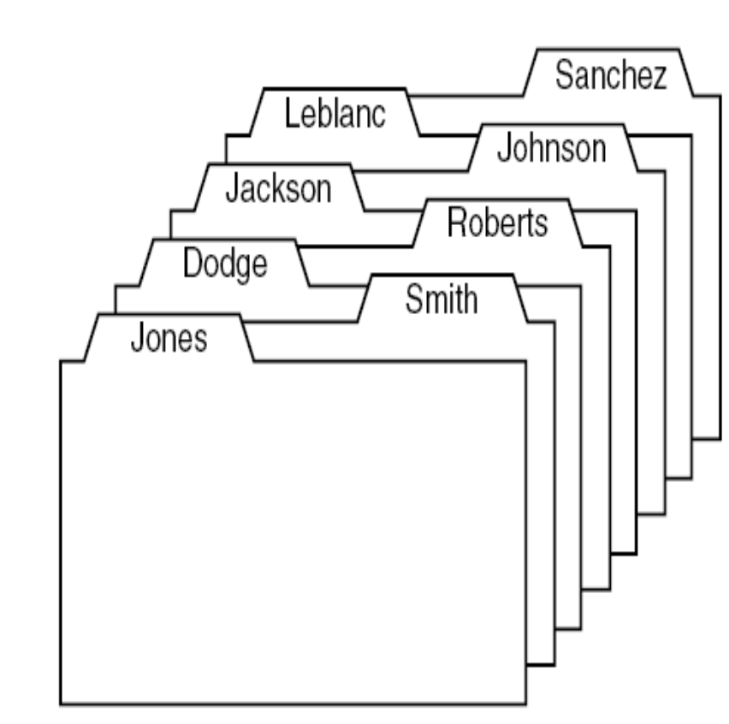
什么是搜索？
应用：信息检索
本章以顺序存储列表为例进行讨论
数据结构与程序设计

Slide 4
什么是搜索？
We are given a list of records, where each record is associated with one piece of information, which we shall call a key(关键字).
We are given one key, called the target, and are asked to search the list to find the record(s) (if any) whose key is the same as the target.
We often ask how many times one key is compared with another during a search. This gives us a good measure of the total amount of work that the algorithm will do.
数据结构与程序设计

Slide 5
内部查找与外部查找
The searching problem falls naturally into two cases.
Internal searching（内部查找） means that all the records are kept in high-speed memory.
External searching（外部查找）, most of the records are kept in disk files.
We study only internal searching.
数据结构与程序设计

Slide 6
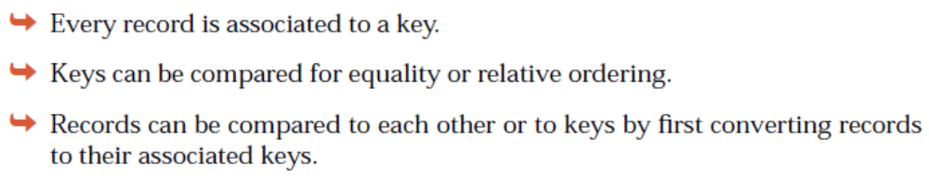
Record与Key
数据结构与程序设计

Slide 7
Implementation of Key Class
class Key {
int key;
public:
Key (int x = 0);
int the_key( ) const;
};
bool operator == (const Key &x, const Key &y);
数据结构与程序设计

Slide 8
Implementation of Key Class
Key::Key(int x){
key=x;
}
int Key::the_key() const{
return key;
}
bool operator == (const Key &x, const Key &y)
{
return x.the_key( ) == y.the_key( );
}
数据结构与程序设计

Slide 9
Record的实现与Key比较-实现方法1
class Record{
public:
operator Key( ); // Record to Key 的隐式转换 .
Record(int x=0, int y=0);
private:
int key;
int other;
};
语法： operator T(), 其中T为要转换的类型
数据结构与程序设计

Slide 10
Implementation of Record Class
Record::Record(int x, int y){
key=x;
other=y;
}
Record::operator Key( ){
Key tmp(key);
    Return tmp;
}
数据结构与程序设计

Slide 11
Test Main
void main(){
Key target(5);
Record myrecord(5,9);
if (target==myrecord) cout<<"yes"<<endl;
else cout<<"no"<<endl;
}
调用operator Key( )构造临时Key tmp,采用void operator == (const Key &x, const Key &y)操作符比较。
Output:
yes
数据结构与程序设计

Slide 12
实现方式二-利用Key的拷贝构造函数
class Key {
int key;
public:
Key (int x = 0);
Key (const Record &r);
int the_key( ) const;
};
bool operator == (const Key &x, const Key &y);
数据结构与程序设计

Slide 13
Implementation of Key Class
Key::Key(int x){
key=x;
}
Key::Key(const Record &r){
key=r.the_key();
}
int Key::the_key() const{
return key;
}
bool operator == (const Key &x, const Key &y)
{
return x.the_key( ) == y.the_key( );
}
数据结构与程序设计

Slide 14
Implementation of Record Class
class Record{
public:
Record(int x=0, int y=0);
int the_key() const;
private:
int key;
int other;
};
数据结构与程序设计

Slide 15
Implementation of Record Class
Record::Record(int x, int y){
key=x;
other=y;
}
int Record::the_key() const{
return key;
}
数据结构与程序设计

Slide 16
Test Main
void main(){
Key target(5);
Record myrecord(5,9);
if (target==myrecord) cout<<"yes"<<endl;
else cout<<"no"<<endl;
}
调用Key(const Record &r)构造临时Key tmp,采用void operator == (const Key &x, const Key &y)操作符比较后，调用析构函数释放tmp。
Output:
yes
数据结构与程序设计

Slide 17
基于列表的顺序查找
数据结构与程序设计

Slide 18
列表的类定义
enum Error_code{underflow, overflow, range_error_new, success};
const int max_list = 30;
template <class List_entry>
class List {
public:
// methods of the List ADT
List( );
int size( ) const;
bool full( ) const;
bool empty( ) const;
void clear( );
void traverse(void (*visit)(List_entry &));//遍历整个List //注意函数指针的使用
Error_code retrieve(int position, List_entry &x) const;
Error_code replace(int position, const List_entry &x);
Error_code remove(int position, List_entry &x);
Error_code insert(int position, const List_entry &x);
protected:
// data members for a contiguous list implementation
int count;
List_entry entry[max_list];
};

Slide 19
Sequential Search 顺序查找
enum Error_code{underflow, overflow, range_error_new, success, fail, not_present};
  underflow: 链表为空之后仍旧删除
  overflow: 数组满了之后插入
  range_error_new: 插入位置有误
  Success： 操作成功
  not_present: 未找到目标
从顺序存储的首地址开始，依次检查每个record, 如果找到，则返回查找成功；否则，返回未发现.
数据结构与程序设计

Slide 20
Sequential Search 顺序查找
Error_code sequential_search(const List<Record> &the_list,
const Key &target, int &position)
/* Post: If an entry in the list has key equal to target , then return success and the
output parameter position locates such an entry within the list.
Otherwise return not_present and position becomes invalid. */
{
int s = the_list.size( );
for (position = 0; position < s; position++) {
Record data;
the_list.retrieve(position, data);
if (target == data) return success;
}
return not_present;
}
数据结构与程序设计

Slide 21
分析-顺序查找中的比较次数
The number of comparisons of keys done in sequential search of a list of length n is:
Unsuccessful search: n comparisons.
Successful search, best case: 1 comparison.
Successful search, worst case: n comparisons.
Successful search, average case: (n + 1)/ 2 comparisons.
数据结构与程序设计

Slide 22
代码补充：指向函数的指针
定义格式为：函数返回值类型 (*指针变量)( 形参列表);
函数存放在内存的代码区域内，它们同样有地址，我们如何能获得函数的地址呢？
  如果我们有一个int test(int a)的函数，那么，它的地址就是函数的名字，这一点如同数组一样，数组的名字就是数组的起始地址。
  定义一个指向函数的指针用如下的形式，以上面的test()为例：
    int (*fp)(int a);//这里就定义了一个指向函数的指针
    函数指针不能指向不同类型，或者是带不同参数的函数。
    指向函数的指针常用于函数的形参中
数据结构与程序设计
Notes:
int *fp(int a);
//这里是错误的，因为按照结合性和优先级来看就是先和()结合，然后变成了一个返回整形指针的函数了，
// 而不是函数指针，这一点尤其需要注意！

Slide 23
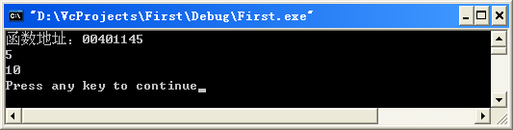
#include <iostream>
#include <string>
using namespace std;
int test(int a);
void main()
{
cout<<“函数地址：”<<test<<endl;//显示函数入口地址
int (*fp)(int a); //定义了一个指向函数的指针fp
fp=test;//将函数test的地址赋给函数指针fp
cout<<fp(5)<<endl;//输出fp(5),这是标准c++的写法, cout<<(*fp)(10)<<endl;//(*fp)(10)这是兼容c语言的标准写法,
//两种写法的功能相同,但注意区分,避免写的程序产生移植性问题!
}
int test(int a)
{
return a;
}
数据结构与程序设计

Slide 24
函数指针的应用
template <class List_entry>
void List<List_entry> :: traverse(
void (*visit)(List_entry &))
/* Post: The action specified by function(*visit) has been performed on every entry of theList , beginning at position 0 and doing each in turn. */
{
for (int i = 0; i < count; i++)
(*visit)(entry[i]);
}
数据结构与程序设计

Slide 25
函数指针的应用
template <class List_entry>
void update(List_entry &x){
x*=2;
}
数据结构与程序设计

Slide 26
函数指针的应用
template <class List_entry>
void print(List_entry &x){
cout<<x<<endl;
}
数据结构与程序设计

Slide 27
基于有序列表的二分查找
数据结构与程序设计

Slide 28
二分搜索
为何需要二分搜索？
  顺序搜索效率太低
二分搜索的前提条件？
  有序列表
首先讨论如何构建一个有序的列表，然后讨论针对顺序列表的二分查找。
数据结构与程序设计

Slide 29
有序列表的定义
An ordered list is a list in which each entry contains a key, such that the keys are in order. That is, if entry i comes before entry j in the list, then the key of entry i is less than or equal to the key of entry j .
数据结构与程序设计

Slide 30
有序列表
class Ordered_list: public List<Record>{ //继承于顺序列表
public:
Error_code insert(const Record &data);
Error_code insert(int position, const Record &data);
Error_code replace(int position, const Record &data);
};
数据结构与程序设计

Slide 31
Ordered Lists
Error_code Ordered_list :: insert(const Record &data)
/* Post: If the Ordered_list is not full, the function succeeds: The Record data is inserted into the list, following the last entry of the list with a strictly lesser key (or in the first list position if no list element has a lesser key).
Else: the function fails with the diagnostic Error_code overflow. */
插入思路？
  从列表第一个位置开始，依次比较插入数据与当前位置的值大小，若插入数据<当前位置值，则继续下一个位置。否则，找到插入位置，并将列表中所有后续数据各自后移一位。
数据结构与程序设计

Slide 32
在有序列表中插入一个数据
Error_code Ordered_list :: insert(const Record &data)
/* Post: If the Ordered_list is not full, the function succeeds: The Record data is inserted into the list, following the last entry of the list with a strictly lesser key (or in the first list position if no list element has a lesser key).
Else: the function fails with the diagnostic Error_code overflow. */
{
int s = size( );
int position;
for (position = 0; position < s; position++) {
Record list_data;
retrieve(position, list_data);
if (data < list_data) break; //book p279 wrong
}
return List<Record> :: insert(position, data);
//调用父类的方法。
}
数据结构与程序设计

Slide 33
在position位置插入一个数据
Error_code Ordered_list :: insert(int position, const Record &data)
/* Post: If the Ordered list is not full, 0 <= position <= n , where n is the number of entries in the list, and the Record data can be inserted at position in the list, without disturbing the list order, then the function
succeeds: Any entry formerly in position and all later entries have their position numbers increased by 1 and data is inserted at position of the List .
Else: the function fails with a diagnostic Error_code . */
需要保证position位置的数据比position-1位置的数据大，且比当前position位置的数据小
数据结构与程序设计

Slide 34
Error_code Ordered_list :: insert(int position, const Record &data)
/* Post: succeeds: Any entry formerly in position and all later entries have their
Else: the function fails with a diagnostic Error_code . */
{
Record list_data;
if (position > 0) {
retrieve(position - 1, list_data);
if (data < list_data)
return fail;
}
if (position < size( )) {
retrieve(position, list_data);
if (data > list_data)
return fail;
}
return List<Record> :: insert(position, data);
}
数据结构与程序设计

Slide 35
将position位置数据替换为data
Error_code Ordered_list :: replace(int position, const Record &data)
{
if (position < 0 || position >= count)return range_error;
Record list_data;
if (position > 0) {
retrieve(position - 1, list_data);
if (data < list_data)
return fail;
}
if (position < size( )-1) {
retrieve(position+ 1, list_data);
if (data > list_data)
return fail;
}
entry[position] = data;
return success;
}
数据结构与程序设计

Slide 36
Ordered Lists
class Record{
public:
Record();
Record(int x, int y=0);
int the_key() const;
private:
int key;
int other;
};
bool operator > (const Record &x, const Record &y);
bool operator < (const Record &x, const Record &y);
ostream & operator << (ostream &output, Record &x);
数据结构与程序设计

Slide 37
Ordered Lists
Record::Record(){
key=0;
other=0;
}
Record::Record(int x, int y){
key=x;
other=y;
}
int Record::the_key() const{
return key;
}
数据结构与程序设计

Slide 38
Ordered Lists
bool operator > (const Record &x, const Record &y)
{
return x.the_key( ) > y.the_key( );
}
bool operator < (const Record &x, const Record &y)
{
return x.the_key( ) < y.the_key( );
}
ostream & operator << (ostream &output, Record &x)
{
output<<x.the_key();
output<<endl;
return output;
}
数据结构与程序设计

Slide 39
Ordered Lists--Main
template <class List_entry>
void print(List_entry &x){
cout<<x;
}
void main(){
Ordered_list mylist;
for(int i=0;i<5;i++)mylist.insert(Record(i*2));
mylist.insert(Record(3));
mylist.insert(0,Record(30));
cout<<"Your list have "<<mylist.size()<<" elements:"<<endl;
mylist.traverse(print); // 函数指针的应用
程序运行结果？
数据结构与程序设计

Slide 40
Ordered Lists--Main
mylist.remove(0, Record(i));
cout<<"After remove(0):"<<endl;
mylist.traverse(print);
程序运行结果？
数据结构与程序设计

Slide 41
Ordered Lists--Main
mylist.replace(0, Record(-1));
cout<<"After replace(0, Record(-1)):"<<endl;
mylist.traverse(print);
}
程序运行结果？
数据结构与程序设计

Slide 42
二分搜索-The Forgetful Version of Binary Search
Forget the possibility that the Key target might be found quickly and continue, whether target has been found or not, to subdivide the list until what remains has length 1.
数据结构与程序设计

Slide 43
The Forgetful Version of Binary Search
Idea: In searching an ordered list, first compare the target to the key in the center of the list. If it is smaller, restrict the search to the left half; otherwise restrict the search to the right half, and repeat. In this way, at each step we reduce the length of the list to be searched by half.
Keep two indices, top and bottom, that will bracket(包括) the part of the list still to be searched.
The target key, provided it is present, will be found between the indices bottom and top, inclusive.
在查找过程中忽略mid位置等于target的情况
数据结构与程序设计

Slide 44
4个主要步骤
1. Initialization: Set bottom = 0; top = the_list.size( ) − 1;
2. Compare target with the Record at the midpoint, mid = (bottom + top)/2;
3. Change the appropriate index top or bottom to restrict the search to the appropriate half of the list.
4. Loop terminates when top <= bottom, if it has not terminated earlier by finding the target.
Make progress toward termination by ensuring that the number of items remaining to be searched, top − bottom + 1, strictly decreases at each iteration of the process.
数据结构与程序设计

Slide 45
Error_code recursive_binary_1(const Ordered_list &the_list, const Key &target, int bottom, int top, int &position){
Record data;
if (bottom < top) { // List has more than one entry.
int mid = (bottom + top)/2;
the_list.retrieve(mid, data);
if (target > data) // Reduce to top half of list.
return recursive_binary_1(the_list, target, mid + 1, top, position);
else // Reduce to bottom half of list.
return recursive_binary_1(the_list, target,bottom, mid, position);
}
else if (top < bottom) // Can be remarked?
return not_present; // List is empty.
else { // List has exactly one entry.
position = bottom;
the_list.retrieve(bottom, data);
if (data == target) return success;
else return not_present;
}
}
递归实现代码
数据结构与程序设计

Slide 46
循环实现代码
Error_code binary_search_1 (const Ordered_list &the_list, const Key &target, int &position)
{
Record data;
int bottom = 0, top = the_list.size( ) - 1;
while (bottom < top) {
int mid = (bottom + top)/2;
the_list.retrieve(mid, data);
if (data < target)
bottom = mid + 1;
else
top = mid;
}
if (top < bottom) return not_present;
else {
position = bottom;
the_list.retrieve(bottom, data);
if (data == target) return success;
else return not_present;
}
}
数据结构与程序设计

Slide 47
Binary Search (在检索中识别与target相同的record)
Examines the element in the middle of the array. Is it the sought item? If so, stop searching. Is the middle element too small? Then start looking in second half of array. Is the middle element too large? Then begin looking in first half of the array.
Repeat the process in the half of the data that should be examined next.
Stop when item is found, or when there is nowhere else to look and item has not been found.
数据结构与程序设计

Slide 48
Trace of Binary Search
item = 84
15 26 38 57 62 78 84 91 108 119
data[0] [1] [2] [3] [4] [5] [6] [7] [8] [9]
first middle last
item > data [ middle ] first = middle + 1
15 26 38 57 62 78 84 91 108 119
data[0] [1] [2] [3] [4] [5] [6] [7] [8] [9]
first middle last
item < data [ middle ] last = middle - 1
数据结构与程序设计

Slide 49
Trace continued
item = 84
15 26 38 57 62 78 84 91 108 119
data[0] [1] [2] [3] [4] [5] [6] [7] [8] [9]
first, last
middle
item > data [ middle ] first = middle + 1
15 26 38 57 62 78 84 91 108 119
data[0] [1] [2] [3] [4] [5] [6] [7] [8] [9]
first,
last,
middle
item == data [ middle ] found = true
数据结构与程序设计

Slide 50
Another Binary Search Trace
item = 45
15 26 38 57 62 78 84 91 108 119
data[0] [1] [2] [3] [4] [5] [6] [7] [8] [9]
first middle last
item < data [ middle ] last = middle - 1
15 26 38 57 62 78 84 91 108 119
data[0] [1] [2] [3] [4] [5] [6] [7] [8] [9]
first middle last
item > data [ middle ] first = middle + 1
数据结构与程序设计

Slide 51
Trace continued
item = 45
15 26 38 57 62 78 84 91 108 119
data[0] [1] [2] [3] [4] [5] [6] [7] [8] [9]
first, last
middle
item > data [ middle ] first = middle + 1
15 26 38 57 62 78 84 91 108 119
data[0] [1] [2] [3] [4] [5] [6] [7] [8] [9]
first,
middle,
last
item < data [ middle ] last = middle - 1
数据结构与程序设计

Slide 52
Trace concludes
item = 45
15 26 38 57 62 78 84 91 108 119
data[0] [1] [2] [3] [4] [5] [6] [7] [8] [9]
last first
first > last found = false
数据结构与程序设计

Slide 53
递归实现代码
Error_code recursive_binary_2(const Ordered_list &the_list, const Key &target, int bottom, int top, int &position)
{
Record data;
if (bottom <= top) {
int mid = (bottom + top)/2;
the_list.retrieve(mid, data);
if (data == target) {
position = mid;
return success;
}
else if (data < target)
return recursive_binary_2(the_list, target, mid + 1, top, position);
else
return recursive_binary_2(the_list, target, bottom, mid - 1, position);
}
else return not_present;
}
数据结构与程序设计

Slide 54
循环实现代码
Error_code binary_search_2(const Ordered_list &the_list, const Key &target, int &position)
/* Post: If a Record in the list has key equal to target , then position locates
one such entry and a code of success is returned. Otherwise, not present is returned
and position is undefined.
Uses: Methods for classes Ordered_list and Record . */
{
Record data;
int bottom = 0, top = the_list.size( ) - 1;
while (bottom <= top) {
position = (bottom + top)/2;
the_list.retrieve(position, data);
if (data == target) return success;
if (data < target) bottom = position + 1;
else top = position - 1;
}
return not_present;
}
数据结构与程序设计

Slide 55
Binary Search -- Main- 阅读代码
void main(){
Key target(5);
Ordered_list mylist;
for(int i=0; i<10; i++) mylist.insert(Record(i,10));
cout<<"The ordered list is: "<<endl;
mylist.traverse(print);
cout<<endl<<"The target is: "<<target.the_key()<<endl;
int bottom=0;
int top=mylist.size()-1;
int position=-1;
cout<<endl<<"Use recursive_binary_1 Method:"<<endl;
if(recursive_binary_1(mylist, target, bottom, top, position)==success)
cout<<"Get the target in position: " << position <<endl;
else
cout<<"Target not present."<<endl;
数据结构与程序设计

Slide 56
Result
The ordered list is:
0 1 2 3 4 5 6 7 8 9
The target is: 5
Use recursive_binary_1 Method:
Get the target in position: 5
数据结构与程序设计

Slide 57
Binary Search -- Main
position=-1;
cout<<endl<<"Use binary_search_1 Method:"<<endl;
if(binary_search_1(mylist, target, position)==success)
cout<<"Get the target in position: " << position
<<endl;
else
cout<<"Target not present."<<endl;
数据结构与程序设计

Slide 58
Binary Search -- Main
cout<<endl<<"Use recursive_binary_2 Method:"<<endl;
if(recursive_binary_2(mylist, target, bottom, top, position)==success)
cout<<"Get the target in position: " << position <<endl;
else
cout<<"Target not present."<<endl;
position=-1;
cout<<endl<<"Use binary_search_2 Method:"<<endl;
if(binary_search_2(mylist, target, position)==success)
cout<<"Get the target in position: " << position <<endl;
else
cout<<"Target not present."<<endl;
cin.get();
}
数据结构与程序设计

Slide 59
二分法的效率分析
二分法检索每经过一次比较就将检索范围缩小一半，第i次比较可能比较的元素个数如下表∶
比较次数 可能比较的元素个数
1 1=2⁰
2 2=2¹
3 4=2²
┇ ┇
j 2^{j-1}
二分法查找的效率近似为 O(log₂n)
数据结构与程序设计

