Slide 1
Internet Radio Streaming Application using MediaBrowserServiceCompat
Android Masterminds
DU1304
haQathon 2020
Global Product Engineering and Lifecycle Services Company
Notes:
Talking points:
We have built QuEST over the last 21 years as a aspiration driven organization. We continue to push the boundaries, create new frontiers across multiple safety critical and hi-tech industries we serve. We do this by offering our Customers a range of Services and Solutions and engagement models that spans – Engineering, Enterprise solutions, Operations, Supply Chain and Technology enabled solutions covering the complete product lifecycle.
As such, QuEST is a Leading Global Product Engineering and Lifecycle Services Company
In this presentation we will cover 3 aspects of QuEST.
WHO we are, WHAT we do and for WHOM, and why we are in business – our purpose
Then we move on to HOW we engage with Customers
Finally we will cover HOW we are different and can add unique value to you and help you “Create the Frontier”

Slide 2
Application for streaming Internet Radio using android media browser compat
Android Masterminds
Mentor | : | Vineesh C
Ideator | : | Praveen P G
Team Lead | : | Praveen P G
Team Members | : | Anu Nair, Rajan Peter Pooja Hari
Notes:
Idea/Solution/Prototype: Give a one-liner about the solution for the given problem statement
Team Name: Add team name to the entry field
Mentor Name: Add mentor’s name to the entry field
Ideator Name: Add ideator’s name to the entry field
Team Lead Name: Add team lead’s name to the entry field
Team Members Name: Add team member’s name to the entry fields one after another

Slide 3
Scope
Problem Statement
Approach
Outcome
Develop an internet radio streaming application using android framework component
MediaBrowserServiceCompat with following functionality,
Connect/Disconnect to internet radio sources.
Features to controls the audio stream (play/pause/next/previous)
Metadata information update.
Browse for metadata categories.
Develop an audio streaming application with minimum dependency between hmi and service side. MediaBrowserServiceCompat, functions like a client-server model. So the whole application will includes three major parts,
An independent HMI application.
The client side (interface between HMI and service)
The server side
It will be a stand alone internet radio streaming application with three APKs
InternetRadio-2.5.0-debug.apk
InternetRadioClient-1.5.0-debug.apk
InternetRadioPlayerService-1.5.0-debug.apk
And the application will support all basic playback control and browse featurtes.
Notes:
Problem Statement: Illustrate the basic problem along with technologies used
Approach: Methods planned to solve the target problem in order to attain a viable solution within the constrained time of 2 days of hackathon
Outcome: Results obtained as part of development towards the end of hackathon to be demonstrated with the help of table, diagram if any

Slide 4
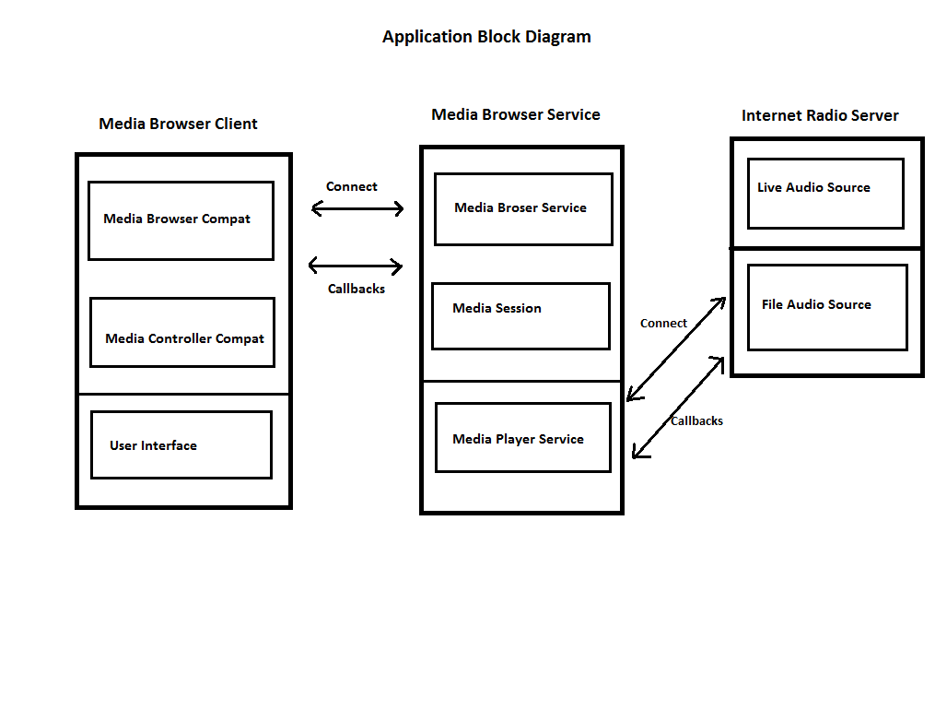
System Architecture
Notes:
System Architecture: Outline & detail the basic architecture of prototyped solution with the help of block diagrams, etc. if any

Slide 5
Technology Choices
Sl. No. | Technologies used | Rationale for selection
1. | Android MediaBrowserServiceCompat | This android component works similar to a client-server model. So it can be used for the developement of an independent audio streaming application.
2. | ExoPlayer | It provides an alternative to Android's MediaPlayer API for playing audio and video both locally and over the Internet.
3. | AIDL (Android Interface Definition Language) | It is an efficient IPC method used for developing android applications.
4. | MVP (Model View Presenter) design pattern | It can be used for developing stable and efficient HMI applications
Notes:
Technology Choice: Add technologies used and rationale for selecting so

Slide 6
Business Case
Product Deployment
Value Added to QuEST / Customer
The application will include three APKs,
InternetRadio-2.5.0-debug.apk
InternetRadioClient-1.5.0-debug.apk
InternetRadioPlayerService-1.5.0-debug.apk
Need to install all APKs for the proper working of the streaming application
Can be use internet radio as a entertainment source in automotive infotainment system like other media sources FM, SXM etc.
The proposed soution can be used as a reusable component for developing efficient and robust audio streaming applications.
Notes:
Product Deployment: How the Solution Can be Deployed? -- Target Environment, What is needed, etc.
Value Added to QuEST: Business Benefits? -- How QuEST can benefit; be specific about customer, VBU etc.

Slide 7
Learning Points
Key Learning
Scope for Improvement
Got some idea about the structure of audio streaming applications for automotive infotainment systems and also familiarized with android framework component MediaBrowserServiceCompat.
Taking challenges and making it happen.
Developing an idea within limited time and limited resources.
Internet Radio is not a widely used entertainment source in automotive infotainment systems, So currently there are not much solutions are available for handling of Internet Radio streaming in automotive industry. So, expects a big developement scope in this area.
Also MediaBrowserServiceCompat can be used for developing efficient music streaming applications.
Notes:
Key Learning: Team Experience, Bottle necks, “Aha” Moments, etc.
Scope for Improvement: How the solution can be improved further?

Slide 8
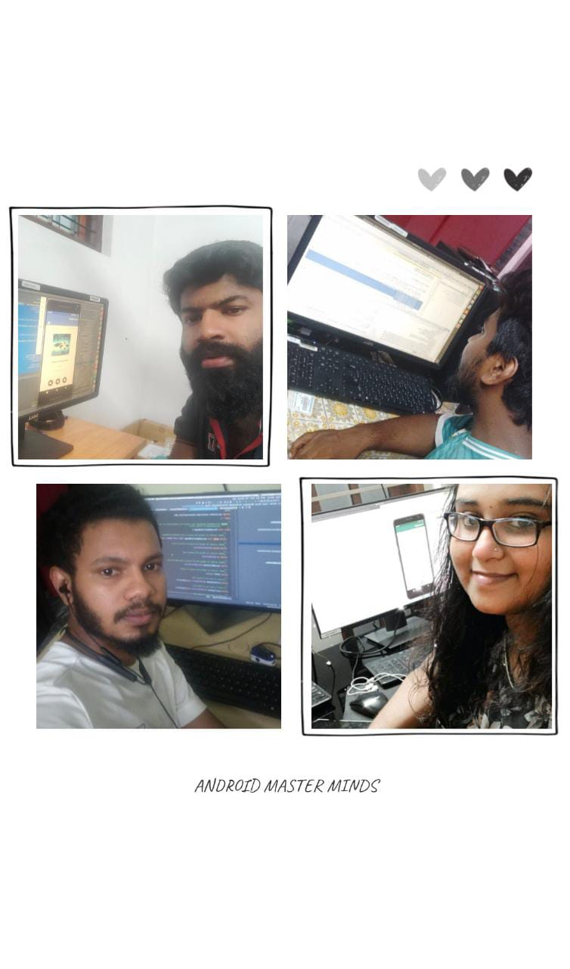
The Experience
The Team
It was a great experiece to work with a team whose members are staying in different locations. Coordinating and management of time while working in different remote locations was also a new challenge.
Overall it was a fun yet a challenging experience for us all.
Notes:
THE EXPERIENCE: Add one liner by team member(s) as well as mentor about their overall hackathon experience. Teams may mention about learning something new, meeting new people, explain the process of building stuff, testing and validating their technical skills, etc. Mentor may talk about working with the team and their achievement at the hackathon.
PHOTO: Add picture of the team along with their developed prototype

Slide 9
Thank You
Engineering | Enterprise Solutions | Operations & Supply Chain | Technology & Digital Solutions

