Slide 1
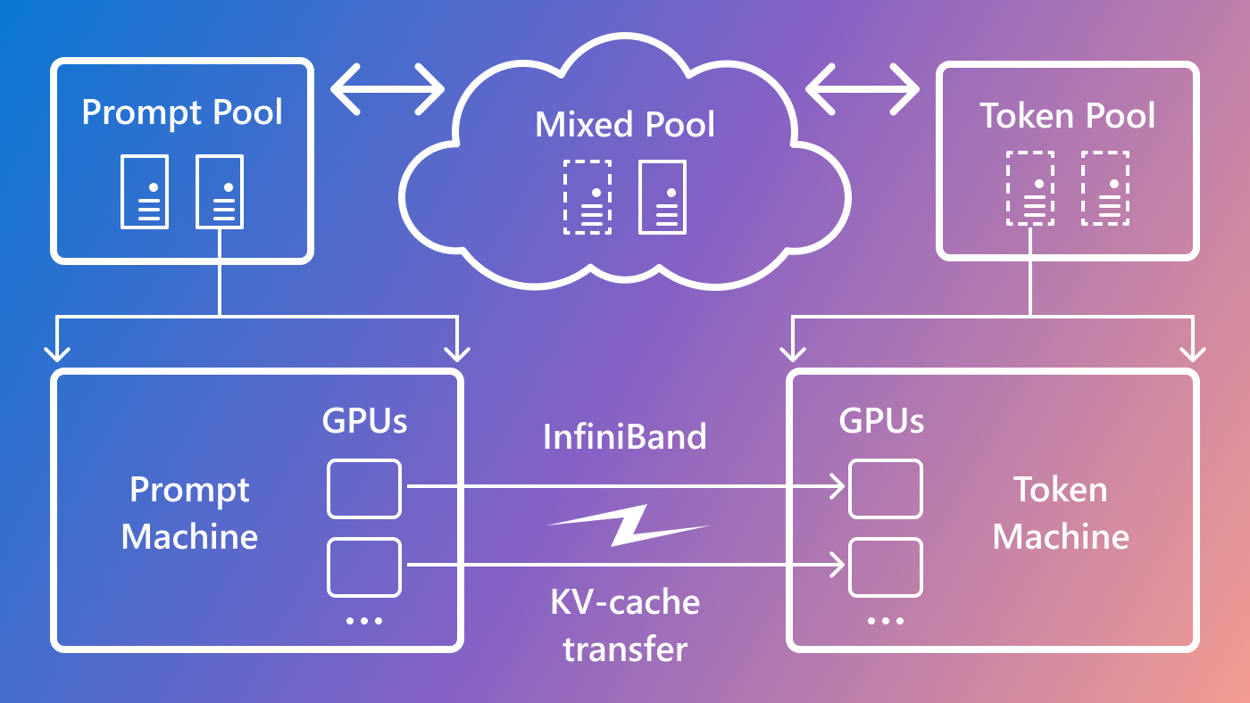

vLLM 架构剖析
ZOMI

Slide 2
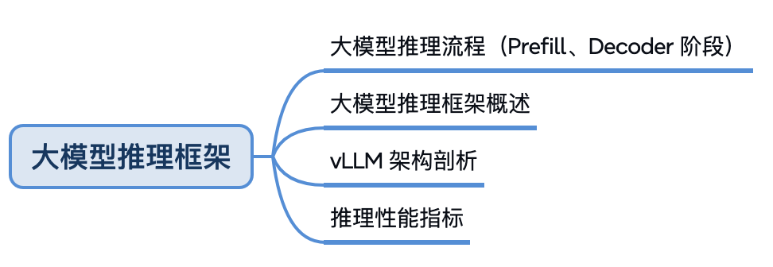
大模型推理

Slide 3
目录
业界大模型推理框架
Huggingface TGI
vLLM
SGLang
LMDeploy
性能对比
小结与思考

Slide 4
01
有哪些大模型推理框架

Slide 6
https://www.omrimallis.com/posts/understanding-how-llm-inference-works-with-llama-cpp/
https://www.databricks.com/blog/llm-inference-performance-engineering-best-practices
SARATHI: Efficient LLM Inference by Piggybacking Decodes with Chunked Prefills

