Slide 1

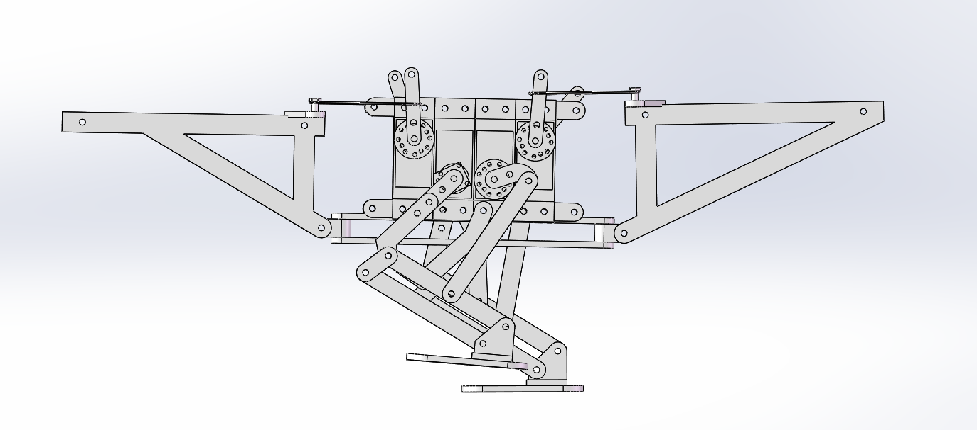
The design and implementation of Virtual Automatic Direction Finding (ADF) Based on LABVIEV
Program and principle brief introduction
名前：梁明輝

Slide 2
ADF brief introduction
When an aircraft is flying in the air, it is necessary to determine its own direction. Some people think that since the radio wave can propagate at high speed in all directions, it is possible to establish a radio beacon station to send radio waves to the outside world through the antenna, and then install a receiver on the aircraft, and use the receiving equipment to determine the relative angle between the longitudinal axis of the aircraft and the beacon station, so as to determine the direction of the aircraft.
So people set up a non directional radio beacon (NDB), which has a large antenna that can transmit radio waves of a specific frequency to all directions.

Slide 3
ADF principle formula
Antenna signal simulation
Sinusoidal loop antenna to receive terrestrial station signal: V1=A sinx cosω_{c}t
Cosine loop antenna to receive terrestrial station signal: V2=A cosx cosω_{c}t
A----The amplitude of the signal voltage x----The relative azimuth angle of the aircraft and the ground station
ω_{c}----Carrier angular frequency of receiving terrestrial station signal
The two balanced modulators are respectively modulated by low-frequency ωm (such as 96Hz) sine and cosine modulation numbers, and the output signals after modulation are V3 and V4:
V3=V1sin ωm t =Asinθ cos ωct sin ωm t
V4=V2cosωm t =Acosθ cos ωct cos ωm t
Combine V3 and V4 to obtain a combined modulation signal V5:
V5=V3+V4
= Acos ωct (Asinθ sinωm t +cosθ cos ωm t)
= Acos ωct cos (ωm t-θ )
V5 is a function containing the relative azimuth angle θ. The signal received by the vertical antenna and the output signal after the phase shift is 90 degrees are V6 and V7:
V6= B sinωct V7= B cosωct
The phase-shifted vertical antenna signal V7 and the combined modulation signal V5 are superimposed to obtain V8:
V8=V7+V5= B cos ωct +Acos ωct cos (ωm t-θ )
=B cos ωct [1+A/B cos (ωm t-θ ) ]
V8 is a heart-shaped directional map with θ angle as a function.

Slide 4
ADF principle formula
is added to the two phase detectors, the two low-frequency sine ( ) and cosine ( ) signals from the modulator are also added to the two phase detectors respectively, and after phase detection, and are obtained:
After filtering by the low-pass filter, the output of the phase detector is
Finally obtain the relative azimuth

Slide 5
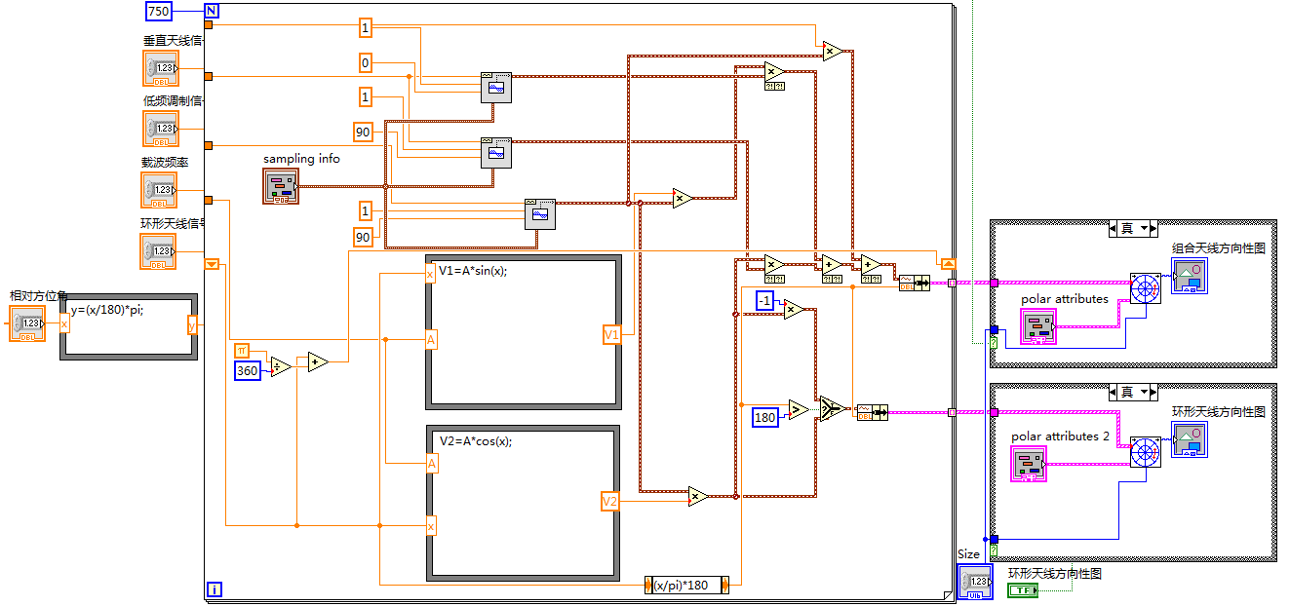
LabVIEW program
Drawing of directional graph

Slide 6
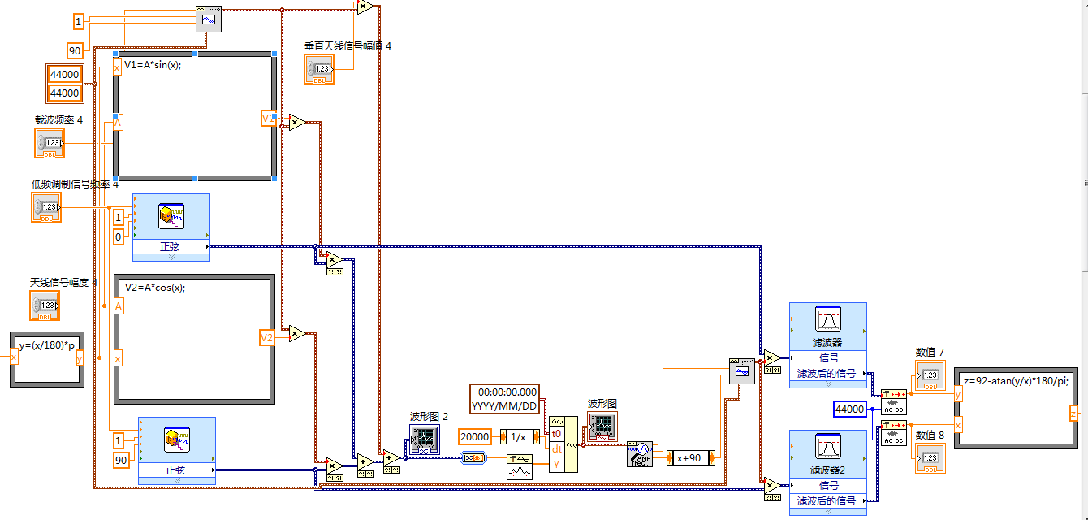
LabVIEW program
Modulation and demodulation of signals

Slide 7
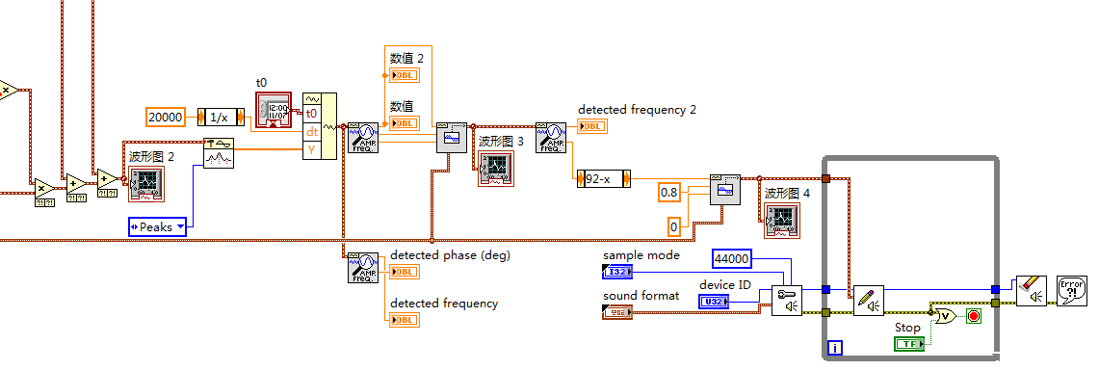
LabVIEW program
Transmission of dual computer communication

Slide 8
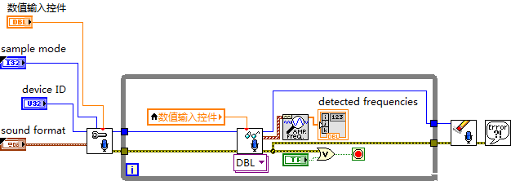
LabVIEW program
Reception of dual computer communication

Slide 9
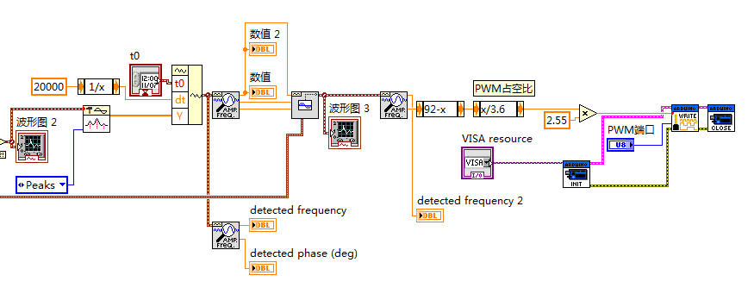
LabVIEW program
Transmitter

Slide 10
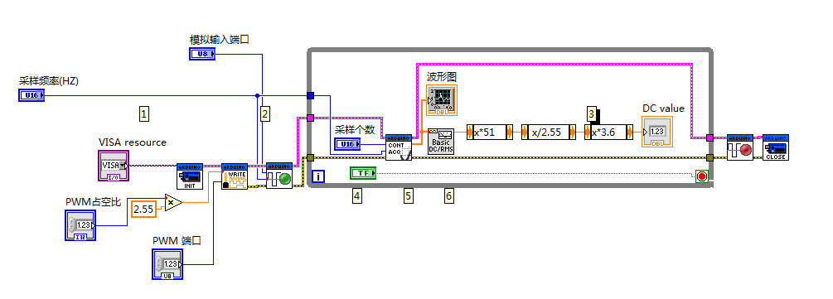
LabVIEW program
Receiver

Slide 11
Conclusion
Thank you for reading.
The entire program and principle of ADF are relatively complicated, and I want to introduce you to the results of this project in a simple form as possible. Because of the Chinese version of LabVIEW, there are some Chinese in the program. I apologize for the trouble it may cause you. Hope to gain your understanding. Thank you very much.

