Slide 1
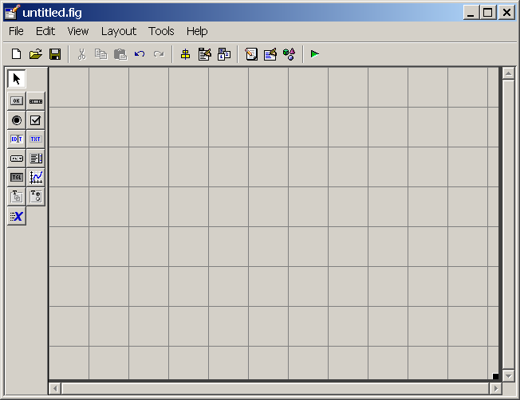
Align Objects
Menu Editor
Tab Order Editor
Property Inspector
Object Browser
GUI Components
Design Area
Drag to Resize Design Area

