Slide 1

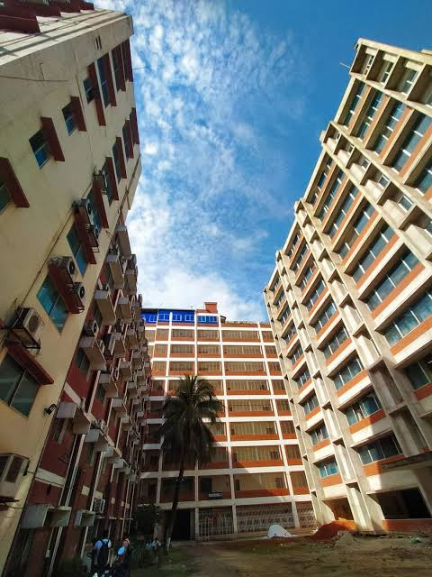

Course Code : CSE 342
Course Title : Computer Graphics Lab
Presented to : Md. Sakhawat Hossain
Lecturer , Dept. of CSE BUBT
29/05/2025
1

Slide 2
Meet Our Team
Name : Lamia Muntaha
ID:21225103185
Name : Md. Mehedi Hasan
ID:21225103334
Name : Most. Sonia Islam
ID:21225103101
Name : Abdullah Al Hill Baki Anim
ID:21225103341
Name : Humayra Kabir
ID:21225103501

Slide 3

Solar
System Simulation
3

Slide 4
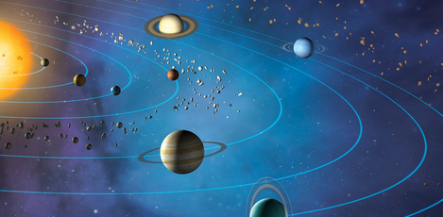
Introduction
Solar System Simulation creates a 3D interactive simulation of the solar system using OpenGL and C++. It helps users visualize planetary movements and orbits, making learning about space more engaging and easy to understand.
4

Slide 5


Motivation
Complex planetary motions are hard to learn from textbooks.
Traditional methods lack interactive visualization.
Need for an engaging, visual astronomy tool.
Growing interest in space exploration.
Supports learning for students and enthusiasts.
Helps developers improve 3D OpenGL skills.
5
5

Slide 6


Problem Statement
Difficulty understanding dynamic planetary motions from static materials.
Lack of interactive tools to visualize celestial relationships clearly.
Limited resources for real-time, 3D solar system simulations.
Need for an educational tool that is both engaging and informative.
Existing models often lack user control over time and perspective.
6

Slide 7
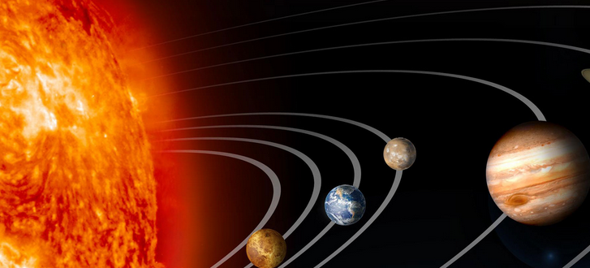
Objective
Develop a real-time 3D solar system simulation using OpenGL and C++.
Visualize planetary orbits, rotations, and celestial interactions accurately.
Provide interactive controls for zoom, rotation.
Create an educational tool to enhance understanding of astronomy concepts.
7

Slide 8
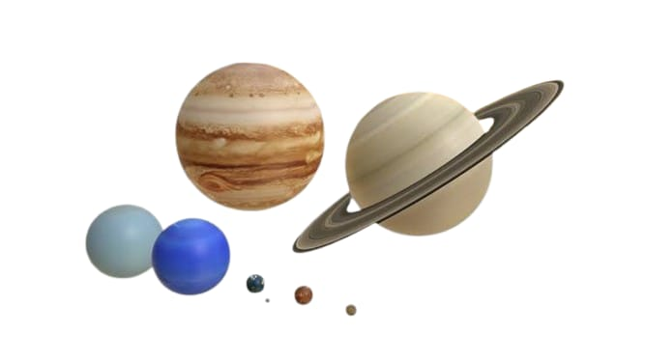
Project Description
A 3D interactive solar system simulation using OpenGL & C++.
Displays Sun, planets and a satellite around Earth with realistic orbits.
Bezier curve signals show animated data transmission from the satellite.
Includes zoom, rotation, and planet focusing features.
Animated star background for enhanced visual experience which sparkle by pressing n or N.
Play background music.
8

Slide 9
Proposed System & Scope
Interactive 3D solar system simulation with OpenGL and C++
Realistic planetary orbits, rotations, and satellite communication
Communication satellite orbiting Earth with animated solar panels and antenna.
Animated Bezier curves visualize satellite signals
Zoom, rotate, and focus on planets.
Play background music.
Background animated stars for space atmosphere
Educational tool for students and space enthusiasts
Future expansion: asteroid belts, real-time data, VR support
9

Slide 10
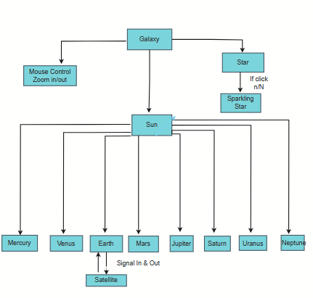
Project
Methodology
10
10
10

Slide 11

System Testing
Functionality Testing: Verified orbits, rotations, and satellite movement.
UI Testing: Checked planets thoroughly.
Performance Testing: Ensured smooth animations and camera controls.
Usability Testing: Verified zoom, rotate, and focus features work easily.
Bug Fixing: Identified and resolved animation and display issues.
11
11

Slide 12
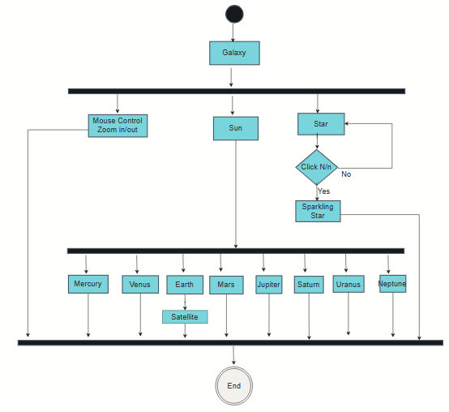
Activity
Diagram
12
12
12
12

Slide 13
Implementation
Setup Environment: Configure C++ and OpenGL.
Project Structure: Organize source and assets.
3D Models & Textures: Create planets and satellite.
Orbit & Rotation: Implement realistic movements.
Satellite Signals: Animate Bezier curve transmissions.
Camera Controls: Add zoom, rotate, and focus.
Testing: Verify functionality and performance.
Deployment: Release.
Documentation: Creating document.
13
13
13

Slide 14
Challenges
• Accurate Simulation: Realistic planetary orbits and rotations. • Animation Complexity: Smoothly animating satellite signals. • Camera Controls: Implementing intuitive zoom and planet focus. • Performance: Maintaining real-time rendering. • Visual Realism: Designing authentic textures, lighting, and star backgrounds. • Modularity: Keeping the system flexible for future expansions. • Synchronization: Coordinating orbit speeds and rotations accurately. • Resource Management: Efficient use of memory and GPU processing. • Cross-Platform Compatibility: Ensuring program works on different systems.
14
14
14
14
14

Slide 15
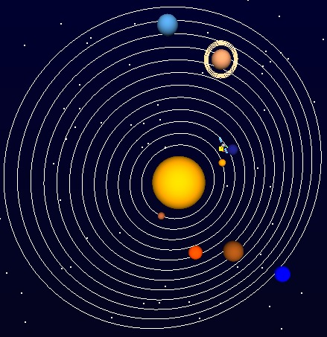
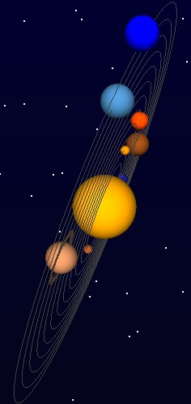
Final Output
Fig 01: Front View
Fig 02: Side View
15

Slide 16
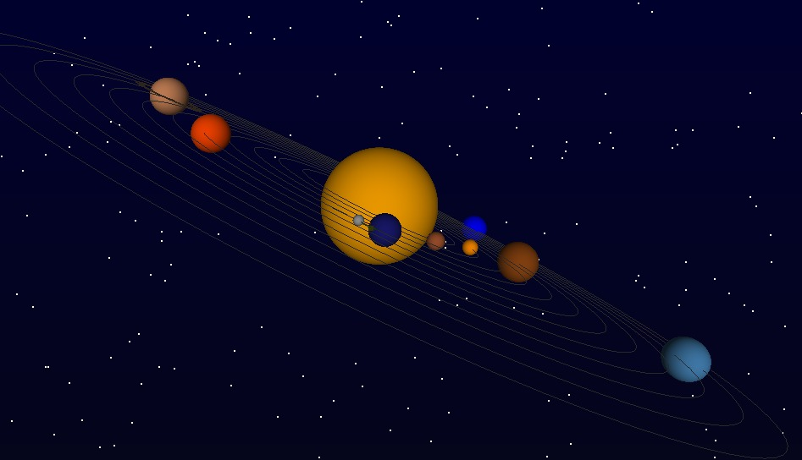
Final Output
Fig 03: Cornered View
16

Slide 17
Future Enhancements
Add asteroid belts, comets and moon for realism
Integrate real-time space data via APIs (e.g., NASA, ESA)
Implement VR/AR support for immersive exploration
Add audio effects and voice-guided tours
Optimize performance for mobile and web platforms
17

Slide 18
Conclusion
Developed an interactive 3D solar system simulation using OpenGL and C++.
Realistically visualizes planetary orbits, rotations, and satellite communication.
Enhances learning with features like zoom, focus, signal animation, and animated star background.
Provides an engaging, educational experience suitable for users of all levels.
18

Slide 19
Thank
You
19

