Slide 1
Server Hosting

Slide 2
Amazon (AWS) On Demand
- is paid per hour
- can be cancelled at any time
- can be up and downgraded
- can be in any region

Slide 3
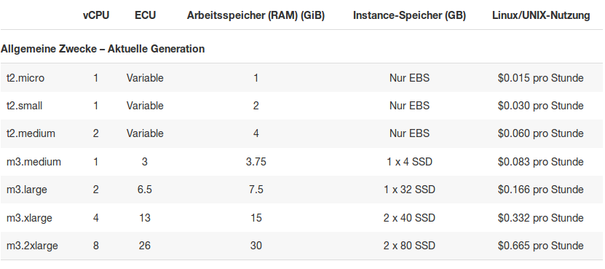
Amazon (AWS) On Demand

Slide 4
Amazon (AWS) Reserved
Are rent for 1 or 3 years
Cheaper (up to 75%, mostly 30-40%)
Can be moved to any region at any time
Can be up or downgraded

Slide 5
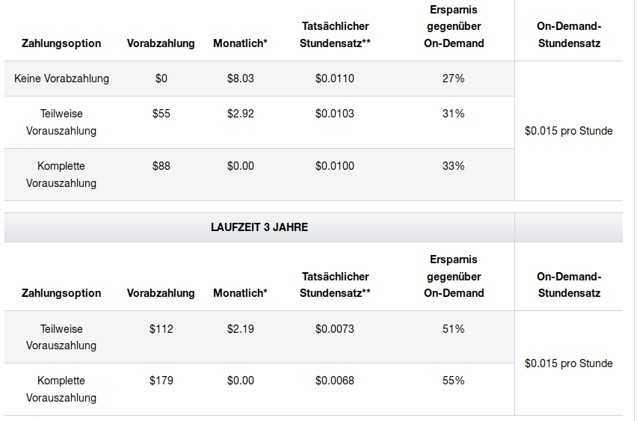
Amazon (AWS) Reserved

Slide 6
Amazon (AWS) data transmission
$0.01 per GB when using public IP addresses
Up to 10tb per month ($0.090 per GB) outgoing to non amazon-servers

Slide 7
Amazon (EBS)
Small VM have no HDD
Different kind of SSD
Cheapest SSD is $0.119 per GB and month
Other SSD have an E/A rate given

Slide 8
Amazon Cloud Watch (Monitoring)
$3.50 per month
Custom metric 0.50$ per custom metric
API Access possible
Logs can be stored at a small price ($0.63 per new GB, $0.0324 per GB after)

Slide 9
Hetzner V-Server
3 kinds of servers, different Hardware (6.90, 11,90, 18,90) Euro
HDD included
Optional monitoring from 2.50 Euro per month
2, 4, 6 TB traffic per month included
No contract period
Backup space (100gb) for 4.90 per month and 4.90 for setup

Slide 10
Microsoft Azure Basic
5 different kinds of instances (different regions of the world)
Cant be scaled up or down
No taxes in following prices

Slide 11
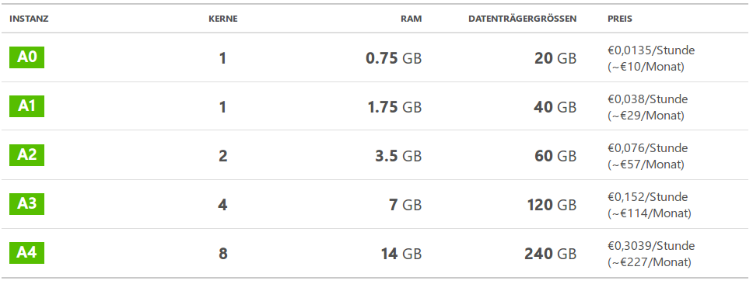
Microsoft Azure Basic

Slide 12
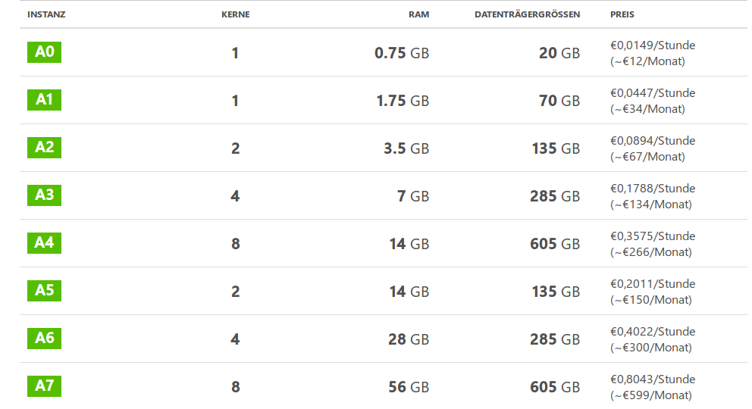
Microsoft Azure Standard

