Slide 1
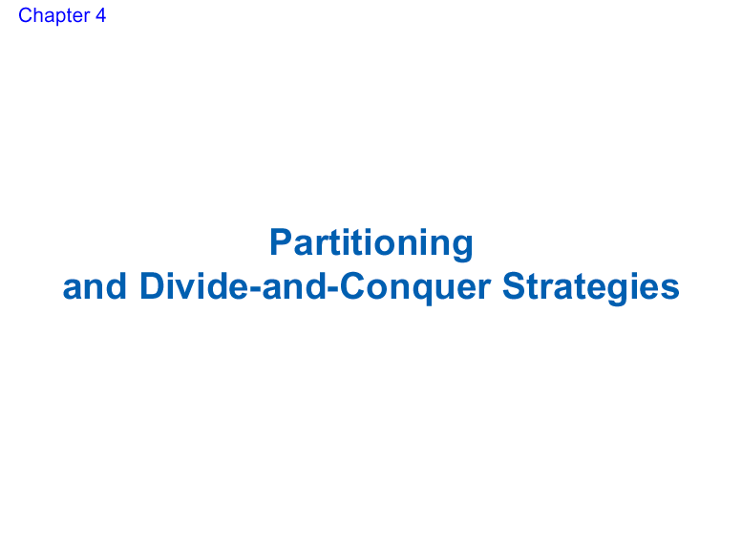

Slide 2
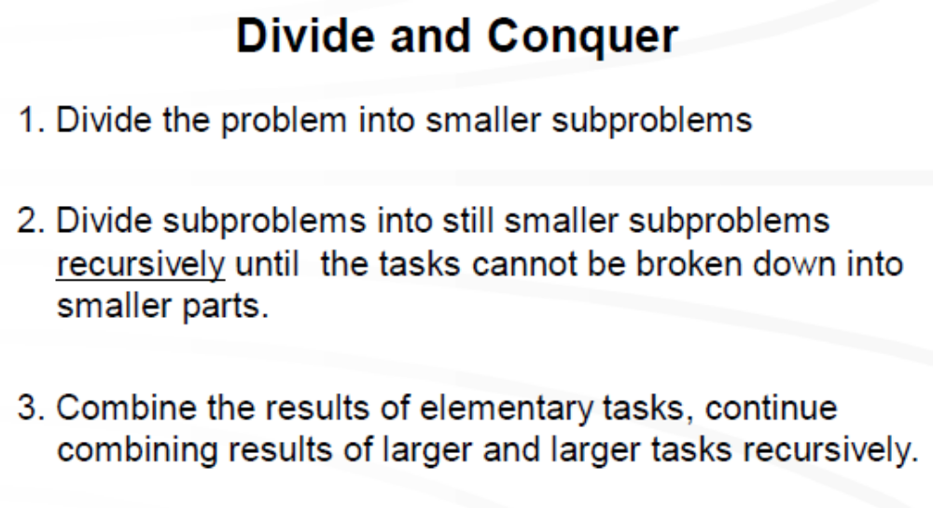

Slide 3
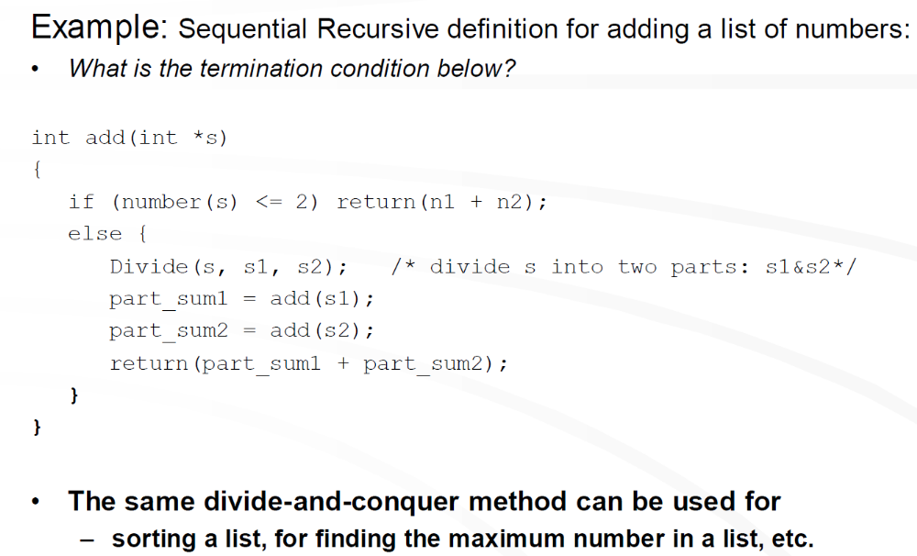

Slide 4
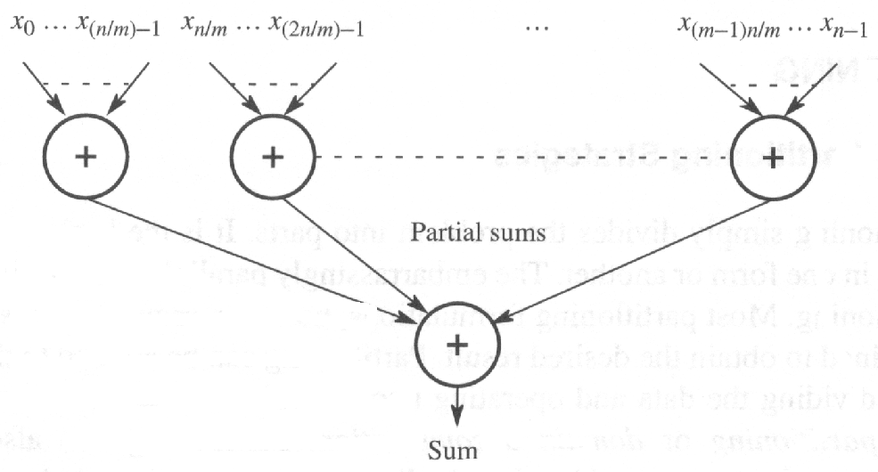
Adding numbers
n data items, p processors
t_{s} = O(n)
t_{p} = O(n/p) if data on each proc => S=t_{s}/t_{p}=O(p)
t_{p} = O(n + n/p) if data needs broadcasting => S=t_{s}/t_{p}=o(1)

Slide 5
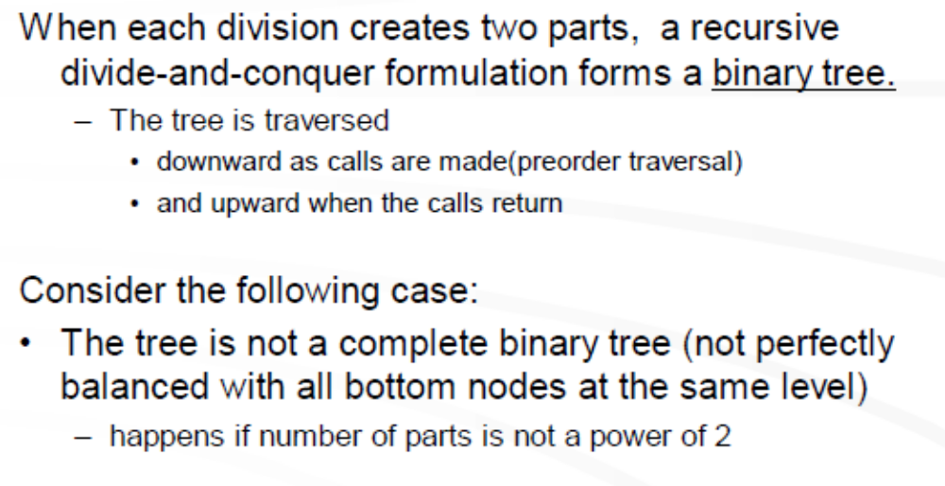

Slide 6
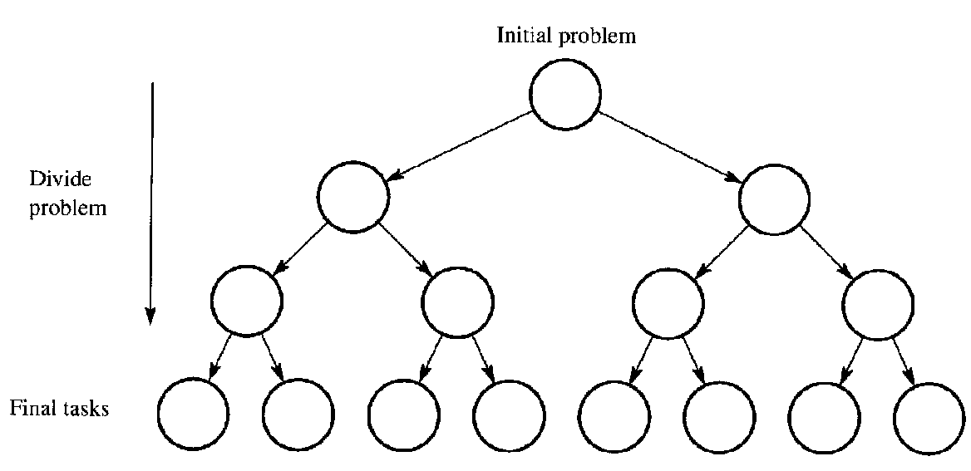

Slide 7
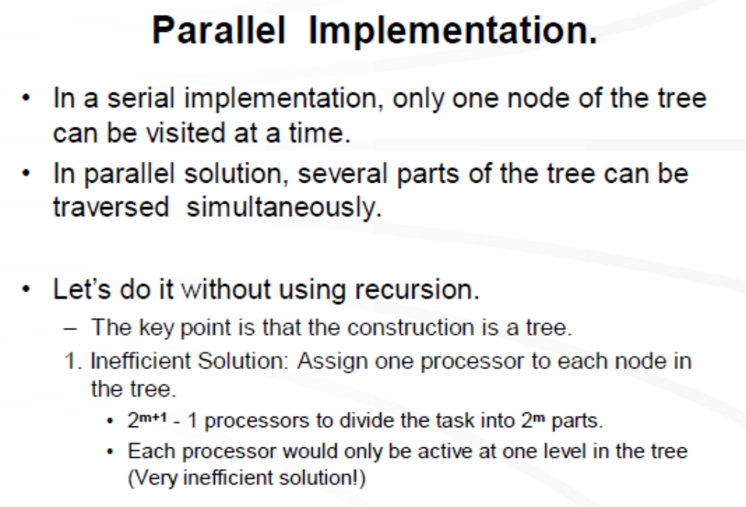

Slide 8
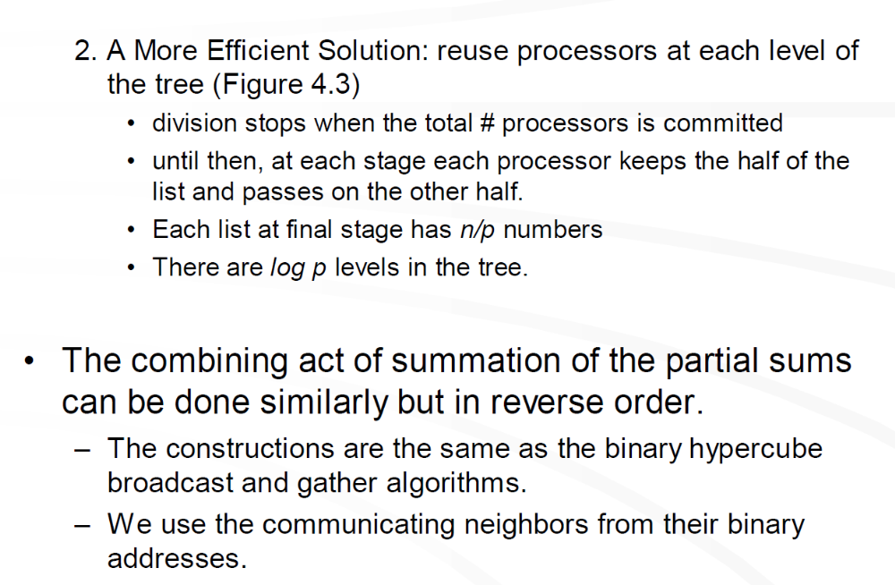

Slide 9
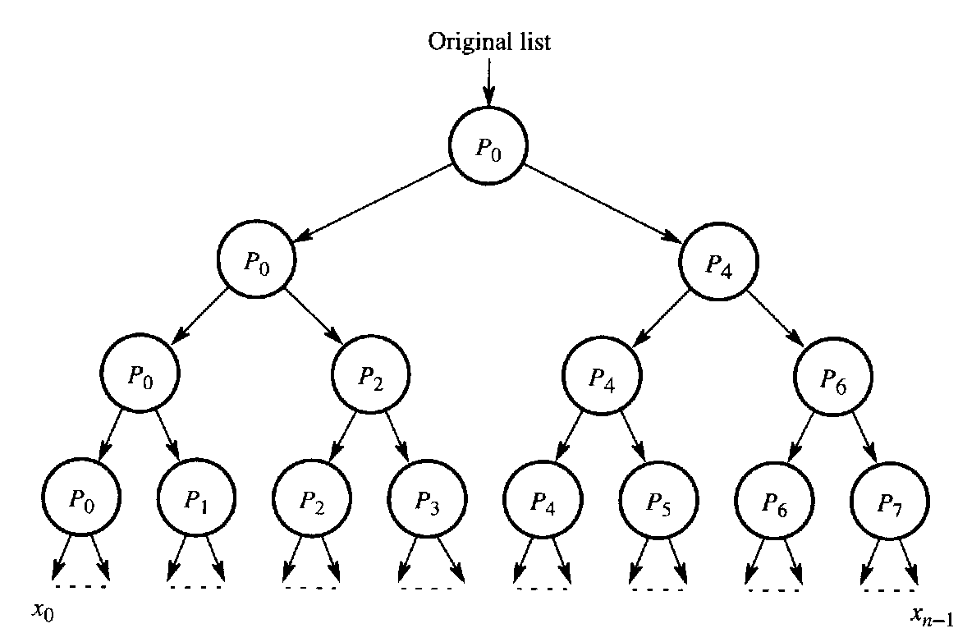
Parallel Recursion
t_{comm} = O(n/2 +n/4 + ..+ n/p) = O(n)
t_{comp} = O(n/2 +n/4 + ..+ n/p) = O(n)
S=o(1)

Slide 10
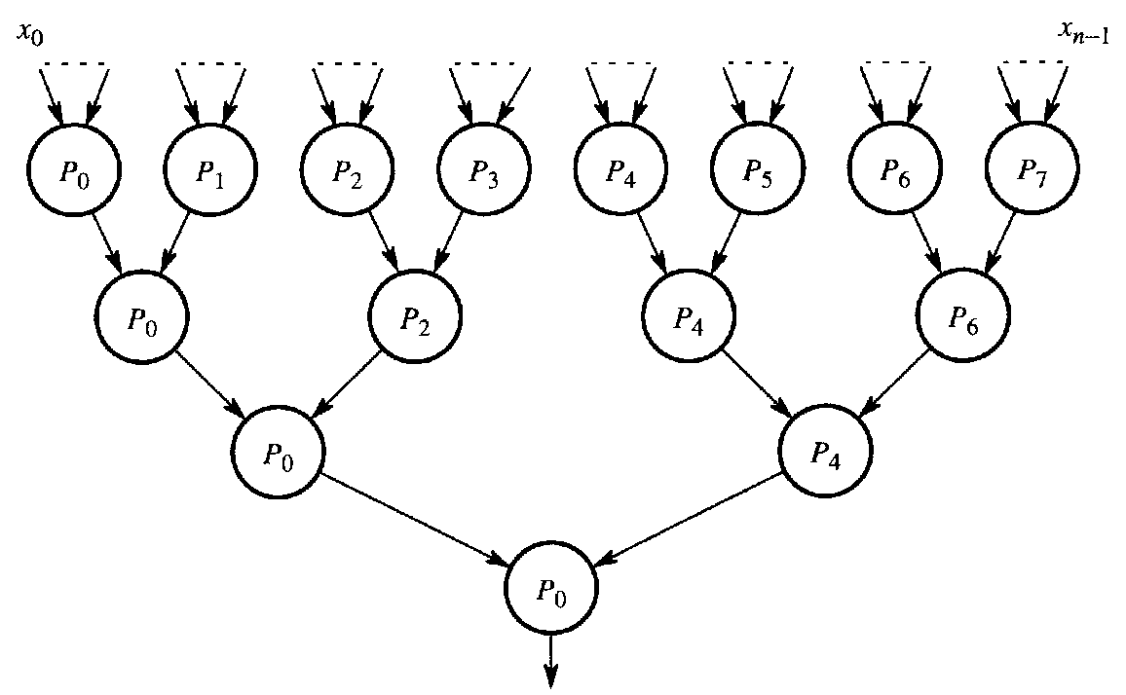
t_{comm} = O(1 +1 + ..+ 1) = O(log p)
S=O(n / log p)
t_{comp} = O(1 +1 + ..+ 1) = O(log p)

Slide 11
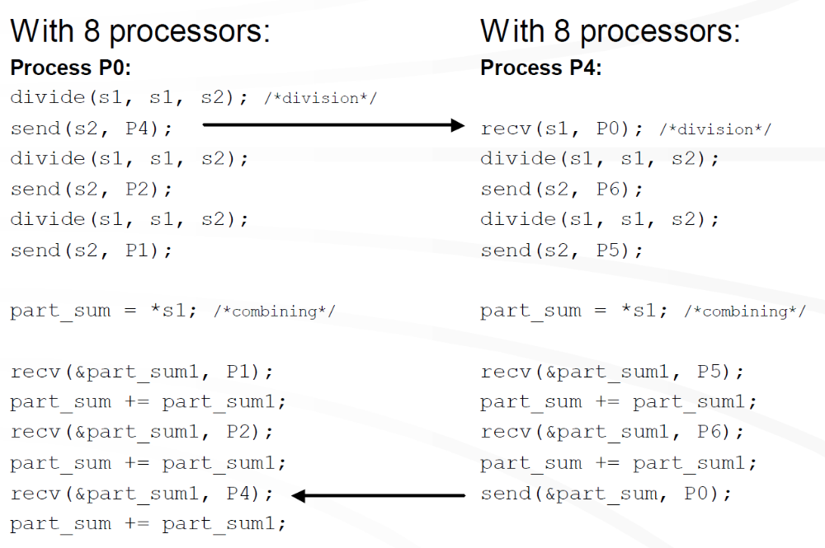

Slide 12
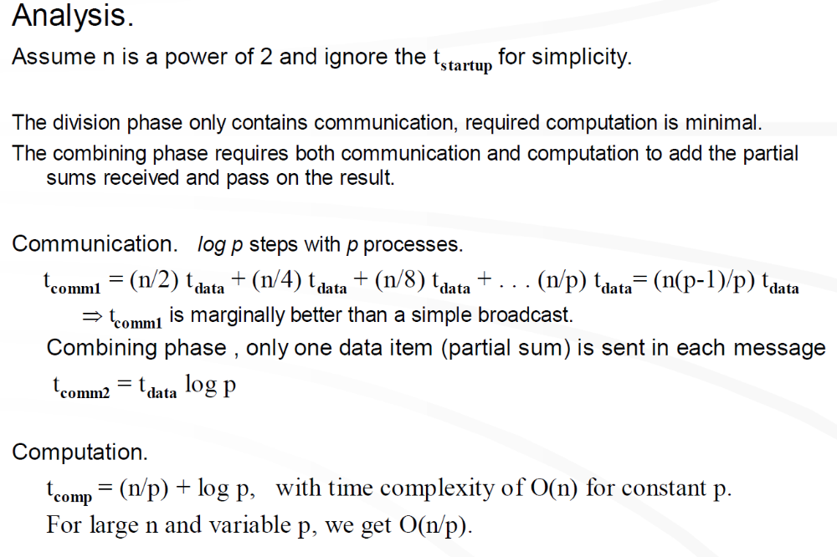

Slide 13
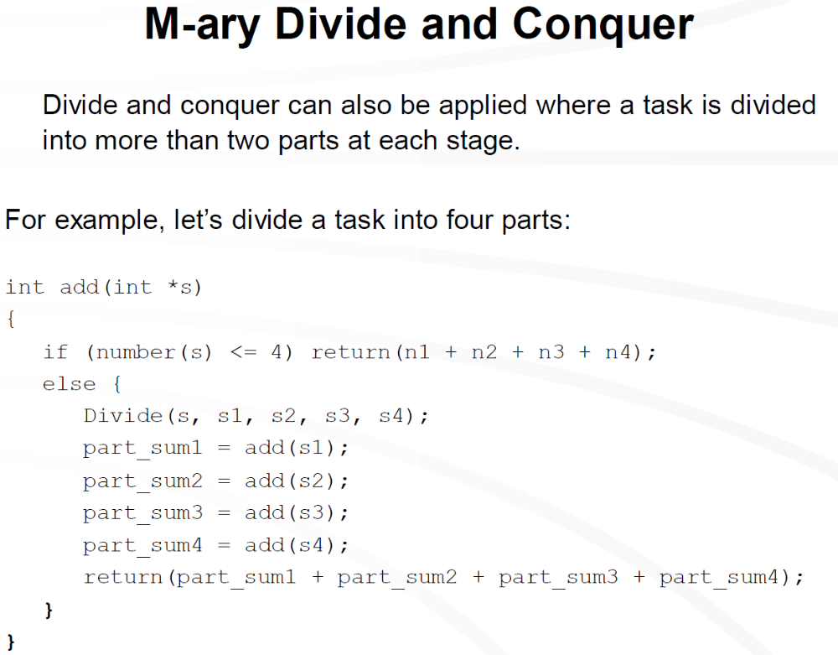

Slide 14
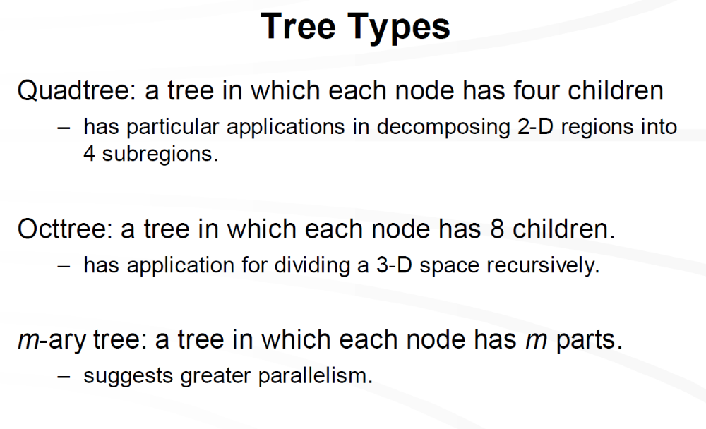

Slide 15
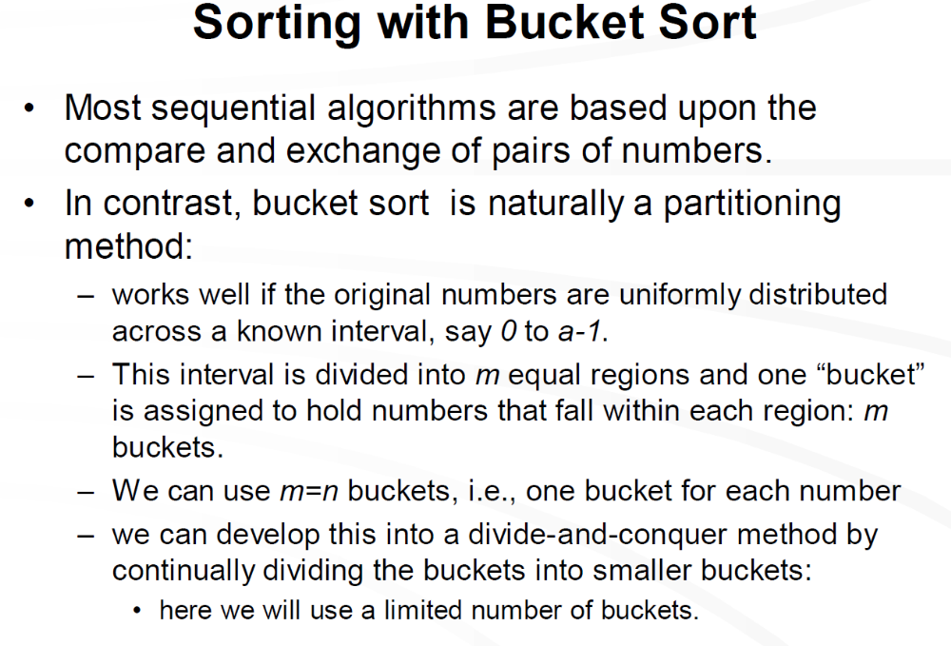

Slide 16
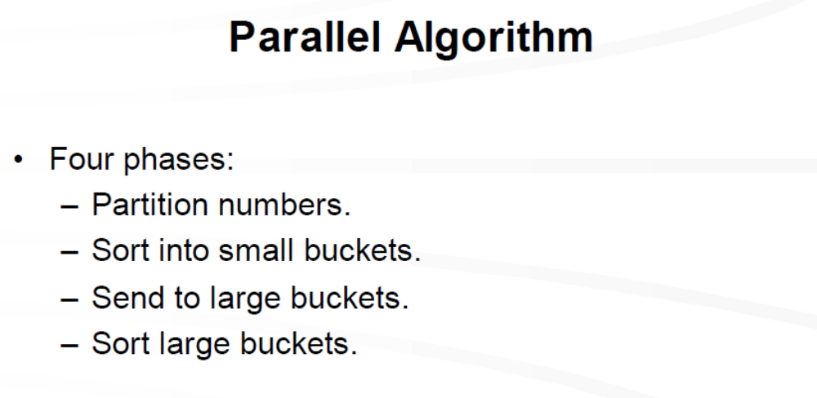

Slide 17
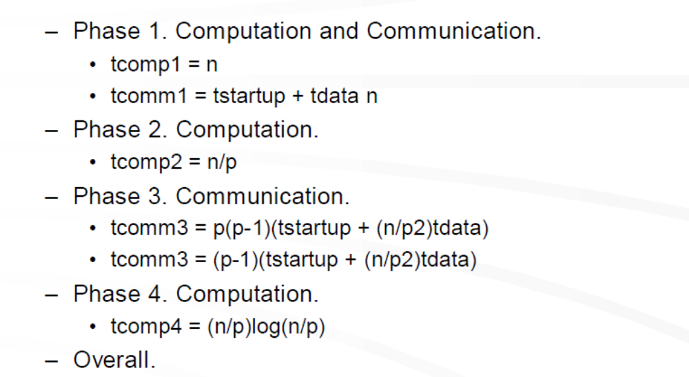

Slide 18
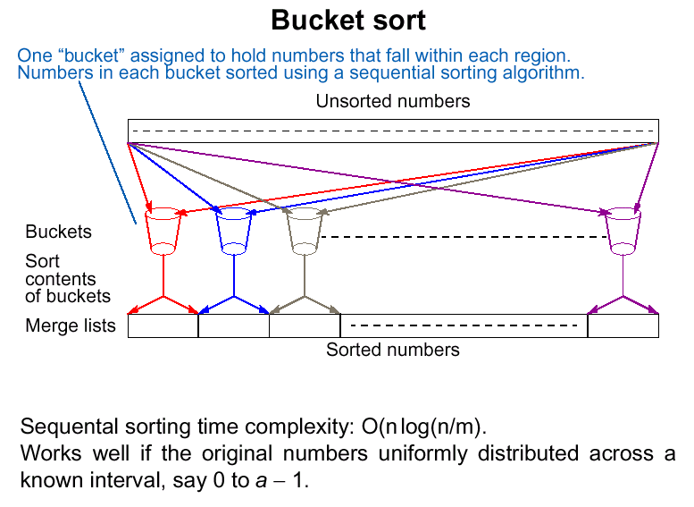
Sequential
m buckets , n numbers
t_{s} = O(n + m((n/m) log (n/m))) = O(n log(n/m))

Slide 19
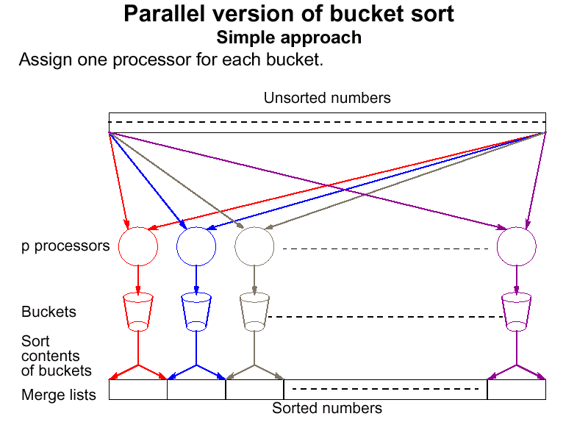
m buckets , n numbers,
p=m processors
t_{p} = O(n + (n/p) log (n/p))

Slide 20
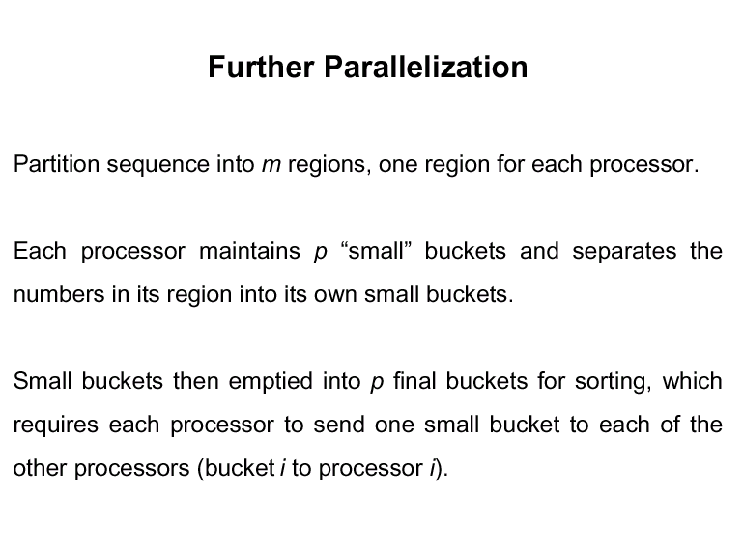

Slide 21
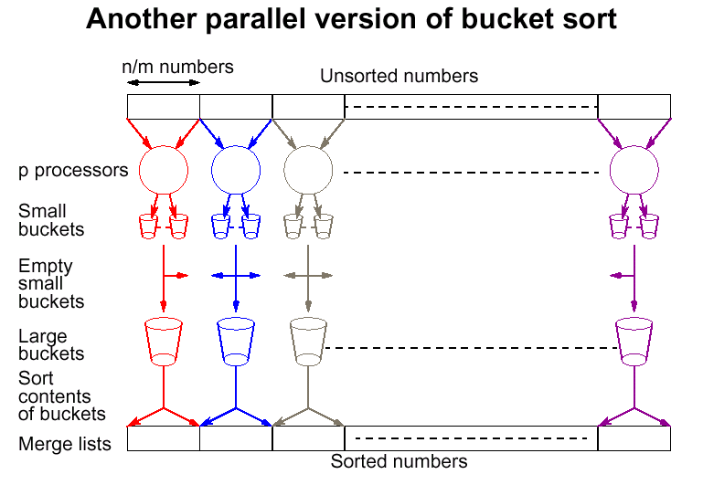
t_{p} = O(n/p + (n/p) log (n/p)) = O( (n/p) log (n/p)) => S=O(p)

Slide 22
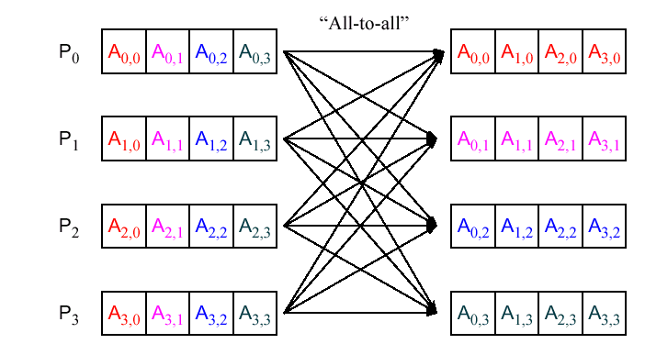

Slide 23
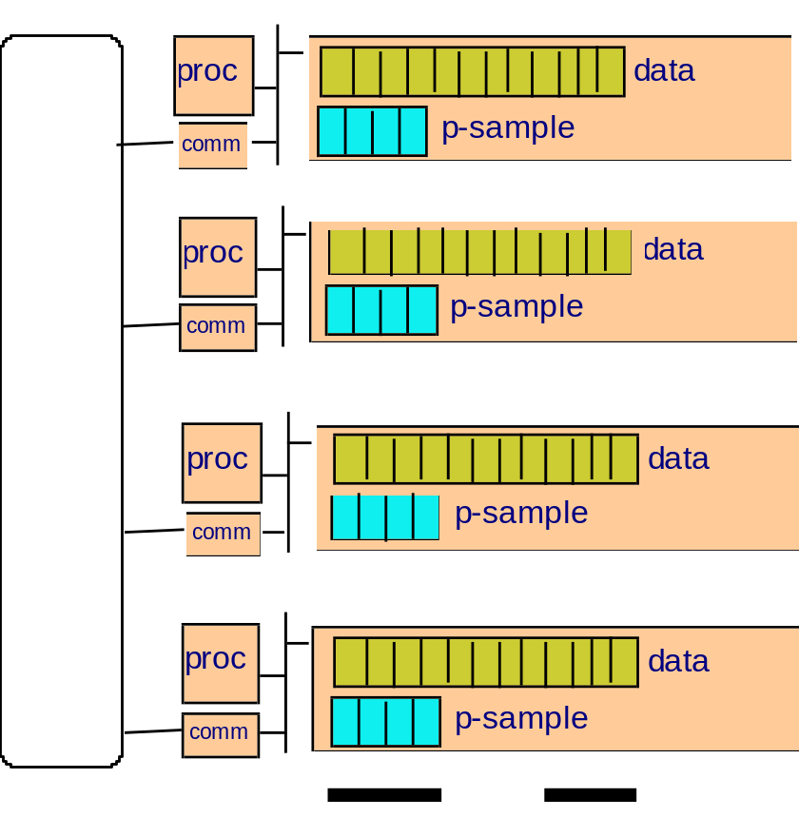
Det. Sample Sort

Slide 24
Det. Sample Sort
sort locally and create p-sample

Slide 25

Det. Sample Sort
send all p-samples to processor 1

Slide 26
Det. Sample Sort
proc.1: sort all received samples and compute global p-sample

Slide 27
Det. Sample Sort
broadcast global p-sample
bucket locally according to global p-sample
send bucket i to proc.i
resort locally

Slide 28
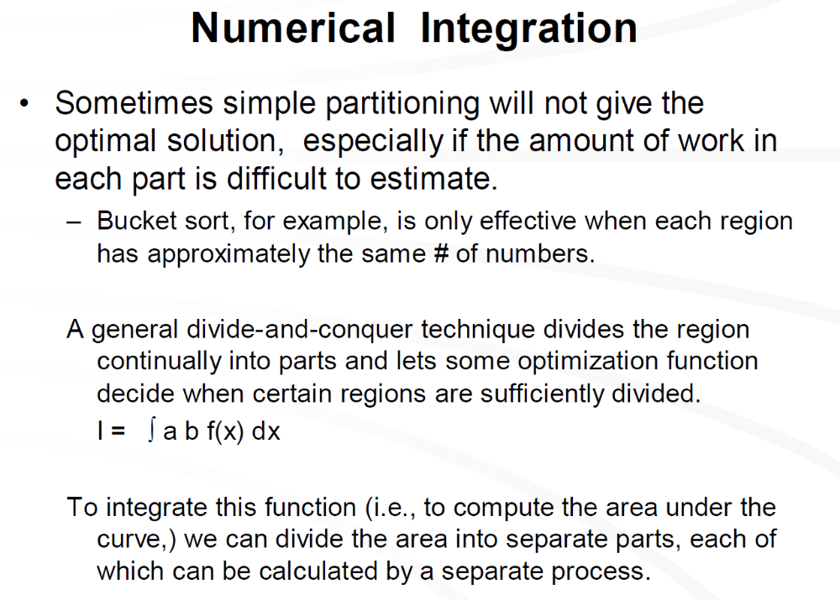

Slide 29
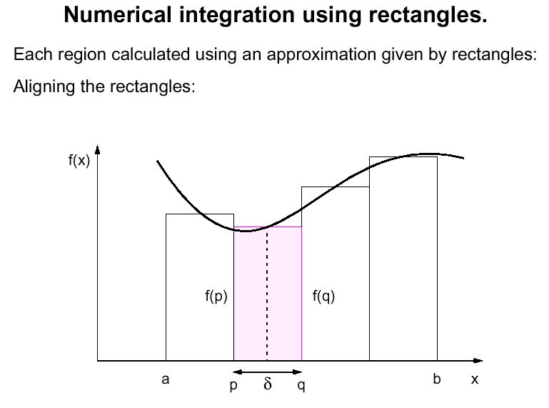
static assignment of processors
to segments of [a,b]
area = δ (f(p)+f(q))/2

Slide 30
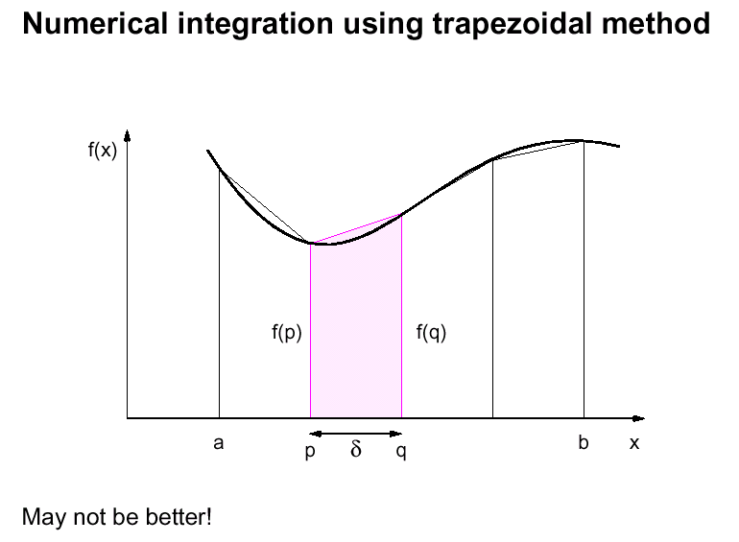
Problem: precision depends on curve’s shape

Slide 31
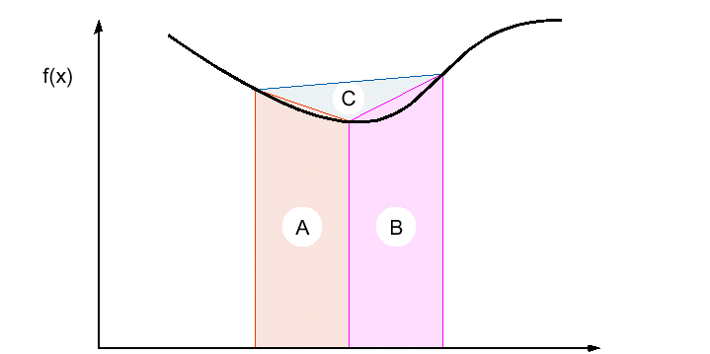
Adaptive Quadrature
Terminate when C is sufficiently small
Problem: different parts of the curve need different resolution

Slide 32
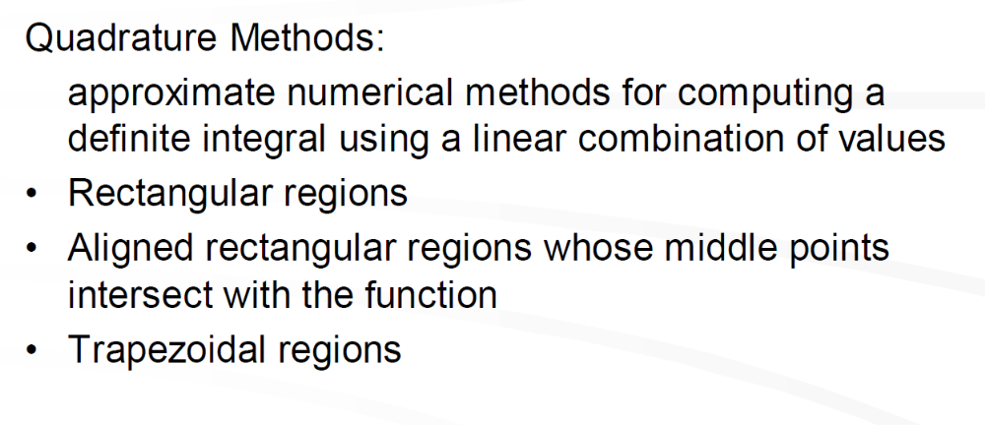

Slide 33
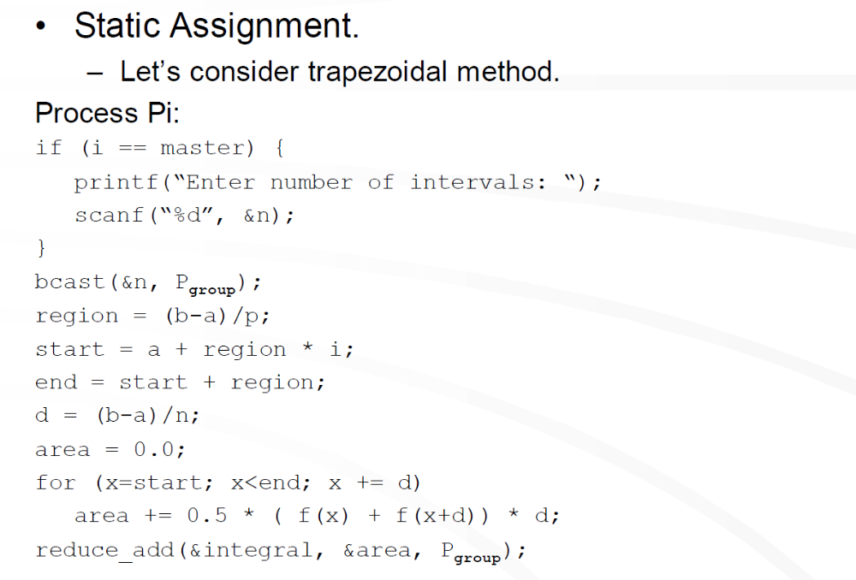

Slide 34
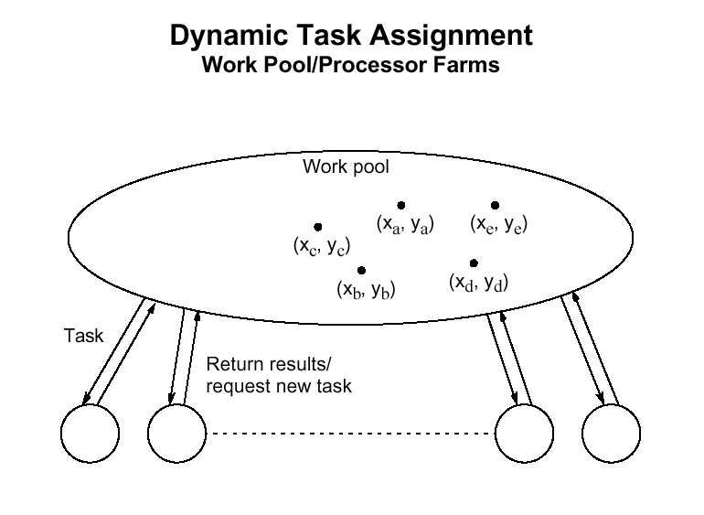
segment 1
segment 3
segment 4
segment 2
segment 5

Slide 35
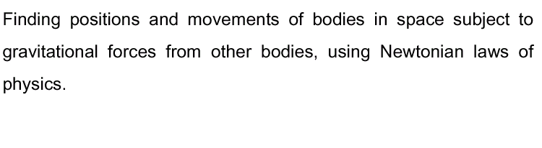
Gravitational N-Body Problem

Slide 36
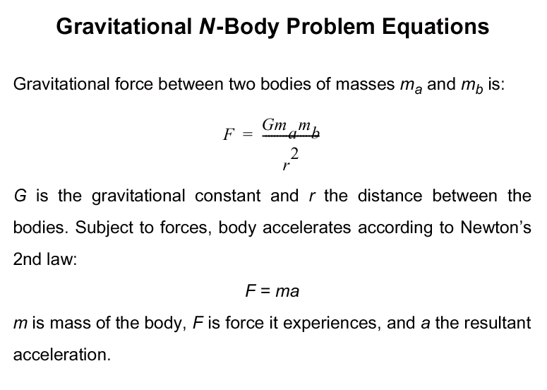

Slide 37
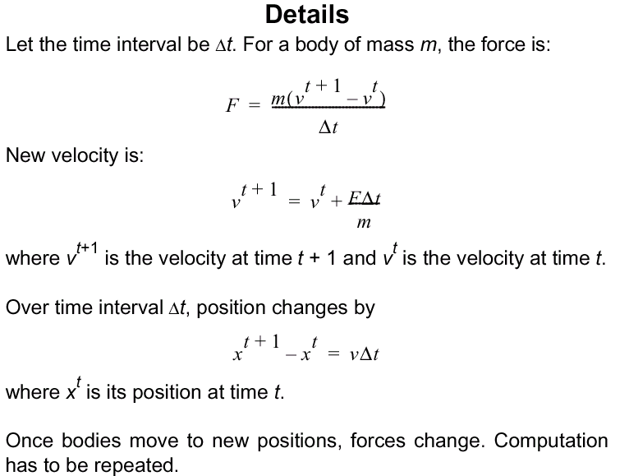

Slide 38
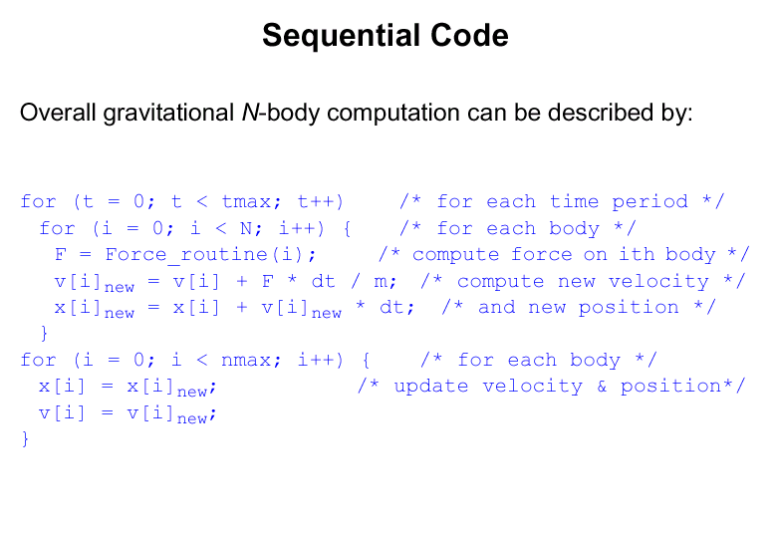
t_{s} = O(n²) per time step

Slide 39
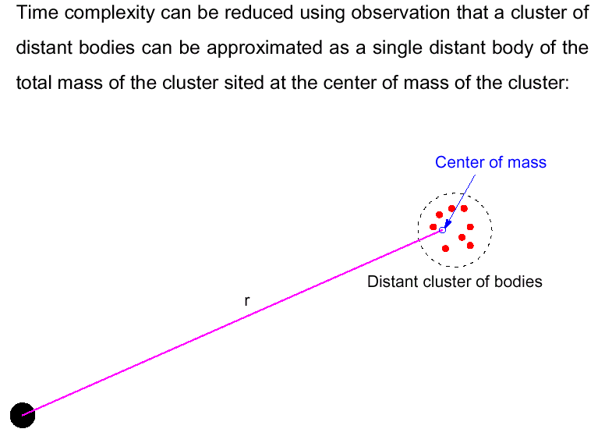

Slide 40
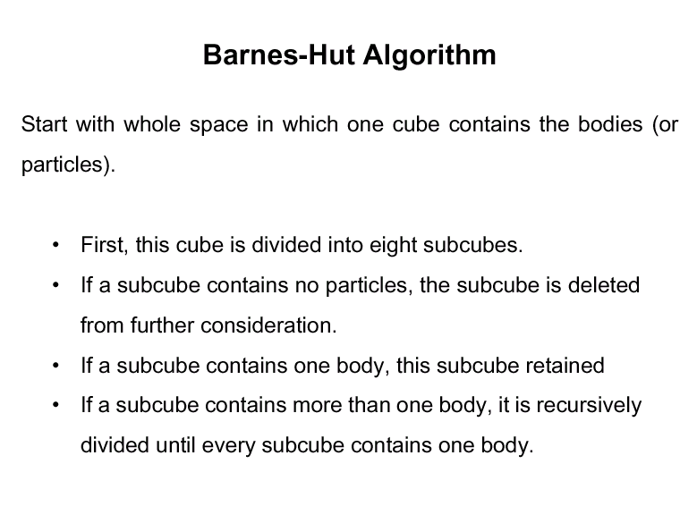

Slide 41
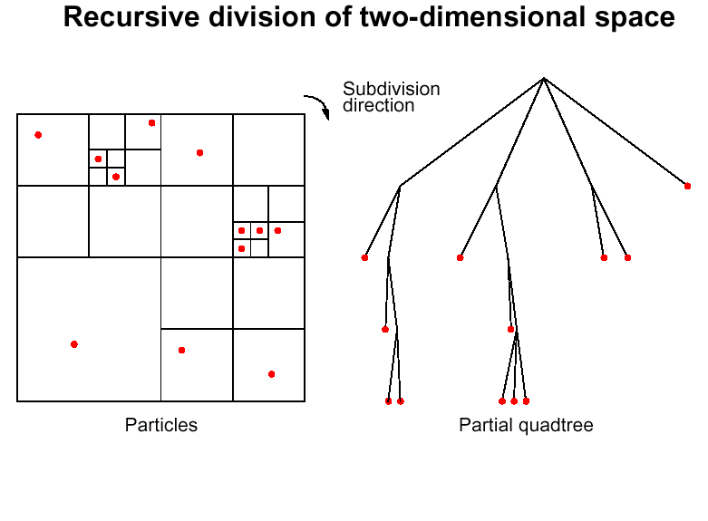

Slide 42
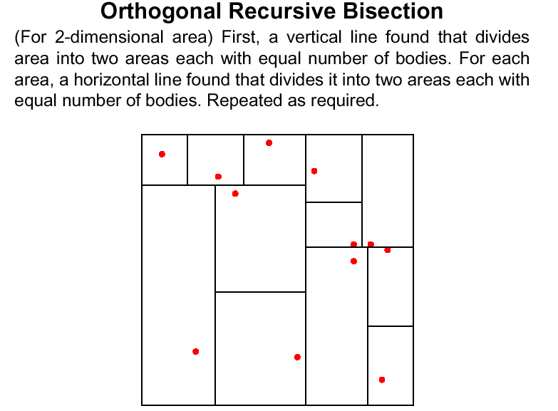

Slide 43
object 1
object 3
object 5
object 2
object 4

