Slide 1


Slide 2
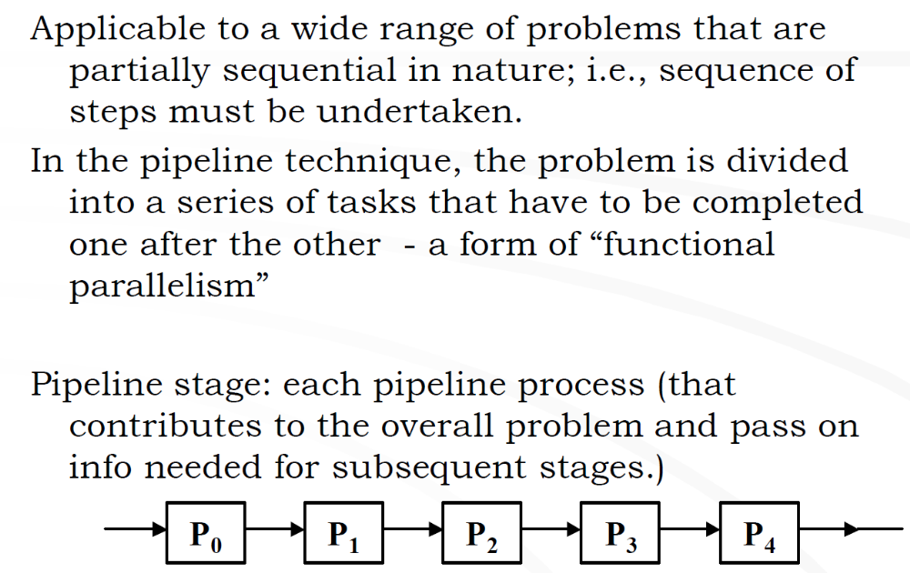
Pipelined computation

Slide 3
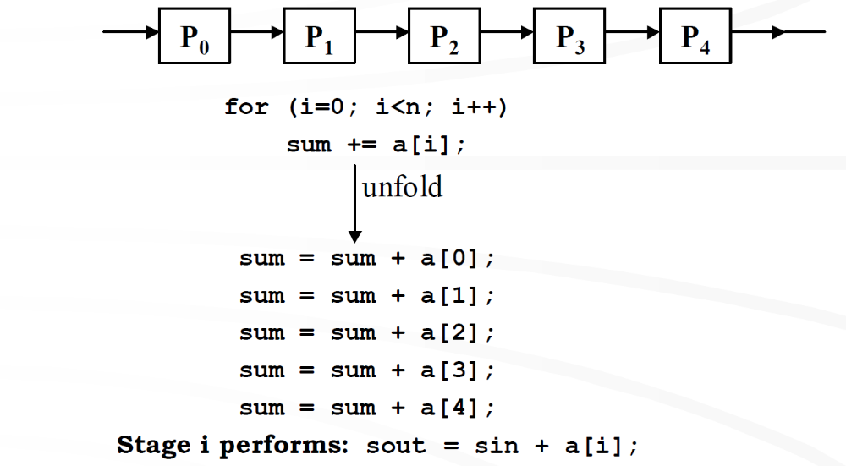

Slide 4
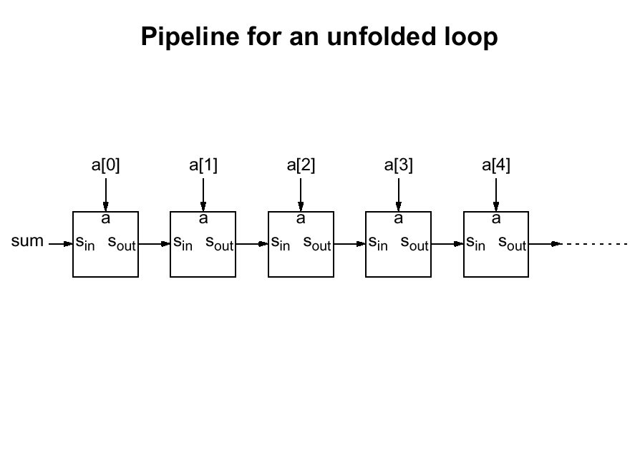

Slide 5
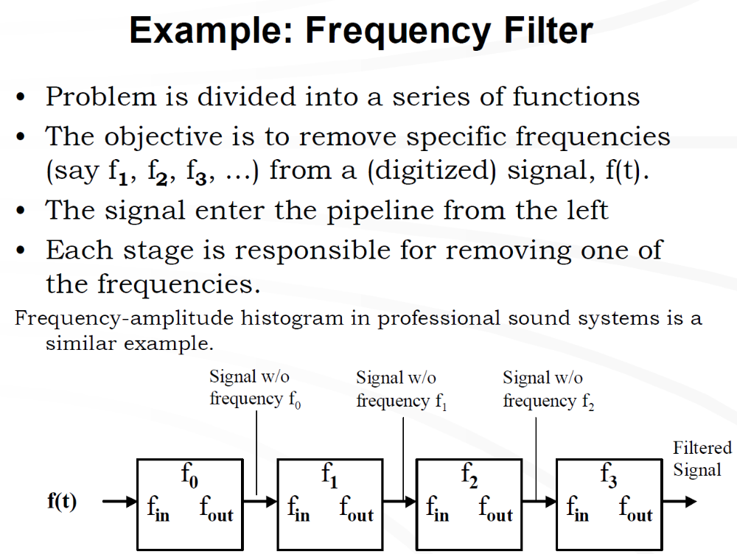

Slide 6
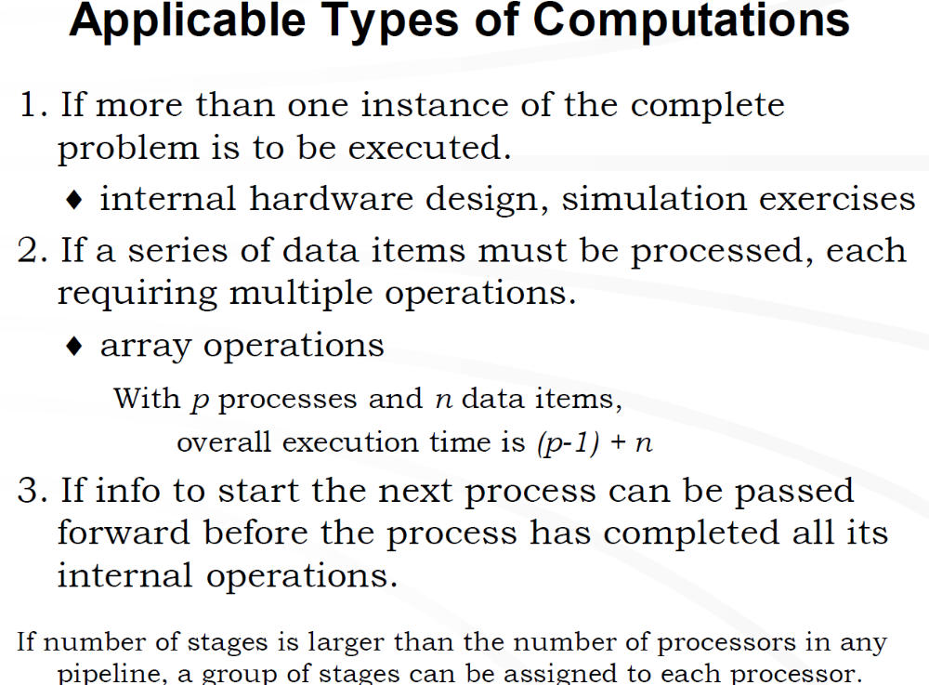

Slide 7
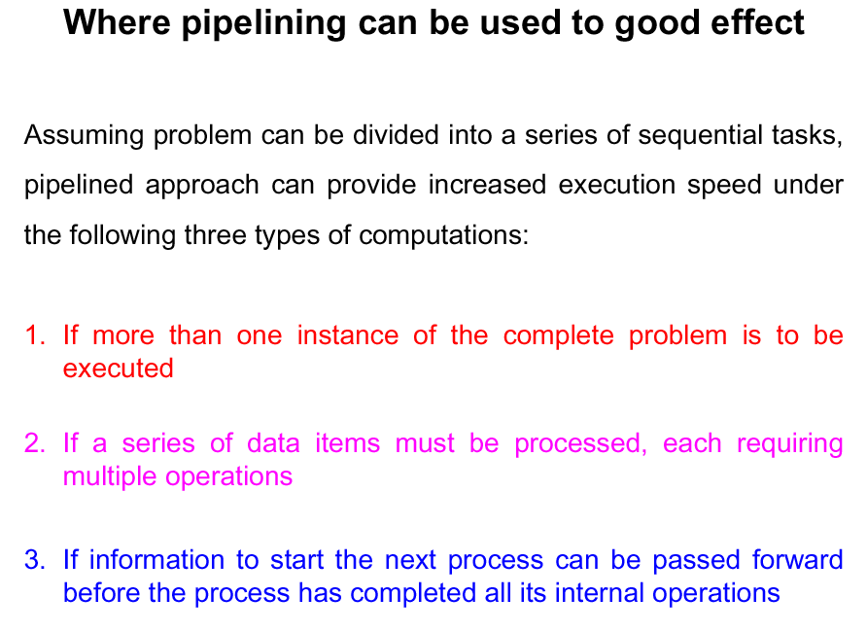
“data stream”
“vector”
“tunnel”

Slide 8
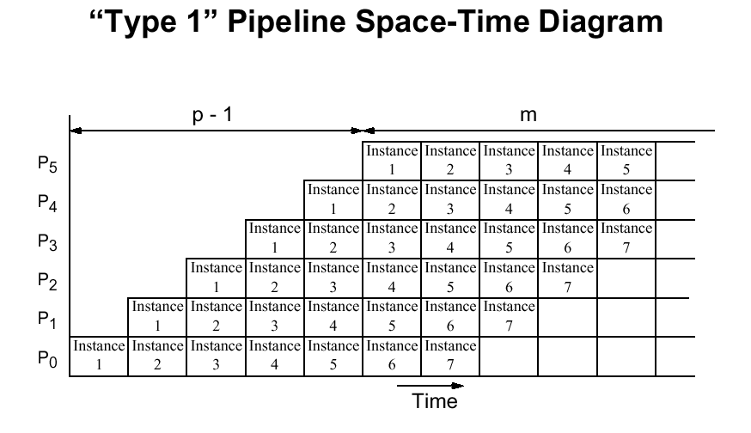
“data stream”
Execution time: p-1+m (For p processors and m instances)
per instance: 1+(p-1)/m -> 1 for large m

Slide 9
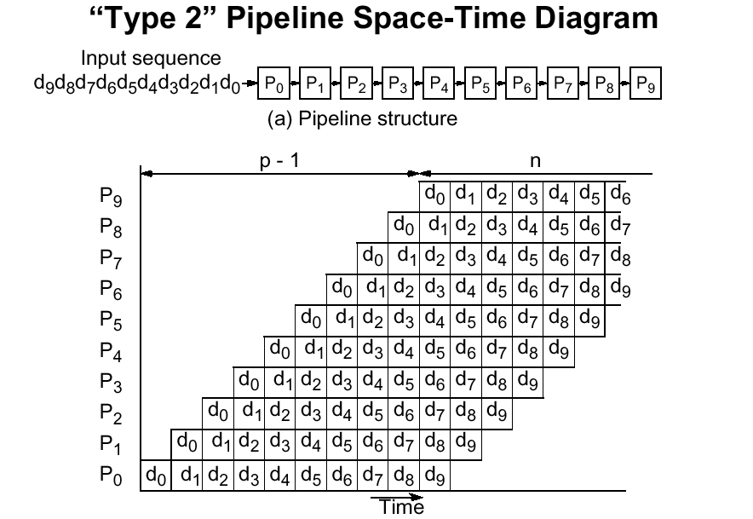
“vector”
Time: p-1+n

Slide 10

Example: Matrix-Vector Product
P0
d0
P1
d1
P2
d2
P3
d3
P4
d4

Slide 11
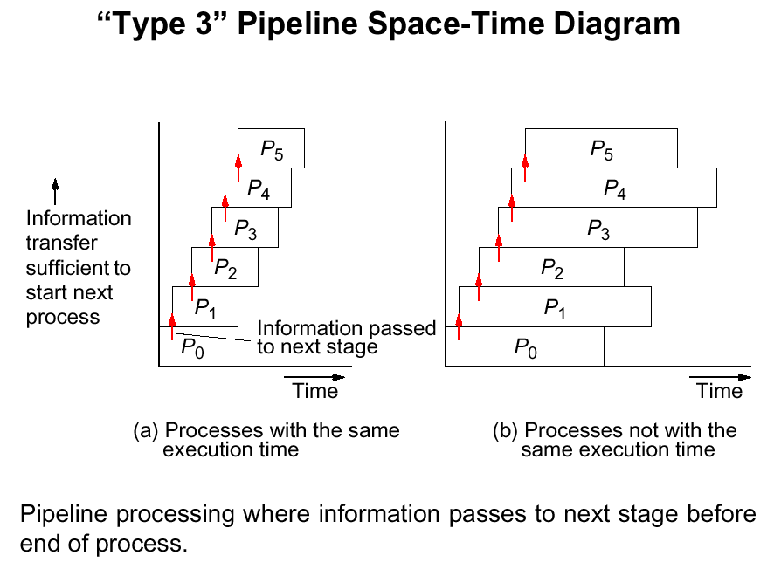
“tunnel”
Example: Graphics Processor

Slide 12
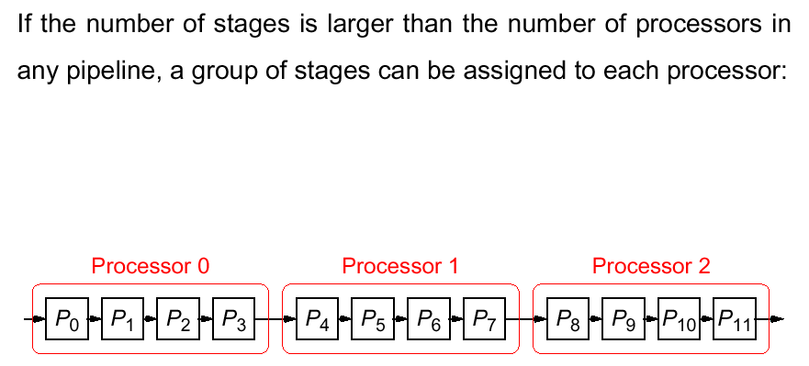

Slide 13
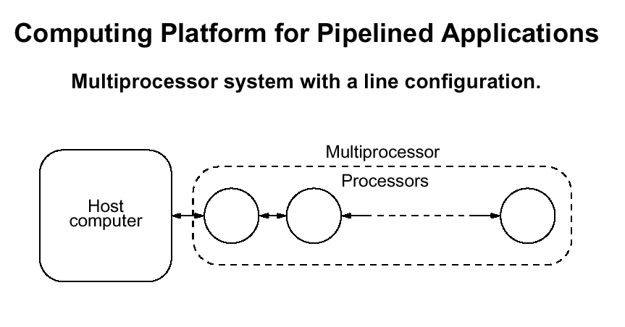

Slide 14
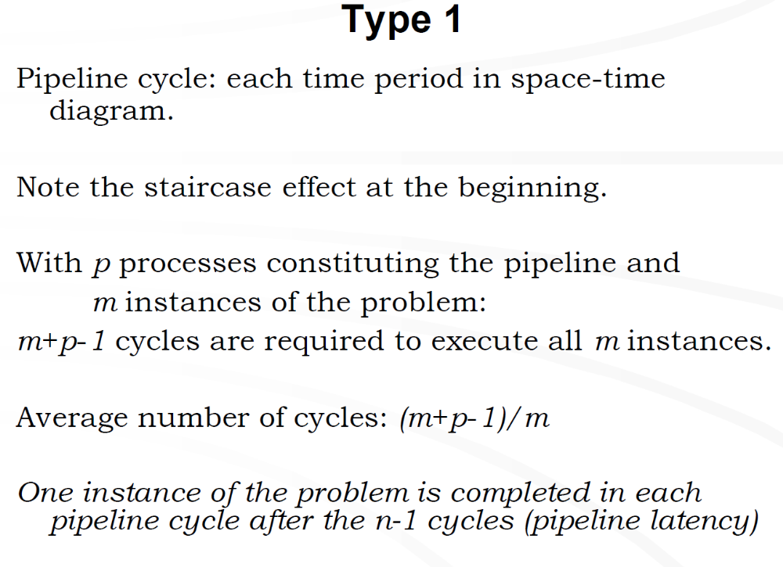

Slide 15
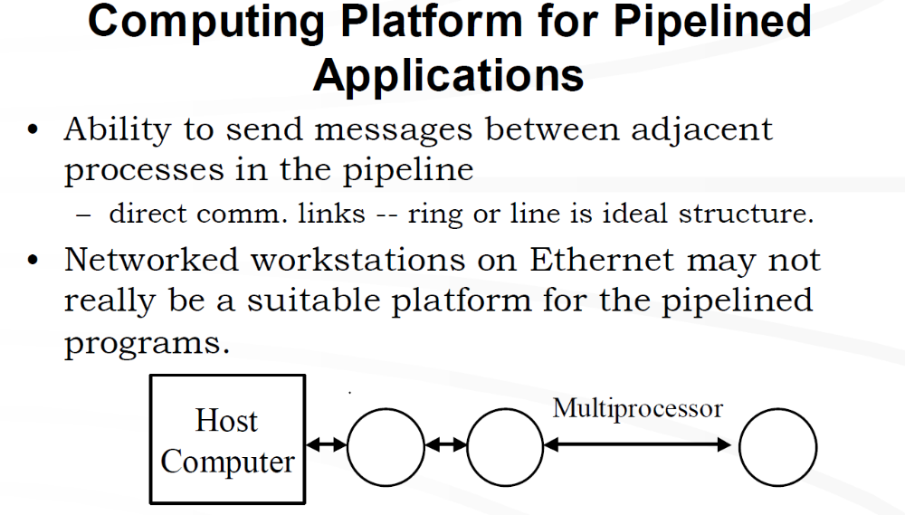

Slide 16
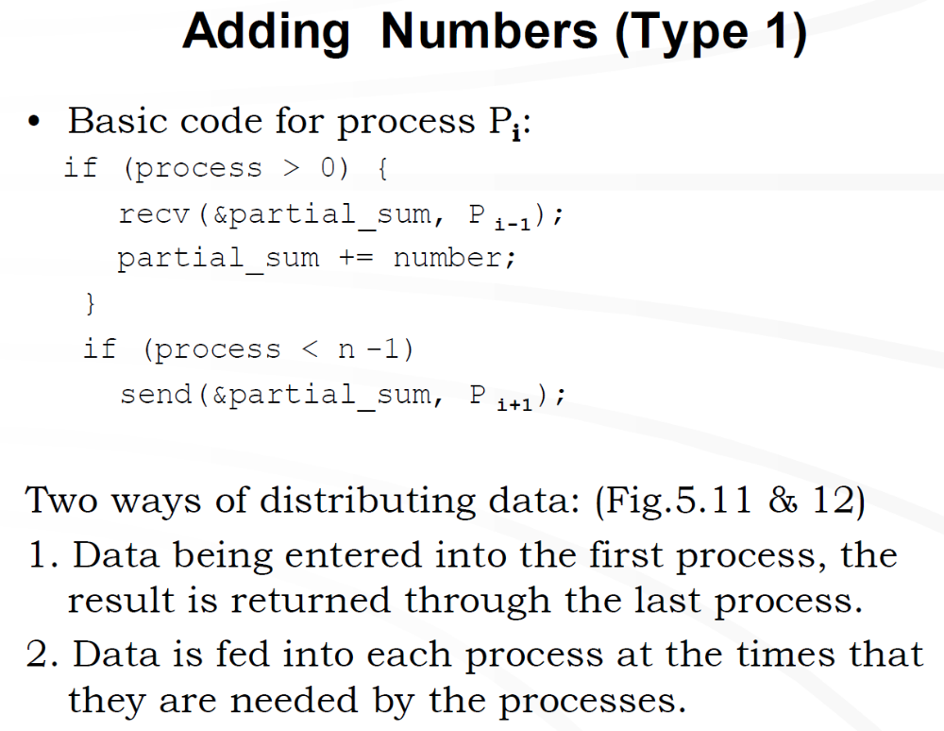

Slide 17
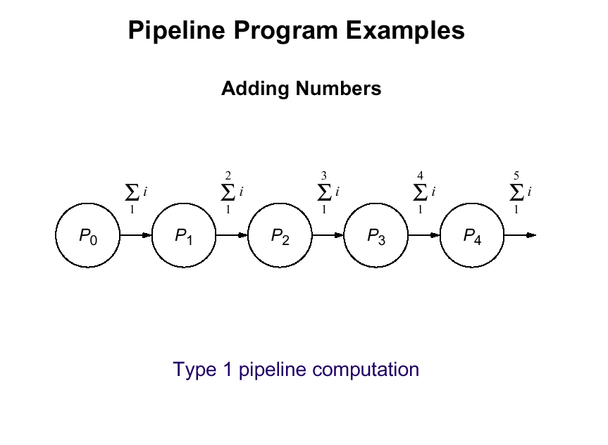

Slide 18
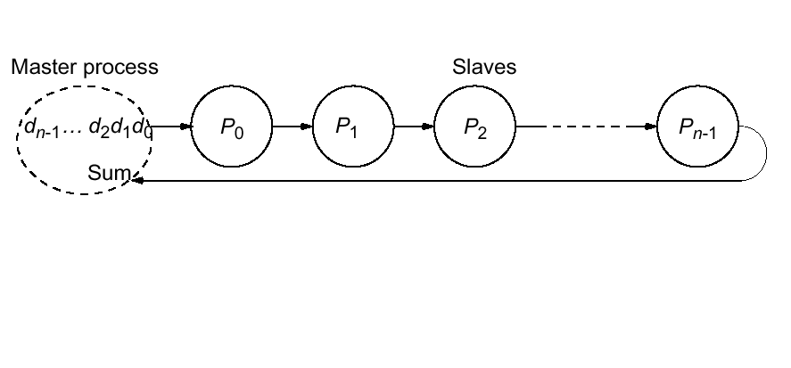
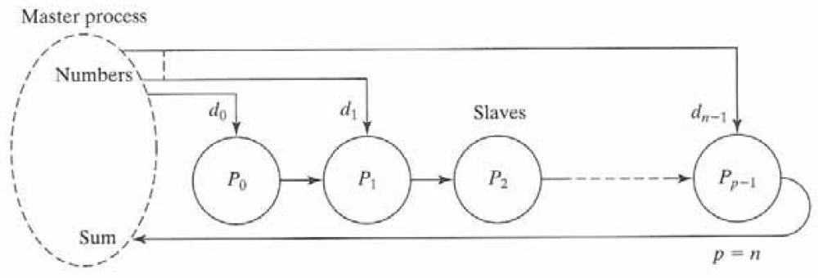
Fig. 5.11
Fig. 5.12

Slide 19
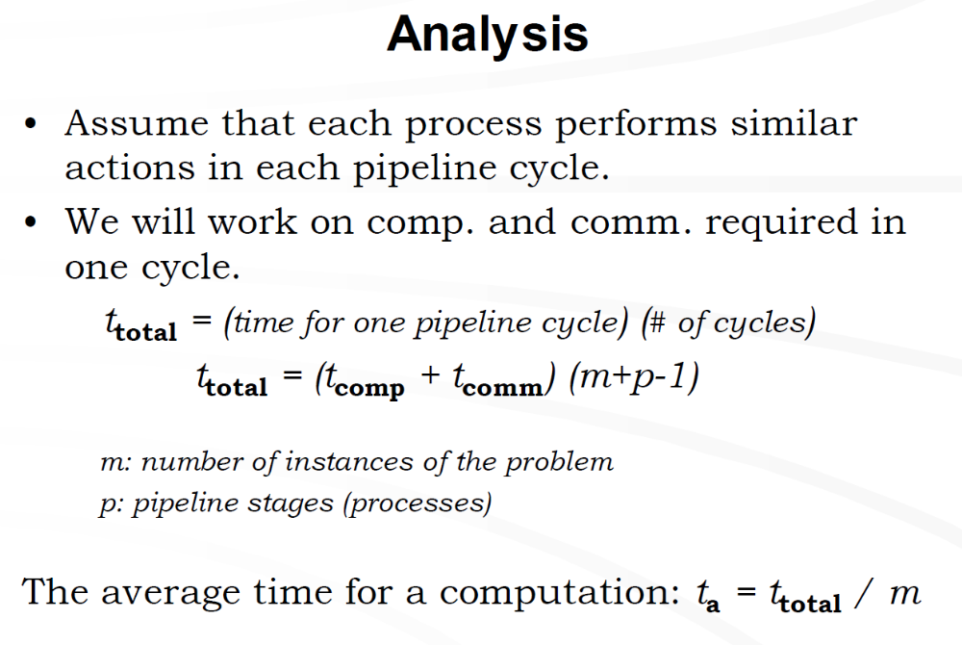

Slide 20
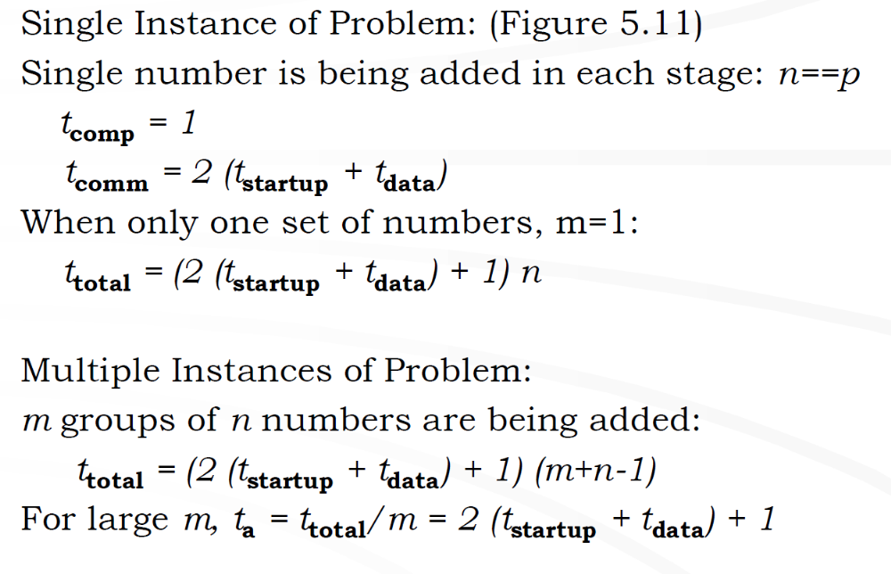

Slide 21
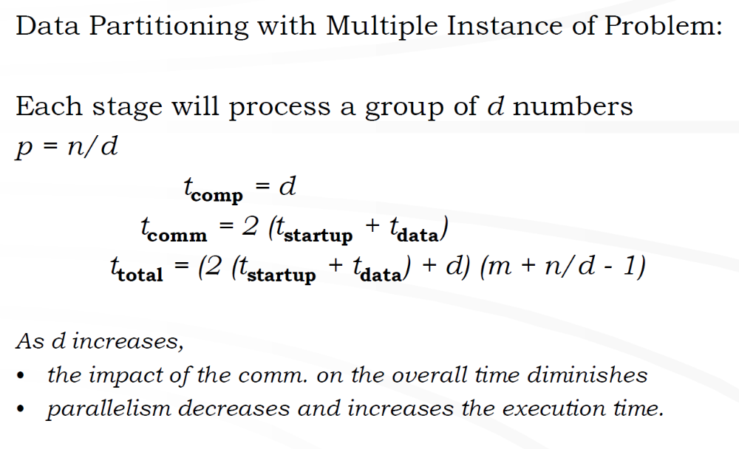

Slide 22
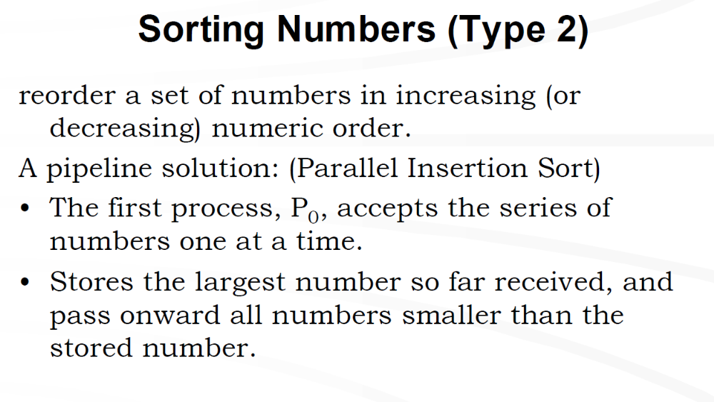

Slide 23
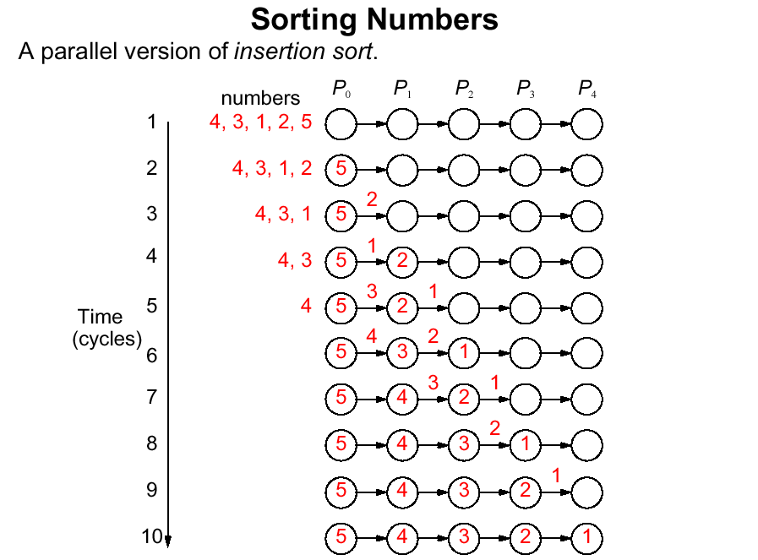

Slide 24
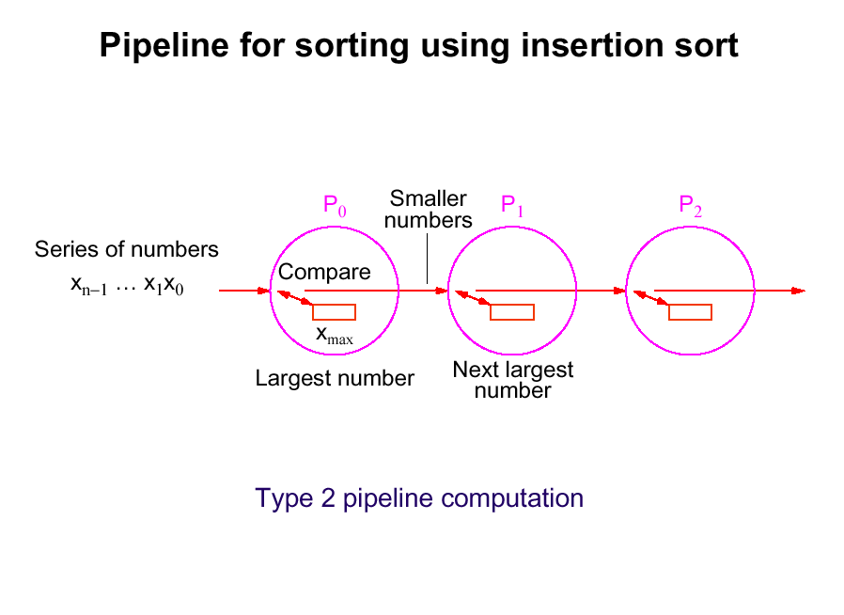

Slide 25
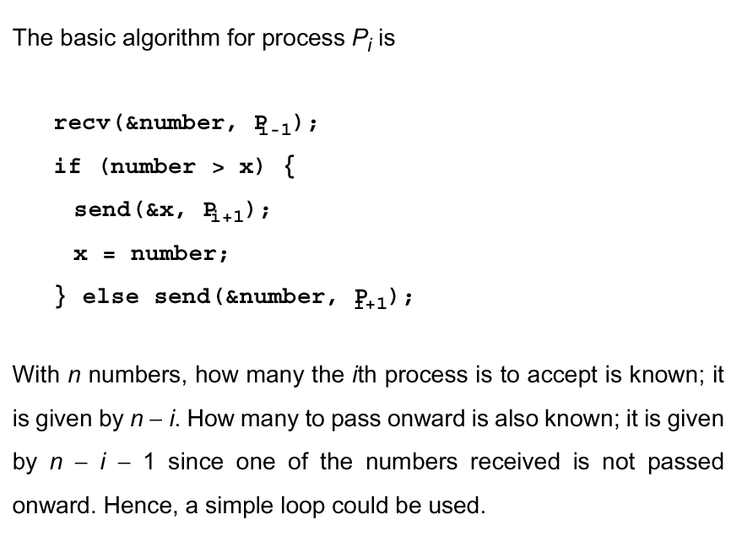

Slide 26
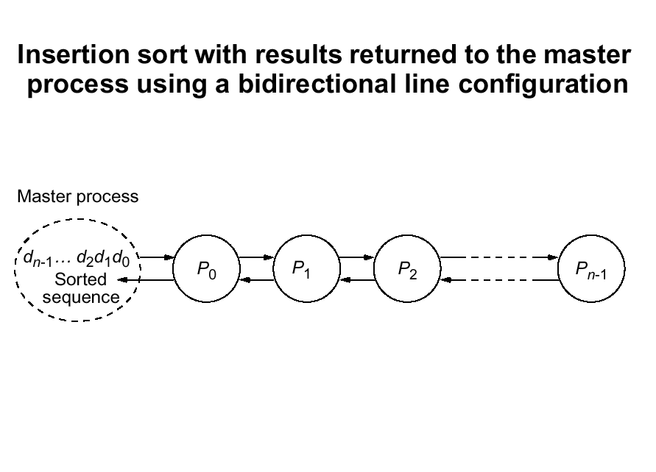

Slide 27
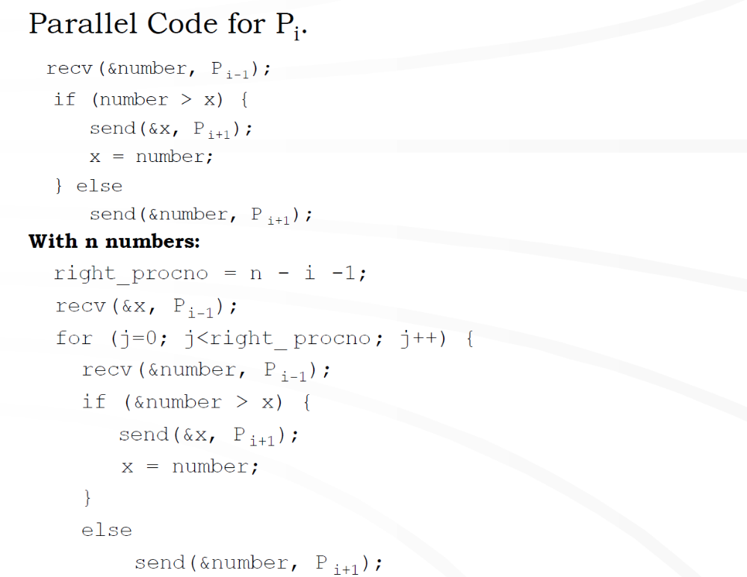

Slide 28
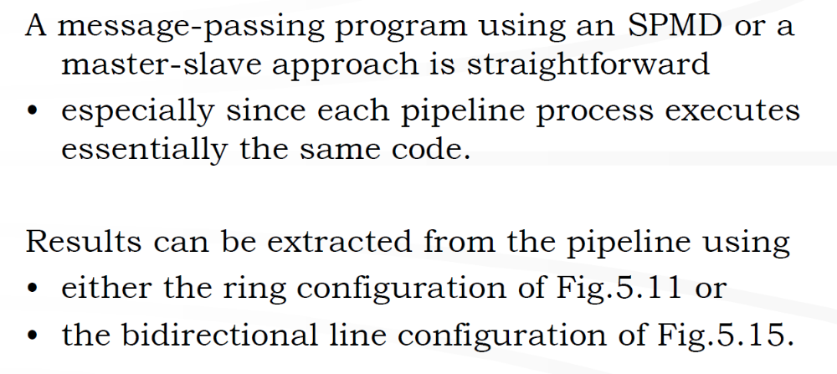

Slide 29
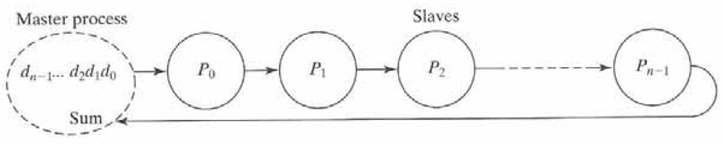
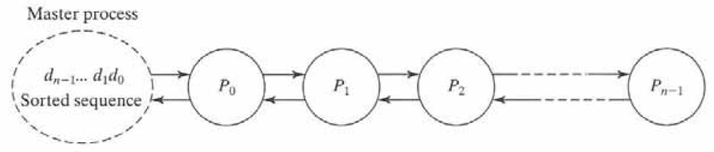
Fig. 5.11
Fig. 5.15

Slide 30
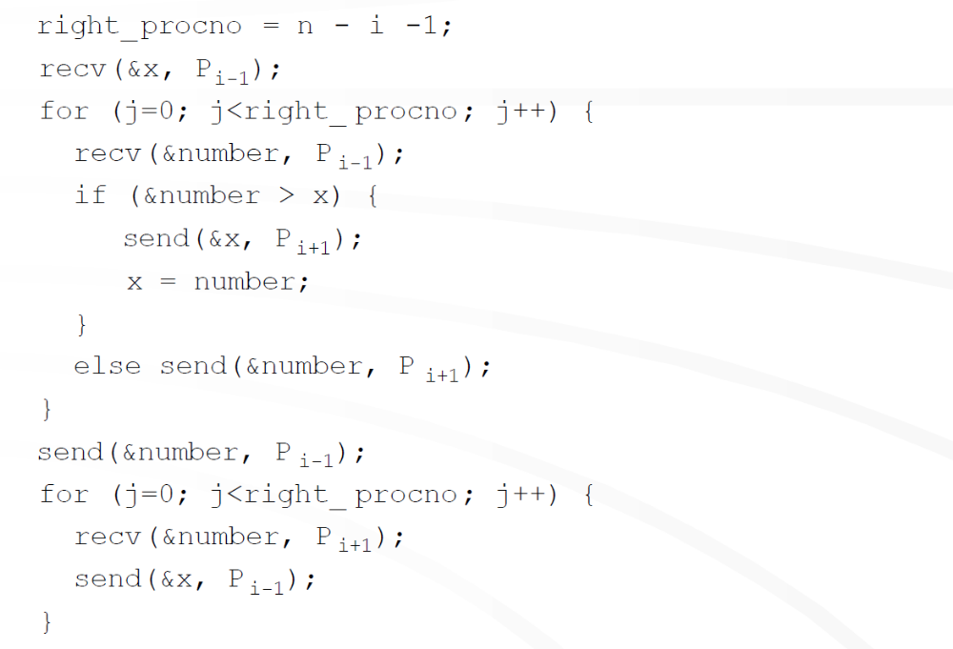

Slide 31
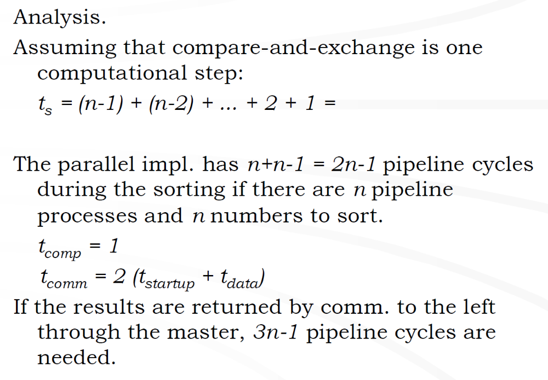

Slide 32
Prime Number Generation
2, 3, 4, 5, 6, 7, 8, 9, 10, 11, 12, 13, 14, 15, 16, 17, 18, 19, 20
To find the primes up to n, it is only necessary to look at
numbers up to sqrt(n).
Sequential Code.
for (i=2; i<n; i++)
prime[i] = 1;
for (i=2; i<= sqrt_n; i++)
if (prime[i] == 1)
for (j=i+i; j<n; j+=i)
prime[j] = 0;
There are [n/2-1] multiples of 2, [n/3-1] multiples of 3, so
on.
Hence, total sequential time is ... with O(n²) complexity

Slide 33
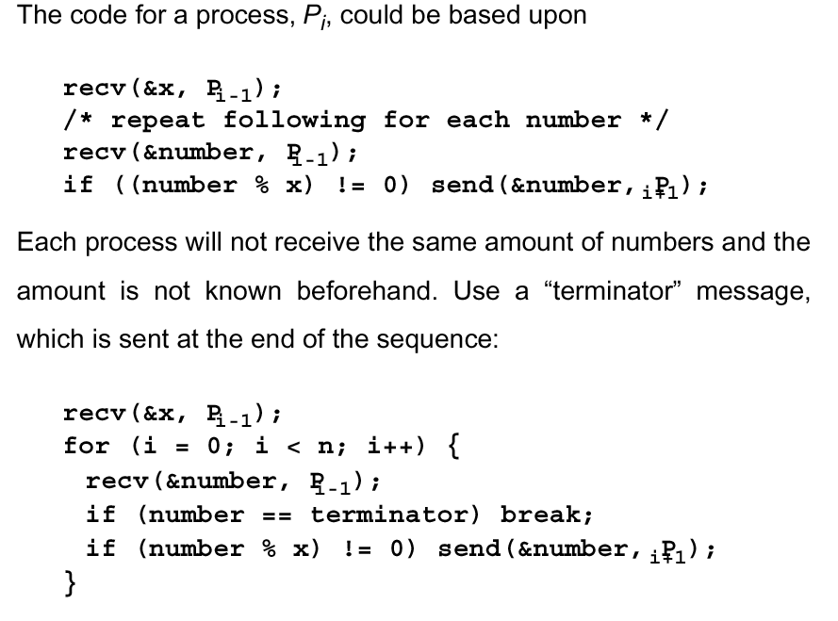

Slide 34
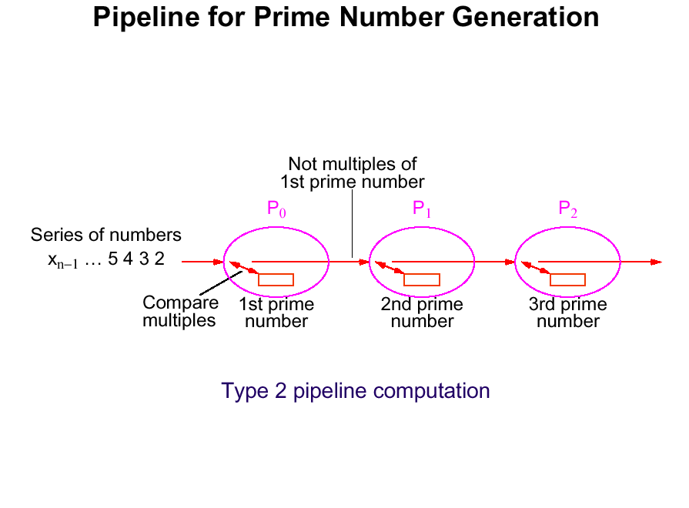

Slide 36
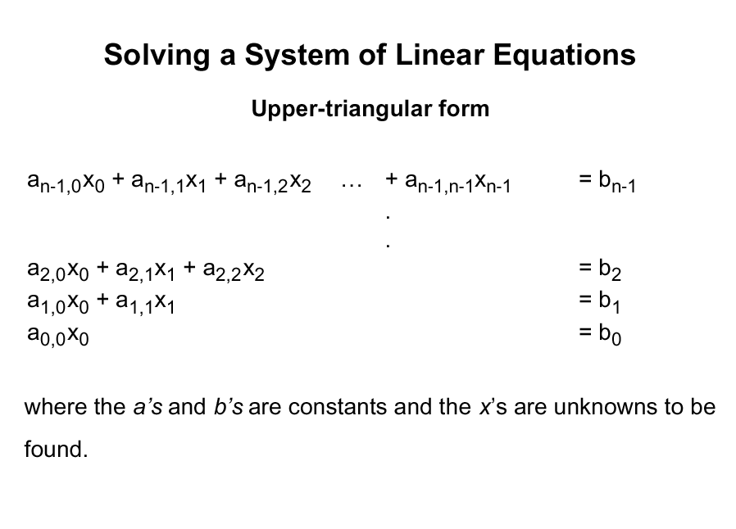

Slide 37
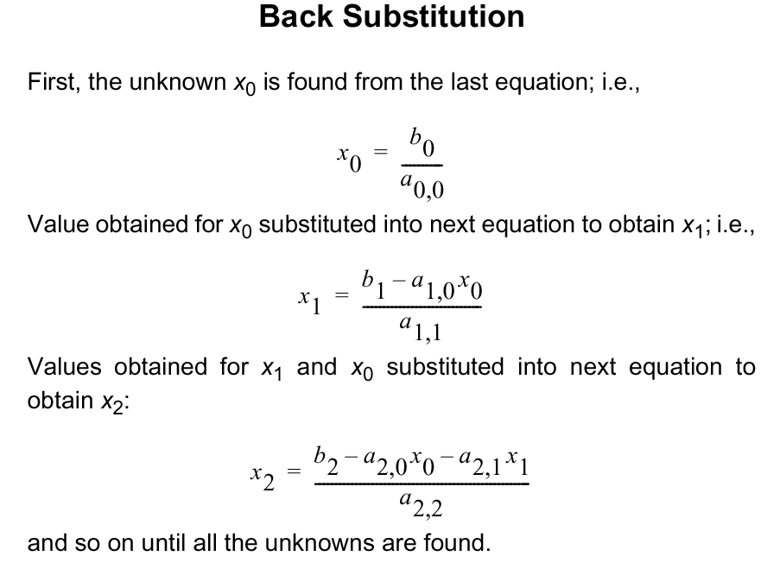

Slide 38
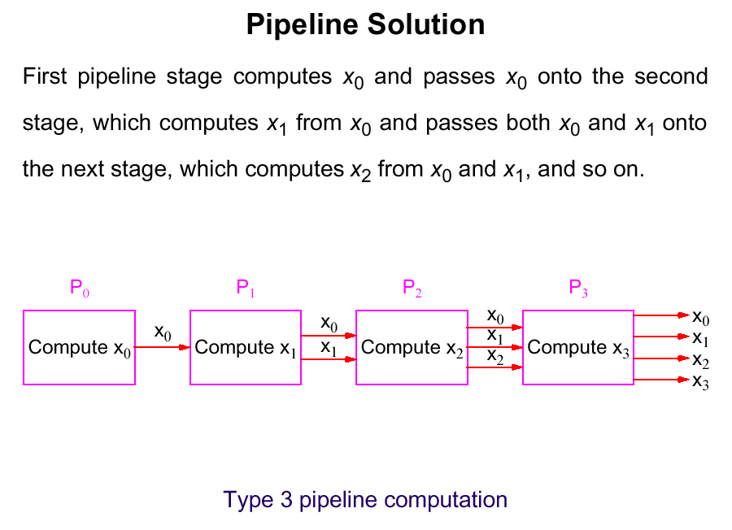

Slide 39
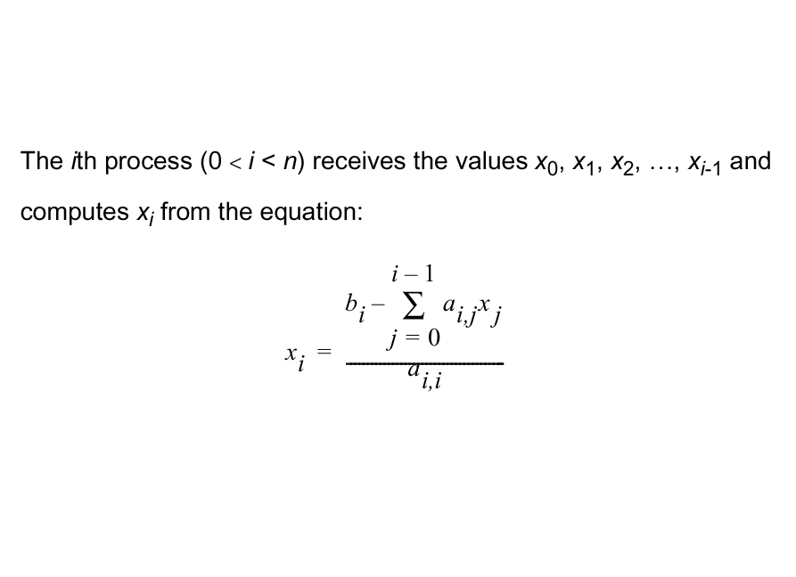

Slide 40
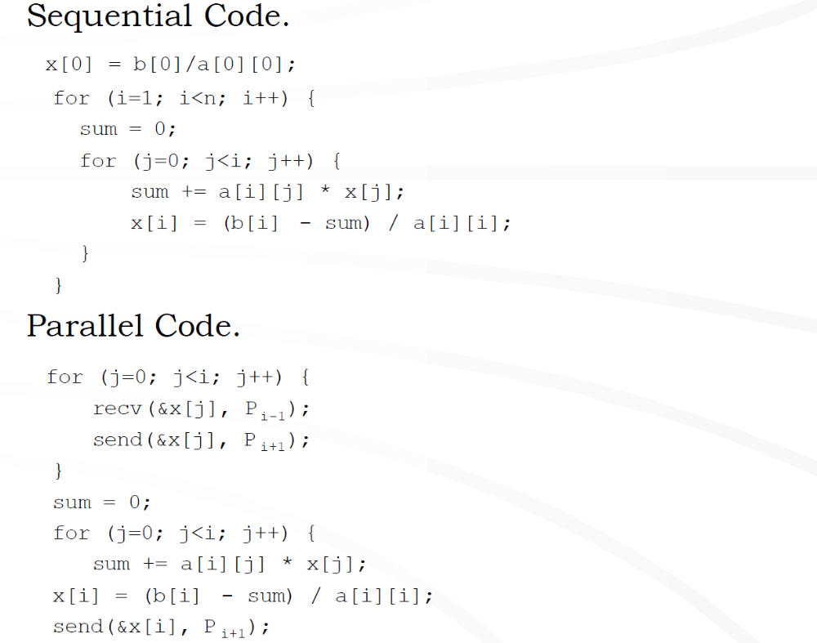

Slide 41
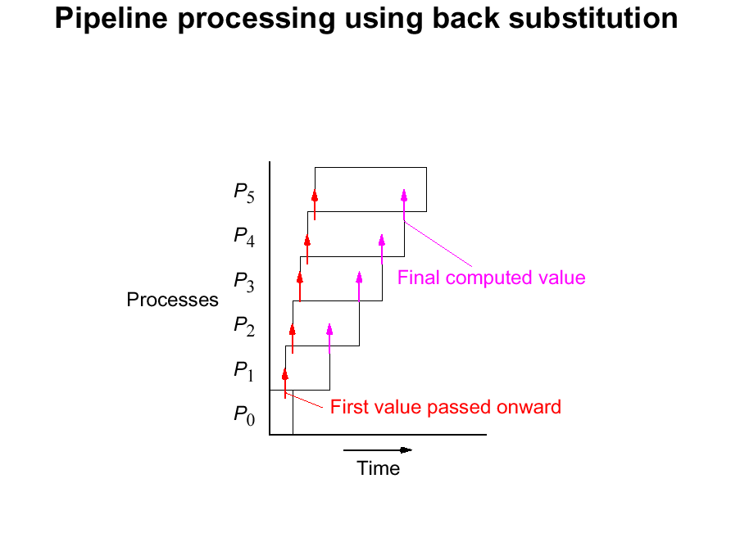

Slide 42
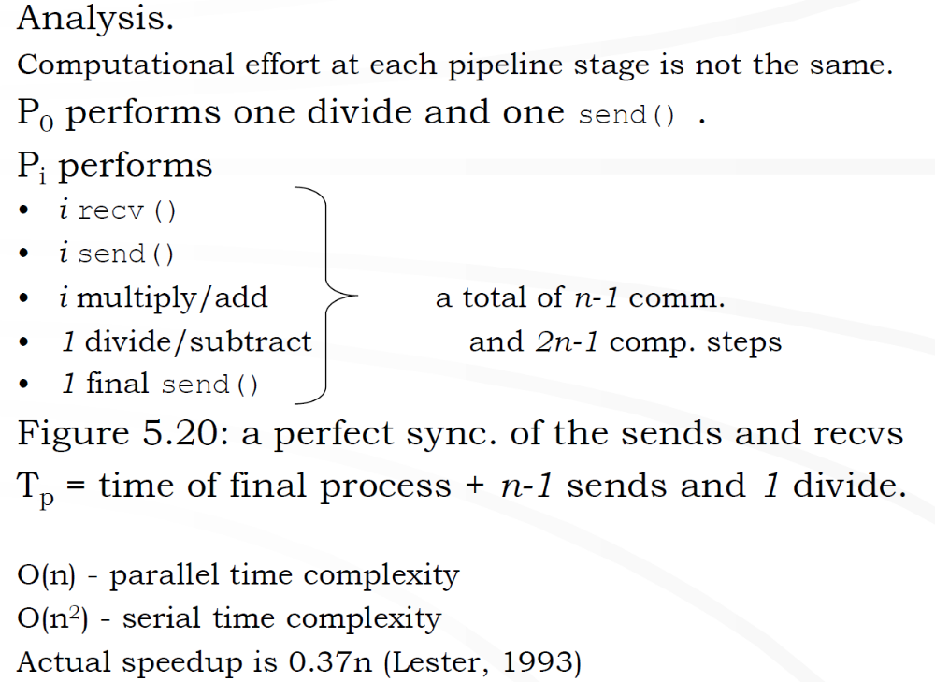

Slide 43
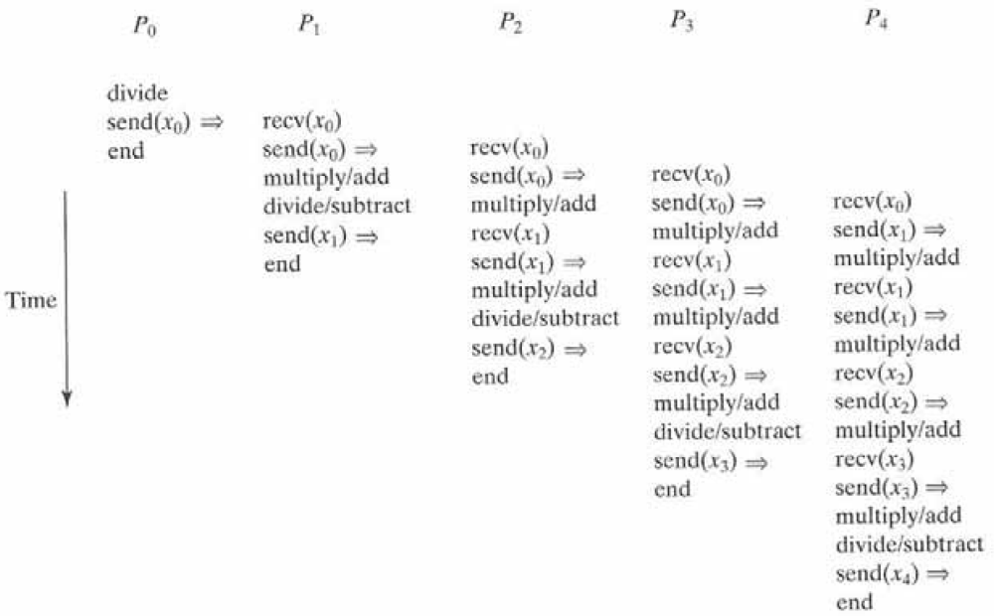

Slide 44
