Slide 1

Exploratory Data Analysis
G2M Case Study
21-05-2024

Slide 2
Introduction
Cab Services is a growing and promising industry due to its steady demand in offering urban transport solution.
With the advancement in technology and careful implementation of a suitable strategy, an investment in the cab industry has a compelling opportunity to achieve profit.
XYZ is a private firm in the US that wishes to flourish its business by investing in the Cab industry.
This presentation is involved in a study about the US market and critically analysed various attributes contributing to the profitable running of the business based on previous statistics.
The study is conducted on data obtained from the Pink and Yellow Cab industry from 2016 to 2018.
Goals
Data Exploration
Find how profit is dependent on attributes (City, gender, age, population etc)
Understand about the habits of people to implement business strategies.
Prediction for future profit
Useful insights for XYZ firm .

Slide 3

Dataset
Dataset
Used four different datasets containing 18 feature points.
Datasets are merged to form a master dataset.
Cab data City Data Customer ID data Transaction ID data Master data
Initial Findings and Assumptions
No null data or missing values found.
No duplicated values were found within the dataset.
Outliers are present within the price for the trip feature, neglected this value as it is independent of other features.
The number of users is considered to calculate the market share of companies.
Profit is evaluated using the price charges and cost of trip features.

Slide 4
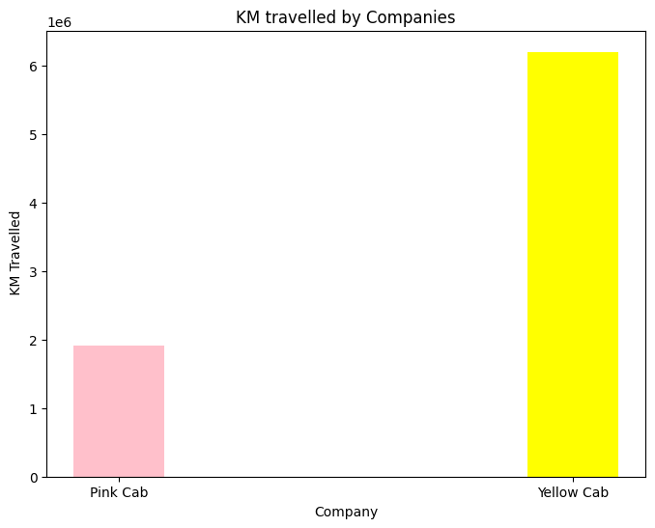
Kilometres Travelled by the Cab Companies

Slide 5
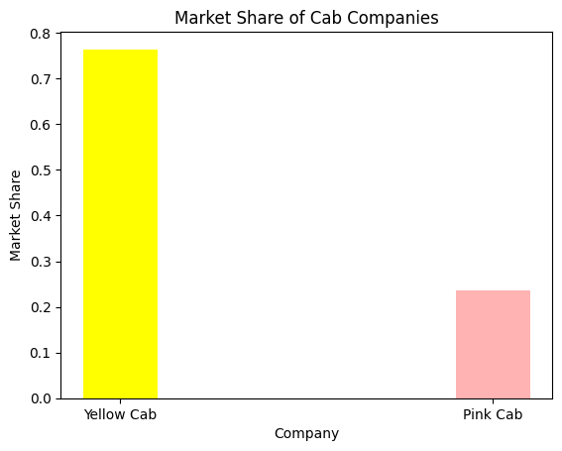
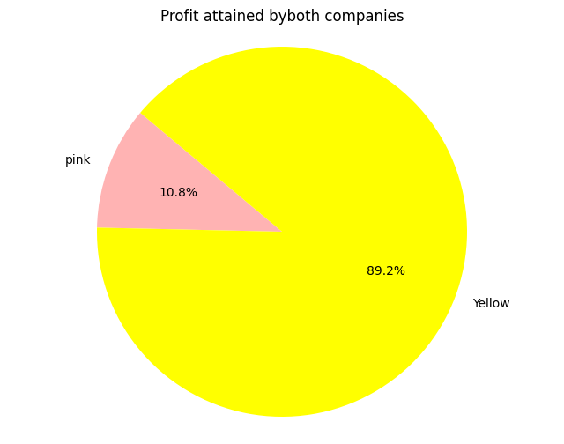
Market Share and Profit Analysis of the Cab Companies
Yellow Cab company attained a higher share in the Industry by 43% in terms of number of rides.
The total profit earned by yellow cab service is immensely high.

Slide 6
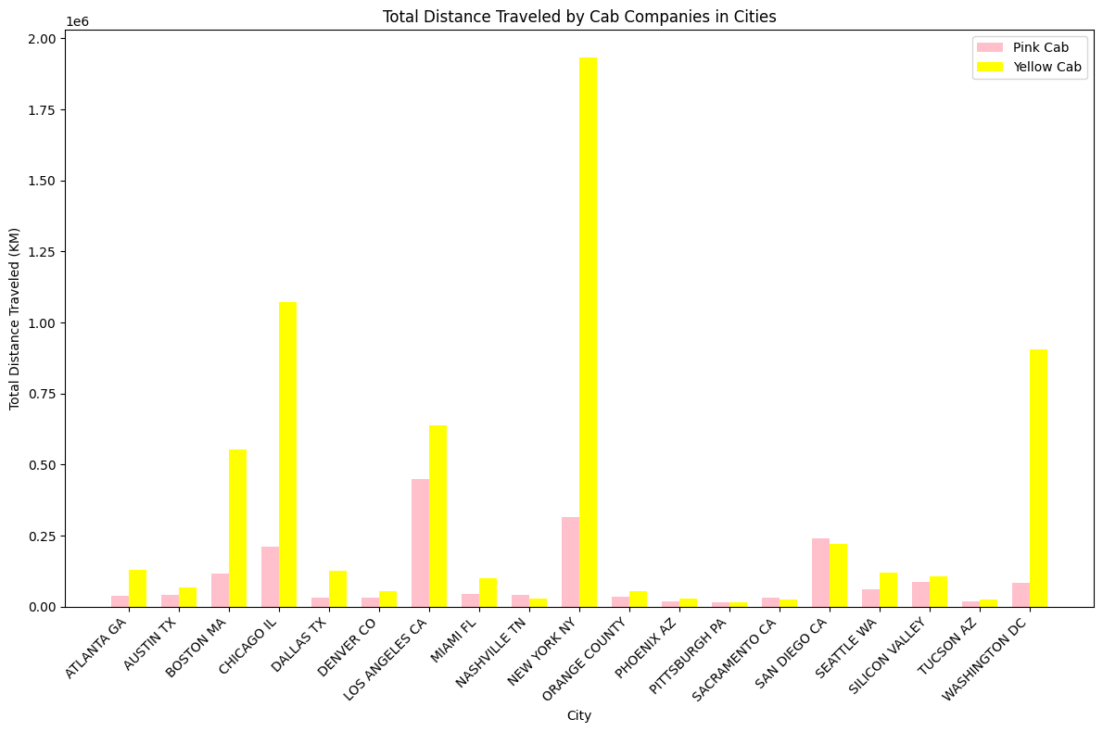
How major US cities dependent on Cab services?
Five major cities that are highly dependent on Cab services
New York
Chicago
Los Angeles
Washington DC
Boston
Within the 19 cities, pink cab services are dominated over Yellow only at Santiago and Sacramento
Yellow Cab is highly preferred and offers its services in highly populated cities like New York, Washington, and Chicago.

Slide 7
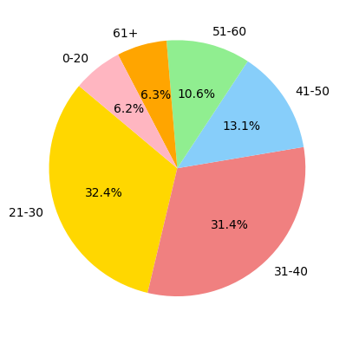
How are Age related to the Cab preferences?
People aged between 21- 40 mainly prefer the services.
The Cab preference of people aged between 51 and 65 is poor. This indicates they are more dependent on public transport since it is free for senior citizens.

Slide 8
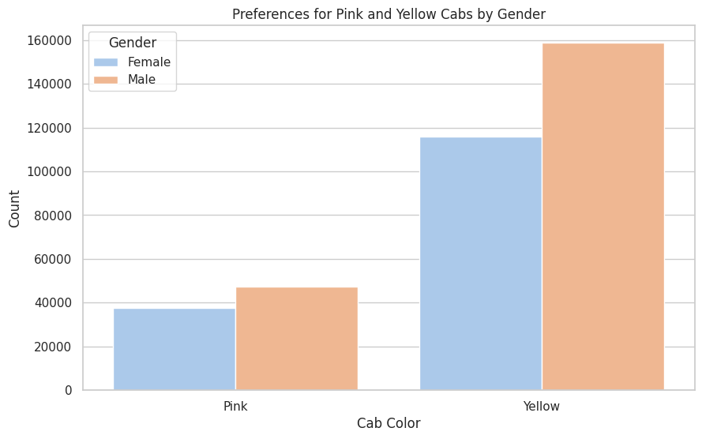
How are Gender related to the Cab preferences?
Males are more dependent on cab services rather than females. It may be because of
Work Travel: Men travel more for work.
Safety: Women avoid cabs due to safety concerns.
Income: Men have more disposable income.
Social Norms: Men travel alone more.
Convenience: Men prefer cabs over public transit.
Most of them prefer yellow cab over the pink service

Slide 9
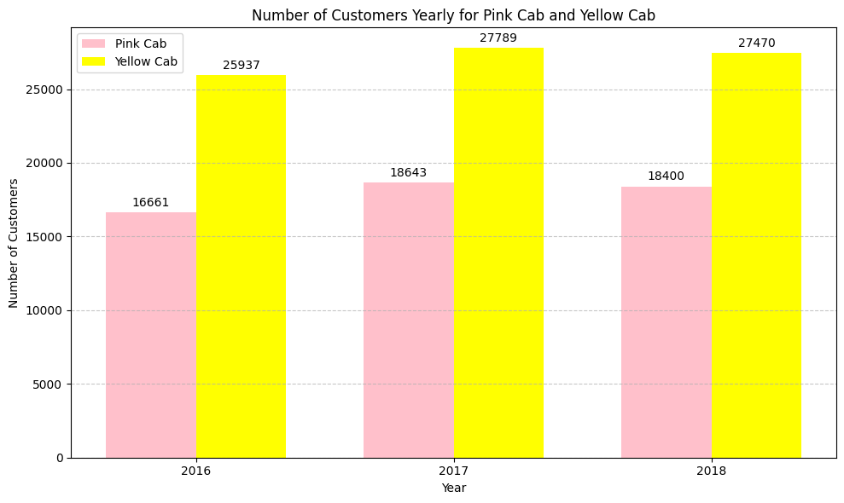
Which company has the maximum number of cab users at a particular period?

Slide 10
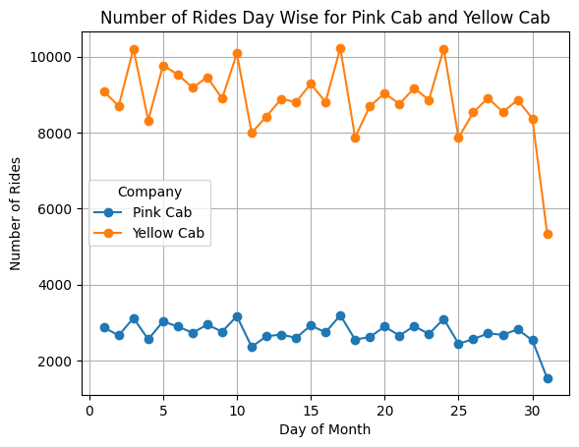
An overall analysis of how cabs are preferred on different days of a moth
Cabs are utilised the most during the middle of every month
Pattern indicates there is less demand during the end and beginning of every month

Slide 11
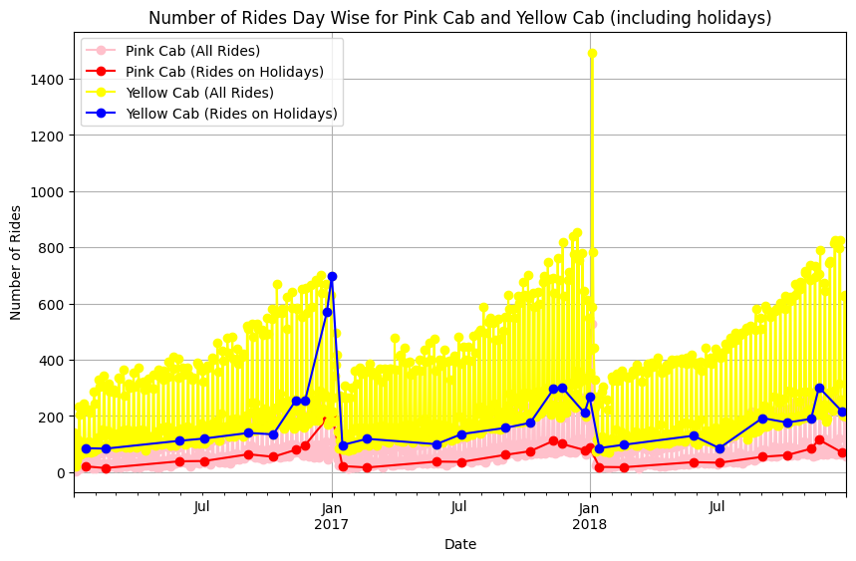
How customers prefer the service during holidays ?
Service used in holidays except Christmas and Thanksgiving days is much lower than other working days. It indicates people prefer to spend holidays at home.

Slide 12
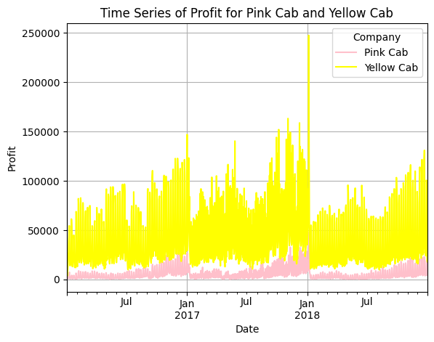
Time series Analysis of Profit
Profit is high for Yellow Cab
It has an increasing pattern towards the end of every year

Slide 13
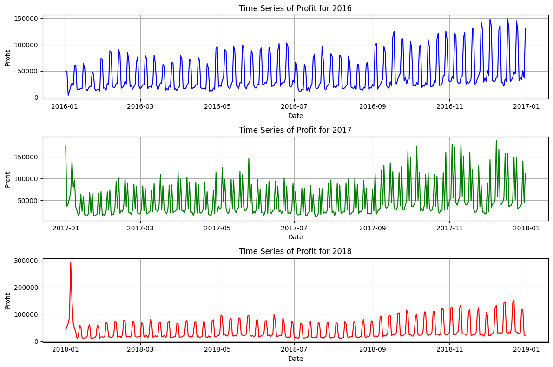
Time series analysis of total profit from both the industries in every year
Combining each analysis, the cab industry is a safe business area to invest in. No sudden drop in income was observed during the year 2016-2018.
The total profit over each year has an increasing patten

Slide 14
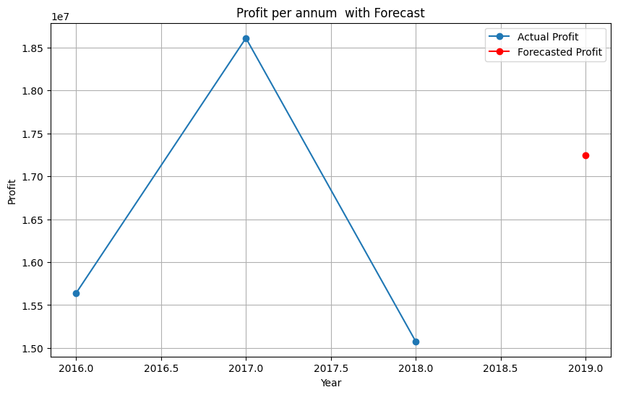
ARIMA model forecast on profit for year 2019
Forecasted Profit for the Next Year: 17247612.1552456

Slide 15
Inference
Yellow Cab is running with higher profit in cities than Pink. It travelled a distance 3 times higher than the Pink.
Major market share is possessed by Yellow Cabs.
Yellow Cab concentrates more on major populated cities by offering more services.
No: of males taking the rides is more than that of females.
People aged between 21 – 40 prefer more services.
No: of customers using a pink cab is 1.5 times less than Yellow cab customers.
people choose more rides during the middle of every month and the count diminishes towards the end. This could indicate the spending habits of people.
Pink has a relatively lower profit than yellow and the profit has an increasing trend towards the end of every year.
A forecast on the profit for the year 2019, is expected to have a higher profit by the end of 2019 in the Cab industry, by an amount of 17247612.15 USD estimated.

Slide 16
Recommendations
Investment in the Yellow Cab industry would be more profitable.
Using the current Yellow cab policy it is estimated to achieve a high profit in year 2019. The appropriate change in the strategy could have room for enhancing more profit.
Improve the quality of the ride by ensuring more safety.
Provide discounts for frequent users and referral bonuses.
Provide easy ways for users to give feedback and act on it.
Offer carpooling options to reduce costs.
Ensure sufficient cabs are available during peak hours.
Ensure the vehicles are well-maintained and comfortable

Slide 17


Thank You

