Slide 1

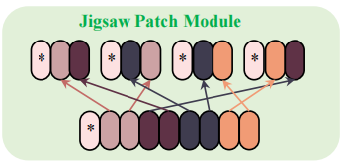
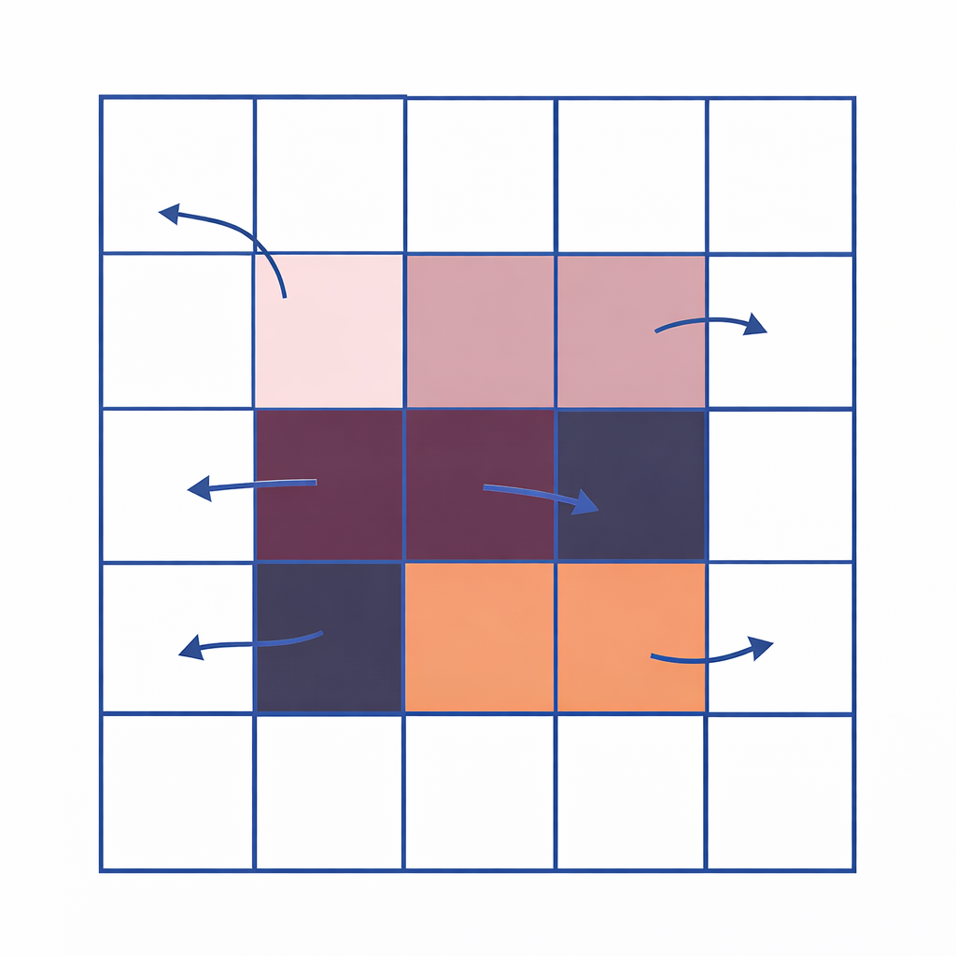
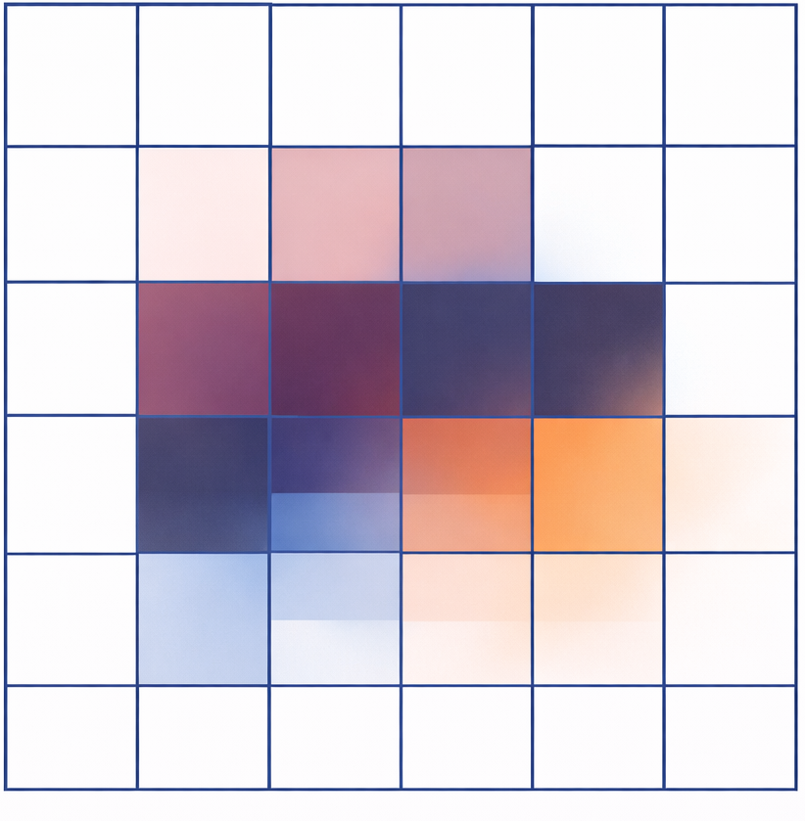

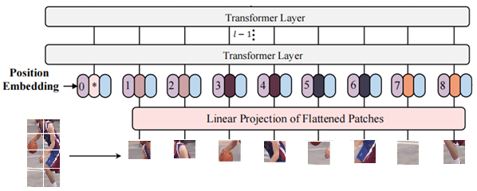
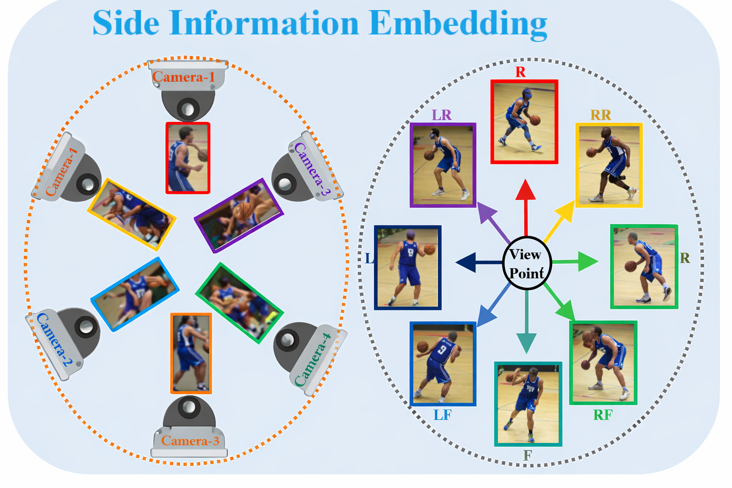
loss
loss
loss
loss
Modified Modules
w1
w2
w3
w4
loss
f1
f2
f3
f4
feat=BN(global_feat)+color_feat
Gate
Transformer Layer
BNN
Extra learnable [cls] embedding
Transformer Layer
refined tokens
tokens->patchmap->offset conv
color branch
Deformable Patch Shift

