Slide 1
key message for presentation
HTML5 and CSS3 can be used today inside the firewall
Good, clean, usable design is always in fashion
Business apps don’t have to be boring, battleship grey
Notes:
© 2010 Microsoft Corporation. All rights reserved. Microsoft, Windows, Windows Vista and other product names are or may be registered trademarks and/or trademarks in the U.S. and/or other countries.
The information herein is for informational purposes only and represents the current view of Microsoft Corporation as of the date of this presentation. Because Microsoft must respond to changing market conditions, it should not be interpreted to be a commitment on the part of Microsoft, and Microsoft cannot guarantee the accuracy of any information provided after the date of this presentation. MICROSOFT MAKES NO WARRANTIES, EXPRESS, IMPLIED OR STATUTORY, AS TO THE INFORMATION IN THIS PRESENTATION.

Slide 2
Digging into an HTML5 Line of Business Start Kit
Colin Bowern
Senior Consultant, MVP – ASP.NET/IIS
ObjectSharp
@colinbowern
colin@bowern.com

Slide 3
scrub checklist
Note: All virtual machines created for use at TechDays MUST be created and tested to work on Windows Server 2008 R2 SP1 Hyper-V
Submit your final deck to your Content Lead on or before September 30, 2011.
Required slides must NOT be removed
Do NOT include any non-template logos and graphics from the walk-in slide
Do include comments, hidden slides and speaker notes in the deck to help speakers in other cities prepare to deliver the content and for content review by Content Leads
Notify Damir Bersinic (damirb@microsoft.com) of any images identified as unlicensed for escalation
Use the provided event template and associated colors, fonts, layout and transition slides
Correct product names to follow applicable branding rules

Slide 4
our journey today
Building for the Next Web
Inside Fabrikam Widgets
Essential Tools

Slide 5
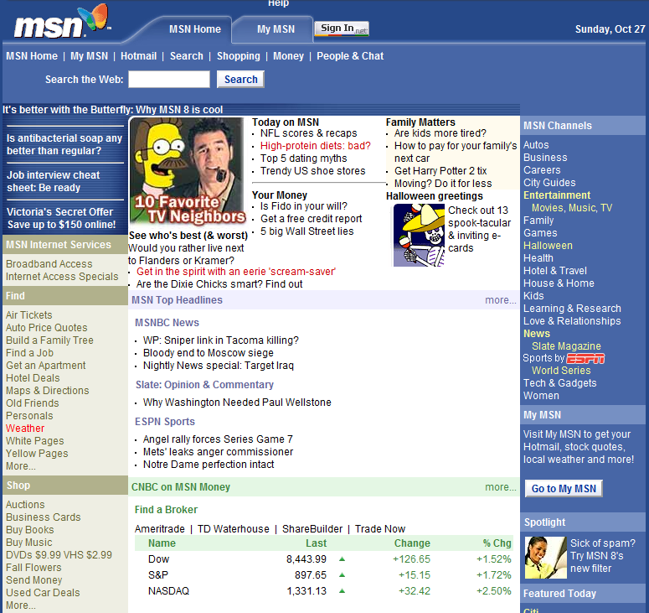
the web has evolved
Static content
Server generated
Minimal interaction
Limited design choices

Slide 6
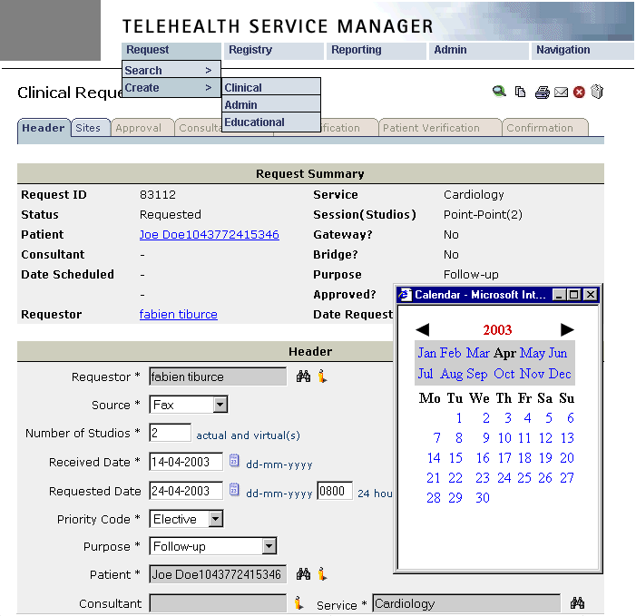
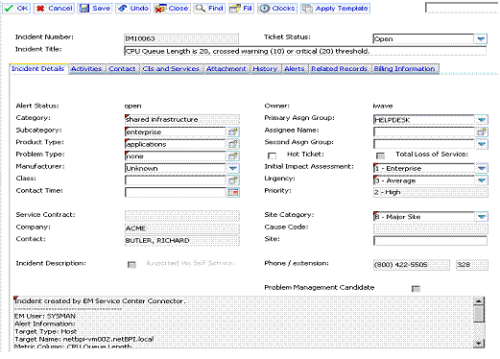
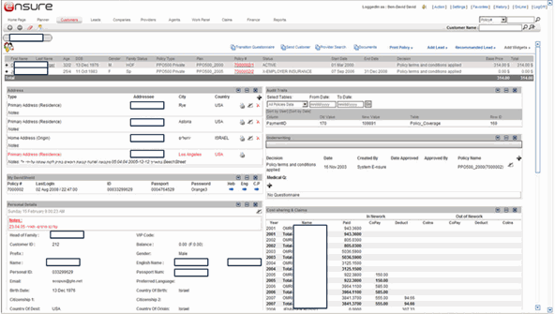
the web has evolved
Functional
Overwhelming
Training required
Bland design
Fails to embrace the web

Slide 7
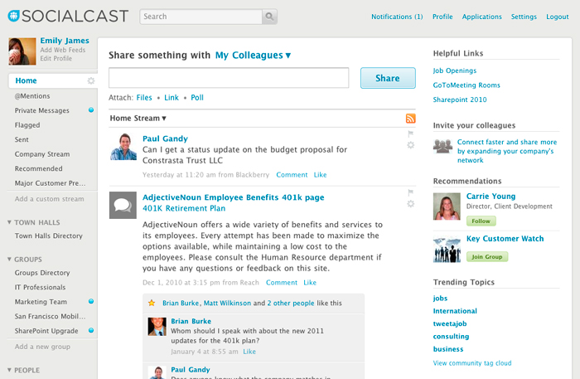
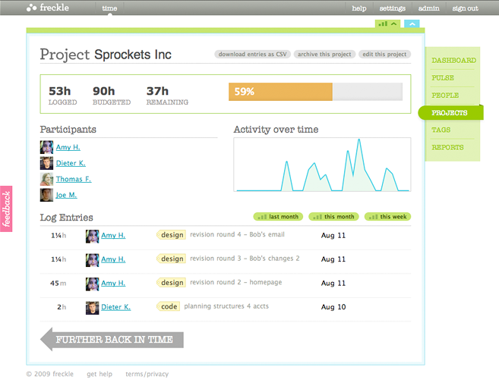
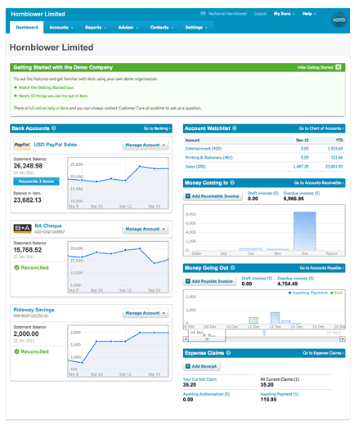
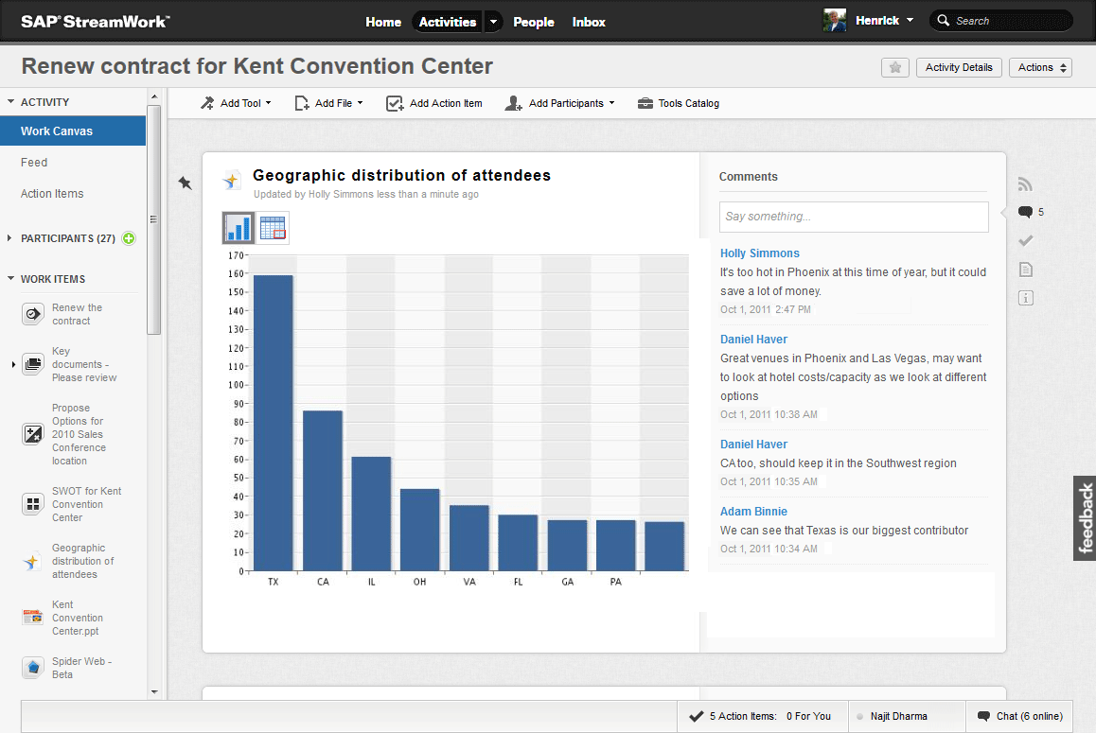
the web has evolved
Responsive interfaces
Visually appealing
Minimal training

Slide 8
HTML5 Content
CSS3
Presentation
JavaScript Behavior

Slide 9





capable browsers
Variety of browsers already in your enterprise
Mobile versions catching up very quickly
Cross-browser interop focus over past few years
Web Standards Project ACID tests
ECMAScript Test Suite
Notes:
http://samples.msdn.microsoft.com/ietestcenter/
http://caniuse.com/

Slide 10
feature detection
Supporting older browsers is not as painful
10+ years to see the light
More smart people focused on the problem
Deeper knowledge and tooling for JavaScript
Polyfills close the gaps by manipulating the DOM to enable support of new features
colinb.me/Html5Polyfills
colinb.me/XBrowserTest

Slide 11
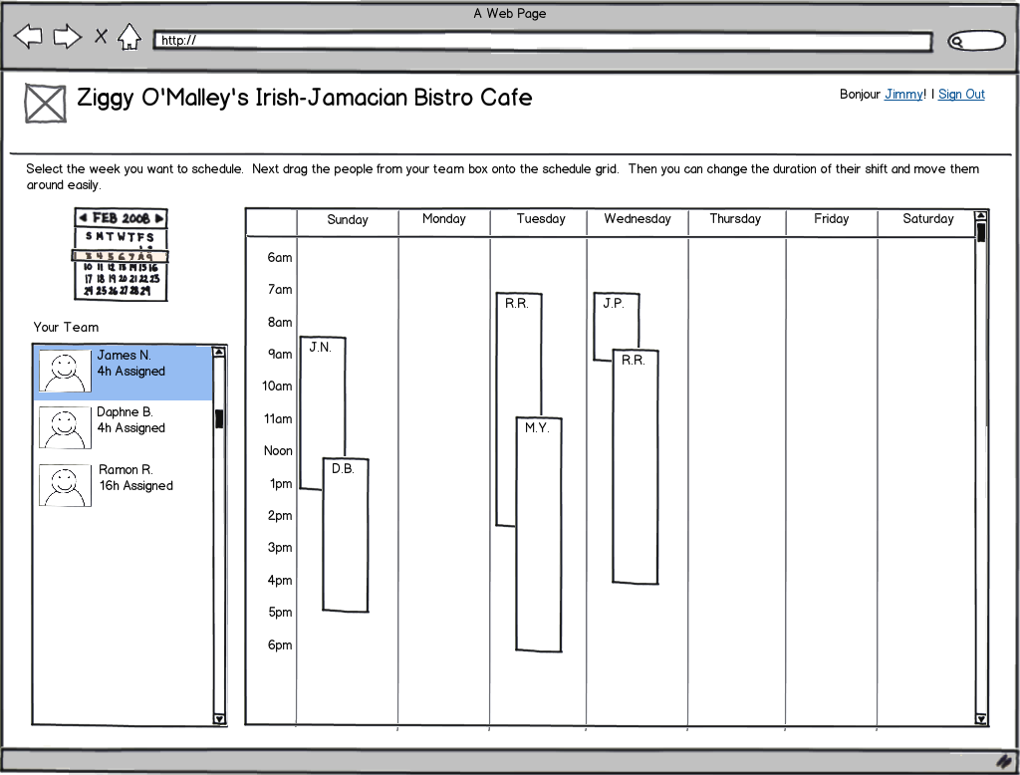
user experience is key
Build with your user in mind
Identify personas + key scenarios
Interview potential users
Sketch possibilities + get feedback
Polish the UI
colinb.me/CheapStockIcons

Slide 12
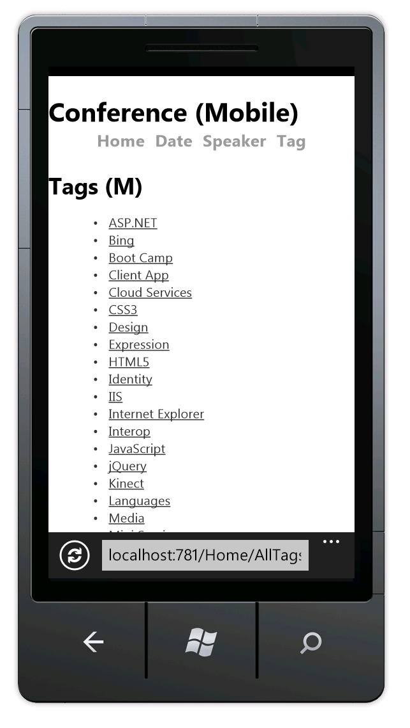
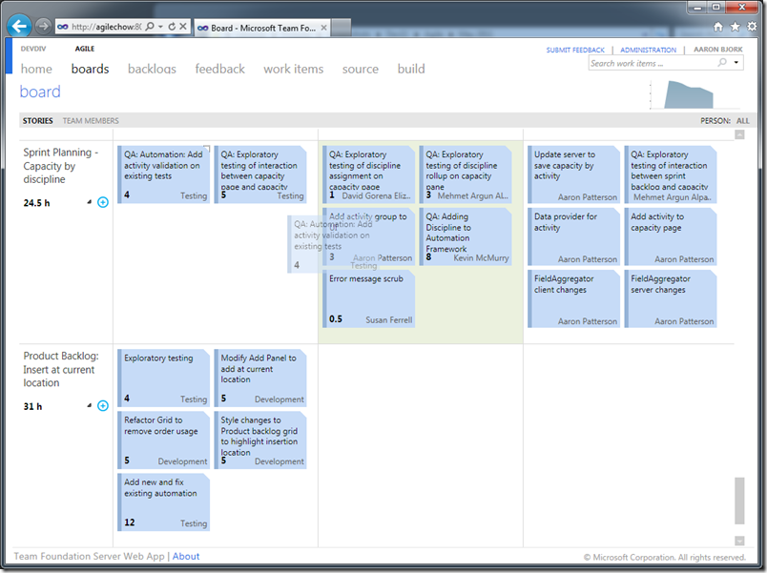
desktop != mobile user experience
!=

Slide 13
fabrikam widgets

Slide 14
structural elements
header
nav
aside
article
New elements introduced to address common scenarios seen across most web interfaces
Data elements allow for richer interaction with content (<time>, <command>, <progress>)
Use with older browsers using appropriate polyfill
section
footer

Slide 15
accessibility (aria)
Describe the purpose, state and other functionality of rich user interfaces
Allows assistive technology to more correctly interpret the intent of the interface
Supports legislation that comes into effect in 2025
Accessibility for Ontarians with Disabilities Act (AODA)

Slide 16
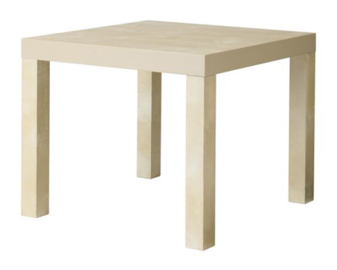
layout and styling
Rounded borders, shadowing, font enhancements for polished look-and-feel
Normalize style rules rather than resetting them
LESS, SASS make rules manageable
Avoid table-based layouts which increase render time and reduce responsiveness

Slide 17
canvas
Leverage GPU-accelerated browsers
Basis for a plugin-less browser experience
Along with audio + video tags few scenarios for plug-ins remain - 3D, hardware interaction
Frameworks abstract primitive canvas operations – Fabric.js, Three.js, Raphaël

Slide 18
web sockets
CAUTION: Spec still in development
Two-way communication between client and server with persistent TCP connection
Less network overhead than long polling / streaming (Comet) or periodic refreshing (AJAX)
Consider the scalability impact of open connections

Slide 19
controls
Form controls enable browsers to provide consistent input experience
Dates & Time, Number, Range, Email Address, URL, Color, Search
Descriptive controls allow for behaviour and semantic description
Menu, Figure, Datagrid, Output, Time, Progress, Meter

Slide 20
drag & drop
Standardizes a scenario that has been invented many times over
Mark elements with draggable attribute
Mark target zones with dropzone attribute
Handle ondrop event to update back-end
Wire into the file and touch events for rich experiences

Slide 21
messaging
Simplifies non-hostile communications between documents
Policy defines domain boundaries
Events used to handle messages
Exposes origin to protect against unauthorized messages

Slide 22
data storage
Session and Local Storage used for string values
Similar to HTTP cookies
Session: tied to top-level document
Local: tied to domain
Web Storage provides a SQL-like mechanism for storing and querying complex data structures

Slide 23
offline applications
State change events provided by the DOM allow you to determine where to retrieve data from
Use in combination with storage to provide rich application experience anytime
Manifest tells browser what files to cache for offline usage

Slide 24
essential tool sets
Starting Point: HTML5 Boilerplate, Phonegap
Gap Analysis: Modernizr, Yepnope, Normalize.css
DOM Control: jQuery, Prototype, Mootools
Controls: jQuery UI, Kendo UI, extJS, SproutCore
Data Binding and Templates: Backbone.js, KnockoutJS, Batman.js, AngularJs, JavascriptMVC, Sammy

Slide 25

next steps
Use HTML5 and CSS3 today!
Bookmark HTML5 specs – developers.whatwg.org
Subscribe to CSS3 feed – css3.info
Implement feature detection – caniuse.com
Use polyfills when needed – colinb.me/Html5Polyfills
Advocate with stakeholders on
What is possible with sketches (linked to business value)
Cost of supporting older browsers
Value of mobile device support

Slide 26

resources
UIs for Business Web Apps
colinb.me/BizWebAppUI
Top 10 App Design Mistakes
colinb.me/TopUXMistakes
Demo Code
colinb.me/Html5BizWebApp
HTML5 Rocks
html5rocks.com
HTML5 Boilerplate
html5boilerplate.com
HTML5 Browser-Feature Matrix
caniuse.com
HTML5 Polyfills
colinb.me/Html5Polyfills

Slide 27

related sessions
Adding the Awesomesauce Flavour with Internet Explorer 9 Pinned Sites – 4:15pm in McKennit 8-10
sessions you missed
Application Development with HTML5
HTML5 and CSS3 Techniques You Can Use Today

Slide 28

evaluations and feedback
Please fill out your evaluations!
Remember: 9 = Good; 1 = Bad
Let us know what you liked and disliked!
Have your voice heard!
Send us an email! td_can@microsoft.com
Notes:
DO NOT REMOVE THIS SLIDE

Slide 29
Notes:
DO NOT REMOVE THIS SLIDE

Slide 30
Notes:
DO NOT REMOVE THIS SLIDE

