Slide 1

P&ID Symbol Detection
haQathon 2020 team
Royal Mech

Slide 2

Human resources slide 8
haQathon Idea
Idea: P&ID Tags Extraction proposed by Kande Ramesh from Exxon Mobil.
Asset Register team of Exxon Mobil ODC process number of engineering documents contains number of P&D symbols and respective tags inside it or in the documents.
Inputs: Scanned P&ID documents.
Output: Extracted tags from document in excel
Current Process
Challenges
Idea Benefits
Manual asset tags extraction from P&IDs for asset register development takes lot of time.
Exxon Mobil process so many documents per year.
Time taking effort.
Possible copy/Paste/ manual errors,
Effort Savings: Manual efforts (four weeks) reduction.
Avoiding errors & improved quality.

Slide 3
Human resources slide 8
Scope : P&ID Symbol Detection
Automatic detection of P&ID Symbols in scanned document.
Chosen the deep learning approach and Tensorflow object detection process to detect the symbols in the scanned document.
Steps:
Data preparation
Tensorflow Object detection
Training the model
Evaluating the model
Testing with test data
Installed Softwares & Libraries:
Python
Tensorflow 2.3
Pandas
Protobuf compilers
Visual C++ 2015 builds

Slide 4
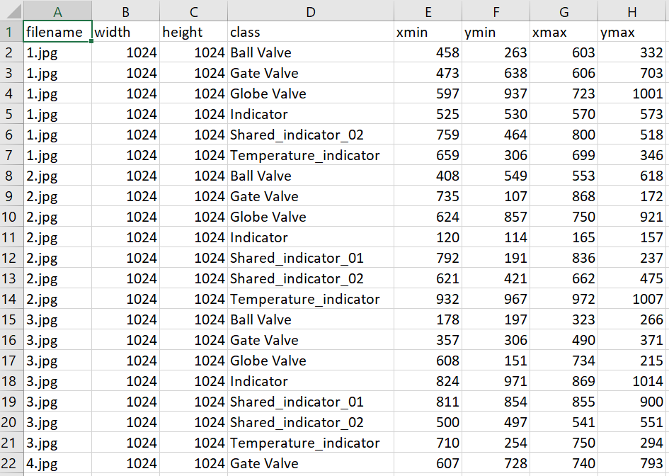

Human resources slide 8
Scope : P&ID Symbol Detection
CSV inputs
Image inputs

Slide 5
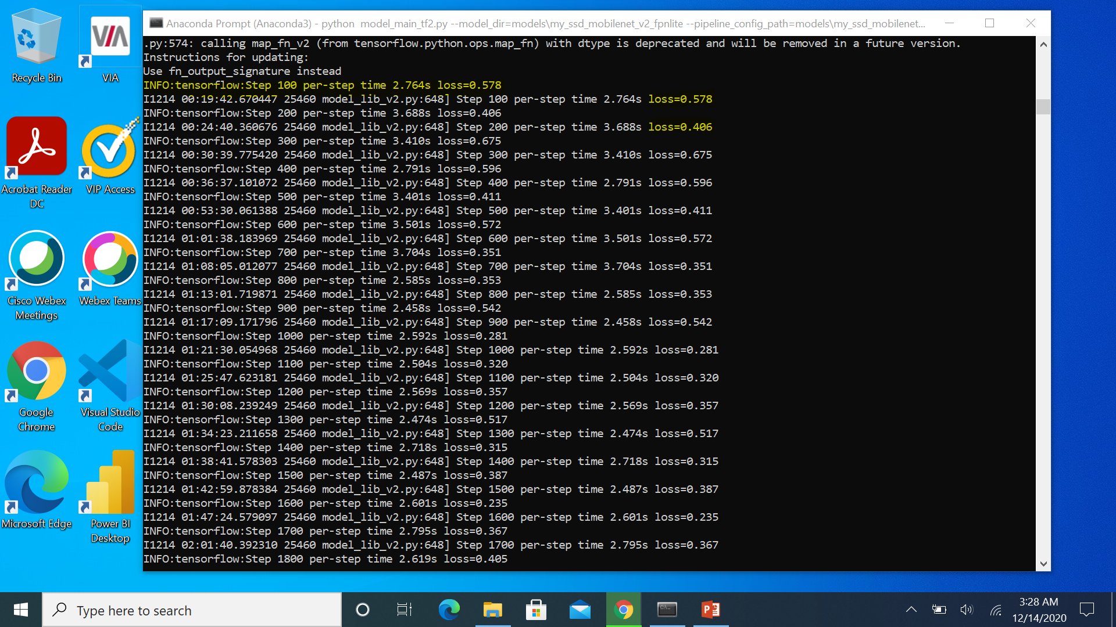
Human resources slide 8
Scope : P&ID Symbol Detection
Start Training the model..
.

Slide 6
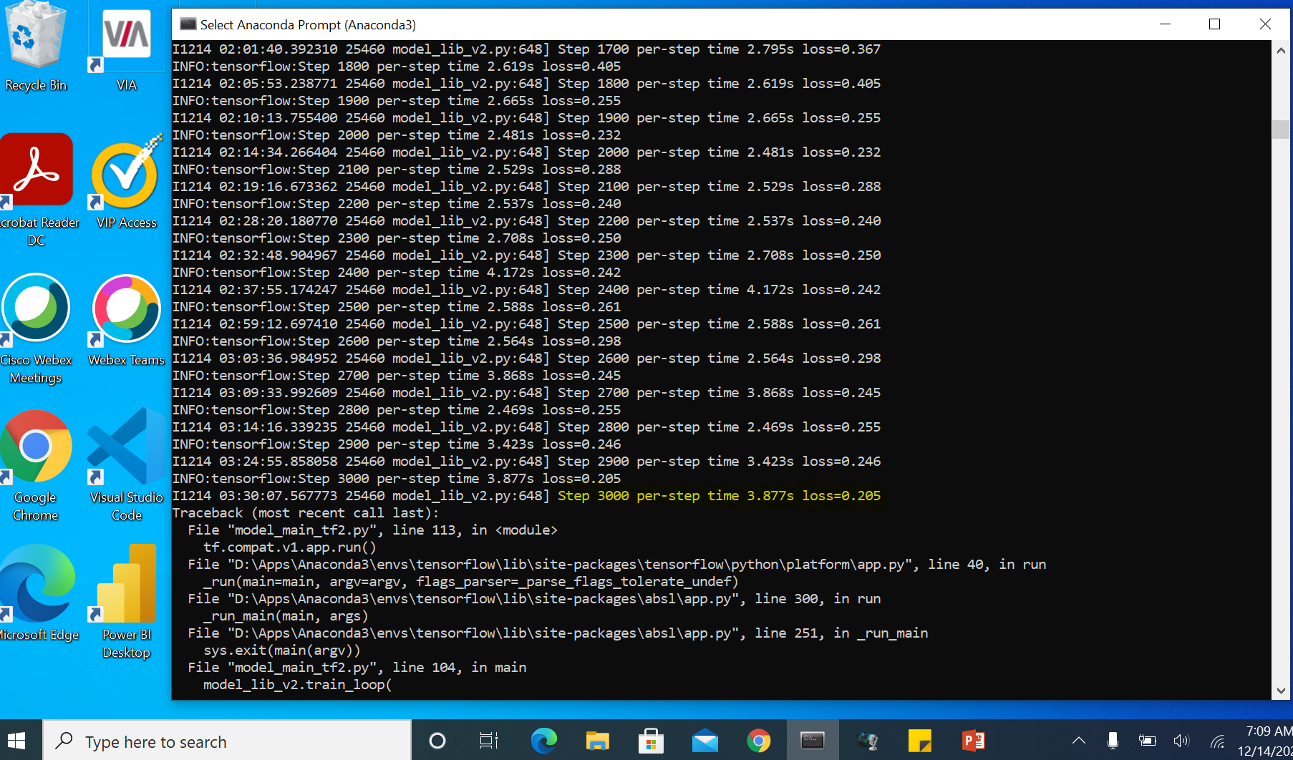
Human resources slide 8
Scope : P&ID Symbol Detection
Finished Training. (Keyboard interrupt when loss >= 0.15 or <= 0.20)

Slide 7
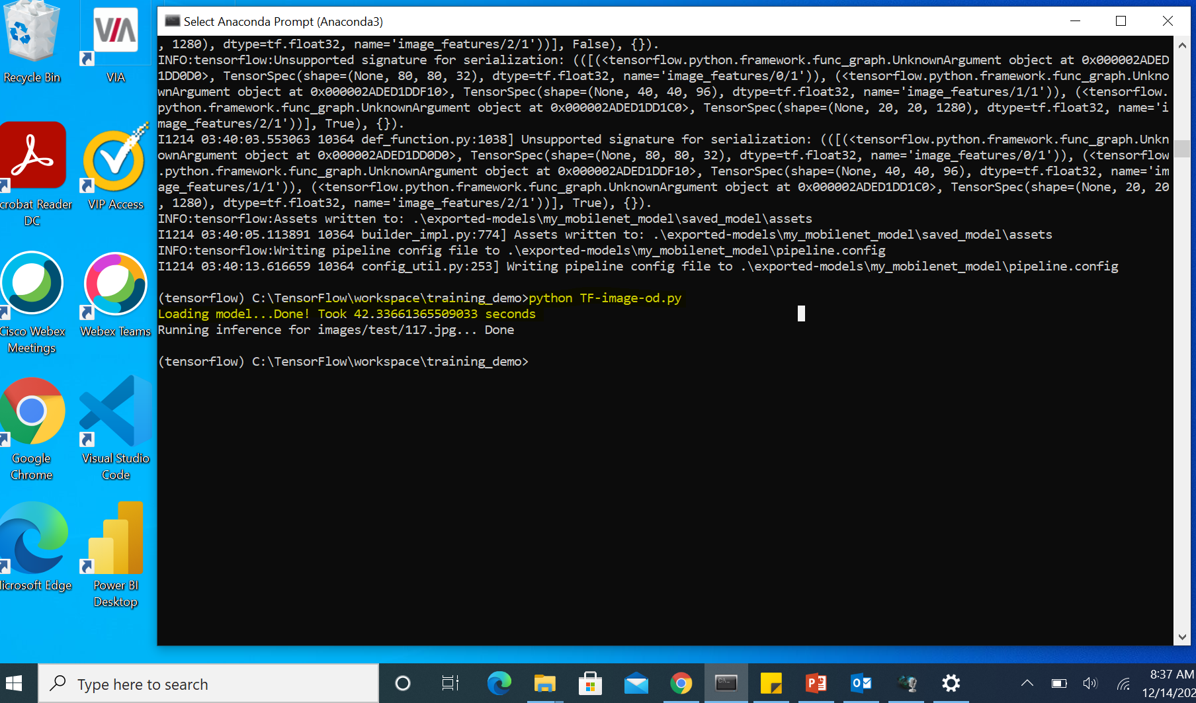
Human resources slide 8
Scope : P&ID Symbol Detection
Test the model..

Slide 8
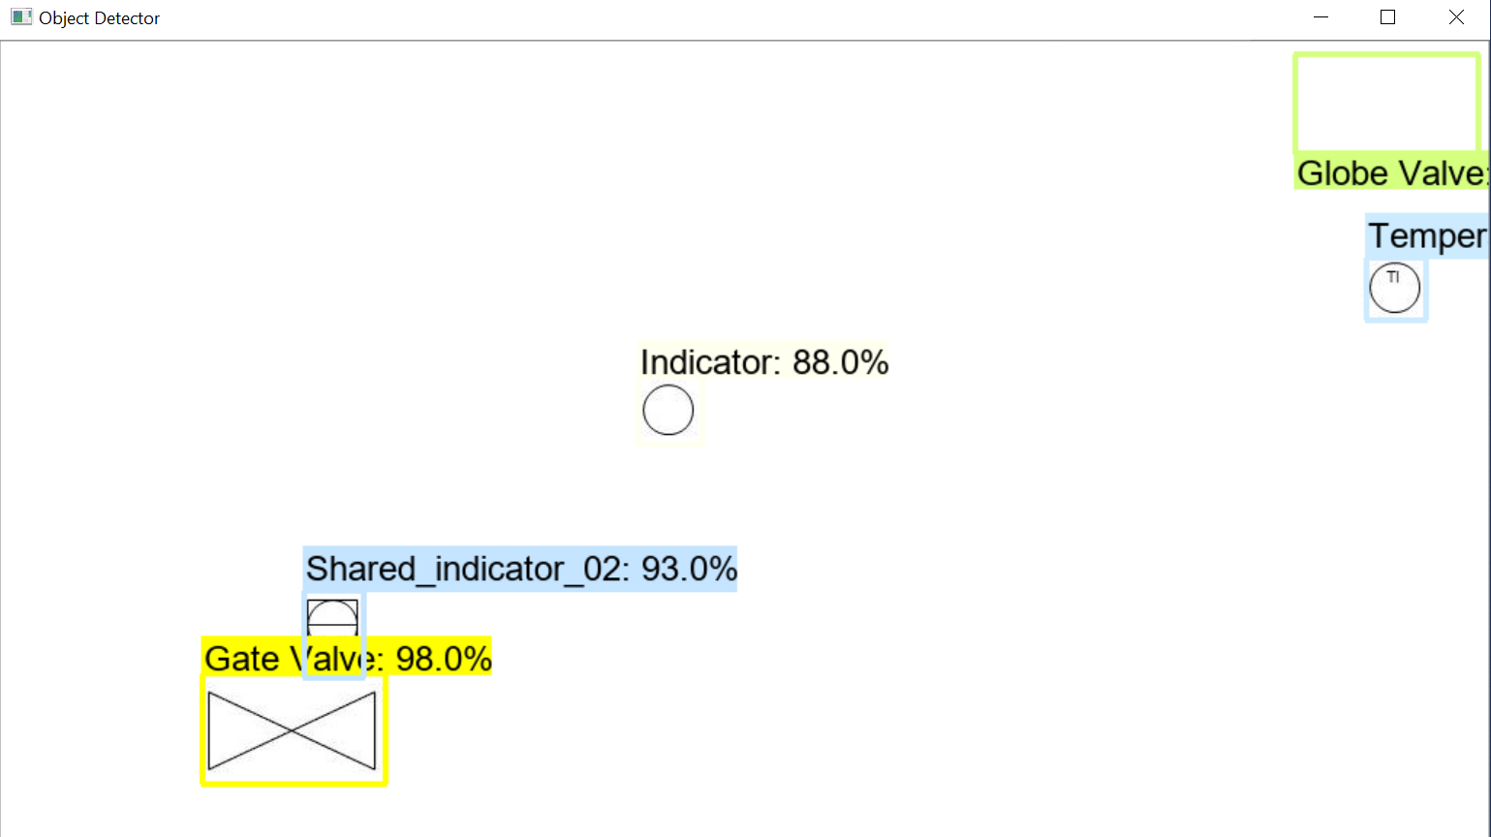
Human resources slide 8
Scope : P&ID Symbol Detection
Detected P_ID symbols in the given image

Slide 9
Thank you ☺

