Slide 1
IoT Based Hand-Free Sanitizer Dispenser
Corona Crusaders
Bhubaneswar
haQathon 2020
Global Product Engineering and Lifecycle Services Company
Notes:
Talking points:
We have built QuEST over the last 21 years as a aspiration driven organization. We continue to push the boundaries, create new frontiers across multiple safety critical and hi-tech industries we serve. We do this by offering our Customers a range of Services and Solutions and engagement models that spans – Engineering, Enterprise solutions, Operations, Supply Chain and Technology enabled solutions covering the complete product lifecycle.
As such, QuEST is a Leading Global Product Engineering and Lifecycle Services Company
In this presentation we will cover 3 aspects of QuEST.
WHO we are, WHAT we do and for WHOM, and why we are in business – our purpose
Then we move on to HOW we engage with Customers
Finally we will cover HOW we are different and can add unique value to you and help you “Create the Frontier”

Slide 2
IoT Based Hand-Free Sanitizer Dispenser
Corona Crusaders
Mentor | : | Chandra Sekhar
Ideator | :
Team Lead | : | Pratik Joshi
Team Members | : | Himansu, kshitish
Notes:
Idea/Solution/Prototype: Give a one-liner about the solution for the given problem statement
Team Name: Add team name to the entry field
Mentor Name: Add mentor’s name to the entry field
Ideator Name: Add ideator’s name to the entry field
Team Lead Name: Add team lead’s name to the entry field
Team Members Name: Add team member’s name to the entry fields one after another

Slide 3
Scope
Problem Statement
Approach
Outcome
To create hand free sanitizer dispenser which can be operated from remotely.
In this COVID era sanitizer is a key ingredient. So looking into the increase in hygiene consciousness we have prepared a hand free sanitizer dispenser.
In this IoT age every single object can be accessible through Internet. So why not a sanitizer dispenser.
We have created a hand free sanitizer dispenser using proximity sensor.
Have developed one android app which will access the dispenser through cloud.
Also developed one AI Bot which will help to control the dispenser.
Notes:
Problem Statement: Illustrate the basic problem along with technologies used
Approach: Methods planned to solve the target problem in order to attain a viable solution within the constrained time of 2 days of hackathon
Outcome: Results obtained as part of development towards the end of hackathon to be demonstrated with the help of table, diagram if any

Slide 4
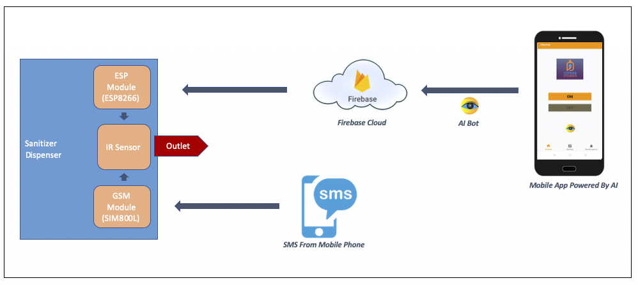
System Architecture
Notes:
System Architecture: Outline & detail the basic architecture of prototyped solution with the help of block diagrams, etc. if any

Slide 5
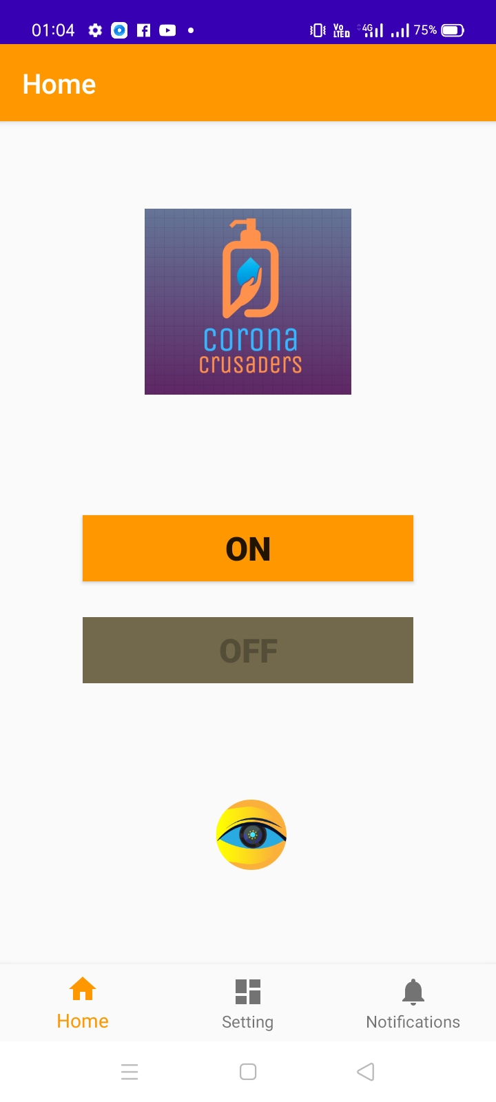
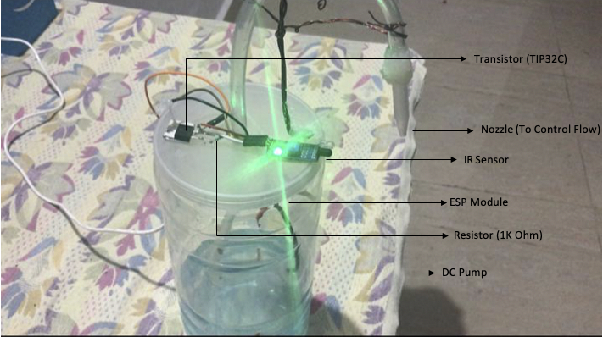
Application Screens
Sanitizer Dispenser
Screenshot of Application to control the dispenser
Notes:
System Architecture: Outline & detail the basic architecture of prototyped solution with the help of block diagrams, etc. if any

Slide 6
Technology Choices
Sl. No. | Technologies used | Rationale for selection
1. | IoT | To connect the dispenser to cloud
2. | Android | To develop mobile App
3. | AI | To develop AI Bot the App
4. | Embedded System | To connect the sensors with the modules
5. | Cloud Computing | To design database in Cloud and manage it
Notes:
Technology Choice: Add technologies used and rationale for selecting so

Slide 7
Business Case
Product Deployment
Value Added to QuEST / Customer
We have prepared the sanitizer dispenser with the the proximity sensor.
Have used ESP module to connect it over cloud. The ESP module need one time setup for the internet connection. Then it can be interacted remote with App or Cloud.
Have developed Android app to control the dispenser through cloud.
Have developed AI Bot which will receive user command and interact with cloud.
The hardware and APP are ready to deploy in any household and organization.
Organizations like QuEST used to provide sanitizer to their employee, there is one dedicated staff to support the same.
Quest can use the sanitizer dispenser in their office premises so that employee can use themselves. So here it will reduce manpower.
The dispenser can be controlled remotely, so it ensure less power consumption.
It will reduce the chances of sanitizer wastage.
Also it ensure the maximum hygiene.
Deployment cost is very less
Notes:
Product Deployment: How the Solution Can be Deployed? -- Target Environment, What is needed, etc.
Value Added to QuEST: Business Benefits? -- How QuEST can benefit; be specific about customer, VBU etc.

Slide 8
Learning Points
Key Learning
Scope for Improvement
Embedded System
Circuit design
Cloud Computing
AI
IoT
The dispenser can be added with home automation device like Alexa.
The design in nozzle can be changed and container capacity can be increased
The dispenser and the App can be used globally in coming days.
Notes:
Key Learning: Team Experience, Bottle necks, “Aha” Moments, etc.
Scope for Improvement: How the solution can be improved further?

Slide 9

The Experience
The Team
It was a very nice experience though this time it was virtually. Faced many challenge while designing the circuit like hardware failure, circuit breakdown.
Notes:
THE EXPERIENCE: Add one liner by team member(s) as well as mentor about their overall hackathon experience. Teams may mention about learning something new, meeting new people, explain the process of building stuff, testing and validating their technical skills, etc. Mentor may talk about working with the team and their achievement at the hackathon.
PHOTO: Add picture of the team along with their developed prototype

Slide 10
Thank You
Engineering | Enterprise Solutions | Operations & Supply Chain | Technology & Digital Solutions

