Slide 1
Develop Control Algorithm and Simulate for HVDC Technology
Wind Admirals
DU013
haQathon 2020
Global Product Engineering and Lifecycle Services Company
Notes:
Talking points:
We have built QuEST over the last 21 years as a aspiration driven organization. We continue to push the boundaries, create new frontiers across multiple safety critical and hi-tech industries we serve. We do this by offering our Customers a range of Services and Solutions and engagement models that spans – Engineering, Enterprise solutions, Operations, Supply Chain and Technology enabled solutions covering the complete product lifecycle.
As such, QuEST is a Leading Global Product Engineering and Lifecycle Services Company
In this presentation we will cover 3 aspects of QuEST.
WHO we are, WHAT we do and for WHOM, and why we are in business – our purpose
Then we move on to HOW we engage with Customers
Finally we will cover HOW we are different and can add unique value to you and help you “Create the Frontier”

Slide 2
Develop Control Algorithm and Simulate for HVDC Technology
Wind Admirals
Mentor | : | Jestin Thekkeveetil
Ideator | : | Jestin Thekkeveetil
Team Lead | : | Faseela Anjum
Team Members | : | Bharani Kumar, Jyothisandhya Rani, Varghese Kurien
Notes:
Idea/Solution/Prototype: Give a one-liner about the solution for the given problem statement
Team Name: Add team name to the entry field
Mentor Name: Add mentor’s name to the entry field
Ideator Name: Add ideator’s name to the entry field
Team Lead Name: Add team lead’s name to the entry field
Team Members Name: Add team member’s name to the entry fields one after another

Slide 3
Scope
Problem Statement
Approach
Outcome
HVDC technology has got cost advantage compare to HVAC for long distance transmission. Companies in energy domain are investing on HVDC controls for competitive advantage. Quest need to demonstrate capability on HVDC technology to get more business in that area.
Model and Simulate HVDC control algorithm in Matlab and Simulink environment.
Conceptual model of HVDC control algorithm.
Notes:
Problem Statement: Illustrate the basic problem along with technologies used
Approach: Methods planned to solve the target problem in order to attain a viable solution within the constrained time of 2 days of hackathon
Outcome: Results obtained as part of development towards the end of hackathon to be demonstrated with the help of table, diagram if any

Slide 4
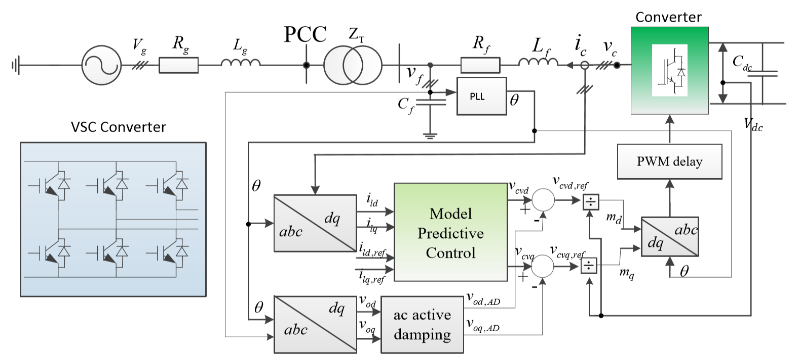
System Architecture
Notes:
System Architecture: Outline & detail the basic architecture of prototyped solution with the help of block diagrams, etc. if any

Slide 5
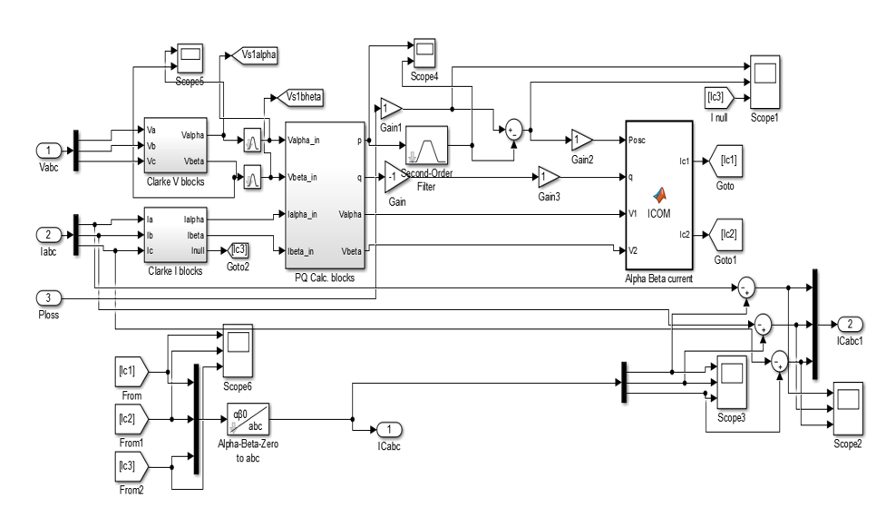
abc to dq model in Simulink

Slide 6
Technology Choices
Sl. No. | Technologies used | Rationale for selection
1 | Matlab & Simulink | It’s a widely used modelling and simulation tool for control algorithms. Many of our customers are using this tool.
Notes:
Technology Choice: Add technologies used and rationale for selecting so

Slide 7
Business Case
Product Deployment
Value Added to QuEST / Customer
This will help to develop the competency in HVDC control algorithm.
Quest will be able to engage with customers in deploying HVDC control products.
This will help Quest to get business opportunity with clients like GE, Siemens and ABB in HVDC technology.
Notes:
Product Deployment: How the Solution Can be Deployed? -- Target Environment, What is needed, etc.
Value Added to QuEST: Business Benefits? -- How QuEST can benefit; be specific about customer, VBU etc.

Slide 8
Learning Points
Key Learning
Scope for Improvement
HVDC domain and technologies
HVDC control algorithms
Modelling and Simulation competency
There is lot of scope for further development of control algorithms and model
Model Predictive Control development
Notes:
Key Learning: Team Experience, Bottle necks, “Aha” Moments, etc.
Scope for Improvement: How the solution can be improved further?

Slide 9
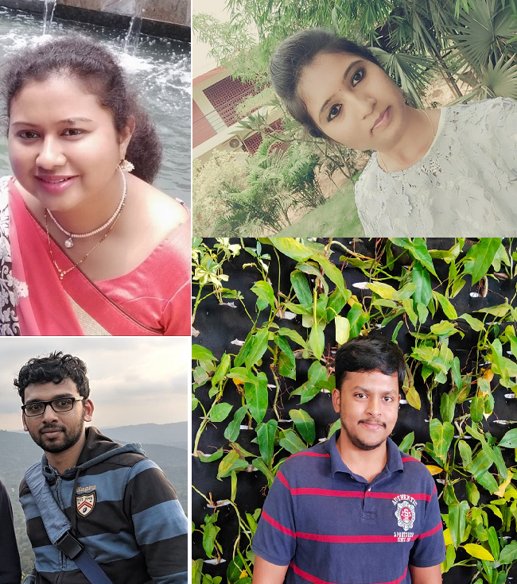
The Experience
The Team
Overall, the experience is good.
We are learning the HVDC domain.
Even though the implementation is difficult, but we are learning it and its challenging.
In short span of HaQathon time we could learn many things and we are able to present it before the panel.
Our mentor is helping us to give our best.
Notes:
THE EXPERIENCE: Add one liner by team member(s) as well as mentor about their overall hackathon experience. Teams may mention about learning something new, meeting new people, explain the process of building stuff, testing and validating their technical skills, etc. Mentor may talk about working with the team and their achievement at the hackathon.
PHOTO: Add picture of the team along with their developed prototype

Slide 10
Thank You
Engineering | Enterprise Solutions | Operations & Supply Chain | Technology & Digital Solutions

