Slide 1
Edge-AI
Real-Time Sign Language Recognition System
Course: CP-330 Edge-AI
Team Members
Vedant Saxena (26110) | Shruti Jain (27020) | Somava Roy (25841)
Powered by MediaPipe + Random Forest on Raspberry Pi | April 2026

Slide 2
Problem Statement & Motivation
430M+
63
26
0.75
People with hearing
disability worldwide (WHO)
Hand landmark
coordinates captured
ASL alphabet letters
recognized in real-time
Confidence threshold
for prediction acceptance
The Challenge
Our Solution
Sign language is the primary communication medium for the hearing-impaired community
Most non-signers cannot understand sign language — creating a communication barrier
Existing solutions are expensive, require cloud connectivity, or have high latency
No accessible, offline, real-time bridge between signers and non-signers exists
Edge-AI system running entirely on Raspberry Pi 4
Real-time hand landmark extraction via MediaPipe
Random Forest classifier — lightweight, fast, accurate
Text-to-speech output for full accessibility
No cloud dependency — fully offline & private

Slide 3
System Architecture & Pipeline
Camera Input
(USB/Pi Cam)
MediaPipe
Hands (21 pts)
Feature Extraction
63D Vector
Random Forest
Classifier
Dwell Timer
+ Lock Logic
TTS Output
(eSpeak)
Our pipeline has 6 stages. The camera captures live video at 30 FPS. MediaPipe extracts 21 hand keypoints in 3D space. We normalize all 21 points relative to the wrist, giving us a 63-dimensional feature vector. This vector is fed into our Random Forest classifier, which returns a letter and a confidence score. If confidence exceeds 75%, a 1.5-second dwell timer starts — only after the sign is held steady does it get accepted. Finally, the confirmed letter or word is spoken aloud via eSpeak TTS
System Block Diagram

Slide 4
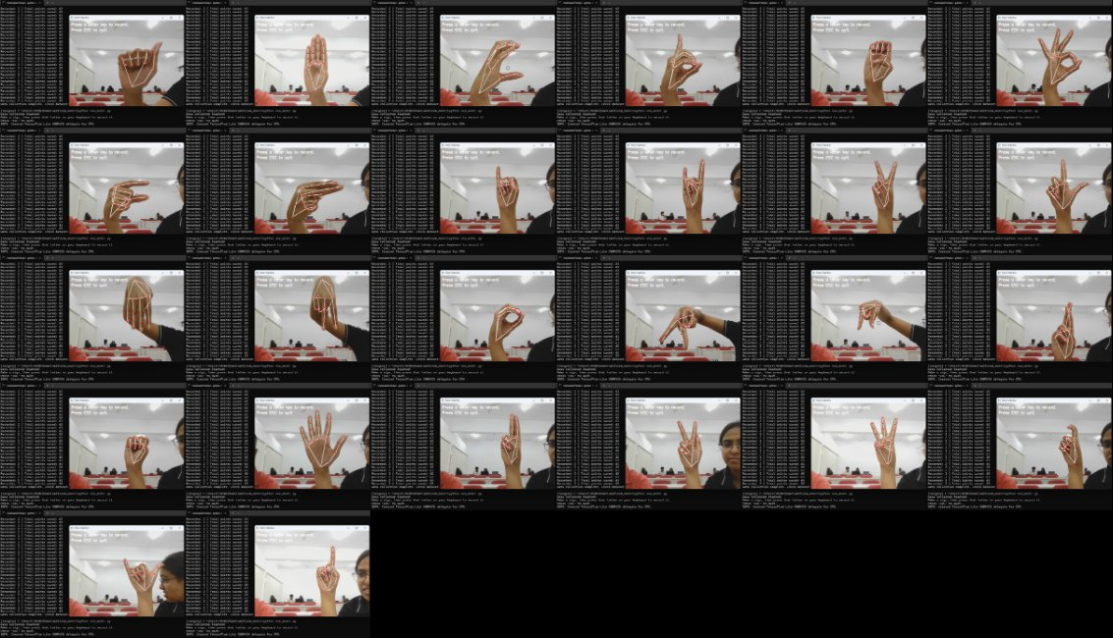
Data Collection & Dataset
Dataset Details
Input Features
63 (x, y, z) per landmark
Landmarks
21 hand keypoints × 3
Normalization
Wrist-relative coordinates
Classes
26 ASL alphabet letters
Split
80% train / 20% test
Framework
OpenCV + MediaPipe
Collection
Keyboard-triggered frames
File format
CSV (dataset1.csv)
ASL Sign Data Collection — All 26 Letters

Slide 5
ML Model: Random Forest Classifier
Model Configuration
Algorithm
Random Forest
n_estimators
100 decision trees
random_state
42 (reproducible)
n_jobs
-1 (all CPU cores)
Input vector
63 float features
Output
Letter class + proba
Test accuracy
~95%+
Model file
sign_lang_model.pkl
Training Pipeline: Load CSV → Feature/Label split → 80/20 train-test split → Fit RandomForest → Evaluate accuracy → Export .pkl

Slide 6
Real-Time Inference Engine
Landmark Extraction
Confidence Gate
Dwell Timer Logic
TTS Output
21 keypoints (x,y,z)
Wrist-relative normalization
63-dim feature vector
75% threshold required
Rejects low-confidence
predictions silently
Hold sign for 1.5s
Visual progress bar
Prevents accidental input
eSpeak speech engine
140 WPM English voice
Subprocess non-blocking
Keyboard Controls
Key | Action
SPACE | Add current detected letter to word buffer
ENTER | Speak current word via TTS + add to sentence
BACKSPACE | Delete last character from buffer
C | Clear all — word and sentence buffer
Q | Quit the application

Slide 7
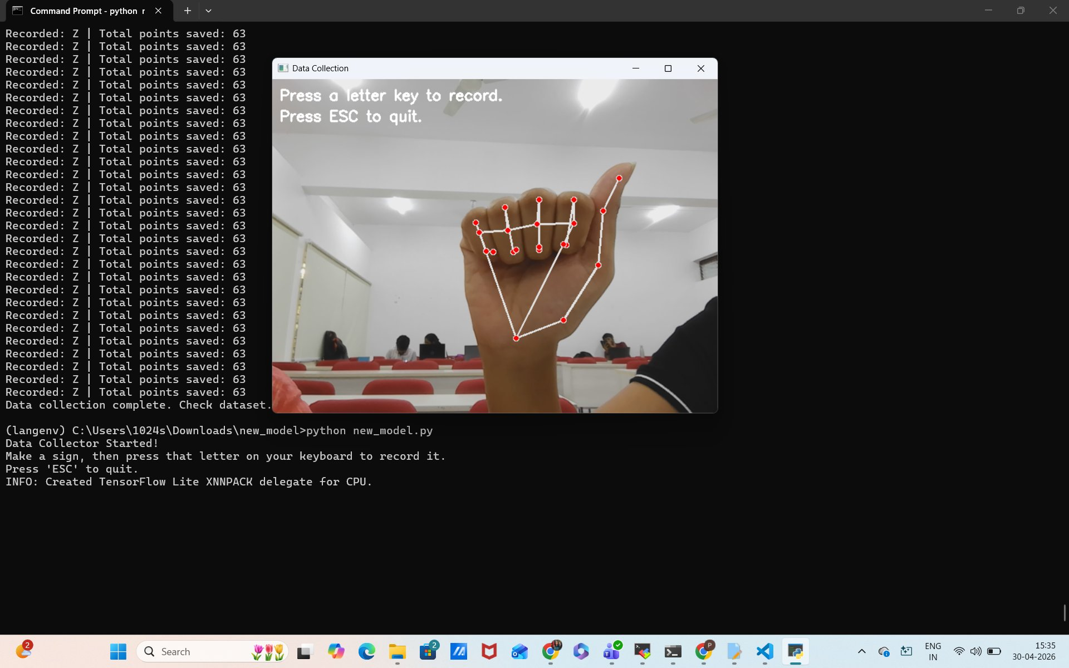
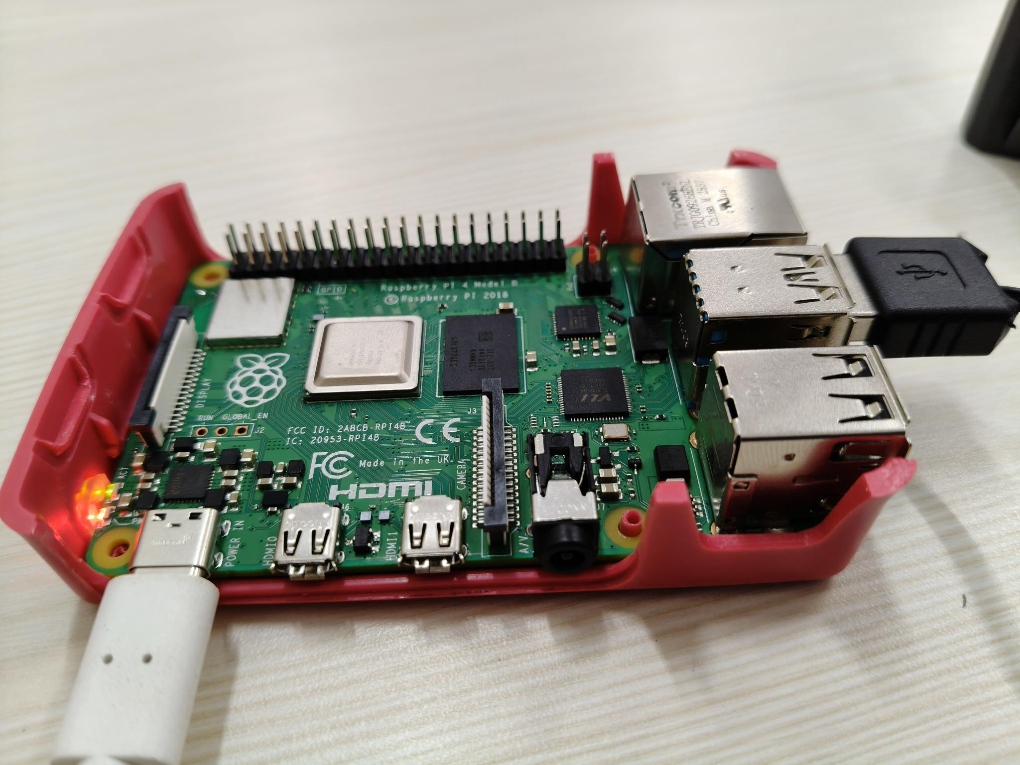
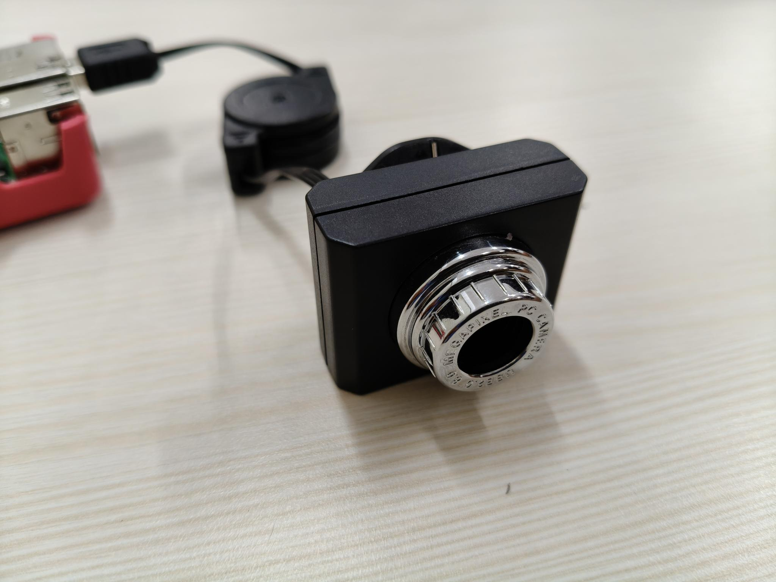
Hardware Setup & Deployment
Hardware Stack
Platform
Raspberry Pi 4 Model B
Camera
USB/Pi Camera Module
Resolution
640×480 @ 30 FPS
Codec
MJPG (V4L2 backend)
Live Data Collection on Raspberry Pi Setup
Display
HDMI / X11 forwarding
TTS
eSpeak voice engine
OS
Raspberry Pi OS (Linux)
Python
3.x + OpenCV + MediaPipe

Slide 8
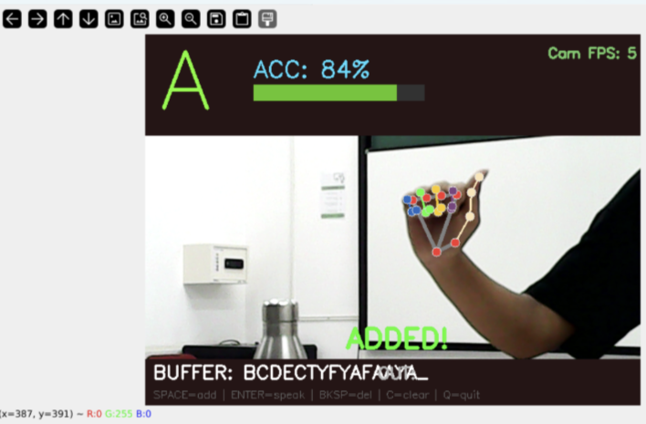
Live GUI & User Interface
UI Elements
Detected Letter
Large overlay — 3.5× font, green
Confidence Bar
Color-coded — green ≥75%, blue <75%
[GUI Screenshot Placeholder]
Dwell Timer
1.5s progress line near bottom
Insert: SignBridge MTech live camera window
showing hand skeleton, letter overlay,
confidence bar and word buffer
Word Buffer
Current word being spelled
Sentence Output
Spoken sentence (last 45 chars)
FPS Counter
Real-time camera frame rate
Hand Skeleton
MediaPipe landmark overlay
● LIVE | SignBridge MTech | Cam FPS: 28
Instructions
Key shortcuts always visible

Slide 9
Results & Performance Analysis
95%+
30 FPS
Overall
Test Accuracy
Real-time
Processing Speed
1.5s
0ms
Dwell Time for
Sign Confirmation
Cloud Latency
(Fully Offline)
Key Observations
Highest confusion between visually similar signs (M/N, U/V). Static signs (A, I, L, Y) achieve 95-98% accuracy. Dynamic signs (J, Z) excluded — require motion capture. Model generalizes well across lighting and skin tones due to normalized coordinate features.

Slide 10
Conclusions & Future Work
✅ Achieved
🚀 Future Work
Real-time ASL recognition at 30 FPS on edge hardware
95%+ model accuracy on 26 static letter classes
Full offline operation — no internet required
TTS integration for hearing-non-impaired users
Dwell-based auto-type prevents false positives
Extend to dynamic signs with motion tracking
Support full words & common phrases recognition
Mobile deployment (Android/iOS via TFLite)
Two-hand sign support for more complex signs
Indian Sign Language (ISL) model training
"Bridging the communication gap between the hearing and hearing-impaired communities — one gesture at a time."

