Slide 1
Movidius NCS on Raspberry Pi
Inference on the edge!

Slide 2
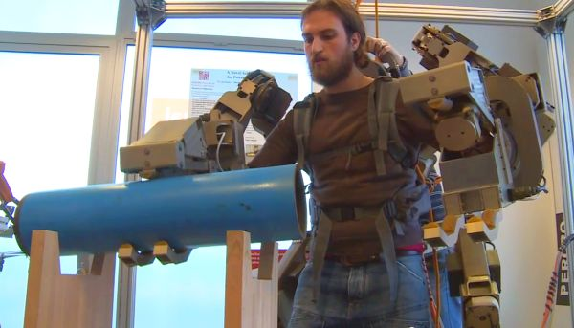
Physical Augmentations Rock!
Perceptual Robotics Laboratory (Percro)

Slide 3
Why use Raspberry Pi?
Sub $100 system
Well known commodity hardware
Lots of OpenCV Computer Vision Demos Online
TensorFlow does run good enough
Good platform for a proof of concept

Slide 4
Tensorflow on RPi
Train Cars, Cucumbers, & Many RC Cars!
https://svds.com/tensorflow-image-recognition-raspberry-pi/
https://cloud.google.com/blog/big-data/2016/08/how-a-japanese-cucumber-farmer-is-using-deep-learning-and-tensorflow
https://www.youtube.com/watch?v=9QRTg-4q634

Slide 5
This is cool, but can we do better?
Server / cloud is a still great option with WiFi access...
$45 AIY Vision Kit:
http://www.microcenter.com/site/content/Google_AIY.aspx?ekw=aiy&amp;rd=1
List of VPUs, TPUs, DSPs, etc:
https://medium.com/@shan.tang.g/a-list-of-chip-ip-for-deep-learning-48d05f1759ae

Slide 6
Movidius Neural Compute Stick
Why:
It’s just the first
Power & speed
Why Not:
Yea… This edge does make you bleed...

Slide 7
Demos...

Slide 8
How can I help you?
Looking for business partners...
Chicago Area Embedded Deep Learning:
Computer Vision RPi workshop
Pumping Station One
This Sunday 12/17 Noon - 5PM

