Slide 1
IoT Edge based ML and visualization
Ingenious Geniuses
haQathon 2020
Global Product Engineering and Lifecycle Services Company
Notes:
Talking points:
We have built QuEST over the last 21 years as a aspiration driven organization. We continue to push the boundaries, create new frontiers across multiple safety critical and hi-tech industries we serve. We do this by offering our Customers a range of Services and Solutions and engagement models that spans – Engineering, Enterprise solutions, Operations, Supply Chain and Technology enabled solutions covering the complete product lifecycle.
As such, QuEST is a Leading Global Product Engineering and Lifecycle Services Company
In this presentation we will cover 3 aspects of QuEST.
WHO we are, WHAT we do and for WHOM, and why we are in business – our purpose
Then we move on to HOW we engage with Customers
Finally we will cover HOW we are different and can add unique value to you and help you “Create the Frontier”

Slide 2
IoT Edge based ML and visualization
Ingenious Geniuses
Mentor | : | Kavita Sudhakaran
Ideator | : | Kavita Sudhakaran
Team Lead | : | Alex Maniyattu
Team Members | : | Mithun Murali, Harihaaran S, Anjali Pillai
Notes:
Idea/Solution/Prototype: Give a one-liner about the solution for the given problem statement
Team Name: Add team name to the entry field
Mentor Name: Add mentor’s name to the entry field
Ideator Name: Add ideator’s name to the entry field
Team Lead Name: Add team lead’s name to the entry field
Team Members Name: Add team member’s name to the entry fields one after another

Slide 3
Scope
Problem Statement
Approach
Outcome
To demonstrate proof of concept for IoT (Internet of Things) edge based ML for failure prediction and monitoring of assets.
To build the solution based on using open source software
Address the connectivity, interoperability and information exchange between devices and systems in an Industrial environment.
Analyzing large amounts of date generated by sensors deployed in Industry on Edge devices like Raspberry Pi 4 or NVIDIA Jetson TX2.
Notes:
Problem Statement: Illustrate the basic problem along with technologies used
Approach: Methods planned to solve the target problem in order to attain a viable solution within the constrained time of 2 days of hackathon
Outcome: Results obtained as part of development towards the end of hackathon to be demonstrated with the help of table, diagram if any

Slide 4
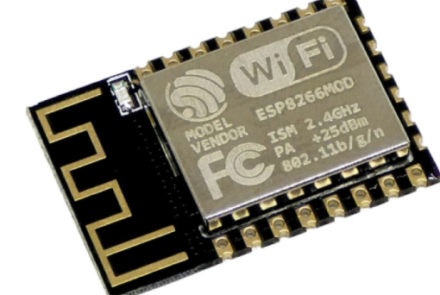





System Architecture
PC 1/ [Sensors with Wi-Fi later on]
IoT Edge
Visualization
Prediction using ML
MQTT server
Data Sources
Sensor simulator
Wi-Fi
Time series data
Simulate 50 pressure sensors and send the data to MQTT server over Wi-Fi or Ethernet
Notes:
System Architecture: Outline & detail the basic architecture of prototyped solution with the help of block diagrams, etc. if any

Slide 5
Technology Choices
Sl. No. | Technologies used | Rationale for selection
1. | Node-RED | Node-RED is an open source visual programming tool that offers a browser-based flow editor for wiring together devices, APIs, and services. Built on Node.js, you can extend its features by creating your own nodes or taking advantage of the JavaScript and NPM ecosystem.
2. | Influx-DB | Influx-DB is a time series database designed to handle high write and query loads.
3. | Grafana | Grafana is the leading open source monitoring and analytics platform that works with every database.
Notes:
Technology Choice: Add technologies used and rationale for selecting so

Slide 6
Learning Points
Key Learning
Scope for Improvement
Got the opportunity to learn and work with new technologies like Node-red, Grafana, Influx-db.
PoC for domain specific IoT Edge computing.
Possibility of extending to applications including analytics algorithms, threshold-based notifications and alarms, diagnostic and monitoring application and custom software code that is executed on the edge.
Storing data locally allowing autonomous running of the Edge platform.
Notes:
Key Learning: Team Experience, Bottle necks, “Aha” Moments, etc.
Scope for Improvement: How the solution can be improved further?

Slide 7
The Experience
The Team
It was a great experience participating in haQathon virtually. At times, we faced many difficulties however, standing united gave us the strength to overcome all the problems.
We all got the opportunity to learn and work on new technologies.
Notes:
THE EXPERIENCE: Add one liner by team member(s) as well as mentor about their overall hackathon experience. Teams may mention about learning something new, meeting new people, explain the process of building stuff, testing and validating their technical skills, etc. Mentor may talk about working with the team and their achievement at the hackathon.
PHOTO: Add picture of the team along with their developed prototype

Slide 8
Thank You
Engineering | Enterprise Solutions | Operations & Supply Chain | Technology & Digital Solutions

