Slide 1


INFO7250 ENGINEERING BIG-DATA SYSTEMS
FLIGHT DATA ANALYSIS

Slide 2
BACKGROUND
In recent years, there has been a tremendous increase in the number of air passengers.
This increasing figures have enhanced problems, ultimately causing flight delays.
Delay in flights is recognized not only the usual factor but also a bothersome experience offered to customers.
Delay might result in loss of monetary value both to customers and airline companies.
By taking this data and applying analysis , companies can know the reasons of delay and consequences due to delays.Apart from delay,many other analysis can also be performed.
According to Berkley news, air flight delays cause a whopping loss of $33 billion for domestic travel and half the brunt is shared by the customer. This is really significant, and by applying big data analysis airline companies can remedy and take measures and hence improve the efficiency of business.(https://news.berkeley.edu/2010/10/18/flight_delays/#:~:text=The%20cost%20of%20domestic%20flight,the%20University%20of%20California%2C%20Berkeley.)

Slide 3
About the Dataset
I have taken Flight Reporting Carrier On-Time Performance dataset from United States Department of Transportation to perform various analysis and drive useful business insights.
The dataset is huge and is a csv file.
The dataset is 5GB.
For analysis I have taken the last 5 years data.
The other dataset used is carriers dataset which consists of carrier code and description.

Slide 4
Frameworks/Tools used:
Hadoop Map Reduce
Hive
Pig
HBASE
PowerBI/Excel for visualizations

Slide 5
Analysis : Hadoop MapReduce
The following are the analysis performed:
1)Total Flights flown between source and destination.
2) Top 30 source destination pair.
3) Number of flights cancelled between 2015-2020
4) Airline companies & the number of times they were flown.
5) Airline companies full name-Inner Join
6) Flight count based on year
7) Number of flights delayed per year:
8) Flights Cancelled Per Year
9) Percentage of Flights delayed per year
10) Percentage of Flights delayed based on day of the week
11) Percentage of Flights delayed based on carrier
12) Inverted index for all source and destination
13) Average flying distance and flying air time based on carrier:

Slide 6
MapReduce Analysis Code Highlights
Used simple map reduce programs to perform few analysis.
Used Top N filtering pattern to get the data for Top 30 source destination pairs.
Used numerical summarization pattern to:
1)To calculate average flying time and average flying distance.
2)To calculate the delay percentage
Built an inverted index to map an origin location to all the destinations.
Apart from that I used combiner where necessary to optimize the code.
I used Reduced Side Inner Join to get the full name of a carrier name based on the carrier code.

Slide 7
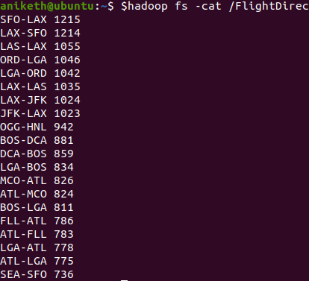
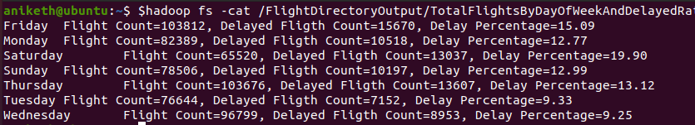
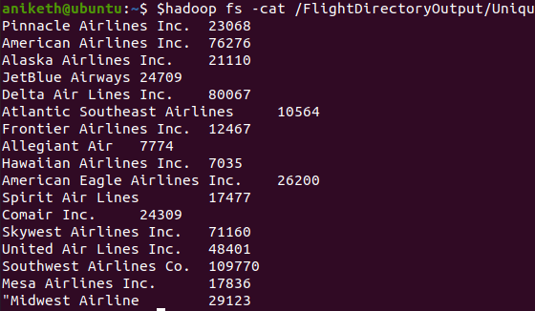
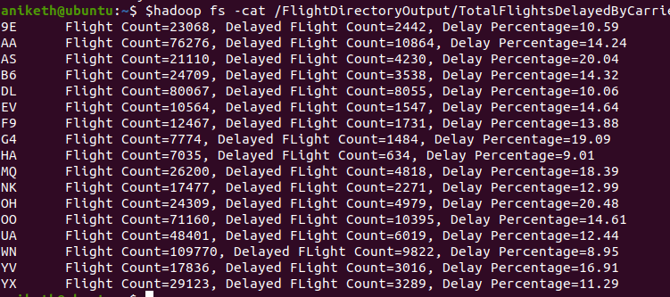
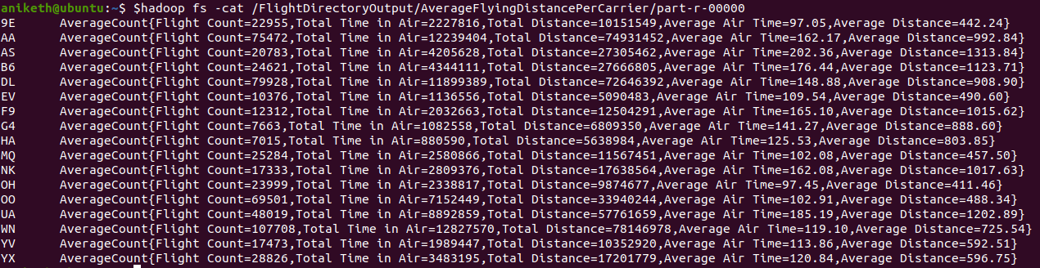
MapReduce Analysis Outcomes:

Slide 8
Analysis : Hive
Mapped the data from HDFS to table in a hive database.
Performed the following analysis:
1)Find the count of all the records.
2) Number of flights which have been delayed by more than 20minutes.
3) Flights cancelled by their source and destination
4) Total cancelled flights by year in ascending order
5) Airline flighcompany names : Used inner join by mapping other carrier dataset from HDFS.
6) Average distance travelled by a carrier.
7) Total Distance travelled by carrier.

Slide 9
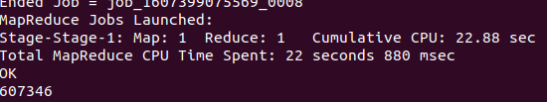

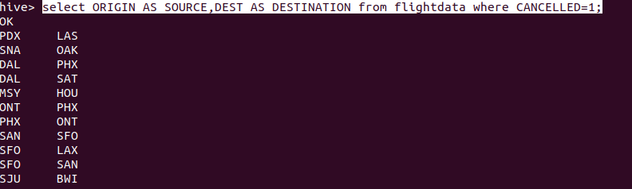
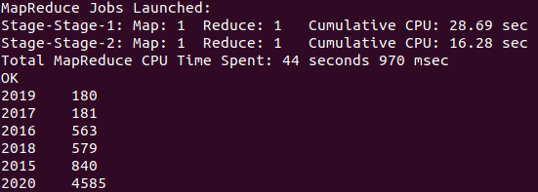
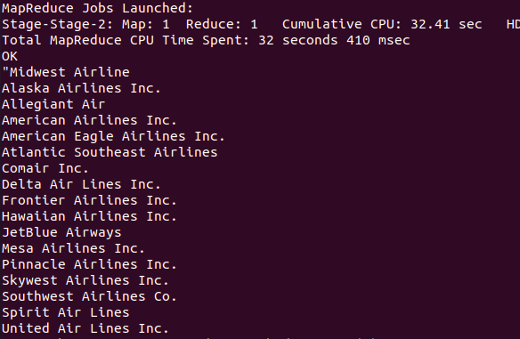
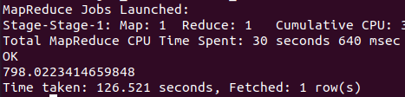
Hive Analysis Outcomes:

Slide 10
Analysis: Pig
Used pig scripts in local mode to run the following analysis:
1)Name of all the flights cancelled for a source-destination
2) Frequency of Destination.
3) Airline popularity-Based on Number of times a carrier is travelled:
4) Time from airport.
5) Airlines Delay Count By Year(Based on Carrier Delay or Weather Delay)

Slide 11
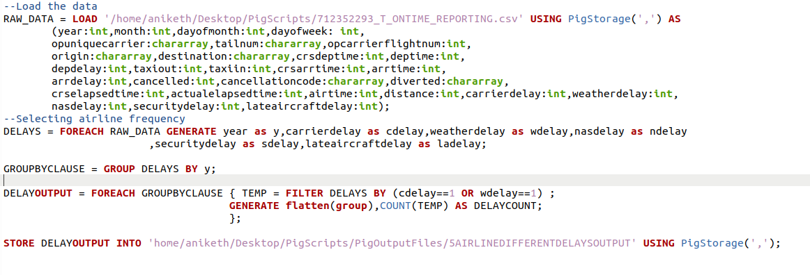
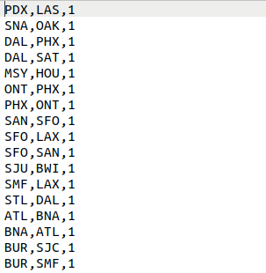
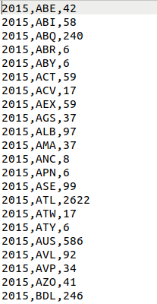
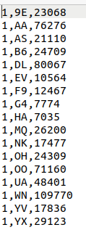
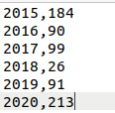
Pig Analysis Outcomes:

Slide 12
Observations made during analysis:
Analysis made by using Pig and Hive was relatively easier.
I performed few similar queries like “Total cancelled flights by year in ascending order” in hive and “Number of flights cancelled between 2015-2020 “ in Hadoop map reduce and found that the query was more faster in Hive.
Other queries were “Airline companies full name-Inner Join” in Hadoop mapreduce and “Airline flighcompany names : Used inner join by mapping other carrier dataset from HDFS” in hive and found similar results. Hive was way faster in this query when compared to above query.
Coming to Pig ,I ran the “Airlines Delay Count By Year(Based on Carrier Delay or Weather Delay)” script and the “Number of flights delayed per year” mapreduce program which are similar queries and found that Pig query performance was much better.
When we compare in terms of “ease of programming” obviously Pig and Hive were easier to use and run our analysis when compared to mapreduce programs

Slide 13
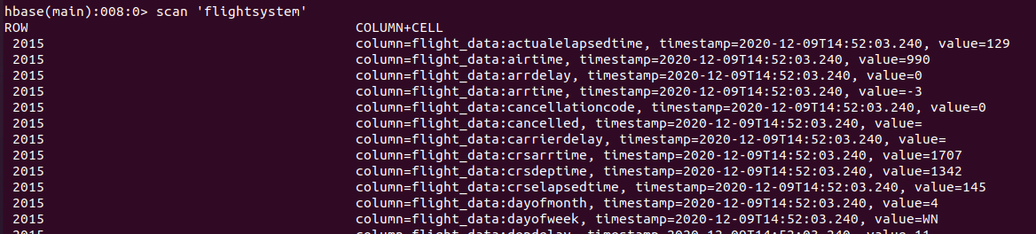
HBASE:
Mapped the dataset from HDFS to HBase
HBase Schema Design:
FLIGHT SYSTEM TABLE
ROW | ColumnGroup(flight_data)
Year | Month Dom Dow Uc Tn Fn Origin Dest Crsdep -----------------

Slide 14
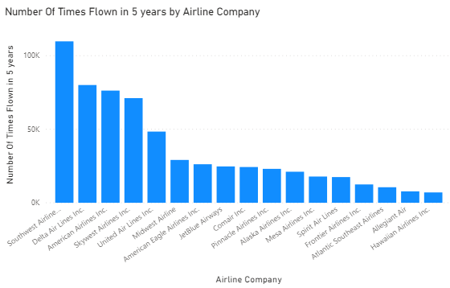
Visualization Reports:
1)AirlineFlightCount

Slide 15
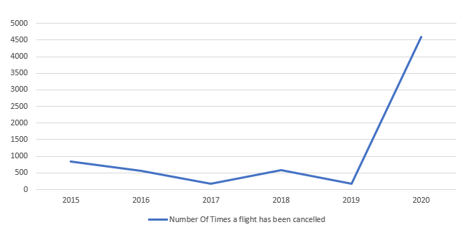
Visualization Reports:
2) Number of times a flight got cancelled based on year

Slide 16
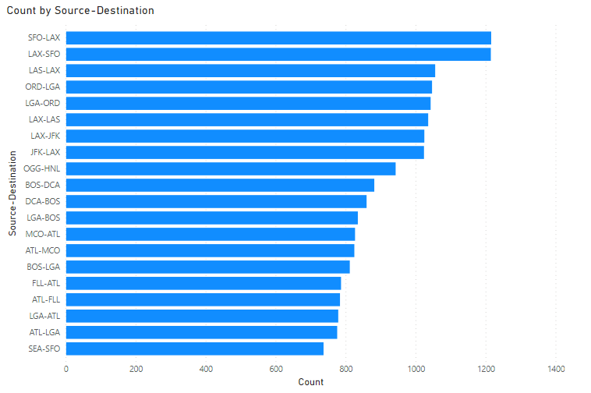
Visualization Reports:
3)Top30SrcDest

Slide 17
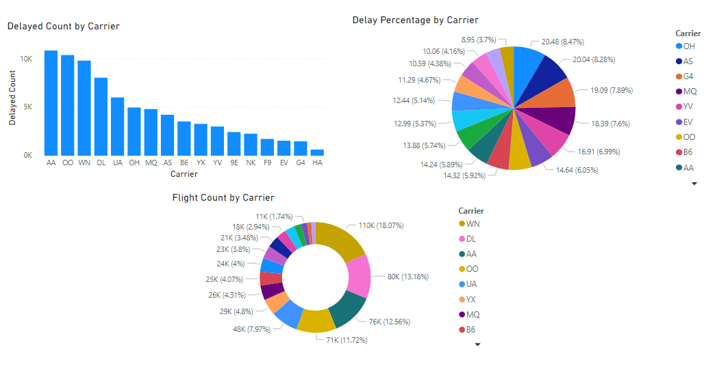
Visualization Reports:
4)Average Delay Percentage:

Slide 18


