Slide 1

DAY CARE PROJECT
Johnson Aniketh Nagamallah

Slide 2
Project Goals:
Enroll students
Track registration events
Track immunization records
Assign students to Teachers according to state regulations
Assign student/teacher Groups to classrooms according to state regulations

Slide 3
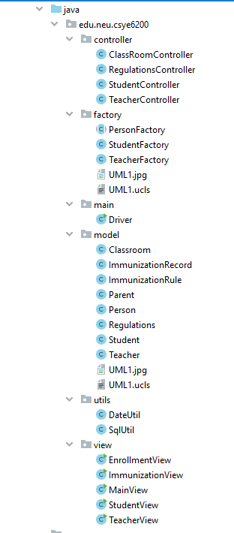
Design Features
Learned from Lectures:
Gang Of Four Factory Design Pattern
Singleton Design Pattern
Model View Controller Design Pattern
Used Java Stream APIs and exception handling.
GUI : Java Swing
Independently Learnt:
Database : MySQL
UML Generator : ObjectAid Plugin
Sequence Diagram : ZenUML

Slide 4
Driver
StudentController
TeacherController
MainView
readStudentsFromCSV
readTeachersFromCSV
StudentView
TeacherView
ImmunizationView
EnrollmentView
MySQL
Enrolled Students

Slide 5
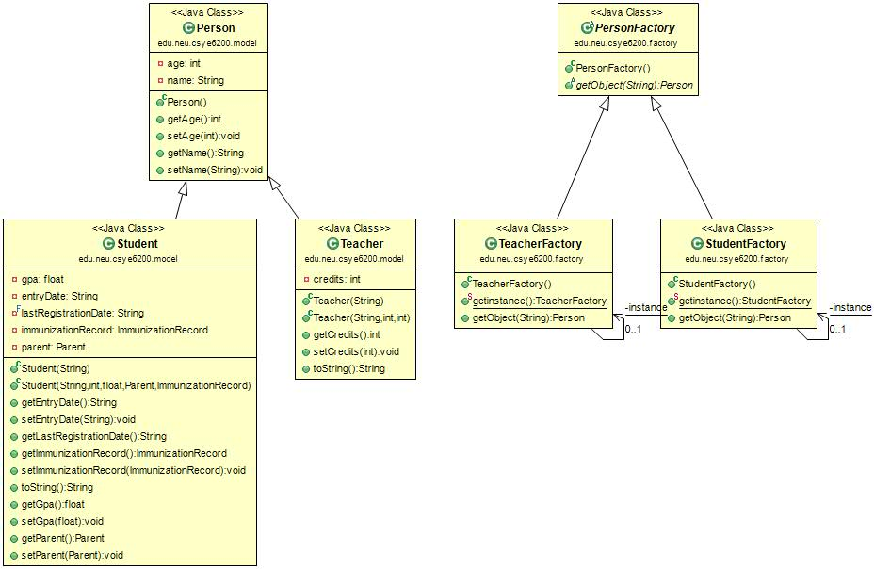
Class Diagram:

Slide 6
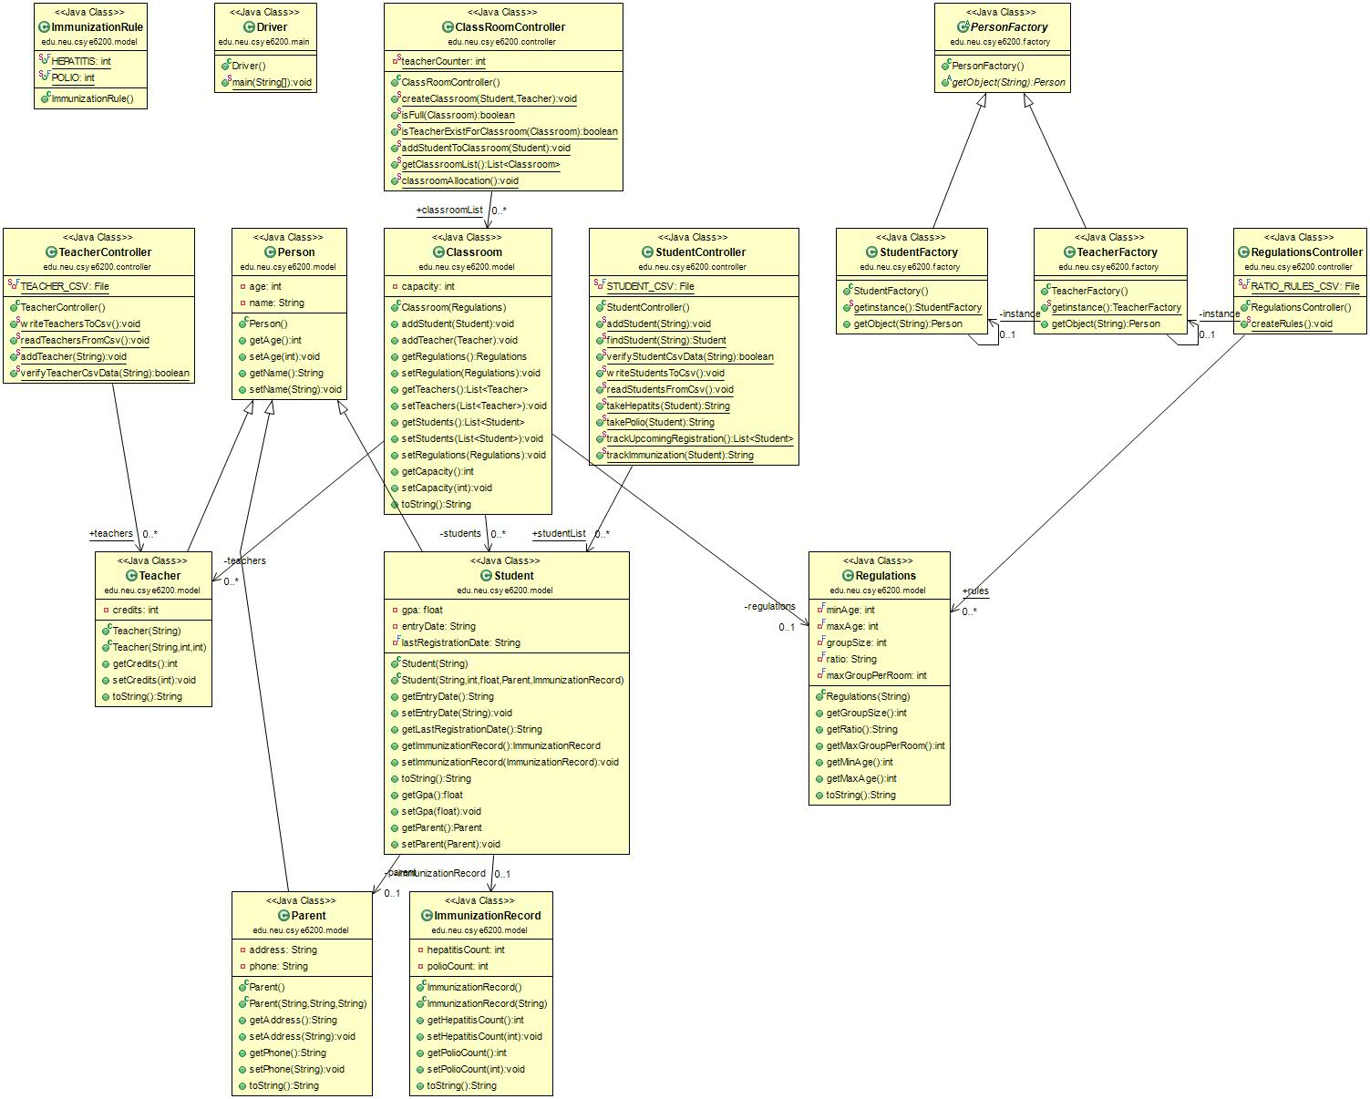

Slide 7
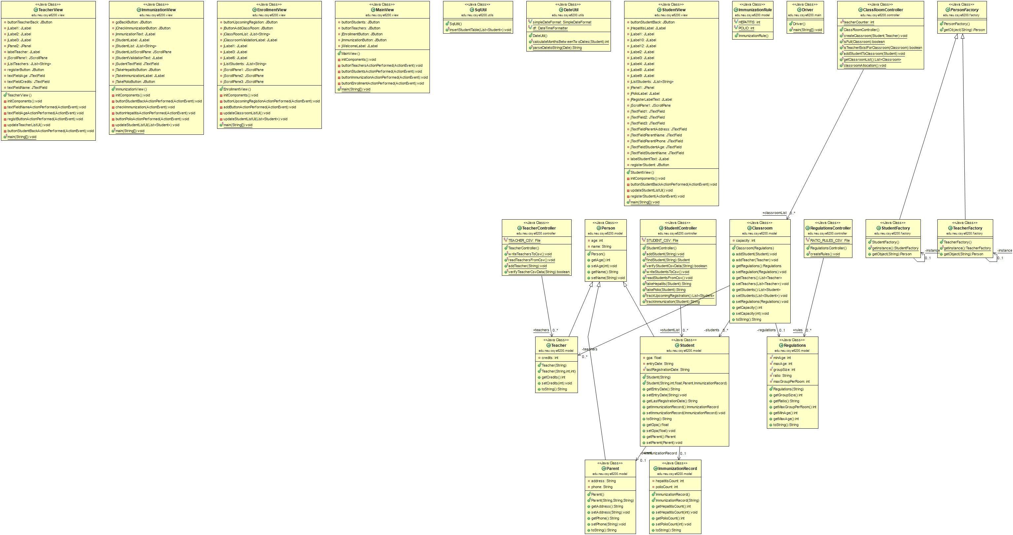

Slide 8
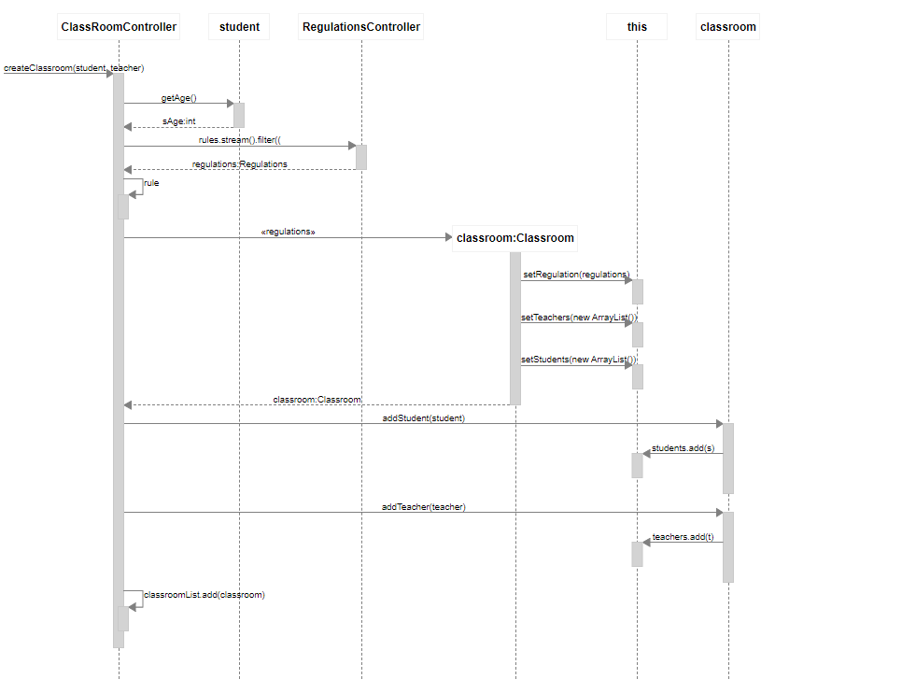
Sequence Diagram:
Classroom Controller

Slide 9
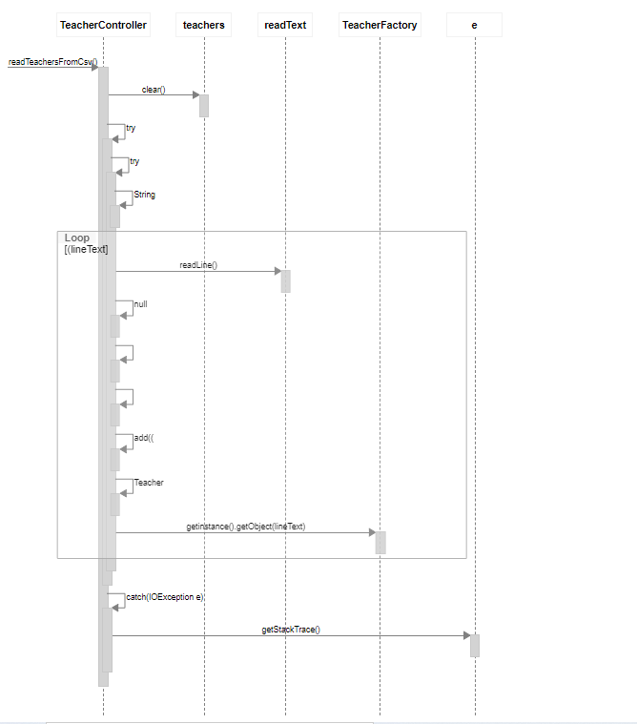
Sequence Diagram:
Teacher Controller

Slide 10
Operation Instructions:
-Run the application.
-Enter the student’s details in the students window.
-Enter the teacher’s details in the teachers window.
-There’s a separate window to track all the immunization records of students and see if the student meet’s all the requirements.
-In the enroll window,check the upcoming students to be registered and add students to the classroom accordingly.
-Make sure that the MySQL is up and running to ensure that all the enrolled student data is dumped into the student table in the daycare db.

Slide 11
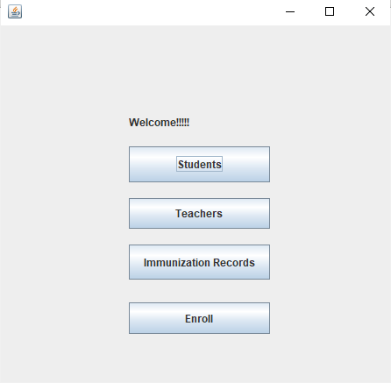
STEP 1:Main Window
1)When we run the application ,a welcome window opens.Each button has various functionalities:
a)Students:This button open a student window containing information of students and parents who can be added to the system.
b)Teachers:This button opens a teacher window containing information of teachers who can be added to the system
c)Immunization Records:This button opens a window and has information to track immunization records.
d)Enroll:This button opens a window and has information about the upcoming/overdue registration events.Here we enroll teachers/students to a classroom.

Slide 12
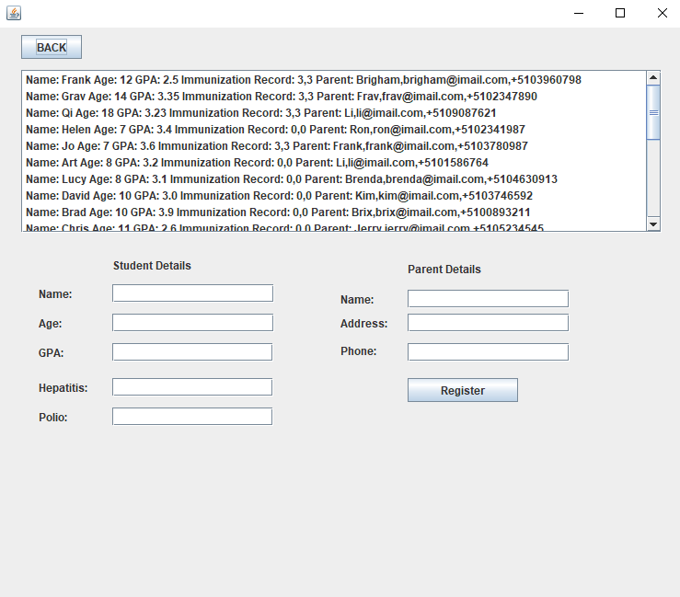
STEP 2:Students window
Here all the students information is displayed.There’s validation for:
a)Any missing field.
b)Age,Hepatits,Polio textfields.
When you register the student the display is updated.

Slide 13
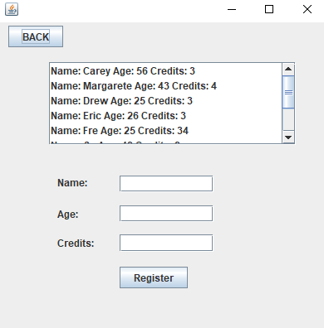
STEP 3:Teachers window
Here you can add teachers and the display is updated accordingly.There’s a validation for:
a)Any missing field
b)The teachers credit should be >=3

Slide 14
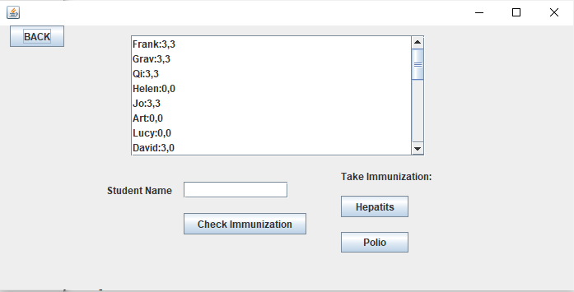
STEP 4:Immunization window
Here you can track the status of immunization for each student.You can check the amount of dosage of Hepatits/Polio for each student,in order to be enrolled to a classroom.If the student does’nt meet the requirements he can take the required dosages by clicking the buttons “Hepatits” and “Polio”.The display automatically updates when the student takes a dosage.
There is validations for:
1)Empty fields
2)Show a prompt that the student does’nt need a immunization dosage.

Slide 15
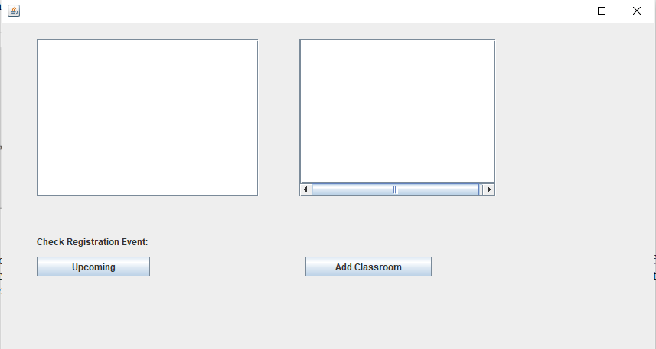
STEP 5:Enrollment window
This window consists of all the details about the enrollment.Here we can track the list of students who have upcoming registrations and the first window is updated if there are any upcoming registrations or else a prompt is showed that there is an overdue .The add class room will make the allocations of students/teacher based on the regulations.The second window is updated when a classroom is created.

Slide 16
THANK YOU

