Slide 1
zekeLabs
Learning made Simpler ! www.zekeLabs.com

Slide 2
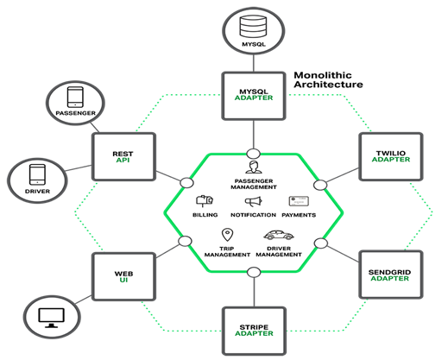
Monolithic Architecture

Slide 3
Monolithic Architecture Features
Easy to Build and Maintain Applications
Provides Continuous Delivery
Flexibility to Use Various Tools for the Required Task
Offers Cross-Team Coordination
Provides High-Quality Code
Provides Granular Scaling
Reduces Risk
Promotes Big Data Practices
Use Minimal Resources With Reduced Cost of Ownership

Slide 4
Monolithic Architecture Challenges
Agility
Scalability
Fault Tolerance
Tightly Coupled
Redeploy entire application on each update
Continuous deployment is difficult

Slide 5
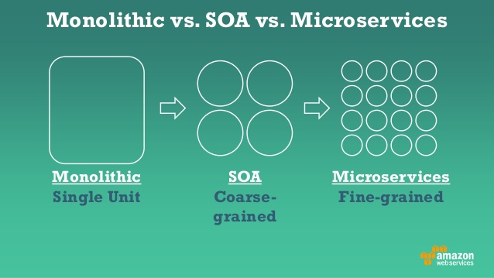
Monolithic vs. Service Oriented Architecture vs. Microservices

Slide 6
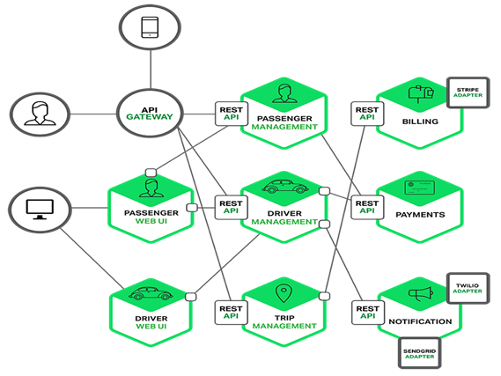
Microservice Architecture

Slide 7
Microservice Architecture
Service Oriented Architecture composed of loosely coupled elements that have bounded contexts
Service Oriented Architecture - Services communicate with each other over the network
Loosely Coupled Elements - You can update the services independently; updating one service doesn’t require changing any other services.
Bounded Contexts - Self-contained; you can update the code without knowing anything about the internals of other microservices

Slide 8
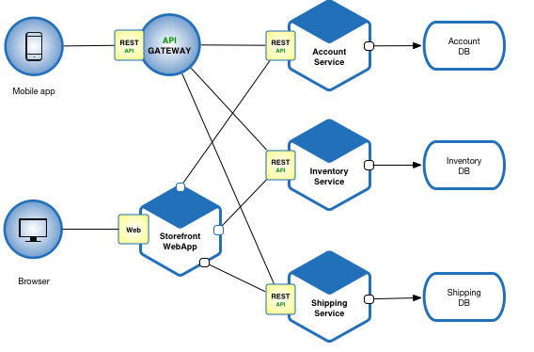
Microservice Architecture - e-commerce application

Slide 9
Benefits of Microservice Architecture
Enables the continuous delivery and deployment of large, complex applications.
Better testability - services are smaller and faster to test
Better deployability - services can be deployed independently
It enables you to organize the development effort around multiple, auto teams.
Each microservice is relatively small
Easier for a developer to understand
The IDE is faster making developers more productive
The application starts faster, which makes developers more productive, and speeds up deployments
Improved fault isolation. If there is a memory leak in one service then only that service will be affected. The other services will continue to handle requests.
Eliminates any long-term commitment to a technology stack.

Slide 10
Drawbacks of Microservice Architecture
Developers must deal with the additional complexity of creating a distributed system.
Developer tools/IDEs are oriented on building monolithic applications and don’t provide explicit support for developing distributed applications.
Testing is more difficult
Developers must implement the inter-service communication mechanism.
Implementing use cases that span multiple services without using distributed transactions is difficult
Implementing use cases that span multiple services requires careful coordination between the teams
Deployment complexity. In production, there is also the operational complexity of deploying and managing a system comprised of many different service types.
Increased memory consumption.

Slide 11
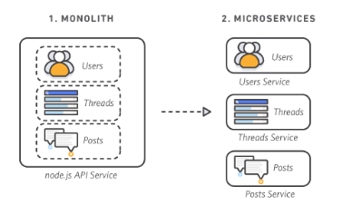
Breaking a monolithic application to microservices

Slide 12
Service and Microservice
A service typically implements a set of distinct features or functionality, such as order management, customer management, etc.
Each microservice is a mini-application that has its own hexagonal architecture consisting of business logic along with various adapters.
Some microservices would expose an API that’s consumed by other microservices or by the application’s clients. Other microservices might implement a web UI.
At runtime, each instance is often a cloud virtual machine (VM) or a Docker container.

Slide 13
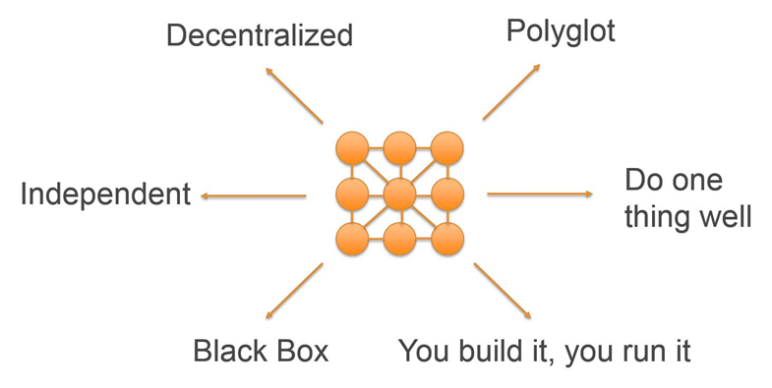
Characteristics of Microservices

Slide 14
Characteristics of Microservices
Decentralized
Microservices architectures are distributed systems with decentralized data management. They don’t rely on a unifying schema in a central database
Independent
Different components in a microservices architecture can be changed, upgraded, or replaced independently without affecting the functioning of other components
Do one thing well
Each microservice component is designed for a set of capabilities and focuses on a specific domain.

Slide 15
Characteristics of Microservices
Polyglot
Microservices architectures take a heterogeneous approach to operating systems, programming languages, data stores, and tools.
Black box
They hide the details of their complexity from other components
You build it; you run it
The team responsible for building a service is also responsible for operating and maintaining it in production

Slide 16
Benefits of Microservices
Agility
Flexible Scaling
Easy Deployment
Technological Freedom
Reusable Code
Resilience

Slide 17
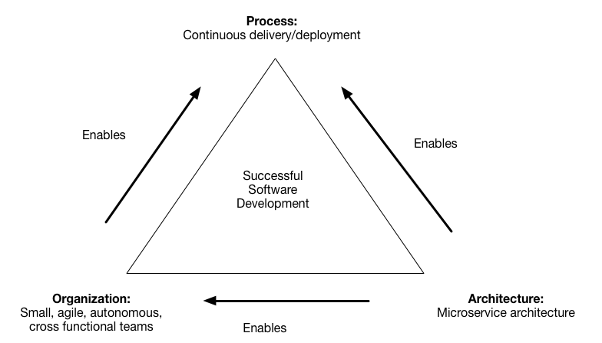
Decompose by business capability

Slide 18
THANK YOU !
Let us know how can we help your organization to Upskill the employees to stay updated in the ever-evolving IT Industry.
Get in touch:
www.zekeLabs.com | +91-8095465880 | info@zekeLabs.com
Visit : www.zekeLabs.com for more details

