Slide 1

COMPUTER HARDWARE

Slide 2
COMPUTER HARDWARE PRESENTATION BY GROUP 7
Name of lecturer
Bright S.K. Anibrika

Slide 3
Computer Hardware
Name of faculty: Applied Science and Technology
Name of department: Computer Science
Title of presentation: Classification of all hardware devices
Course Name: computer Hardware
Name of group member and Index number
Nsiah Godfred 04/2023/2145D
Asiwoko Enoch 04/2023/2091D
Asare Enock : 04/2023/2187D
Degadzor Bright 04/2023/0705D
Asante Andrew Kwasi 04/2023/2061D

Slide 4
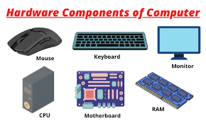
Classification of hardware devices
What are hardware devices: They are the external and internal devices and equipment that enable you to perform a major function of a computer system. Hardware are group into various type which include input devices, processing devices, output devices, storage devices and data communication devices. Example of hardware devices include mouse, keyboard, monitor, system unit, etc.

Slide 5
Classification of hardware devices
Classification of hardware
Input devices
Processing devices
Output devices
Storage devices
Communication devices
Input devices
Input devices is any hardware component that allows a user to enter data and give instruction to the computer. It is the stage where we feed the computer with data to be convert it into machine readable form. Example of common input devices include keyboard, mouse, camera, microphone. Selecting the right input device for your needs is important for getting the most out of your computer.

Slide 6
Classification of hardware devices
Processing devices
It is the transformation of the input data to more meaningful form in the CPU (Central Processing Unit). When a computer receives a data form an input devices. Example keyboard it goes through an intermediate stage before it’s sent to an output devices. example monitor.
Example of processing devices
CPU (central processing unit )
GPU (Graphics Processing Unit )
Motherboard
Network card
Sound card
RAM (random Access Memory )

Slide 7
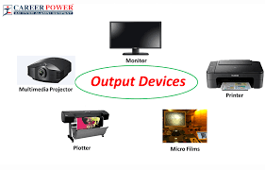
Classification of hardware devices
Output devices
"Output devices are components of a computer system that provide information to users in various forms, such as text, images, sound, or video. Here's some information about common output devices:
Monitor: Also known as a display screen or screen, a monitor visually displays text, images, videos, and other graphical information generated by the computer's CPU.
Speakers: Speakers output audio generated by the computer, allowing users to hear sound effects, music, voice-overs, and other audio content.
Headphones: Similar to speakers, headphones deliver audio output to users but in a more private manner. They're often used for listening to music, audio calls, or multimedia content without disturbing others.

Slide 8
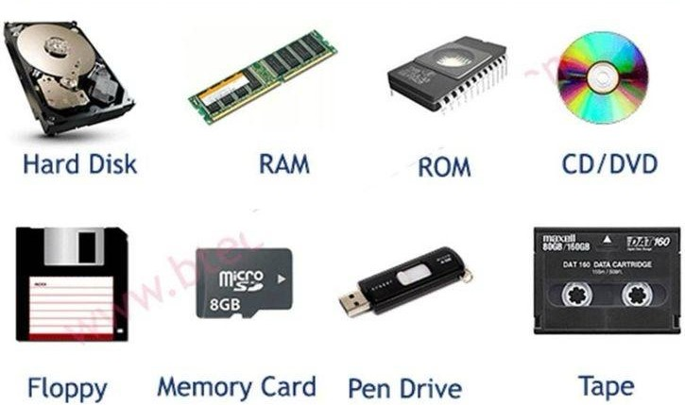
Classification of hardware devices
Storage devices
The storage unit is a part of the computer system which is employed to store the information and instructions to be processed. A storage device is an integral part of the computer hardware which stores information/data to process the result of any computational work. Without a storage device, a computer would not be able to run or even boot up. Or in other words, we can say that a storage device is hardware that is used for storing, porting, or extracting data files. It can also store information/data both temporarily and permanently.

Slide 9
Classification of hardware devices
Types of Computer Memory
Primary Memory Secondary Memory Tertiary Memory
Primary Memory: It is also known as internal memory and main memory. This is a section of the CPU that holds program instructions, input data, and intermediate results. It is generally smaller in size. RAM (Random Access Memory) and ROM (Read Only Memory) are examples of primary storage
Secondary Memory: Secondary storage is a memory that is stored external to the computer. It is mainly used for the permanent and long-term storage of programs and data. Example Hard Disks, CDs, DVDs, Pen/Flash drives, SSD
Tertiary Memory: Tertiary Memory is a type of Memory that is rarely used in personal computers and due to this, tertiary memory is not considered to be an important one. Tertiary memory works automatically without human intervention.

Slide 10
Classification of hardware devices
Data communication
A data communication device is any hardware component or device that facilitates the transmission of data from one point to an other. These devices are essential for sending and receive data over network. Example include; modems, switches, network interface cards, hubs, routers, smartphones, Television remote control.
Hubs: Connect multiple devices in a network.
Routers: Direct data between different network, such as between a local network and the internet.
Switches: Direct data within a network to its intended destination.
Smartphones: Combines multiple communication features likes calls, text, messages, internet, browsing and mobile apps.
Television remote controls: Enable users to interact with TVs for changing channels, adjusting volume and accessing feature

