Slide 1
DataSci 223 Final Project

Slide 2
Table of contents
Problem
Description of dataset
Data cleaning
Exploratory data analysis
Model
Results

Slide 3
Problem: Predict CHD risks from BRFSS data
Coronary heart disease (CHD) is a common health risk for men above the age of 45 and for women above age of 55. CHD is often caused by plaque build-up in blood vessels, obstructing blood flow, preventing sufficient oxygen from reaching the heart.¹ Risk factors of CHD include age, family history, obesity, hypertension, diabetes, lack of exercise and smoking status.²
Although many prediction models were built to estimate CHD risk with clinical data such as LDL-C count, HDL-C counts, systolic blood pressure, and diastolic blood pressure, this project aims to establish an affordable and personalized approach to predict and address CHD risk. Not many models assess the ability of questionnaire data to predict CHD risk.
Goal of this project is to build and assess the stability of a CNN model that predicts CHD risks from questionnaire data.
Notes:
1. Coronary Heart Disease - Causes and Risk Factors | NHLBI, NIH. NHLBI, NIH. https://www.nhlbi.nih.gov/health/coronary-heart-disease/causes.
2. Coronary Heart Disease - Causes. nhs.uk. https://www.nhs.uk/conditions/coronary-heart-disease/causes/. Published February 6, 2024.

Slide 4
Description of the dataset
Behavioral Risk Factor Surveillance System (BFRSS) is a nation-wide survey conducted through telephone calls into households in the United States. One participant from each household completes the questionnaire by answering a series of questions related to demographics, lifestyle, chronic health conditions, and health-related risk behaviors . Question sets in the questionnaire may differ year to year. For the purpose of this project, survey data from 2015 was selected.³
Notes:
3. Centers for Disease Control and Prevention. (2017, August 24). Behavioral risk factor surveillance system. Kaggle. https://www.kaggle.com/datasets/cdc/behavioral-risk-factor-surveillance-system

Slide 5
Data Cleaning - Variable selection
Input features:
4 Demographic variables: sex, race, age5y, ever_married
age5y: age in 5 year categories
3 Socioeconomic status variables: education, income, employment
3 Health variables: diabetes, hypertension, bmi
5 Behavioral variables: smoke, vegetable, fruit, binge_drink, exercise
Vegetable / fruit : Binary variable of 0/1 of if vegetables or fruits were consumed one or more times per day
binge_drink: Times of binge drinking in past 30 days (having five or more drinks on one occasion for males OR having four or more drinks on one occasion for females)
Outcome: chd occurrence coded as 0/1

Slide 6
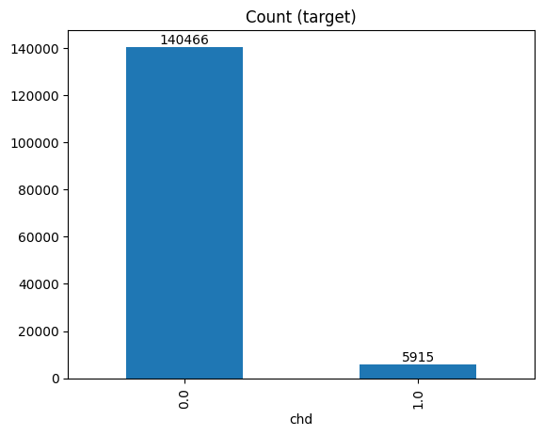
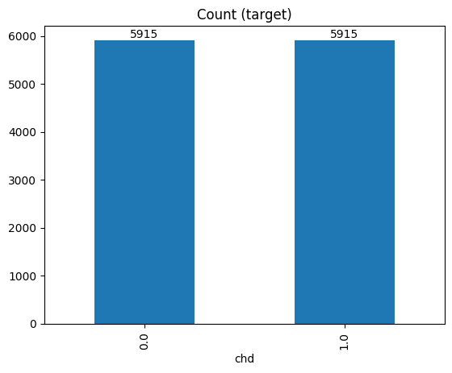
Data Cleaning - Data imbalance
random sampling from chd=0
Since there was a lot more data in the chd=0 group, data imbalance was handled by randomly sampling from the class with more samples (chd=0). This method of random sampling is simple to perform but can potentially create a subset that has different variable distribution than the original chd=0 group.
Notes:
The final balanced dataset was used to train the CNN model.
Code for random down-sampling is in the “ (Optional) Random downsampling” section of Clean Data.ipynb. However, in the CNN.ipynb notebook, preprocess_data(), a predefined function, also handles imbalanced data and perform random down-sampling.

Slide 7
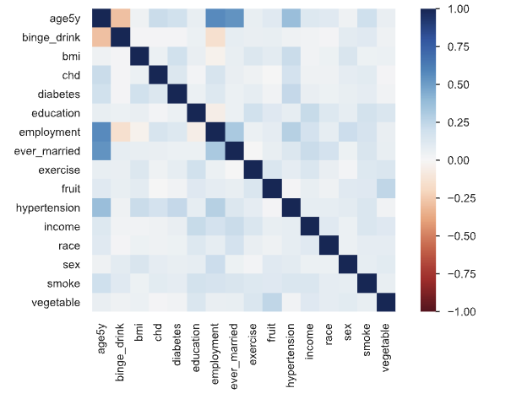
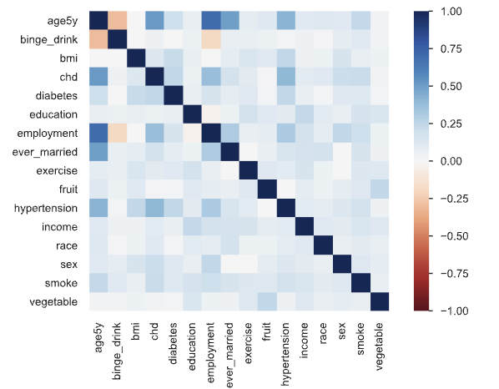
Exploratory data analysis: Heatmap generated with ydata-profiling
Notes:
After balancing the two classes, CHD correlation to to age, employment, hypertension, and diabetes look stronger. These results are somewhat expected.

Slide 8
Overview of tasks in each notebook
`Clean data.ipynb`
Select variables from BRFSS 2015
Clean selected data
Visualize data with ydata-profiling as a widget in the Jupyter notebook
(Optional) Use under-sampling to balance data between chd = 0 and chd = 1
Two outputs are saved into the same folder:
Imbalanced cleaned dataset: cleaned_data_imbalanced.csv
Balanced cleaned dataset: cleaned_data.csv
`CNN.ipynb`
Cleaned imbalanced data (cleaned_data_imbalanced.csv) is loaded into the Jupyter notebook
Data is down-sampled, formatted, and split into 7:3 training and testing set.
CNN is trained with 100 epochs.
5 repetitions were done for model training.
For each repetitions, precision, recall, f score, accuracy, miss rate, and fall out rate were recorded.
The training and validation loss and accuracy for each repetition was graphed.

Slide 9
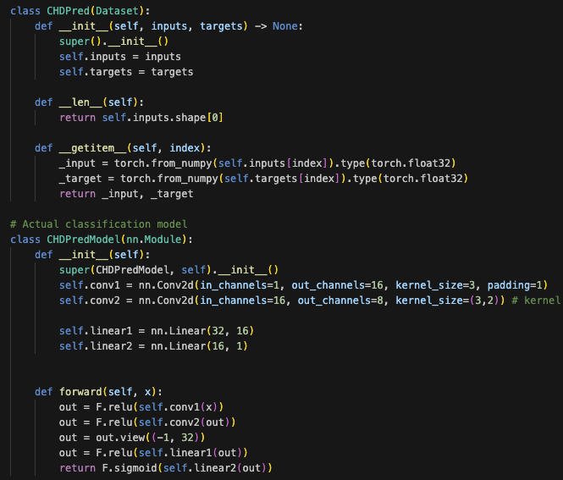
Model explanation
CNN model was taken from a manuscript that attempted to use the CNN model to predict stroke risk with tabular EHR data.³
Code of the model was adjusted to take in 3x5 tensor inputs instead of a 2x5 tensor inputs. Subsequent code was adjusted according to the input shape as well.
The model contains the following layers:
torch.Size([32, 1, 3, 5])
First convolutional layer with ReLu activation
torch.Size([32, 1, 3, 5])
Second convolutional layer with ReLu activation
torch.Size([32, 8, 1, 4])
A flatten layer
torch.Size([32, 32])
First linear layer with Relu activation
torch.Size([32, 16])
Second linear layer with Sigmoid activation
Notes:
4. Dev S, Wang H, Nwosu CS, Jain N, Veeravalli B, John D. A predictive analytics approach for stroke prediction using machine learning and Neural Networks. Healthcare Analytics. 2022;2:100032. doi:10.1016/j.health.2022.100032

Slide 10
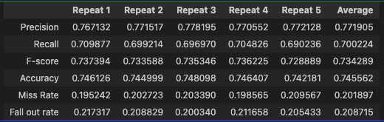
Results
Repeating 5 times shows that each trained model has quite stable performance in precision, recall, F-score, accuracy, miss rate, and fall out rate.

Slide 11
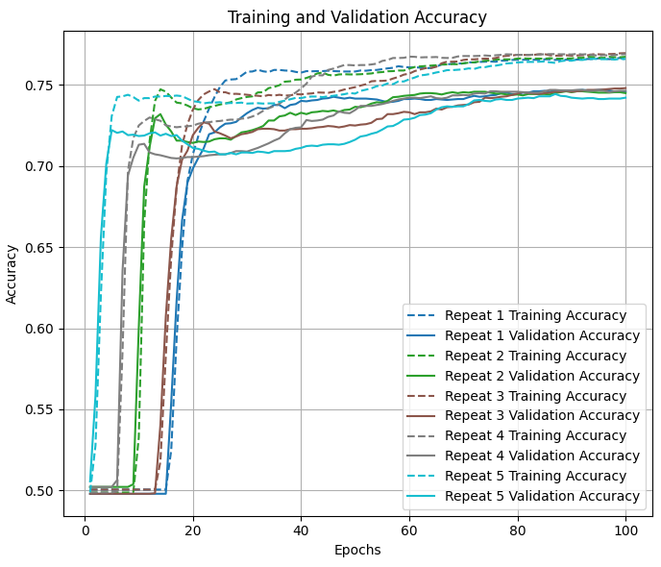
Decisions and Trade-offs
Variable recoding : some variables were regrouped, which may lead to a decrease in resolution.
Hypertension and diabetes: Females who were only told to have the condition during pregnancy and those who were told to be borderline high risk for the conditions were excluded.
Marriage status: Marriage status were grouped into 0 = never married or 1 = have married.
Smoking: Smoking was recoded into variable with 3 categories (never smoked, current smoker, former smoker).
Learning rate
Learning rate of the optimizer was decreased from 1e-4 in the original model to 1e-5. This may lead to more training time. However, 100 epochs has been shown to be enough to reach a plateau in accuracy.

Slide 12
References
Coronary Heart Disease - Causes and Risk Factors | NHLBI, NIH. NHLBI, NIH. https://www.nhlbi.nih.gov/health/coronary-heart-disease/causes.
Coronary Heart Disease - Causes. nhs.uk. https://www.nhs.uk/conditions/coronary-heart-disease/causes/. Published February 6, 2024.
Centers for Disease Control and Prevention. (2017, August 24). Behavioral risk factor surveillance system. Kaggle. https://www.kaggle.com/datasets/cdc/behavioral-risk-factor-surveillance-system
Dev S, Wang H, Nwosu CS, Jain N, Veeravalli B, John D. A predictive analytics approach for stroke prediction using machine learning and Neural Networks. Healthcare Analytics. 2022;2:100032. doi:10.1016/j.health.2022.100032

