Slide 1
Communication Tool:
Iteration 0
September 19, 2019

Slide 2
Team Roles
Team Member | Role(s)
Laura Kocubinski | Team Leader
Hang Shi | Backup Team Leader Requirement Leader
Xi You | QA Leader
Jhuanderson (Joe) Macias | Design and Implementation Leader
Mikhail (Misha) Chertushkin | Security Leader
Bofeng (Beven) Liu | Configuration Leader

Slide 3
Project Vision (Misha)
Build a web-based communication tool to facilitate real-time communication between members of a group or team
Similar to Slack, Skype for Business, Telegram, etc.
Important features include:
Low latency time
Direct messaging
Guaranteed message delivery
Easy sign-up and sign-in process
Nice-to-have features include:
Chatrooms
Emoji
Translation
Message statistics

Slide 4
High-Level Requirements (Hang)
Functional Requirements
Essential
User registration/login
1:1 text messaging
Real-time messaging
Error reporting
Non-Functional Requirements
Constraint
External interface
User interface
Error handling
Desired
Data background management: add/delete, change/check
Link sharing by third-party app (i.e. Instagram)
Emoji, image, attachment, and interest sharing
Quality
Reliability
Performance
Security
Maintainability
Portability

Slide 5
Management Plan (Laura)
Process Model
Agile-like iterative and incremental development process
Objectives and Priorities
The overall objective is to deliver a high-quality software tool by that facilitates real-time communication between team members
Each iteration (i.e. project milestone) and associated documentation should be completed on time
Each iteration should deliver high-quality software via testing and timely defect resolution
By the end of the project, all core customer requirements should be implemented

Slide 6
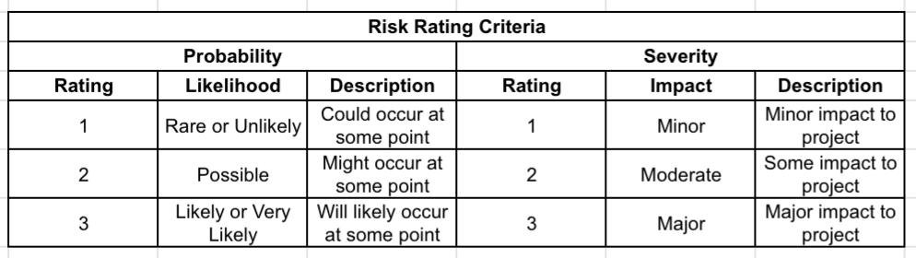
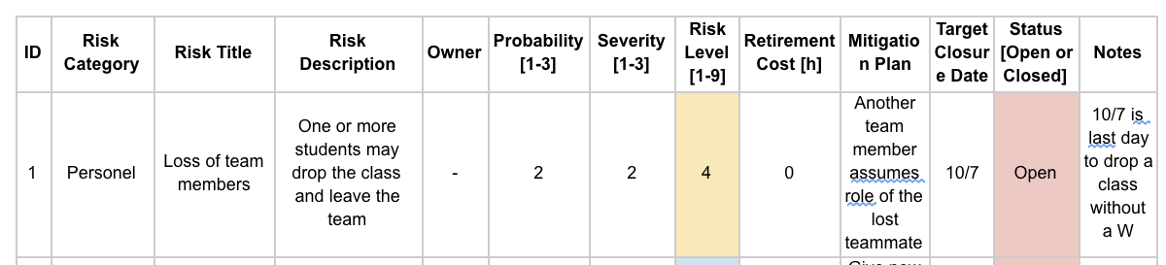
Management Plan Continued (Laura)
Risk Management

Slide 7
Management Plan Continued (Laura)
Monitoring and Controlling Mechanisms
GitHub will be used for revision control and defect tracking
Slack will be used for inter-team communication and alignment
Google Docs will to share project documents (SPPP, SDD, STD, minute minutes, etc.)
Pivotal Tracker will be used to manage software requirements (i.e. user stories) and to assign said user stories and tasks to team members

Slide 8
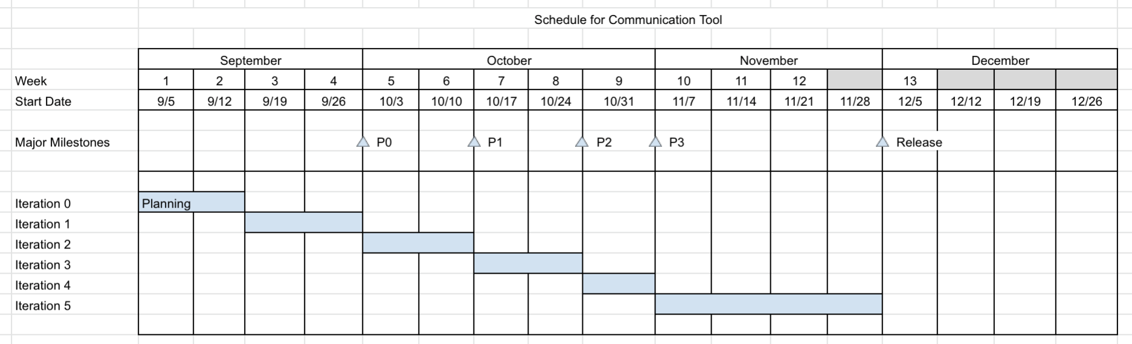
Management Plan Continued (Laura)
Schedules and Deadlines

Slide 9
Quality Assurance (QA) Plan (Xi)
Metrics
Product
Size/complexity, defect density, mean time to failure, customer problems, customer satisfaction
Process
Project milestones, effort (hours), lines coded per MM, testing progress, defect detection rate, defect resolution rate, productivity
Standards
Documentation
Template
IEEE 829-1998 (STD), IEEE 1016-1998
Code
Python - PEP 8
Database

Slide 10
Quality Assurance (QA) Plan (Xi)
Inspection/Review
Review as team at least once; repeated as necessary
Software requirements review (Requirements)
Architecture design review (Design)
Detailed design review (Design)
Test plan review (QA)
Verification and validation review (QA)
Testing
Unity Testing
Regression Testing
Integration Testing
Functional Testing
Nonfunctional Testing
Acceptance Testing

Slide 11
Configuration Management Plan (Beven)
Configuration Items and Tools
GitHub, Google Docs, Slack, Live Classroom/Zoom, Pivotal Tracker, Selenium
Change Management and Branch Management
Master branch, development branch
Code Commit Guidelines
All commits must be commented clearly and meaningfully.
Integration and Deployment
Individual units should be tested before integration

Slide 12




Architecture Design (Joe)
Client-Side
Server-Side

Slide 13
Related Work
https://slack.com
https://telegram.org/
https://www.flowdock.com/
https://www.whatsapp.com/
https://www.skype.com/en/business/

Slide 14
References
Braude, E. J., & Bernstein, M. E. (2016). Software Engineering: Modern Approaches. Long Grove: Waveland Press.

