Slide 1

Communication App:
Iteration 1
October 3, 2019
Laura Kocubinski, Hang Shi, Xi You, Jhuanderson (Joe) Macias, Mikhail (Misha) Chertushkin, Bofeng (Beven) Liu

Slide 2
Team Roles
Team Member | Role(s)
Laura Kocubinski | Team Leader
Hang Shi | Backup Team Leader Requirement Leader
Xi You | QA Leader
Jhuanderson (Joe) Macias | Design and Implementation Leader
Mikhail (Misha) Chertushkin | Security Leader
Bofeng (Beven) Liu | Configuration Leader

Slide 3
Requirement Analysis (Iteration 1) (Hang)
User stories implemented
As a user, I want to be able to send messages.
As a user, I want to create login credentials (email and password), so I can securely access my account.
As a user, I want to use my login credentials (email and password) to login and access my account.
As a user, I want to login my account and hope no one can join my account by mistake
As a database manager, I want to easily manage our customer database and no confuse about our login process.

Slide 4


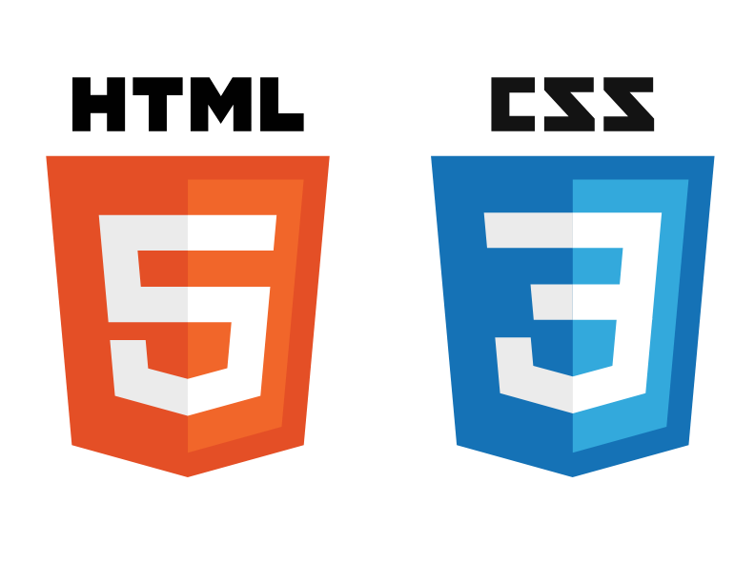


Web App Software Architecture: Diagram (Joe)
REST
HTTP Request
Client-Side
Server-Side

Slide 5
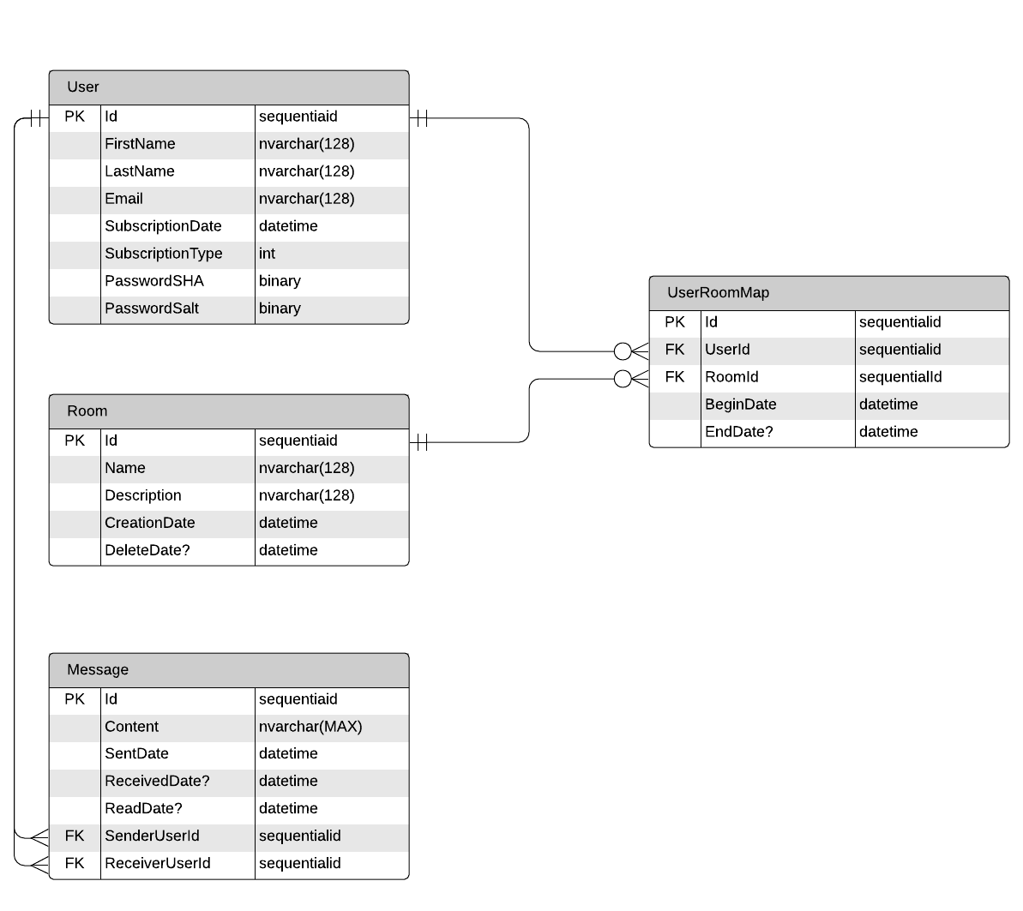
Web App Software Architecture/Design (Misha)
PostgreSQL ER-D

Slide 6
Web App Implementation (Joe)
Environment
Python virtualenv (feature_docker) branch for local development
$ pip install -r requirements.txt
Docker created Docker.yml.
Spins up a Linux Environment with all libraries expressed on the requirements.txt file
Framework
Django with local SQLite database (for now) -> PostgreSQL on AWS
Basic HTML/CSS for front-end

Slide 7
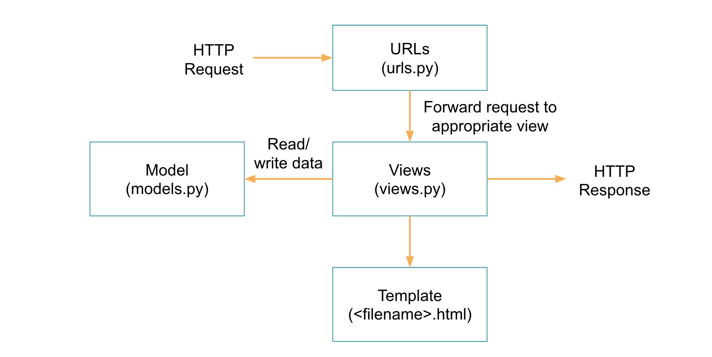
Web App Software Architecture/Design (Joe/Misha)
MTV Design Pattern
Single point of entity creation
I.e Rooms

Slide 8
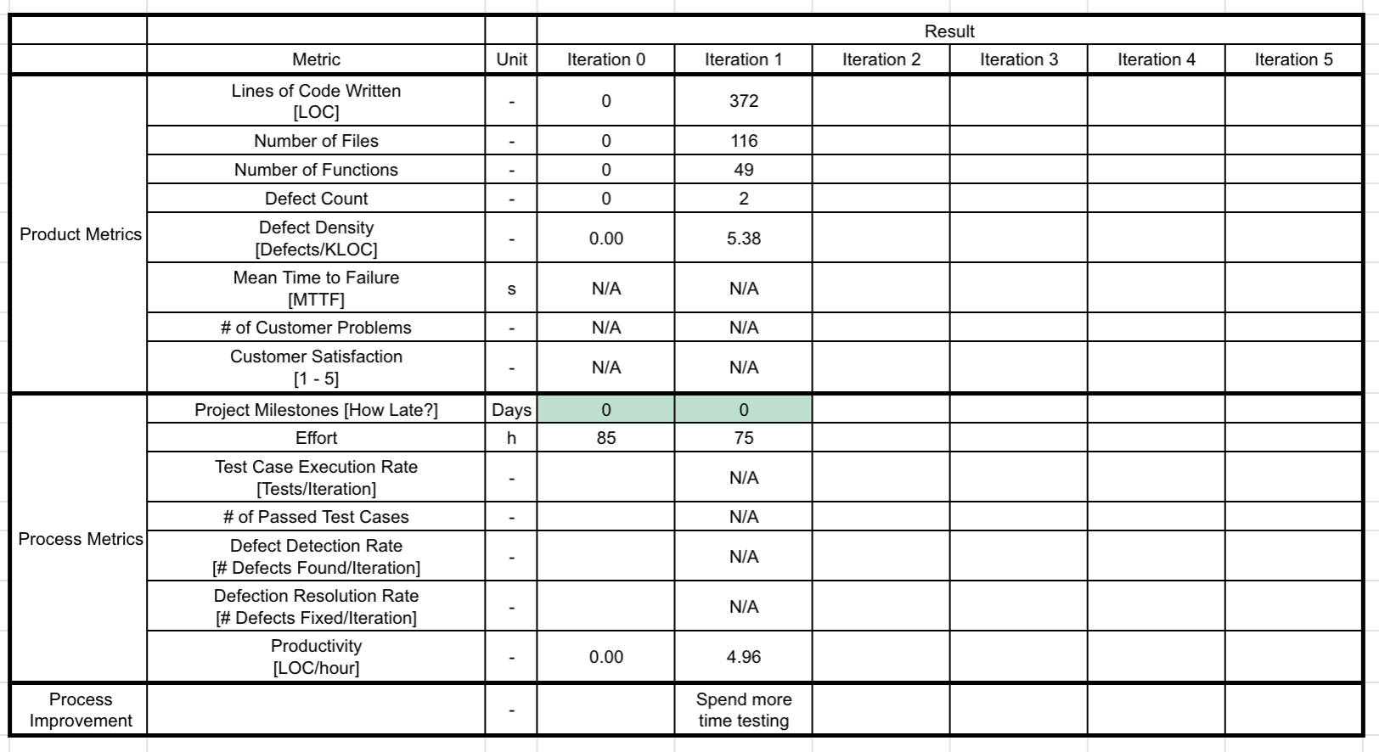
Product and Process Metrics (Laura)

Slide 9
Testing (Xi)
No testing done this iteration

Slide 10
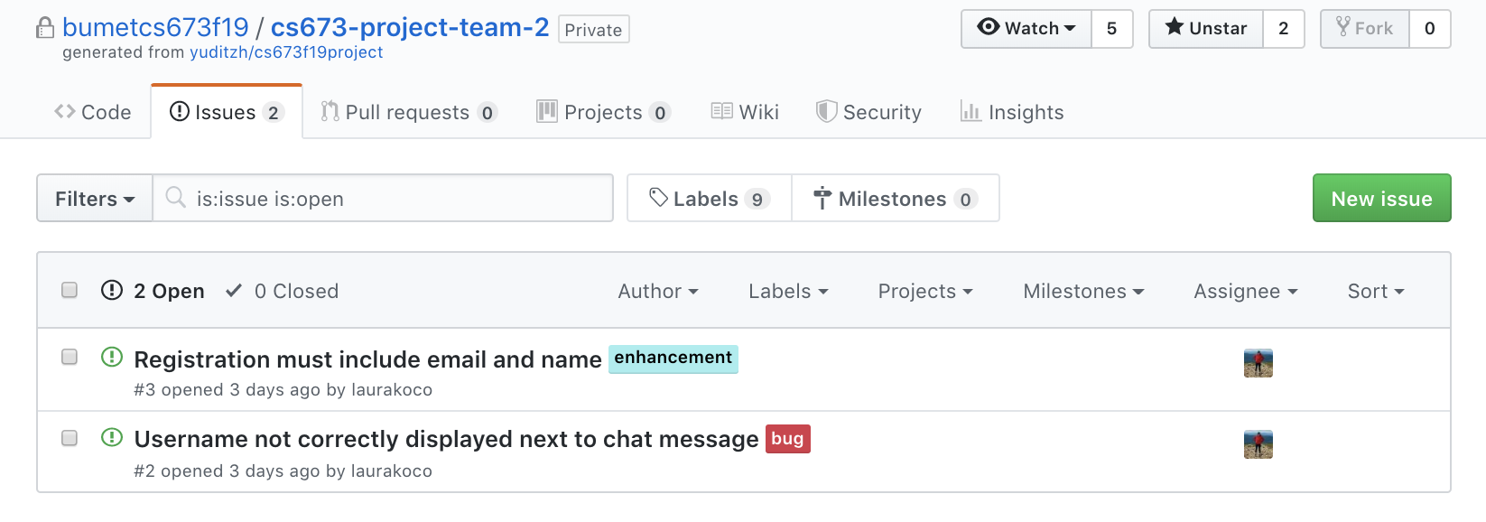
Defect Management and Metrics (Beven)
GitHub Issue Tracker

Slide 11
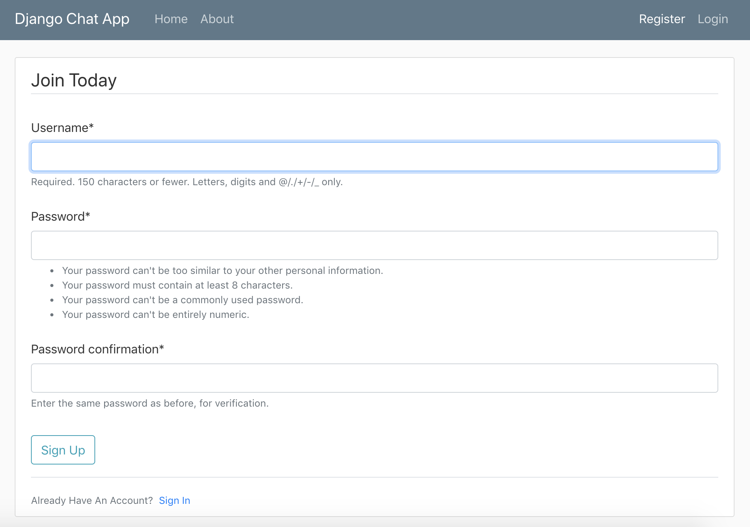
Software Demo (Laura)

Slide 12
Appendix: Django Data Flow
HTTP Request
URLs (urls.py)
Forward request to appropriate view
Read/ write data
Model (models.py)
Views (views.py)
HTTP Response
Template (<filename>.html)

