Slide 1

Communication App:
Iteration 3
October 31, 2019 (Halloween)
Laura Kocubinski, Hang Shi, Xi You, Jhuanderson (Joe) Macias, Mikhail (Misha) Chertushkin, Bofeng (Beven) Liu

Slide 2
Team Roles
Team Member | Role(s)
Laura Kocubinski | Team Leader
Hang Shi | Backup Team Leader Requirement Leader
Xi You | QA Leader
Jhuanderson (Joe) Macias | Design and Implementation Leader
Mikhail (Misha) Chertushkin | Security Leader
Bofeng (Beven) Liu | Configuration Leader

Slide 3

Requirement Analysis (Iteration 3)
User stories implemented this iteration
Completed
Allow user to update their profile (username, email, avatar)
Allow user to upload an avatar
In progress
Display user’s avatar next to sent message
User’s friends list
Direct messaging (1:1)
Display when a user has joined the chat room

Slide 4
Django Architecture (MTV)
HTTP Request
URLs (urls.py)
Forward request to appropriate view
Read/ write data
Model (models.py)
Views (views.py)
HTTP Response
Template (<filename>.html)

Slide 5
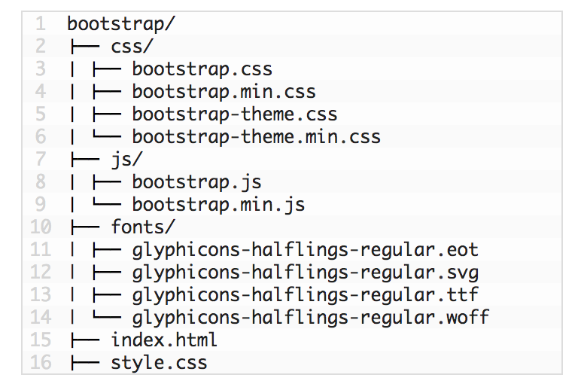
High-Level File Structure
/communication_app
/communication_app routing.py settings.py urls.py (url mapper) /about /chat /users /direct_messaging admin.py apps.py consumers.py routing.py tests.py urls.py models.py (model) views.py (view) /templates
/chat
template.html (template)

Slide 6

Bad Smells
Lack of comments
Duplicated code
Front-end not using the vue or the other structure
We have not combined the front-end and back end together
The process of testing in the interaction could not be easy

Slide 7
Testing Plan and Testing Results
Selenium automation testing
Unit test
User registration (Django’s UserCreationForm)
User login
Selenium
Main page’s button function or document related checking
System testing
Black box or white box?

Slide 8
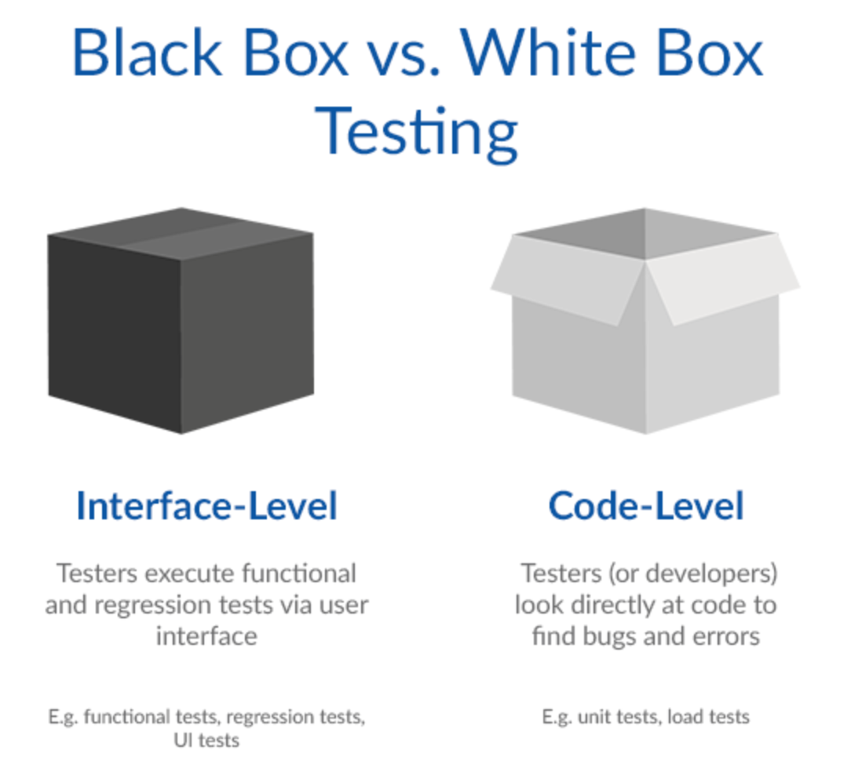
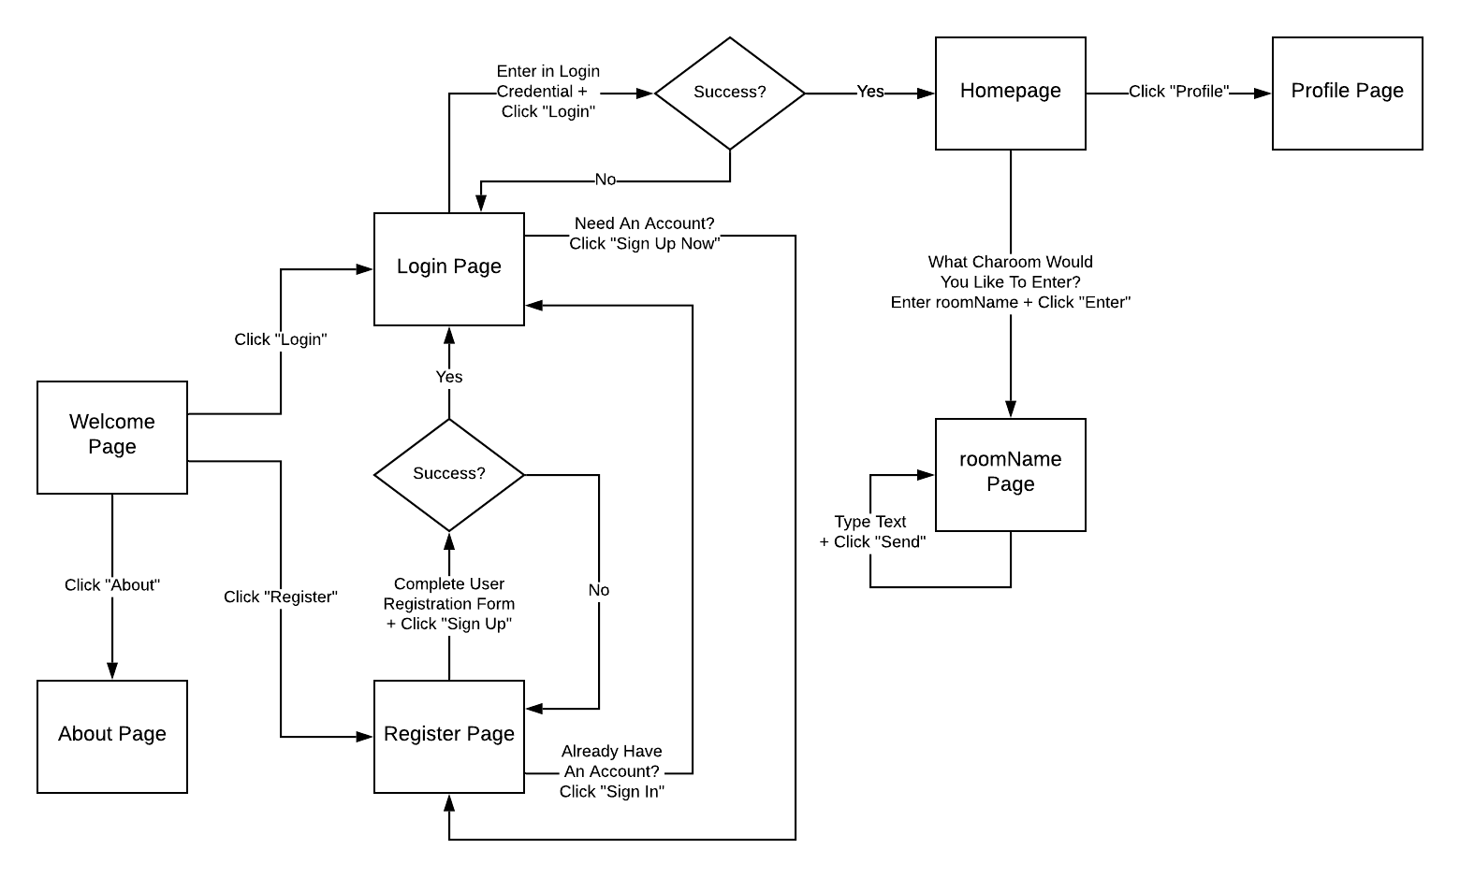
Front-end Black box testing
System process testing follow black-box testing
The test process follow the UI flow diagram

Slide 9
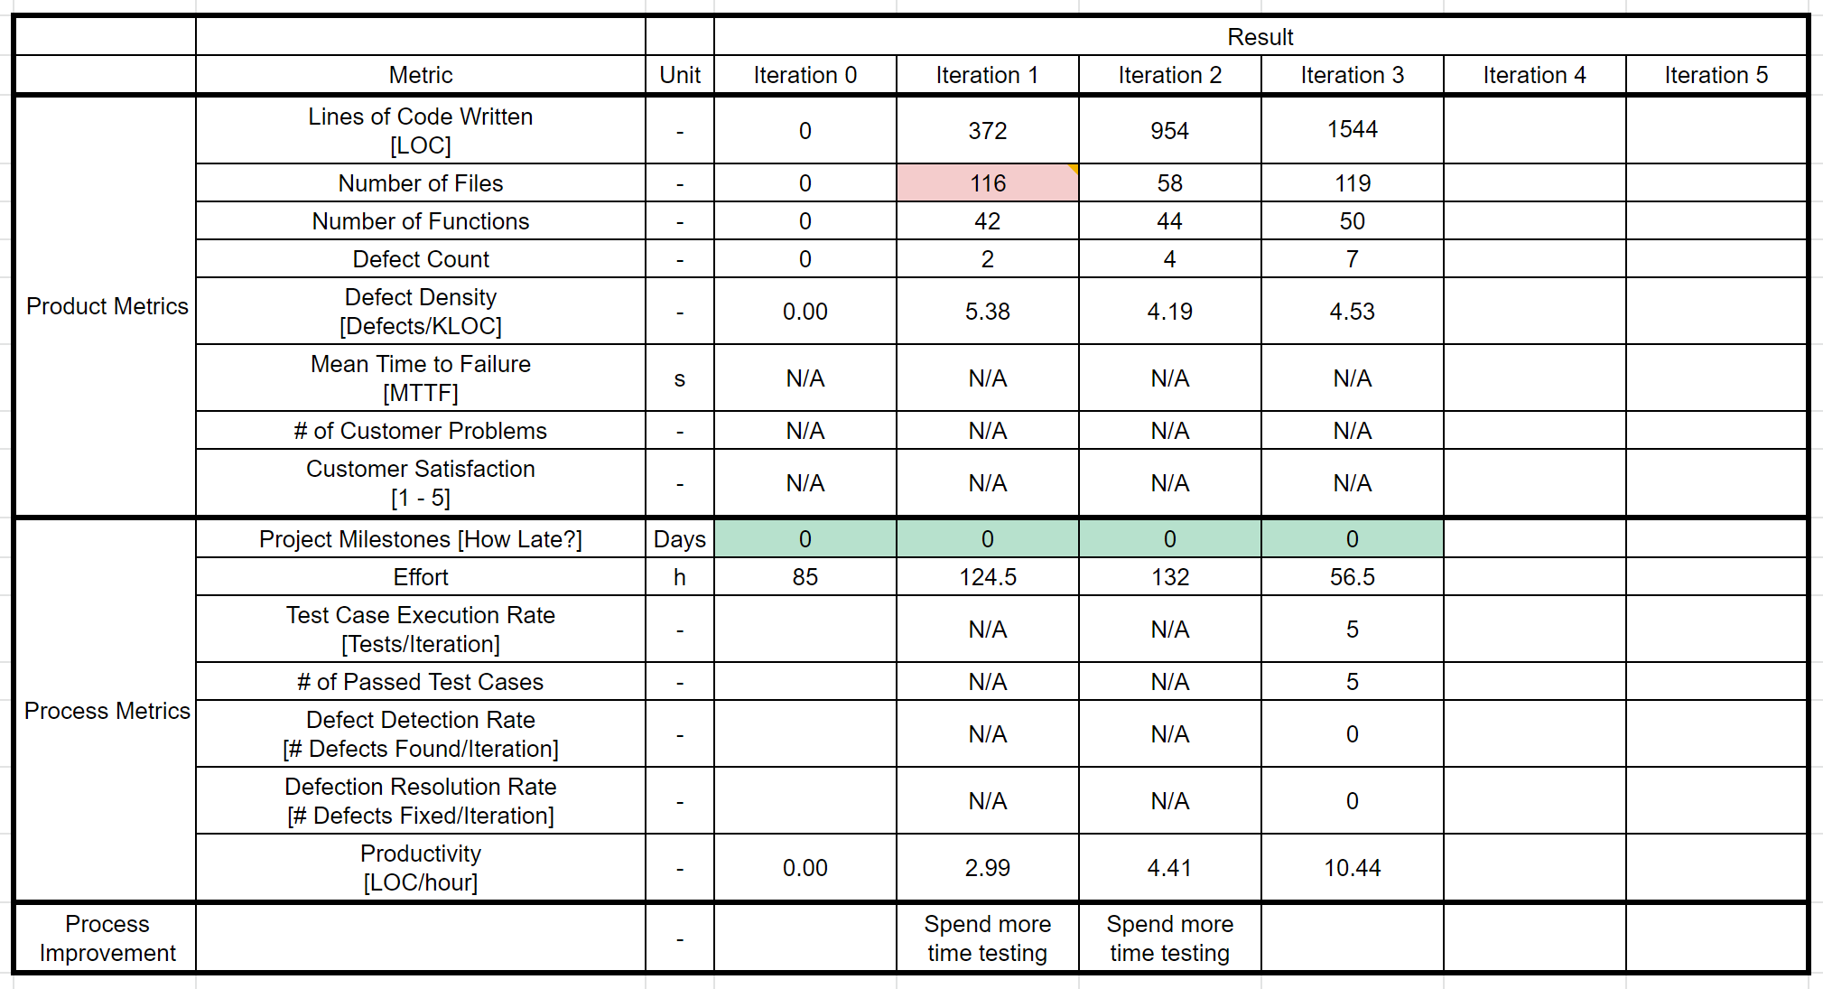
Process Metrics
Not all team members completed progress report

Slide 10
Process Improvements
Good practices that we’d like to keep
GitHub branches working well
Bad practices that we’d like to change
It’s really hard to evaluate the process as many don’t use GitHub Issue Tracker, PivotalTracker or fill in progress report
Lessons learned
Plans for next iterations
Emphasis will be on updating front-end and testing
Focus will not be on implementing new features

Slide 11

Software Demo

