Slide 1
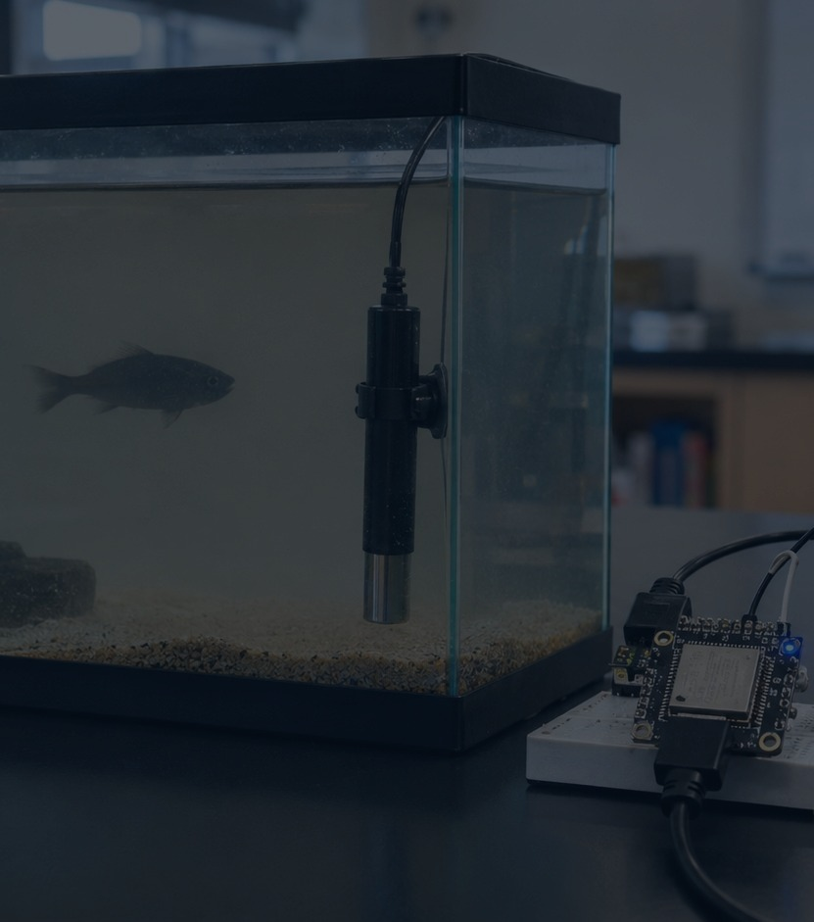
Water Turbidity Detection
Weekly Update
Hardware integration progress update
Sensor arrived. Wiring started. Measurement is not stable yet.
Done
Done
Now
Fixing
Image labeling
Research
Sensor wiring
Analog read error
Team members
104240336 Võ Văn Nhật Quốc · 104240141 Nguyễn Văn Tấn Tài · 104240400 Hồ Vũ Minh Đăng
1/5
Notes:
Good morning everyone. This is our weekly update for the Water Turbidity Detection project. Last week, we completed the early research stage and worked on labeling fish images for the image-quality part of the project. This week, the turbidity sensor has arrived, and our team started wiring the sensor with the microcontroller to read water turbidity values. The main progress is that the project moved from research into real hardware testing. However, the sensor reading is still not stable yet, so we are currently debugging the circuit and analog reading process.

Slide 2
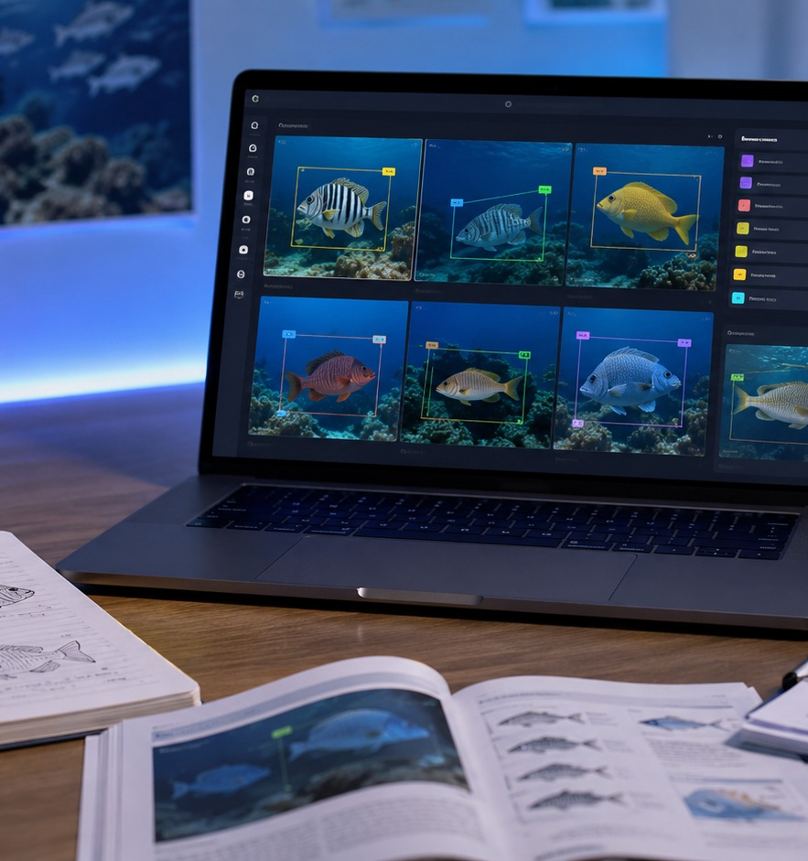
What We Completed Last Week
Progress
Research foundation + labeled image data + sensor purchasing.
Image labeling
Prepared fish image labels for later comparison with water clarity.
Sensor research
Studied turbidity sensor workflow: voltage reading → turbidity level.
Component order
Ordered the turbidity sensor and prepared ESP32 wiring plan.
Project repository: github.com/104240336-png/Water-Turbidity-Detection-
2/5
Notes:
Last week, our team focused on preparation work. First, we worked on image labeling so that later we can compare fish image clarity under different water conditions. Second, we researched how turbidity sensors work. The basic idea is that the sensor outputs an analog voltage, and the microcontroller reads that value to estimate the water clarity. Third, we ordered the sensor and started preparing the wiring plan based on our GitHub project direction and the references we studied. This gave us the foundation to move into hardware integration this week.

Slide 3
Current Hardware Integration
Hardware
The sensor is here, but raw readings still need debugging.
Sensor probe
ESP32 ADC
Serial output
Next
Placed in water
Reads analog signal
Shows raw value
OLED + cloud logging
Current issue
Debugging plan
Analog values are unexpectedly low / unstable.
Possible causes: wiring, ADC pin, power level, or calibration.
We are isolating the sensor before adding dashboard features.
Test ADC pin with GND and 3.3V.
Verify common ground and signal pin.
Compare readings in clean and cloudy water.
3/5
Notes:
This slide explains the current hardware stage. The turbidity sensor has been connected to the microcontroller, and we started reading analog values through the ESP32 ADC pin. At the moment, the system can print values to the Serial Monitor, but the values are not reliable enough for final measurement. We think the issue may come from wiring, power supply, ADC pin selection, or calibration. Our immediate plan is to test the ADC pin separately, check the common ground, verify the signal pin, and then compare clean water with cloudy water samples. We are fixing the sensor layer first before moving to OLED display and cloud dashboard.

Slide 4
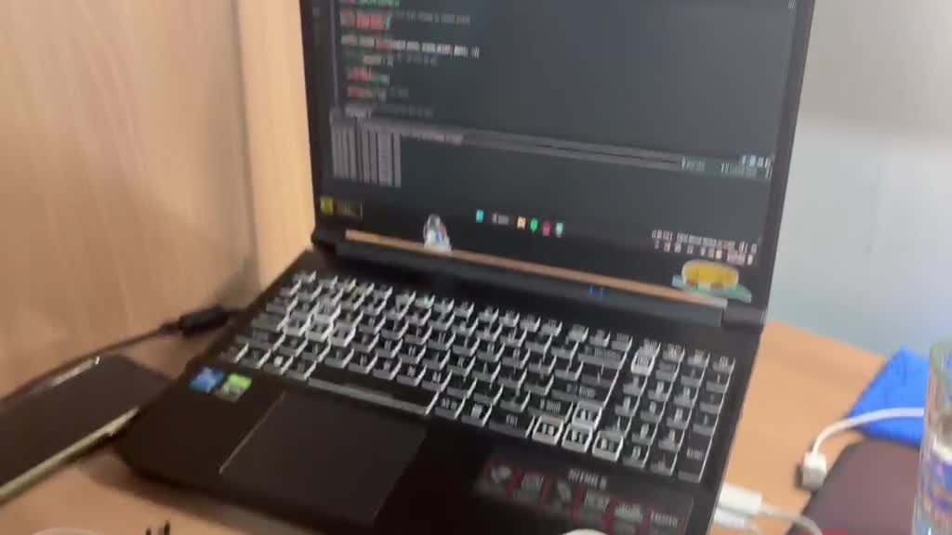
Video Proof of Hardware Testing
Proof
The team has started real sensor testing, not only research.
Observation
Sensor wiring is already being tested.
Serial Monitor shows changing analog readings.
The reading is still not calibrated enough for final results.
This is the current integration problem we are fixing.
Note: embedded video included as project evidence.
4/5
Notes:
This slide includes a video proof of our hardware testing. In the video, we can see that the team has already started connecting the turbidity sensor and reading values from the system. The important point is that this is no longer only a theoretical project. We are already testing real hardware. However, the current measurement is not final yet because the analog readings are still unstable or not calibrated. This proves our current progress and also shows the technical issue we need to solve next.

Slide 5
Next Steps and Expected Outcome
Next Sprint
Finish sensor debugging, then build the data pipeline.
1
Fix raw readings
Confirm ADC pin, power, GND, and signal wiring.
2
Create thresholds
Test clear, medium, and cloudy water samples.
3
Display status
Show CLEAR / CLOUDY / TURBID on OLED.
4
Log data
Push readings to GitHub codebase and cloud dashboard later.
Expected demo: sensor reads turbidity → ESP32 classifies water clarity → display shows if fish imaging is recommended.
5/5
Notes:
For the next sprint, our priority is to fix the raw sensor reading first. We will check the ADC pin, power connection, ground connection, and signal wiring. After that, we will collect readings from clear water, slightly cloudy water, and turbid water to create our own thresholds. Once the sensor reading becomes stable, we will connect the OLED display and show the water status directly on the device. The final expected demo is simple but practical: the sensor measures water turbidity, the ESP32 classifies the water clarity, and the display tells the user whether fish image capture is recommended.

