Slide 1
Lab. – Regression :House Sale Price Prediction
學號:104310023
班級:四電四甲
姓名:王柏翔

Slide 2
目錄
01 做法說明
02 程式方塊圖與寫法
03 畫圖做結果分析
04 討論預測值誤差很大的，是怎麼回事？
05 如何改進？

Slide 3
Part One
做法說明

Slide 4
01
Import package and Load .csv file
Feature selection
Feature Standardization
Create the model
Xgboost
Neural network
Predict and save
Part One
做法說明

Slide 5
01
Neural network
Part One
做法說明
Fit the model
Predict and save
Adjustment parameters
Compile the model
Set model parameter

Slide 6
01
Part One
做法說明
Xgboost
Set XGB parameter
Fit the model
Predict and save
Adjustment parameters
Difficult!!!

Slide 7
Part Two
程式方塊圖與寫法

Slide 8
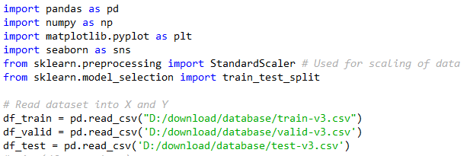
02
Part Two
程式方塊圖與寫法
Import package and Load .csv file

Slide 9
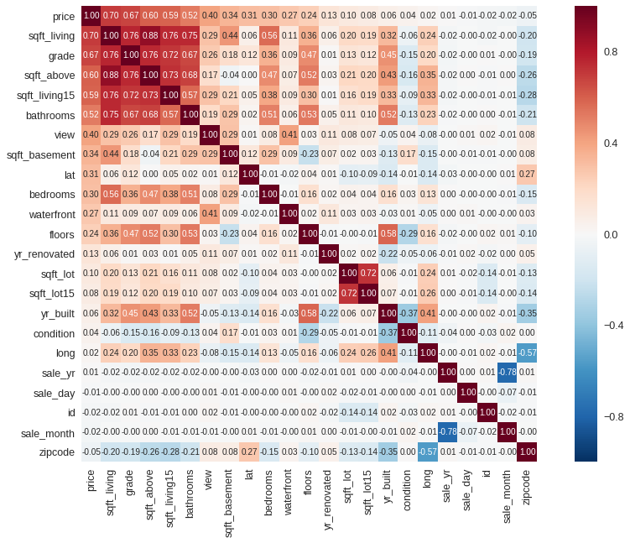
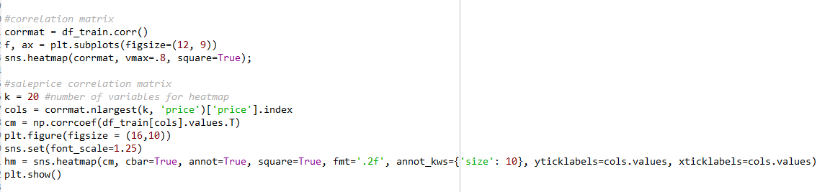
02
Part Two
程式方塊圖與寫法
Feature selection

Slide 10
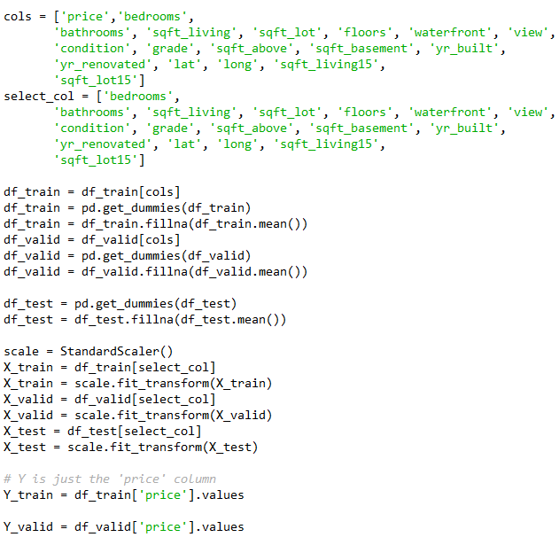
02
Part Two
程式方塊圖與寫法
Feature Standardization

Slide 11
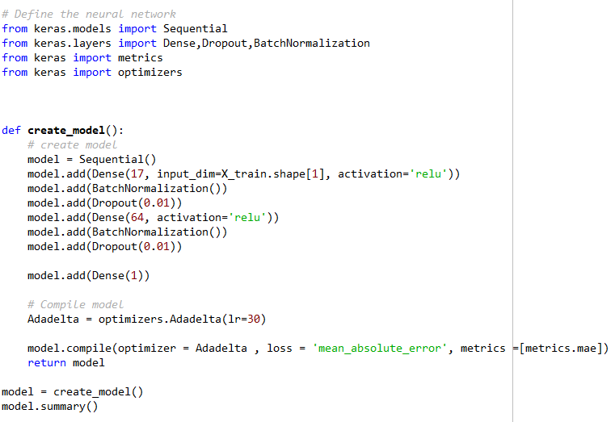
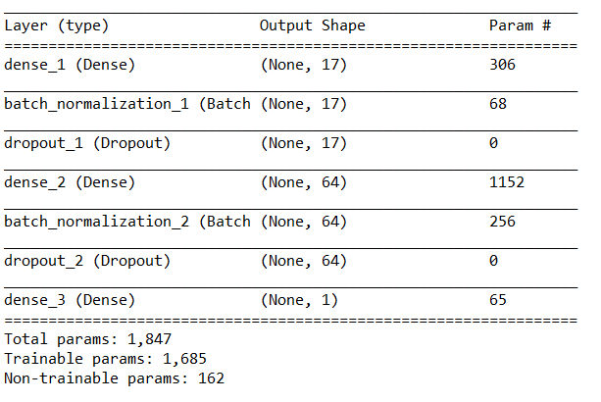
Dense layer input (17)
BatchNormalization()
Dropout(0.01)
Dense layer (64)
BatchNormalization()
Dropout(0.01)
Dense layer output (1)
02
Part Two
程式方塊圖與寫法
Create the model-Neural network

Slide 12
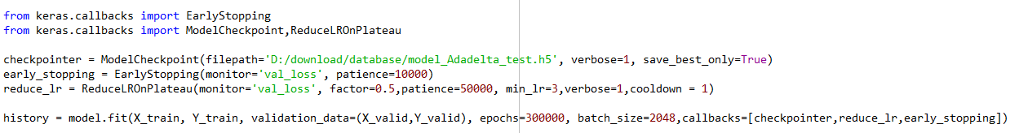
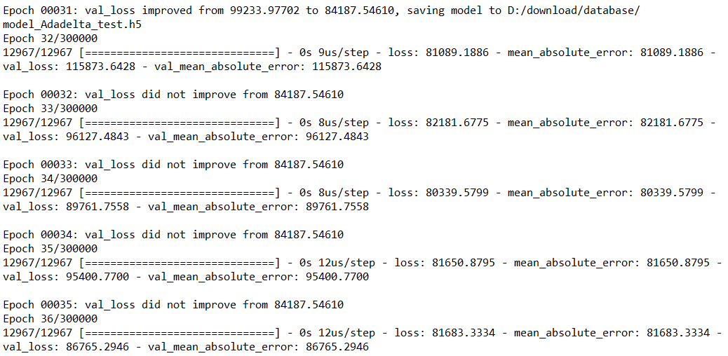
02
Part Two
程式方塊圖與寫法
Fit the model-Neural network

Slide 13
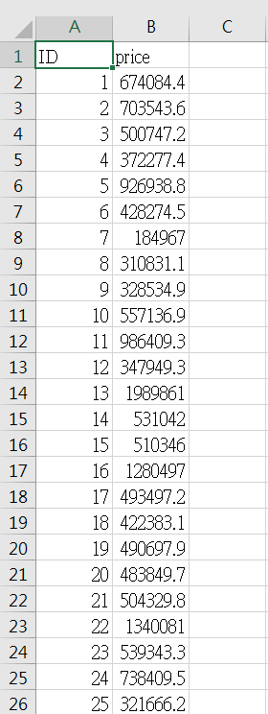
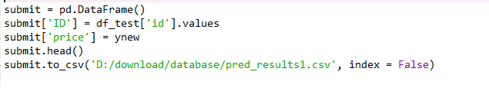
02
Part Two
程式方塊圖與寫法
Predict and save

Slide 14
Part Three
畫圖做結果分析

Slide 15
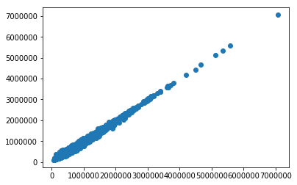
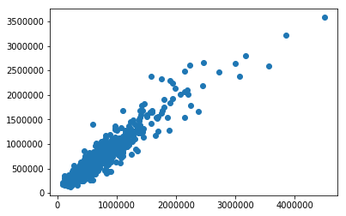
03
Part Three
畫圖做結果分析
Train data
MAE: 22971.3125
Valid data
MAE: 38393.65625

Slide 16
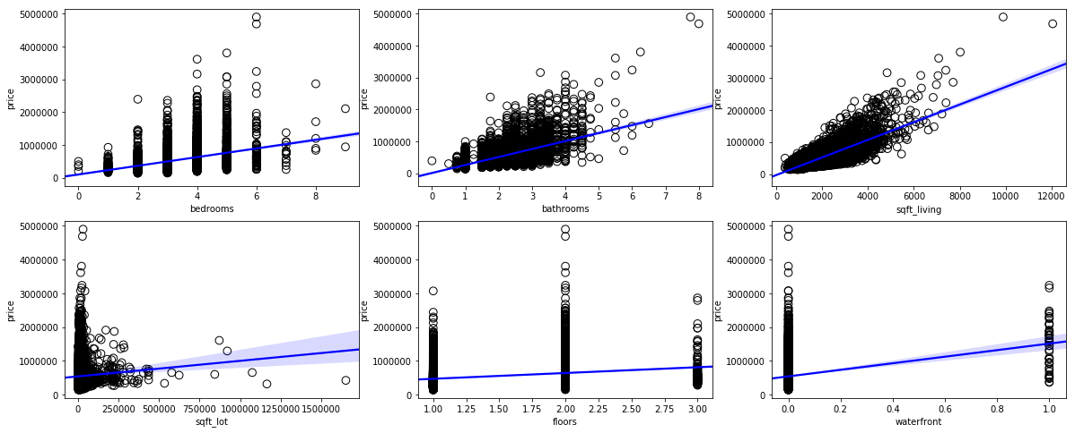
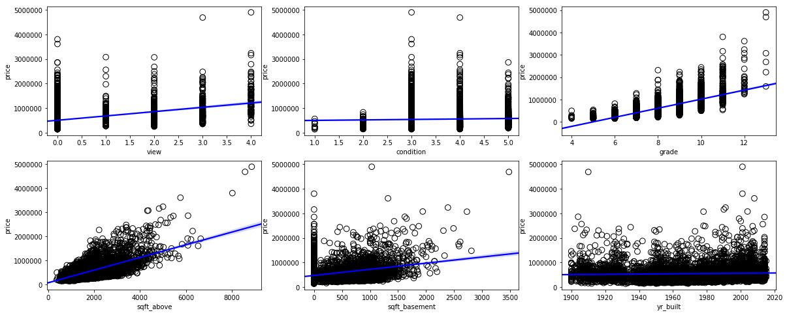
03
Part Three
畫圖做結果分析
Test data
MAE: 62715.3

Slide 17
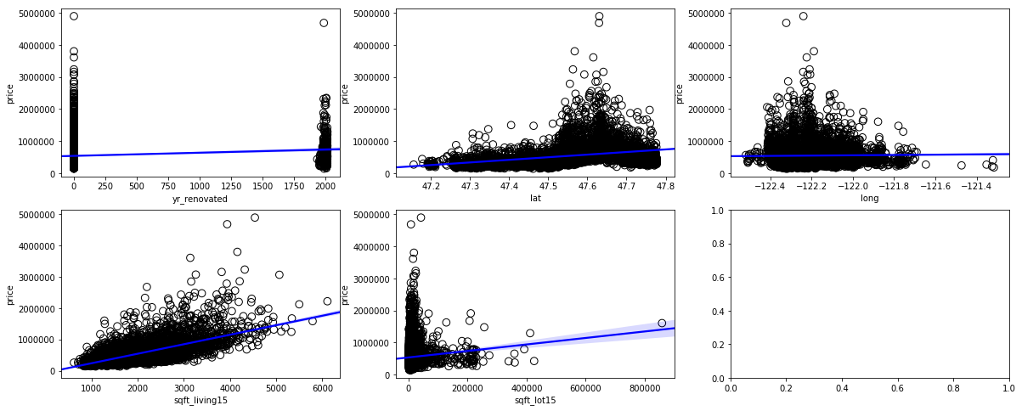
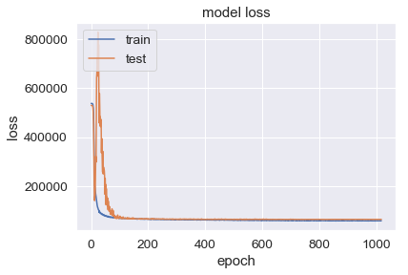
03
Part Three
畫圖做結果分析

Slide 18
Part four
討論預測值誤差很大的，是怎麼回事？

Slide 19
04
Part four
討論預測值誤差很大的，是怎麼回事？
You don’t use skill of feature selection and extraction
You don’t standardize your data
Your model is Underfitting
Your model is Overfitting
You must modify model of complexity(parameter adjustment)

Slide 20
Part five
如何改進？

Slide 21
05
Part five
如何改進？
You don’t use skill of feature selection and extraction
You can find the correlation between price and your data.
Select the better data point of performance on training process.
At the same time, remove the poor data point.
Use some extraction method in order to reducing dimensionality.

Slide 22
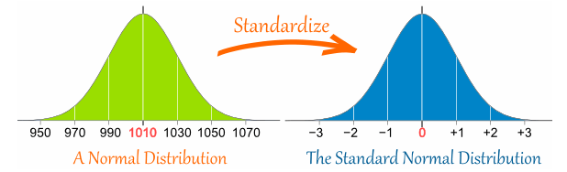
05
Part five
如何改進？
2.You don’t standardize your data
You must pre-processing your data to ensure that your feature are normalized.
Join the BatchNormalization layer on your model , it can normalize your data on training process.

Slide 23
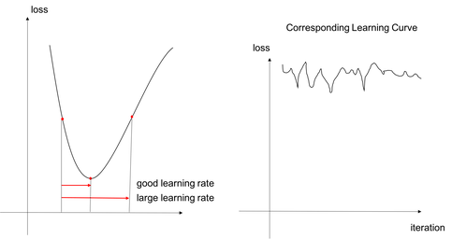
05
Part five
如何改進？
3. Your model is Underfitting
4. Your model is Overfitting
You can reduce learning rate on the training process with callback function, it can let you get faster and better performance .

Slide 24
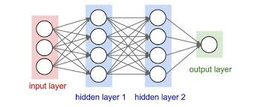
05
Part five
如何改進？
5.You must modify model of complexity(parameter adjustment)
You can expand the neural network more and deeper or change your optimizer to find the best solution .

Slide 25
THANK YOU
FOR WATCHING

