Slide 1
Introduction to Algebraic Multigrid Solver: Part 1

Slide 2
Linear System: Ax = b
Linear solvers play key role in scientific computing.
Simple method: Jacobi, Gauss-Seidel, SOR, and SSOR.
Krylov solvers: GMRES, LGMRES, CG, and BiCGSTAB.
Preconditioner: ILU(k), block ILU(k), and ILUT.
Algebraic multigrid methods (solver and preconditioner).
Solvers can occupy up to 90% of total simulation time in reservoir simulations.

Slide 3
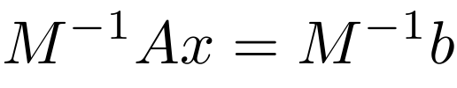
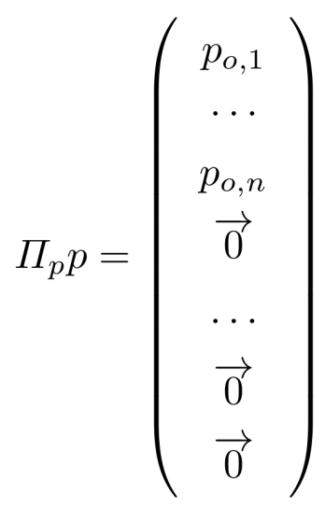
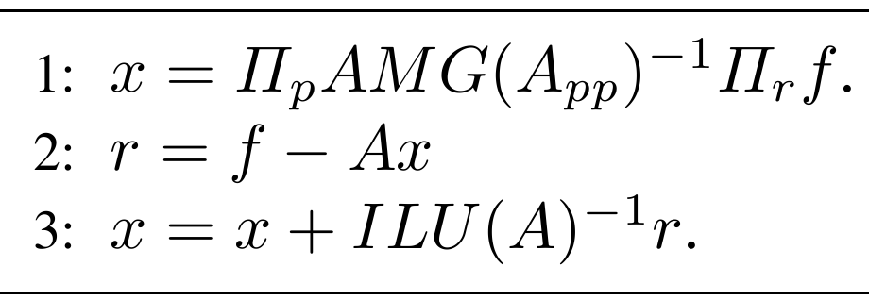

Constrained Pressure Residual Method
Preconditioning system: M x = f

Slide 4
AMG: What is Algebraic Multigrid?
Any multilevel method where geometry is not used (and may not be available) to build coarse grids, interpolation and restriction, or coarse-grid operators.
“Classical” AMG was introduced by Brandt, McCormick and Ruge in 1982. It was explored early on by Stuben in 1983, and popularized by Ruge and Stuben in 1987.
This tutorial will describe only the classical AMG algorithm.

Slide 5
AMG: What is Algebraic Multigrid?
AMG is for positive definite matrix.
Types: classical AMG and smoothed aggregation methods.
AMG can serve as a solver for elliptic problems, such as Poisson equations.
AMG can be used as a preconditioner.
In reservoir simulations, CPR-type methods are the most effective methods, and AMG is a key component.

Slide 6

THANK YOU
PPT模板下载：www.1ppt.com/moban/ 行业PPT模板：www.1ppt.com/hangye/
节日PPT模板：www.1ppt.com/jieri/ PPT素材下载：www.1ppt.com/sucai/
PPT背景图片：www.1ppt.com/beijing/ PPT图表下载：www.1ppt.com/tubiao/
优秀PPT下载：www.1ppt.com/xiazai/ PPT教程： www.1ppt.com/powerpoint/
Word教程： www.1ppt.com/word/ Excel教程：www.1ppt.com/excel/
资料下载：www.1ppt.com/ziliao/ PPT课件下载：www.1ppt.com/kejian/
范文下载：www.1ppt.com/fanwen/ 试卷下载：www.1ppt.com/shiti/
教案下载：www.1ppt.com/jiaoan/
字体下载：www.1ppt.com/ziti/

