Slide 1
Introduction to Algebraic Multigrid Solver: Part 3

Slide 2
Highlights of Multigrid: Smooth Error
A smooth function:
Can be represented by linear interpolation from a coarser grid:
On the coarse grid, the
smooth error appears to
be relatively higher in
Frequency.
Relaxation will be more
effective on this mode if
done on the coarser grid!!

Slide 3
Highlights of Multigrid: Coarse-grid Correction
Perform relaxation on on fine grid until error is smooth.
Compute residual, and transfer to the coarse grid .
Solve the coarse-grid residual equation to obtain the error:
Interpolate the error to the fine grid and correct the fine-grid solution:

Slide 4
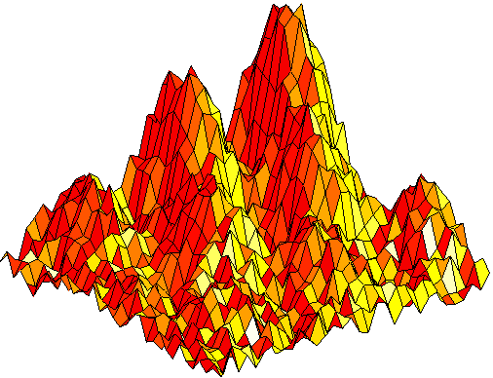
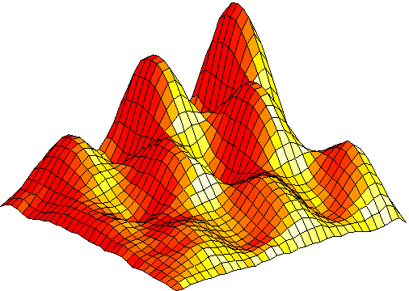
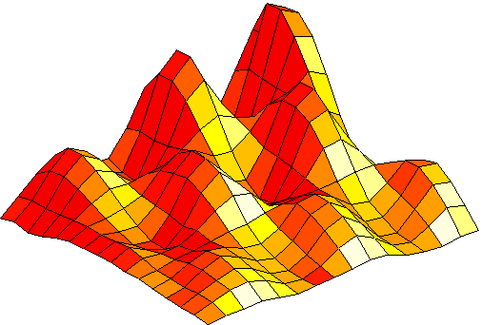
Highlights of Multigrid: Coarse-grid Correction
smoothing
The Multigrid
V-cycle
Finest Grid
prolongation
(interpolation)
restriction
Smaller grid
First Coarse Grid

Slide 5
Highlights of Multigrid: Tools Needed
smoothing
The Multigrid
V-cycle
Finest Grid
prolongation
(interpolation)
Restriction
Smaller grid
First Coarse Grid
Coarsest Solver

Slide 6
Highlights of Multigrid: Recursion

Slide 7

THANK YOU
PPT模板下载：www.1ppt.com/moban/ 行业PPT模板：www.1ppt.com/hangye/
节日PPT模板：www.1ppt.com/jieri/ PPT素材下载：www.1ppt.com/sucai/
PPT背景图片：www.1ppt.com/beijing/ PPT图表下载：www.1ppt.com/tubiao/
优秀PPT下载：www.1ppt.com/xiazai/ PPT教程： www.1ppt.com/powerpoint/
Word教程： www.1ppt.com/word/ Excel教程：www.1ppt.com/excel/
资料下载：www.1ppt.com/ziliao/ PPT课件下载：www.1ppt.com/kejian/
范文下载：www.1ppt.com/fanwen/ 试卷下载：www.1ppt.com/shiti/
教案下载：www.1ppt.com/jiaoan/
字体下载：www.1ppt.com/ziti/

